Slide 1


FINAL YEAR PROJECT PRESENTATION
TITLE: DESIGN OF GROUND STATION FOR A CAN-SIZED SATELLITE
TEAM: BIZIMA Issiak Okyes
NSENGIMANA Daniel
SUPERVISOR: Dr. Louis SIBOMANA
28th January 2021

Slide 2
INTRODUCTION AND PROJECT BACKGROUND
Rwanda and other African countries are advancing in science and technology, due to this reason studying and understanding well the science theories and principles is very critical. Science and technology are very essential in our daily life using them we can solve most of the social issues. Therefore, better understanding of science and engineering principles is the key.
This led to the growth of students choosing to learn science and other technology-related fields, and the number of students exploring different technology concepts grew and hence some choose to explore satellite communication as their field of interest. Further, as it is shortly written stands for a can-sized satellite which is a type of small satellite where all components of satellite functions are housed inside a can-sized like structure and Ground station graphical user interface is needed to visualize and displays data extracted.

Slide 3
ABSTRACT
CanSat is a type of small satellite that is easy and cheap to build. Previous works focused on designing and implementation of but they did not consider a working ground station for its control and monitoring. As such, this project aims to design a ground station to make the visualization of data easier, faster, and much more enjoyable. Our main objective is to create a working user interface that allows any user with valid credentials to control, monitor, and access different functionalities of the Can-Sat.
The designed GS_GUI interacts with the so as to visualize and display the data coming from the . Examples of measurements of environmental variables or data to be collected and analyzed include temperature, humidity, atmospheric pressure, and altitude. The results of extracted data from the are visualized or displayed by the ground station graphical user interface (GS_GUI) using a chart presentation in form of graphs to make it more readable and understandable.

Slide 4
PROJECT OBJECTIVES
The main objective of our project is to design a working ground station for the . The ground station (GS) is made of a GUI which interacts with the and provides a way of communication between and GS.
Other Objective is to visualize and displays data on the Ground station graphical user interface designed (GS_GUI) and present data using a chart presentation in form of graphs.

Slide 5
METHODOLOGY
Documentation
In building our ground station we relied on a lot of information gathered through reading books, articles, journals, and websites. We extensively used the internet during our GS_GUI design.
System development
In coding the main graphical user interface(GUI), we used different software and tools. The main programming language we used was python. we only used different python packages like Tkinter, pandas and many more.

Slide 6
CANSAT TECHNOLOGY
A Can-Sat is a simulation of a real satellite, integrated within the volume and shape of soft drinks can [1]. The main reason of can-sat creation is to challenge students on to fit all the major subsystems found in a satellite, such as power, sensors, and a communication system, into this small volume. Can-Sat is considered "a very small and simple satellite", and has a similar function with satellites and operates away from the human operators. This fact makes the education based on Can-Sat very suitable as a first step in training towards real satellite development [2].

Slide 7
CANSAT GROUNDSTATION AND GROUND STATION GUI
A satellite communications system is broadly divided into two segments: a ground segment and a space segment [3]. The ground segment or ground station handles tracking, telemetry, command and monitoring of the can-sat. GS is merely a graphical user interface(GUI) specifically made to interface with the satellite and in our case a Can-Sat. GUI provides the user with a familiar environment in which to work. E1nvironment contains push buttons, toggle buttons, lists and so forth, all of which are already familiar to the user so that he or she can concentrate on using the application rather than on the mechanics involved in doing things. The GS_GUI we developed interacts with the can-sat that was done in the previous works.

Slide 8
DESIGNING THE GROUND STATION GUI
The user interface is the primary method by which users interact with Can Sat. The GS_GUI has different icons, menus, and another visual indicator (graphics) representations to display information and related user controls [4] It consists of a series of forms and components that trigger a series of events “hidden” from the user [19]. The GUI design incorporate the usability design principles and the programming basics needed in the control, monitoring, and command of the Can-Sat. The goal of an interface design is to create a GS interface that is easy to use and resourceful.

Slide 9
GROUNDSTATION GUI DEVELOPMENT
The ground station user interface (GS_UI) was built using python mainly. We used different python modules like Tkinter , Python , Thingspeak and many more. Python wasn’t the only programming language used in the development, some features were built using other languages like HTML(hypertext markup language) and CSS(cascading style sheet). We also did use git and github to share codes remotely.

Slide 10
GROUND STATION FEATURES AND FUNCTIONALITIES
The GS_GUI is made of different functionalities and the main command line.
GS GUI FUNCTIONALITIES
File functionality: this allows GS user to interact with the pc storage.
Settings functionality: allows user to alter and manipulate different GS command.
Data functionality: allows user to interact with GS_GUI ,hence control the can-sat.
Help functionality: provides user with all the information regarding the GS_GUI.
GS GUI COMMAND LINE
The GS_GUI command line provides user with a direct control and interaction to the can-sat using commands. All the commands are specified in the HELP functionality.

Slide 11
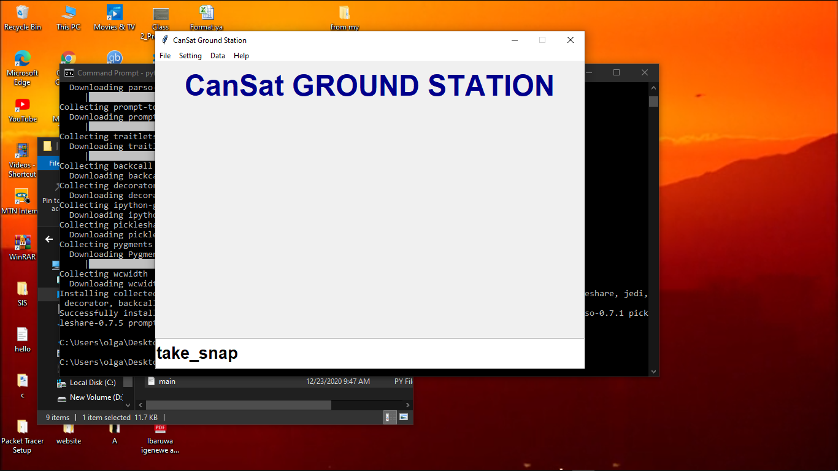
GROUND STATION_ GRAPHICAL USER INTERFACE (GS_GUI)

Slide 12
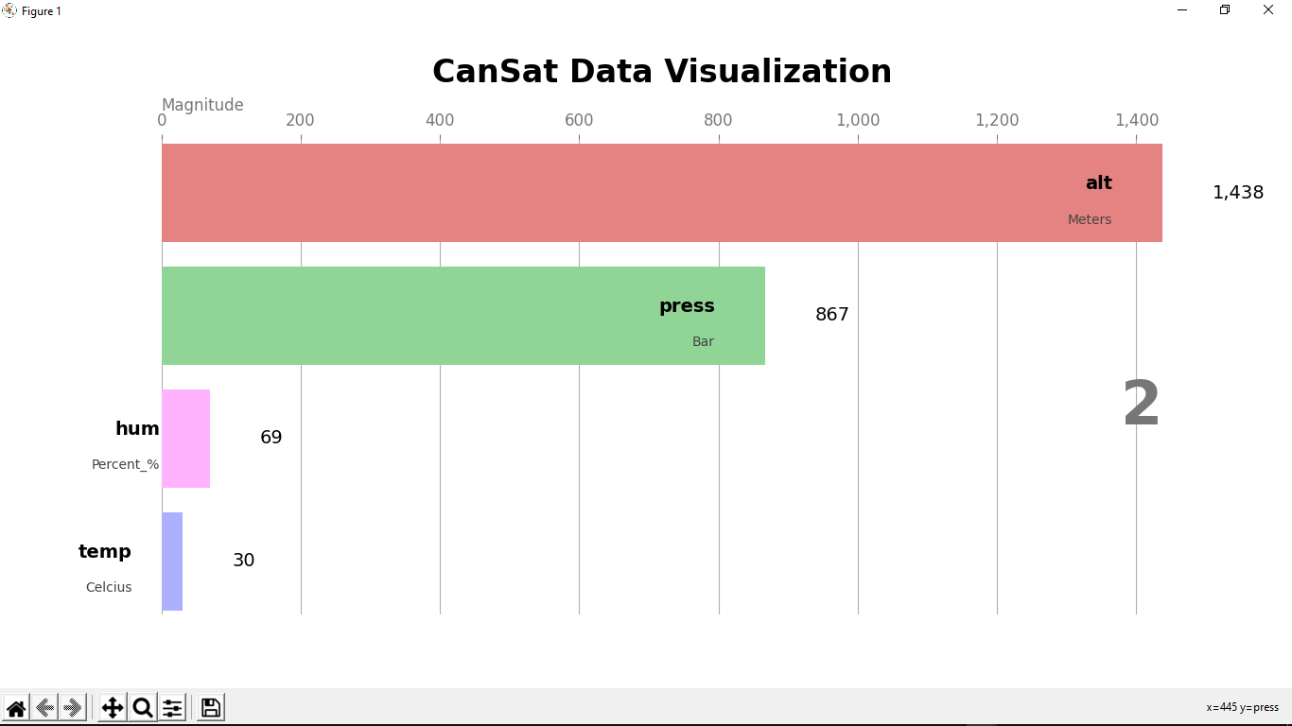
DATA VISUALISATION ON THE GS_GUI

Slide 13
FUTURE SCOPE OF THE PROJECT
Extend the GS_GUI functionalities by providing more functionalities and new features.
Make a cross platform executable file.
Customize the user interface so that any user can modify and add new features as needed.

Slide 14
CONCLUSION AND RECOMMANDATION
CONCLUSION
The goal of our project was to create a well functioning ground station for a can-sat, the ground station had to be made of a ground station GUI. We can conclude that the GS_GUI was created and all of the parts are functioning and interacting as we planned. Sources codes are hosted on the github repository to allow others to access them for future use.
RECOMMANDATION
We recommend that the ground station for can-sat be used any where in can-sat related to can-sat technology, we encourage engineering student to use the system we created in visualizing and displaying all can-sat related data. In addition, further research and exploration is needed so as to improve the technology in general.

Slide 15
REFERENCE
[1] University Space Engineering Consortium – Japan (UNISEC) November. Can satellite ().Design manual. 2011. Ver. 1.0.
[2]https://esero.ie/wp-content/uploads/2018/01/-image-1.jpg.visited on the 20th December 2020 [3] University Space Engineering Consortium, Can Sat Pico Size artificial satellite:" A Guidebook for building successful can sat project", published 2011.
[4] K. P. Moran, C. Bernal-Cárdenas, M. Curcio, R. Bonett and D. Poshyvanyk, "Machine Learning Based Prototyping of Graphical User Interfaces for Mobile Apps," in IEEE Transactions on Software Engineering.

