Slide 1
Data-driven Modelling of a multi-coil Magnetic Actuation System
By: Gediyon M. Girma
Supervisors: Dr. Eric Diller,
Daniel Sieben,
Erik Fredin
December 18, 2024

Slide 2
Outline
Introduction
Background and Literature review
Approach
Result and discussion
Conclusion

Slide 3
Introduction
Previous term: magnetic actuation system characterization performed.
Goal: to extend the system’s control capability from a single pt. to 3D workspace.
Highlights: challenges of the dipole model
Main challenges:
determining the exact magnetic moment value of the core material and
Modelling cross-magnetization effect
Mean average percentage error over 100%
It was also noted that FEM modeling is too slow for real-time control.
We need a better way to model our system.

Slide 4
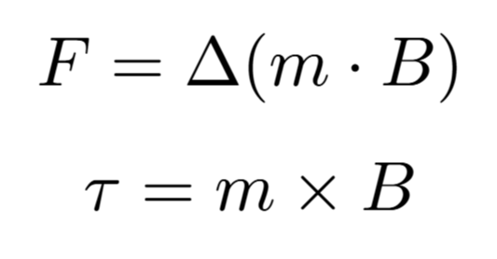
Background
Magnetic actuation occur when a magnetic element, i.e magnetic surgical tool tip, resides in an external field generated by a magnetic actuation system.
Where:
F and τ are the force and torque on the magnetic element,
m is the magnetic moment of the element and
B is the magnetic field generated by the actuation system.

Slide 5
Literature review
Study | Model/System | Key Findings
Sikorski et al. | FEM Modeling (6-coil system) Measurement-based calibration 10cm diameter spherical workspace | Mean error: 3.36% per coil and 15.21% for the entire system
Heris et al. | FEM Simulation (8-coil system) | Error up to: 17%
Yu et al. | ANN Model (Linear Magnetization) 8-coil magnetic actuation system 10 cm³ Workspace | RMSE: 3.01 mT
Charreyron et al. | CNN Model (Non-linear Magnetization) 8-coil magnetic actuation system 10 cm³ Workspace | RMSE: 0.83 mT MAE: 0.51 mT

Slide 6

Approach
NN b/c no specialized knowledge of input and output structure and proven universal function approximation
Network architectures well suited for our task
Input: Current and spatial position (11D vector)
Output: 3D magnetic field vector
The physics of electrodynamics can be embedded into the network using the training data.
The model architecture and hyper-parameters tunning:
Using software tools MLflow and Optuna together to implement Bayesian optimization called Tree-structured Parzen Estimator.
Convolution Neural Networks (CNN) | Feed Forward Network (FFN)
predicts on a grid Requires interpolation function with its own inaccuracies | Predicts at any point in the workspace Interpolation is not required Direct calculation of field gradient

Slide 7
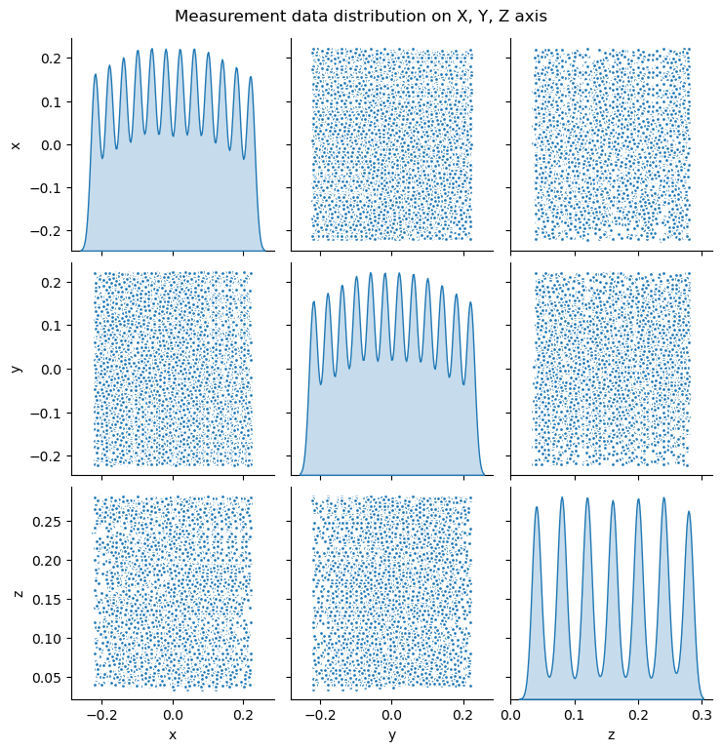
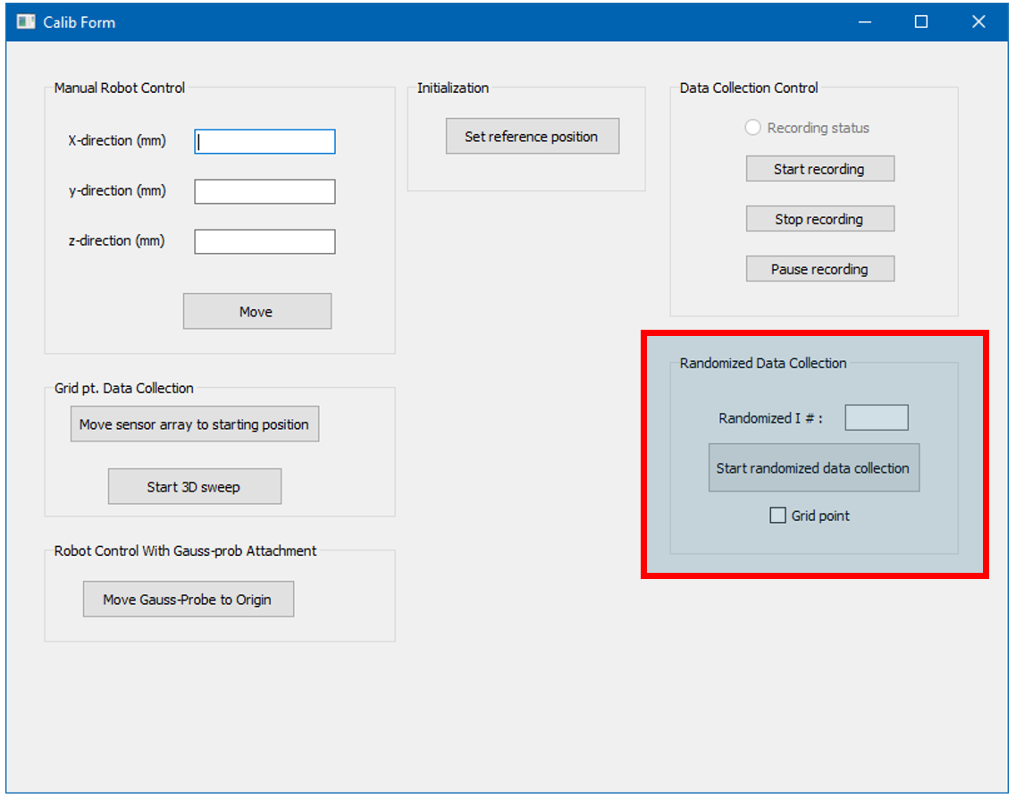
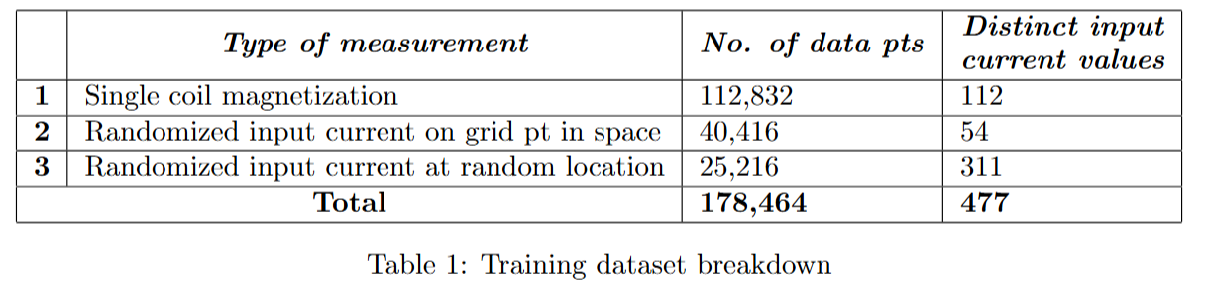
Model training dataset
Figure 5: New feature, shown in red, for randomized data collection
Figure 4: Training data distribution on x, y and z axis

Slide 8
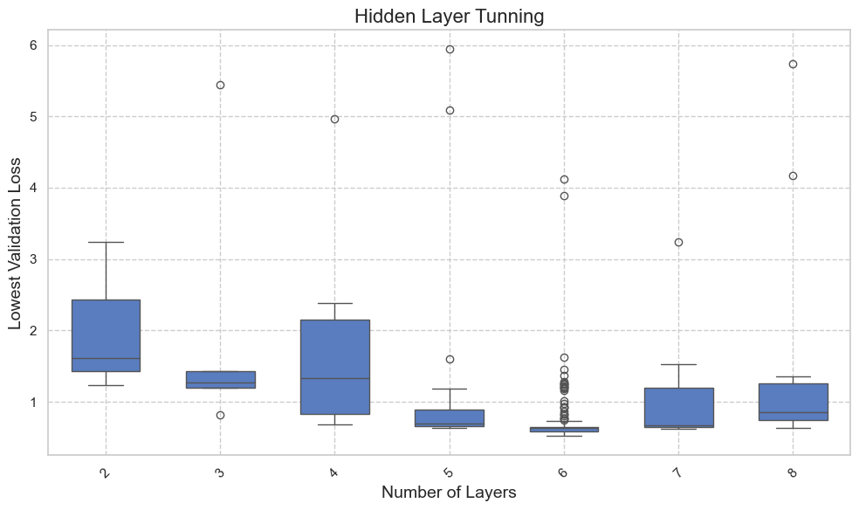
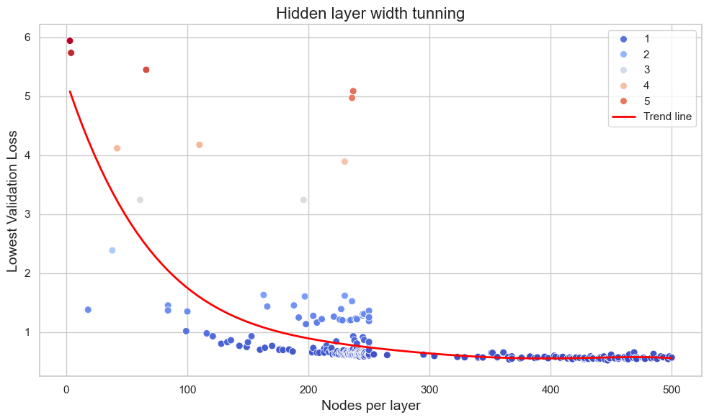
Result: Model Architecture Tunning

Slide 9
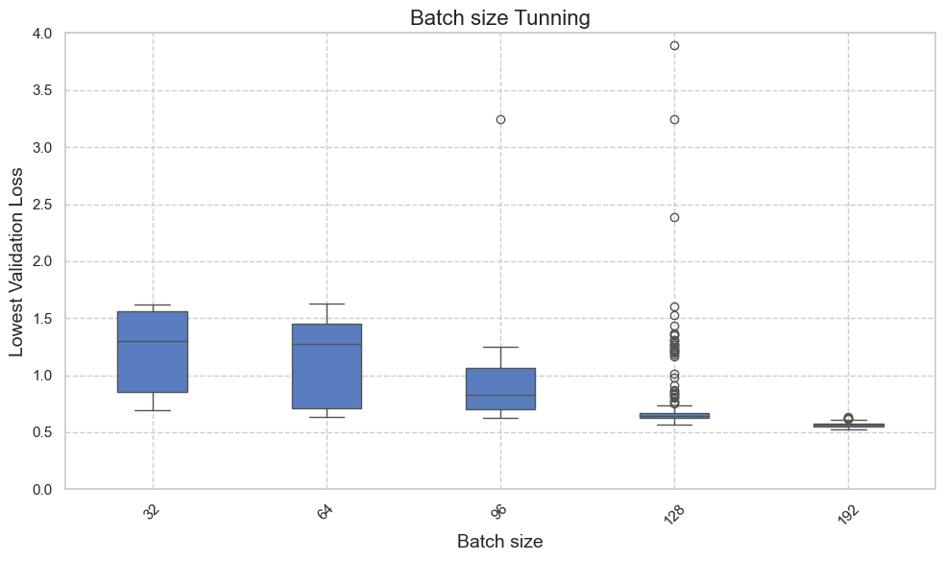
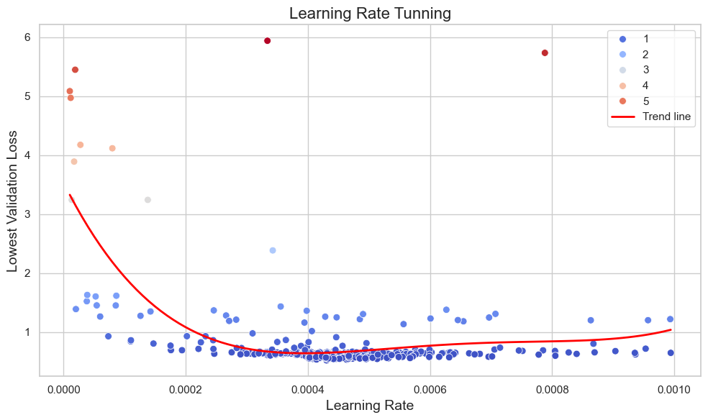
Hyper-parameter tunning

Slide 10
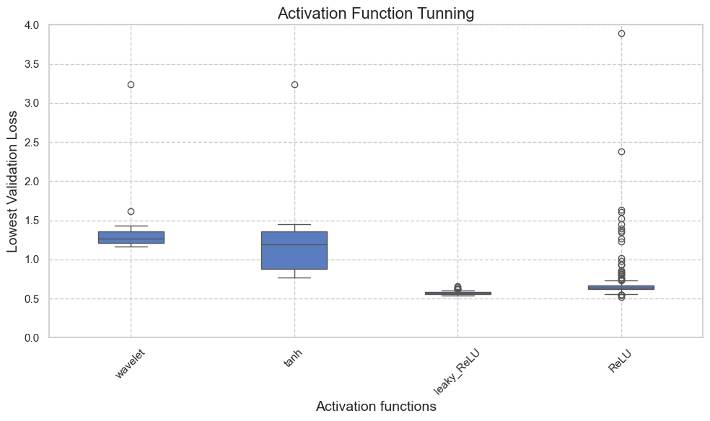
Cont’d

Slide 11
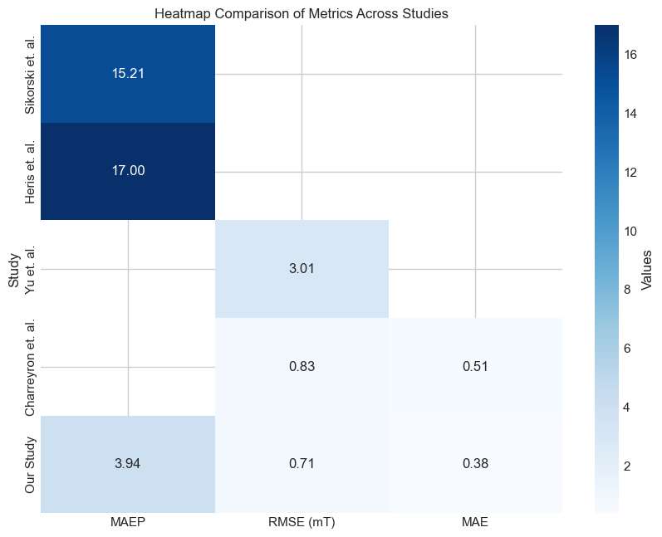
Optimized model
Performance:
Inference time for 100 predictions: 0.001000 seconds
Model architecture
Hdden layers | 6
Nodes per layer | 447
Parameter
Learning rate | 0.00043
Activation function | ReLU
Batch size | 192
Test Metrics
RMSE | 0.71
MAE | 0.38
MAPE | 3.94%
pitch angle | 2.18
yaw angle | 3.69

Slide 12
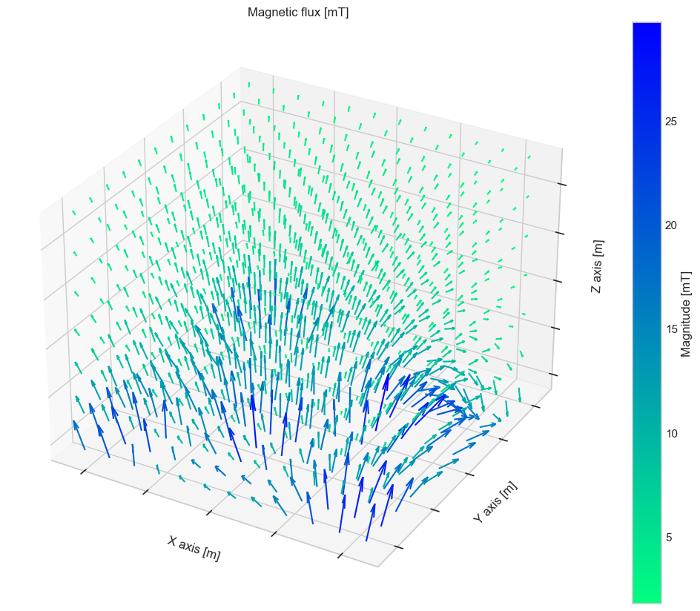
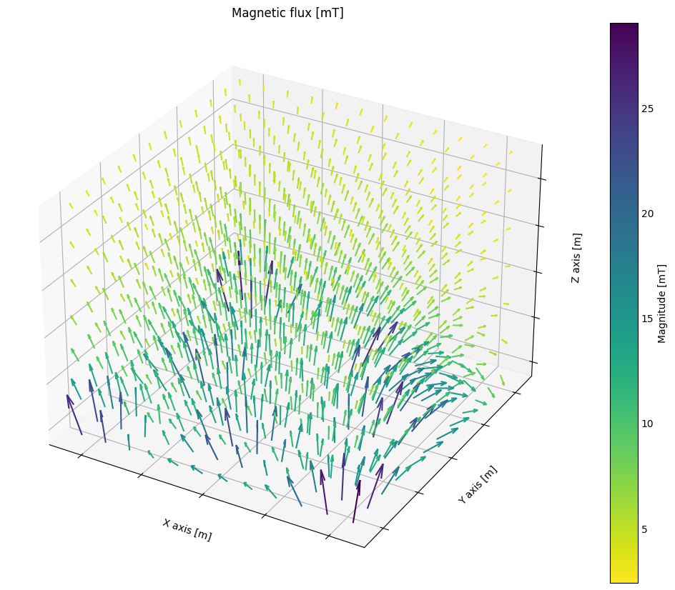
Model Prediction vs Measurement
FFN model prediction
Measurement data
 | MAE [mT]
B_{x} | 0.70
B_{y} | 0.80
B_{z} | 1.59
Norm | 1.43
Φ (Pitch) | 6.24º
Θ (yaw) | 9.58º
MAPE (%)
75.0
457.6
49.6
17.3
 | Coil 1 | Coil 2 | Coil 3 | Coil 4 | Coil 5 | Coil 6 | Coil 7 | Coil 8
Current setting | 5 | 5 | 5 | 5 | 5 | 0 | 5 | 5

Slide 13
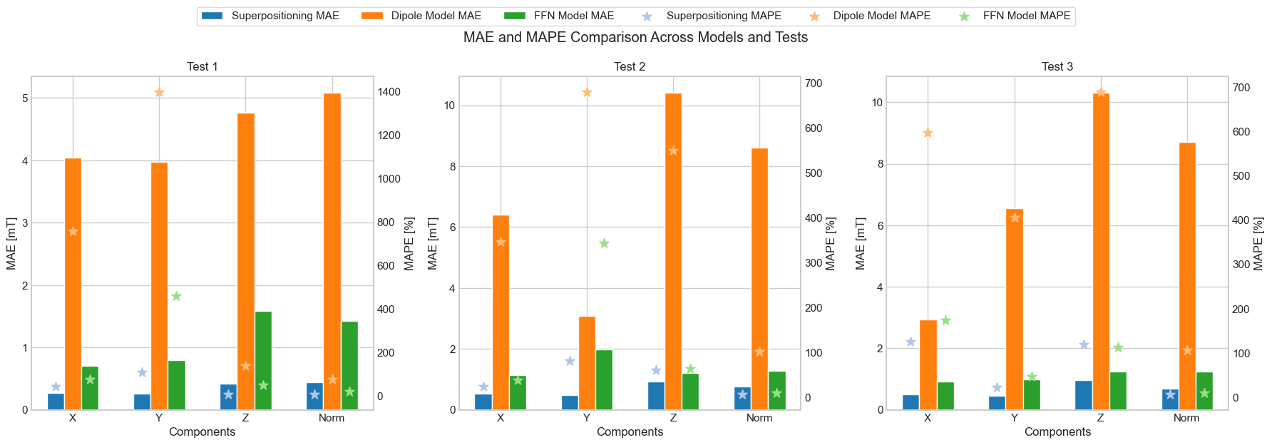
FFN vs Dipole vs Super-positioning

Slide 14
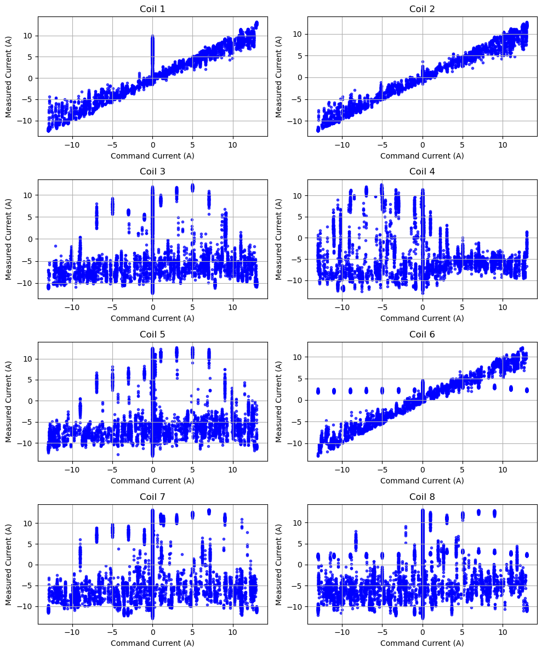

Measured vs command Current
Cross-magnetization effect or faulty current controller?

Slide 15
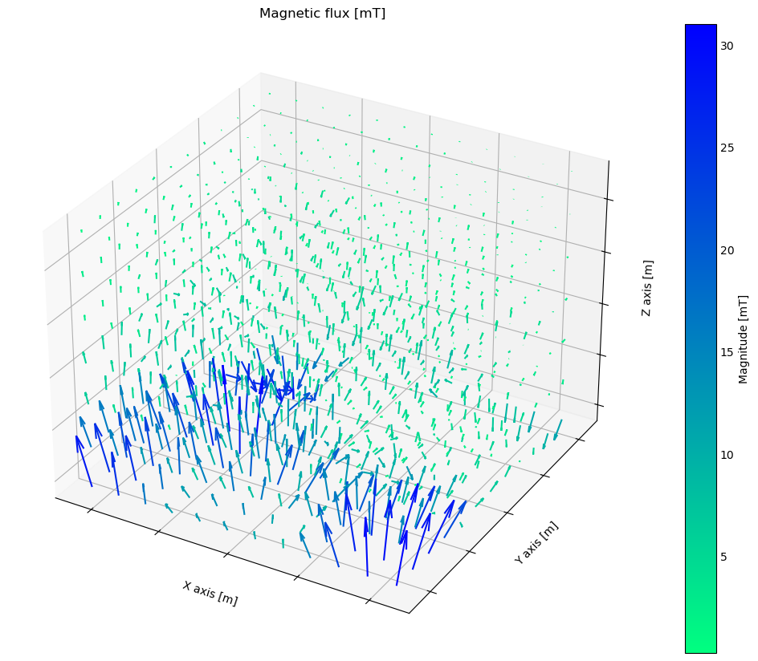
Measured Current model
msdCurrent model
Measured data
Model architecture
Hdden layers | 6
Nodes per layer | 447
Parameter
Learning rate | 0.00043
Activation function | ReLU
Batch size | 192
Test Metrics
RMSE | 0.86
MAE | 0.63
MAPE | 11.80%
 | MAE [mT]
B_{x} | 2.768
B_{y} | 3.49
B_{z} | 5.62
Norm | 3.77
Φ (Pitch) | 50.30º
Θ (yaw) | 53.97º
MAPE (%)
3.71
28.90
0.9634
44.6
 | Coil 1 | Coil 2 | Coil 3 | Coil 4 | Coil 5 | Coil 6 | Coil 7 | Coil 8
Current setting | 5 | 5 | 5 | 5 | 5 | 0 | 5 | 5

Slide 16
Conclusion and Future work
In this project, a data-driven model has been successfully developed with a competitive performance for real-time control.
Further model training with varied input-current data should be considered for improved prediction accuracy.
Further investigation is needed to determine the relation between measured and command current. Some questions that might be worth considering
What caused the observed uncorrelated relation? Cross-magnetization effect or faulty current controller?
Is the current controller counteracting the cross-magnetization effect?
Development of an inverse model for control

Slide 17
Thank you! Questions?

