Slide 1
Aviation safety chronicles
Safer skies and enjoyable flights for all.

Slide 2
INTRODUCTION
This project explores patterns in aviation accidents to uncover actionable insights aimed at improving aviation safety and reducing risks. By analyzing historical data, we aim to empower airlines, regulators and passengers in the mission to make air travel faster.

Slide 3
PROJECT GOALS
Provide recommendations to enhance safety.
Highlight patterns across flight phases, weather conditions, aircraft models and accident locations.

Slide 4
DATA OVERVIEW
Source NTSB Aviation data set.
Size : Contains accident records and detailed information.
Key Variables: Accident phase, Weather conditions(IMC vs VMC), Injuries, Aircraft Model.

Slide 5
METHODS
Data Cleaning
Data Analysis
Visualization by use of Tableau

Slide 6
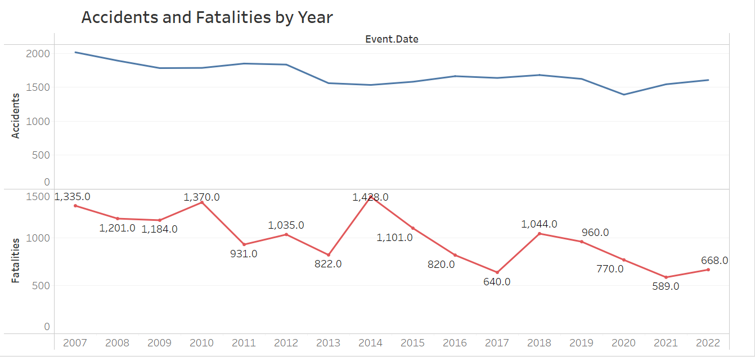
KEY FINDINGS
Accidents and fatalities by year.
We all agree accidents have been there. They have reduced as time goes as its evident on the graph.

Slide 7
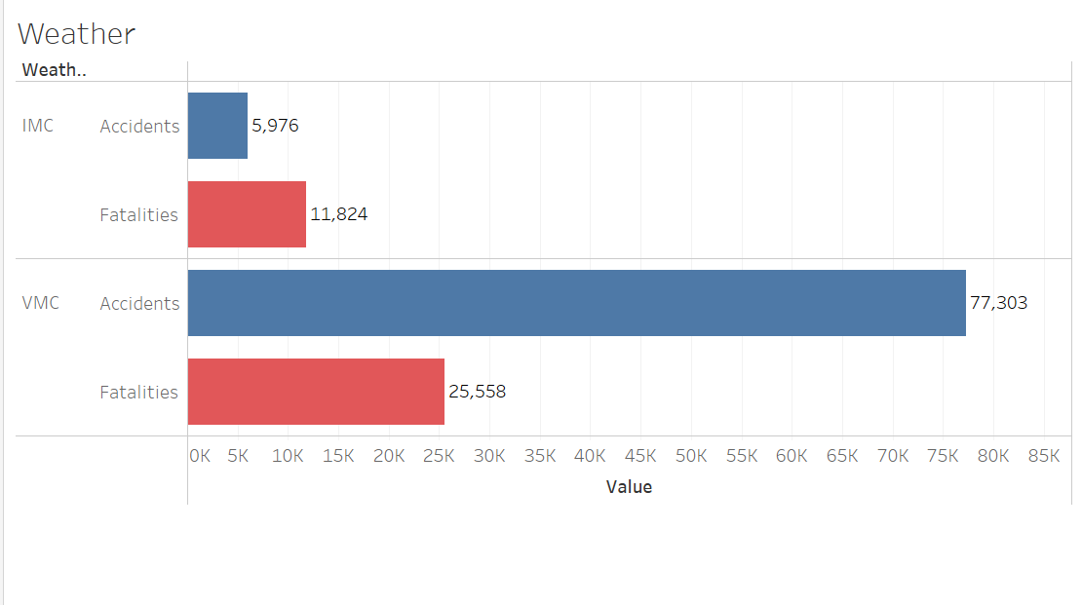
KEY FINDINGS
2. Weather
Weather is one factor that led to accidents. Its advisable to pilots and crew to be considerate of weather conditions before taking a flight, this will help reduce accidents by a bigger percentage. Accidents are more frequent under IMC (Instrument Metrological Conditions compare to VMC (Visual Metrological Condition

Slide 8
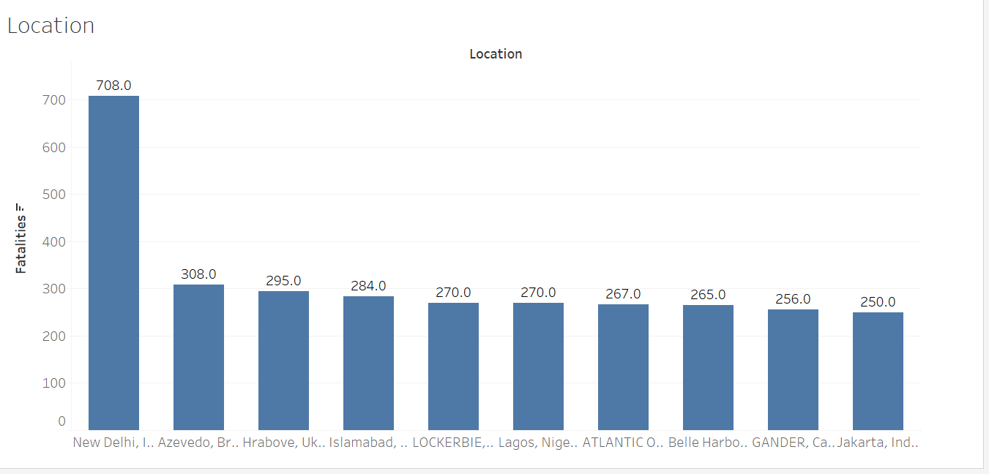
KEY FINDINGS
3. Location
Most of the accidents took place in New Delhi followed by Azevedo. Its crucial if the accident-prone areas can have more safety measures to curb and reduce the number of accidents.

Slide 9
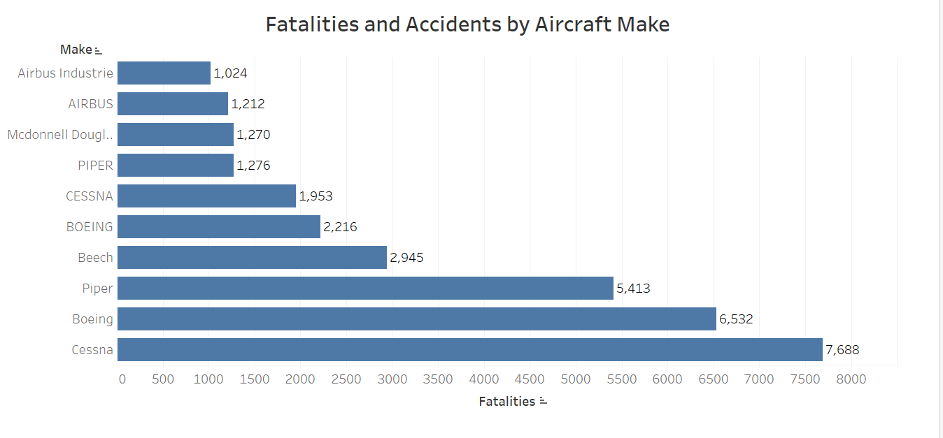
KEY FINDINGS
4. Common aircrafts in accidents.
Certain aircraft models such as Cessna, appear frequently in accident reports.

Slide 10
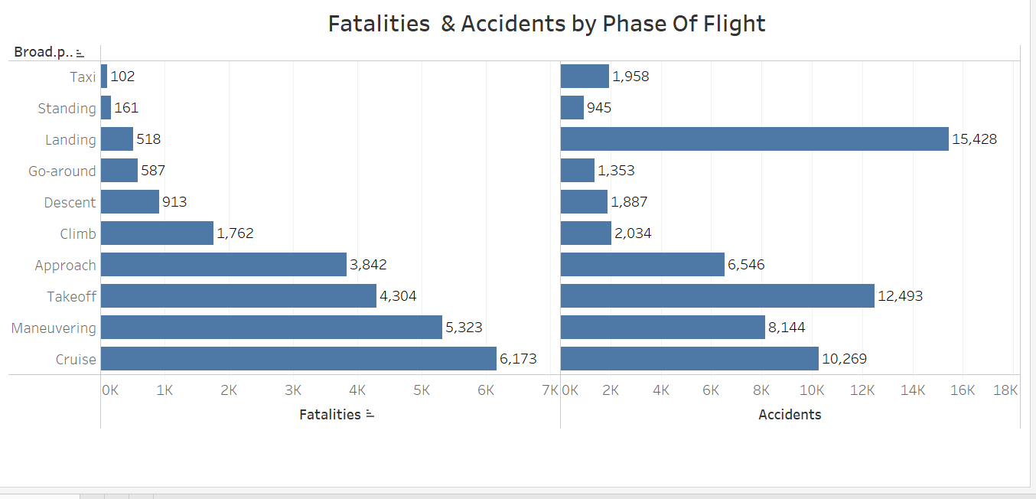
KEY FINDINGS
5. Occurrence by Phase of Flight.
Most accidents occur during critical phases.
Cruise (highest count 6173)

Slide 11
CONNECTING INSIGHTS TO STAKEHOLDER NEEDS
For airlines Train pilots for adverse weather scenarios and prioritize the maintenance of high risk aircraft models.
For regulators Implement stricter safety protocols during the landing and take off phases.
For passengers Highlight how these measures reduce risks, ensuring peace of mind during travel.

Slide 12
CHALLENGES AND LESSON LEARNT.
Challenges
Missing data created inconsistencies in initial analyses
Tableau performance issues for large data sets.
Lesson learnt
Data cleaning is vital for actionable insights.
Visualizations tailored to stakeholder needs drive engagement and value.

Slide 13
THANK YOU
You can find me on email at : gedimwas@gmail.com
LinkedIn: username – Gerald Mwangi.

