Slide 1
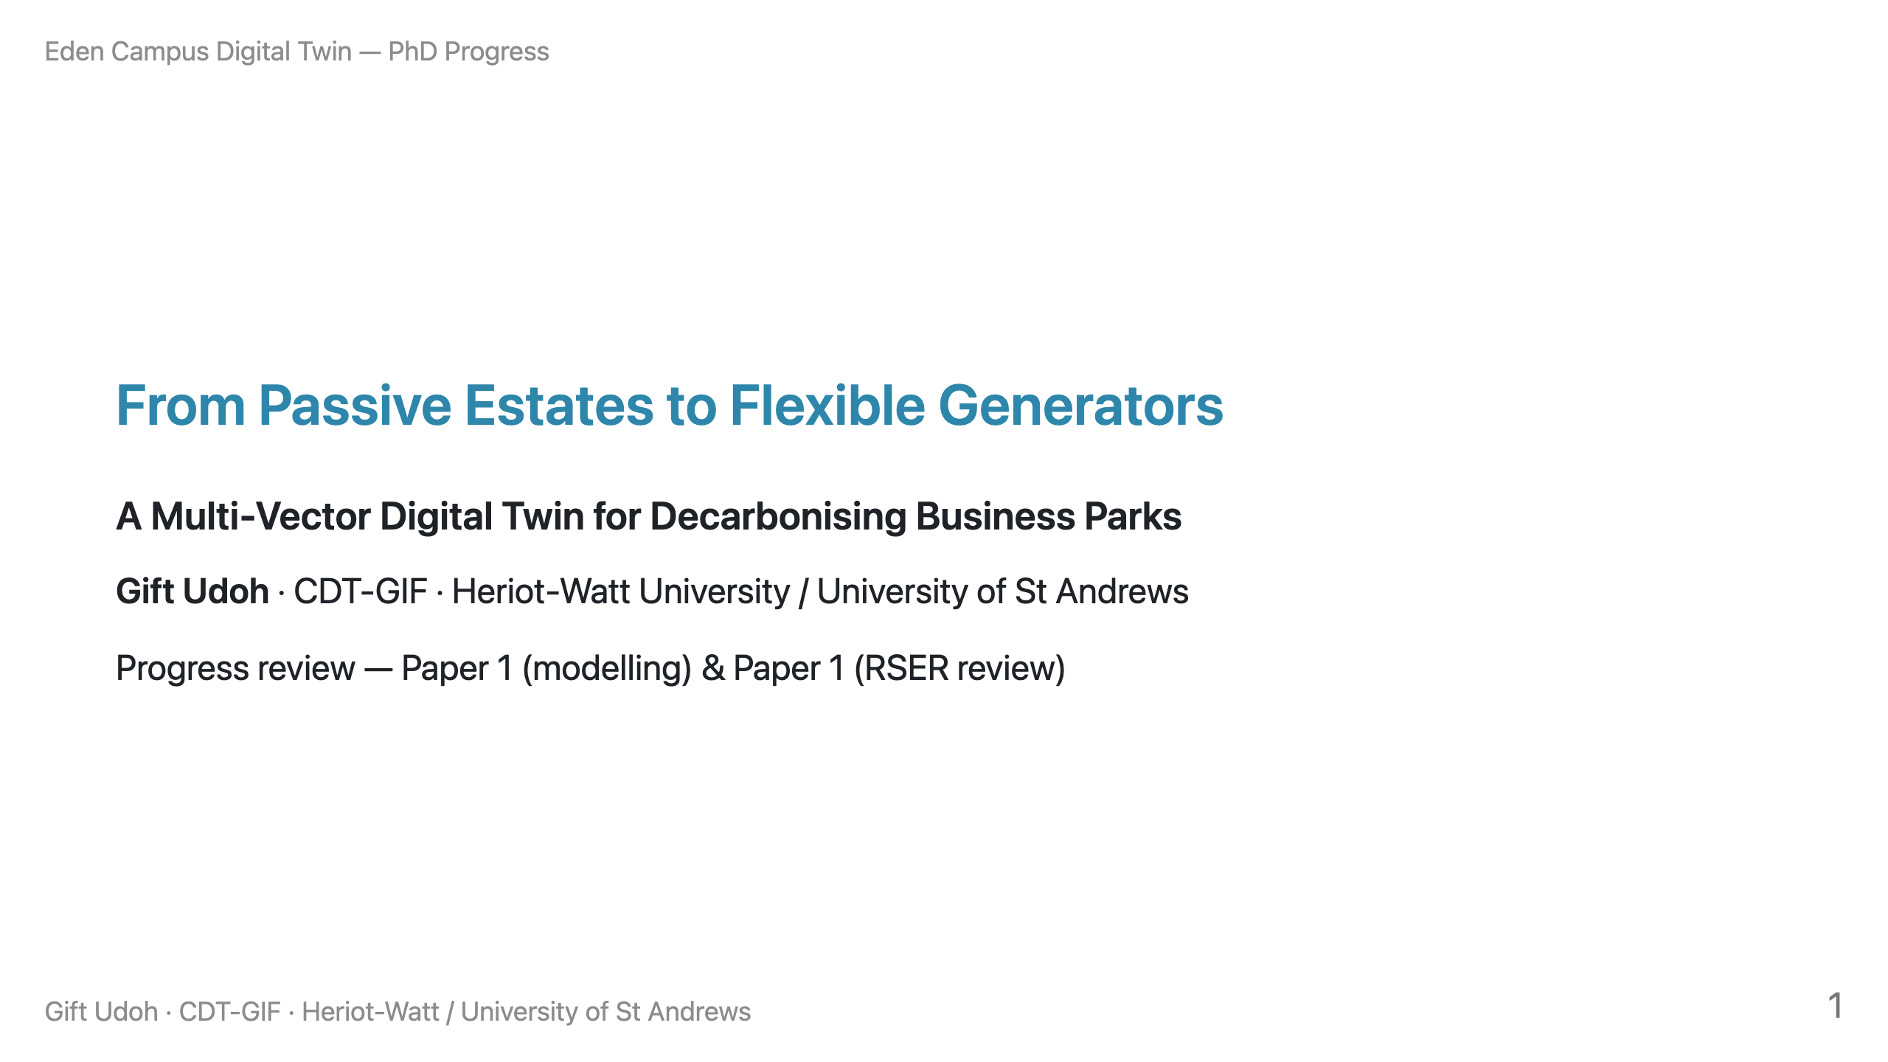
Notes:
SPEAKER NOTE: One sentence to open. "I'll cover two outputs — the Eden Campus
modelling paper, which is my main result, and the systematic review that frames
it. I'll be upfront that the demand data is currently synthetic, and show you
exactly why my conclusions are robust to that." Set the honest tone immediately.

Slide 2
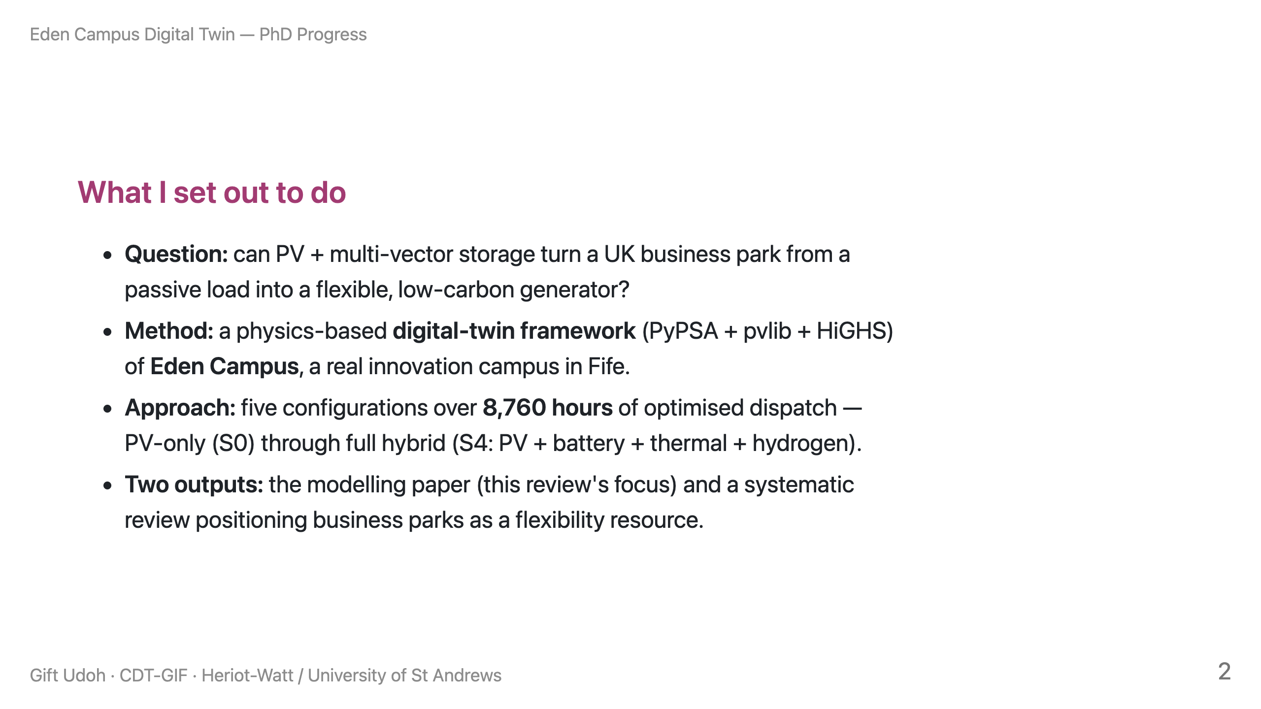
Notes:
SPEAKER NOTE: Keep to 45 seconds. The audience has the dataset, so don't oversell
"digital twin" — say "digital-twin framework" and move to results.

Slide 3
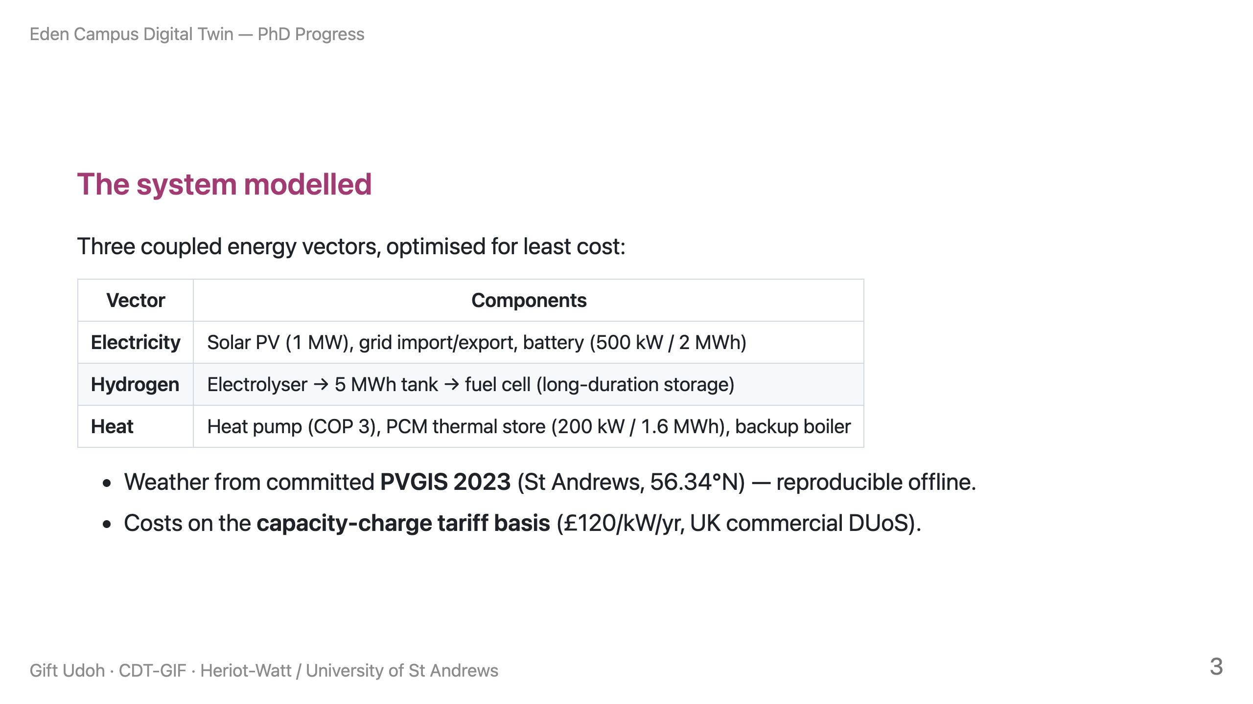
Notes:
SPEAKER NOTE: This slide pre-empts "what did you actually build." The reproducible/
committed-data point matters — it's a strength the dataset-holder will appreciate.

Slide 4
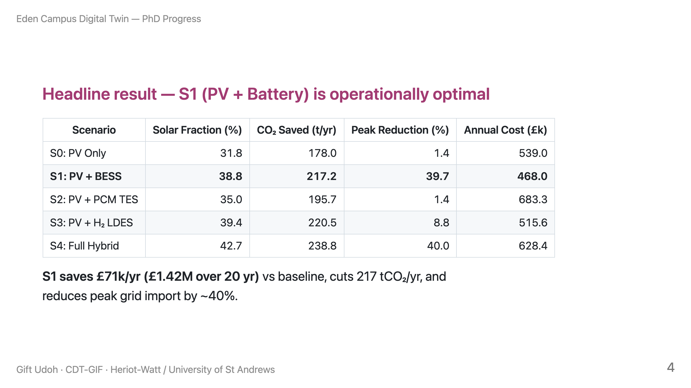
Notes:
SPEAKER NOTE: This is the money slide. Numbers are from the generated table
(manuscript_table3). If asked "why does S1 beat S4?" — S4 adds heat-pump electrical
load that, under this tariff, raises cost; storage of electricity (S1) is the
cheapest marginal improvement. Let them probe.

Slide 5
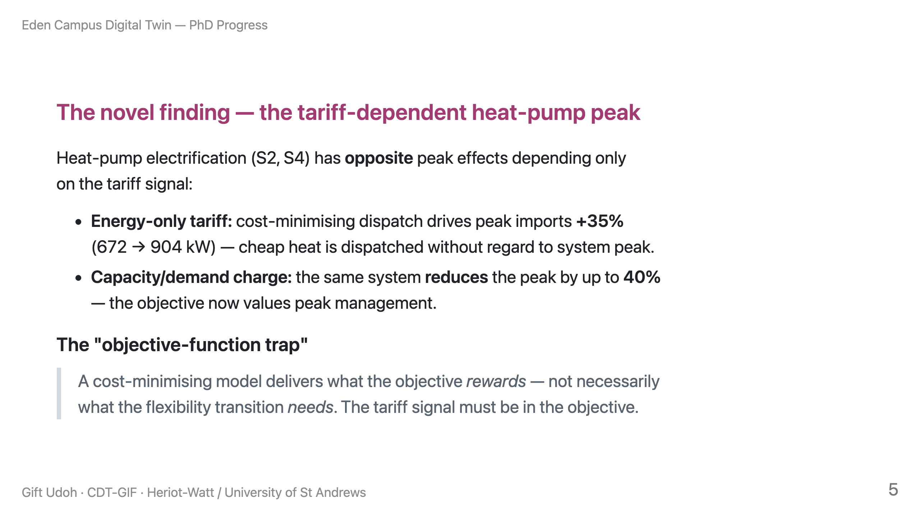
Notes:
SPEAKER NOTE: This is the intellectual contribution — emphasise it. It's the bridge
between the modelling paper and the review paper. The identical physical system,
opposite outcomes, same tariff lever.

Slide 6
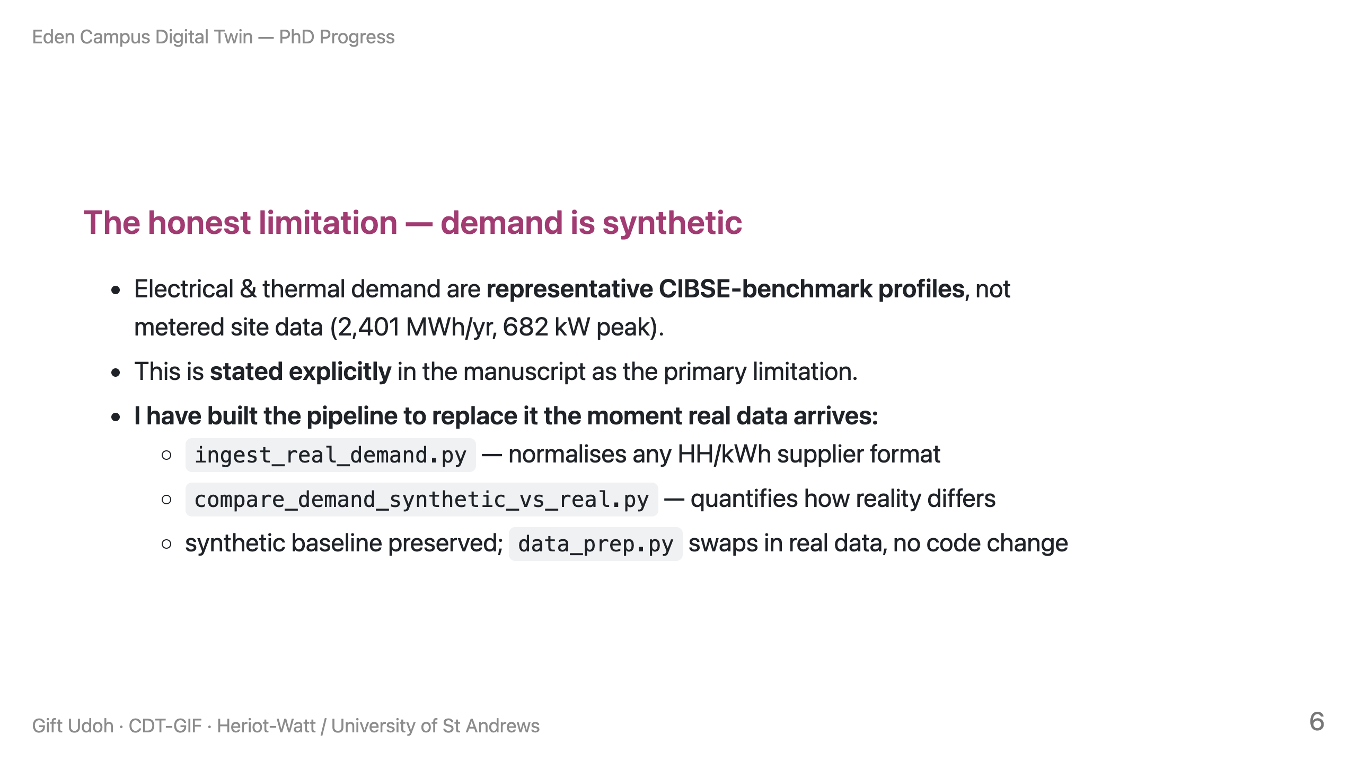
Notes:
SPEAKER NOTE: SAY THIS BEFORE THEY DO. This is the slide that wins the room with a
dataset-holder. Posture: "I know exactly what the limitation is and I've engineered
for it." Then immediately go to the next slide — the stress test — which is the
evidence that it doesn't matter to the conclusions.

Slide 7
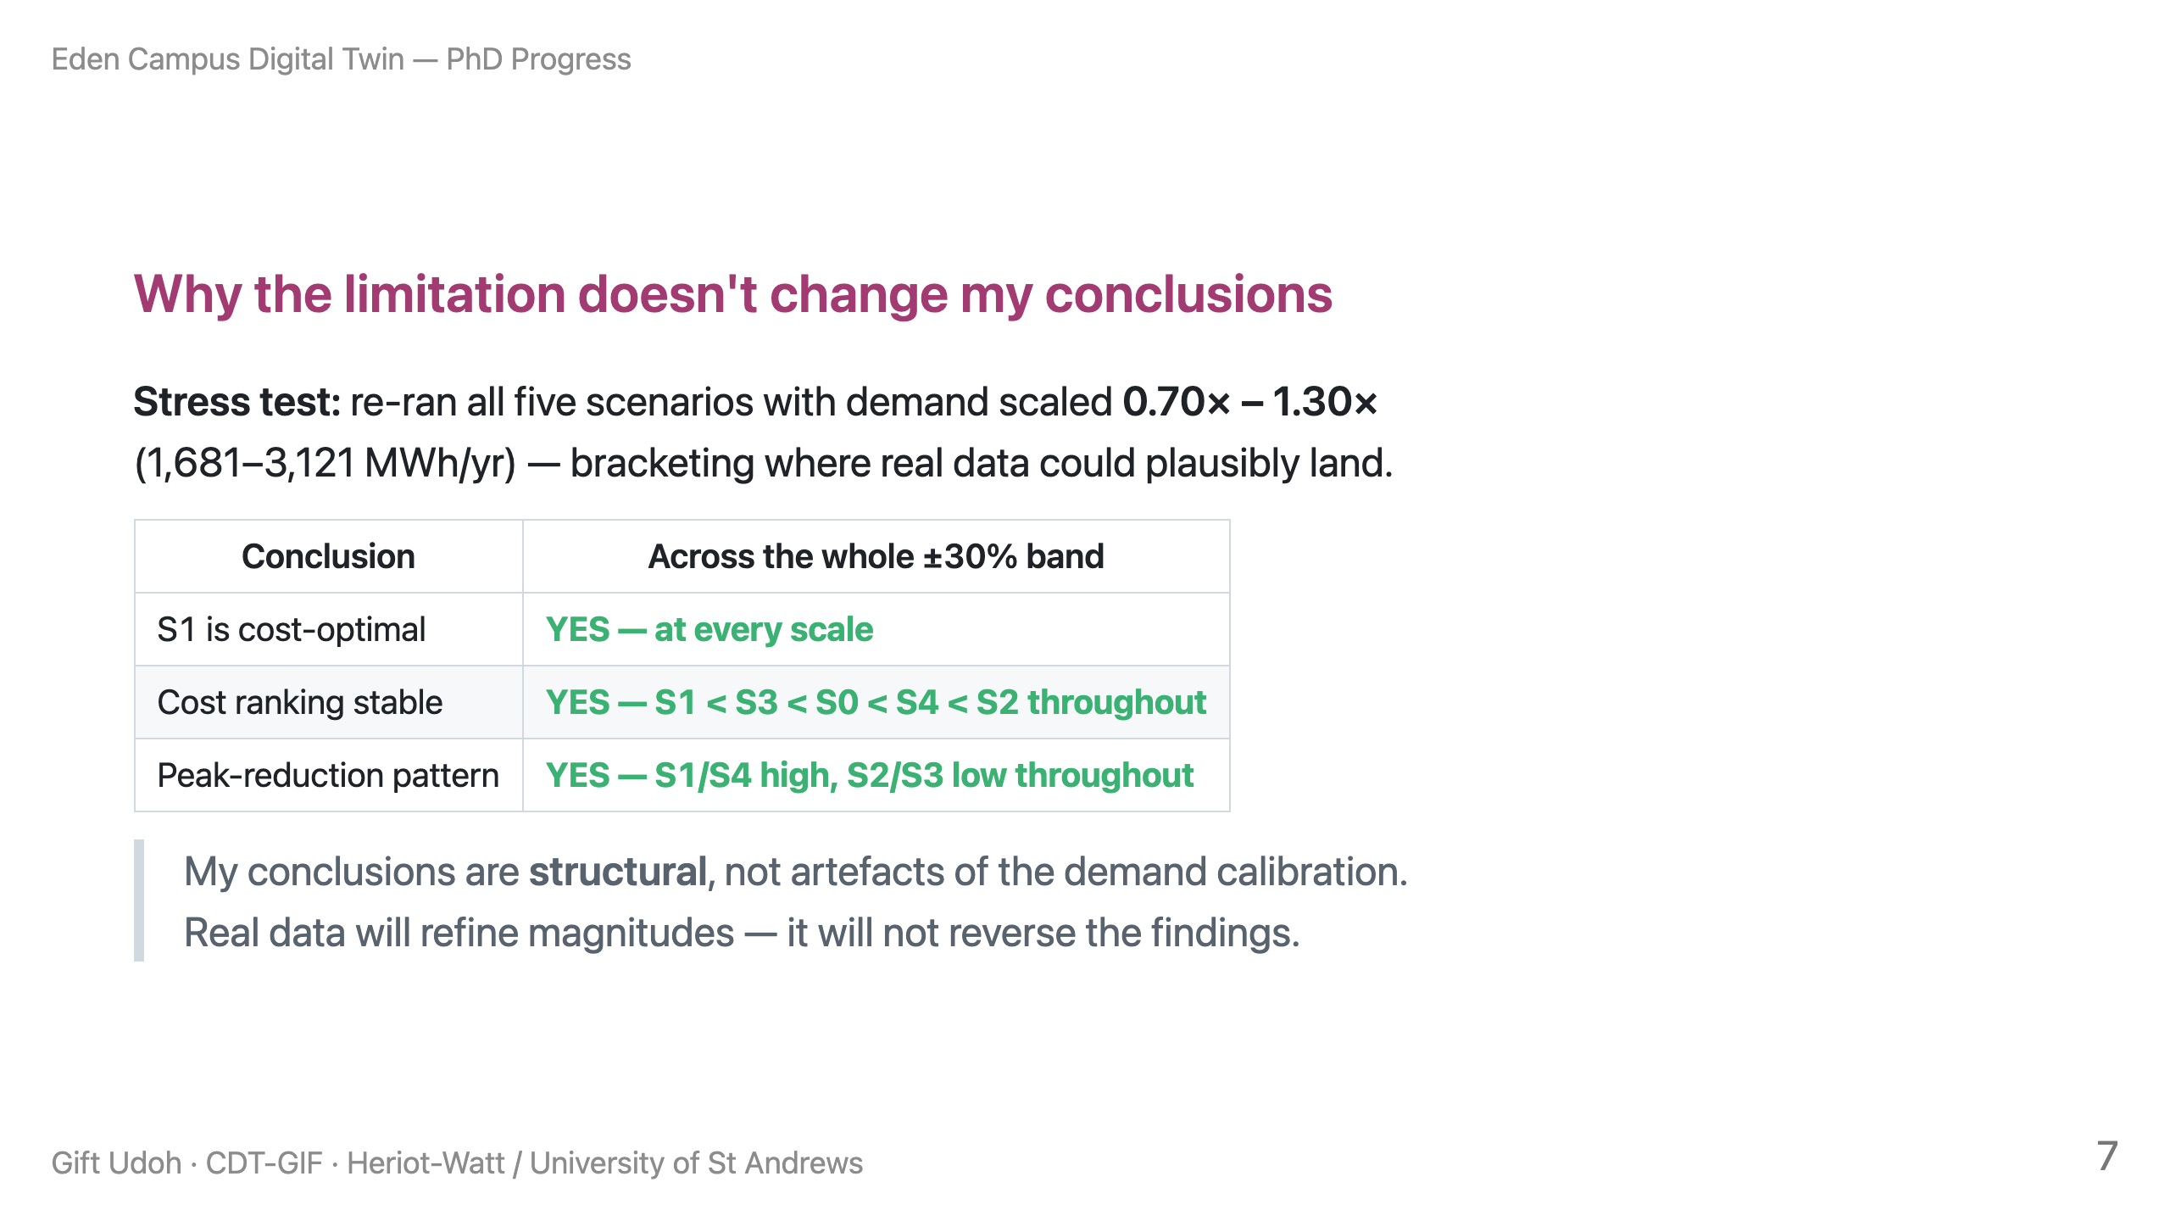
Notes:
SPEAKER NOTE: This is your shield. Reproducible: stress_test_demand_sensitivity.py.
If pressed: "I scaled magnitude uniformly; shape validation is the next step, and
the comparison harness is built for exactly that." Honest about what's shown vs not.

Slide 8
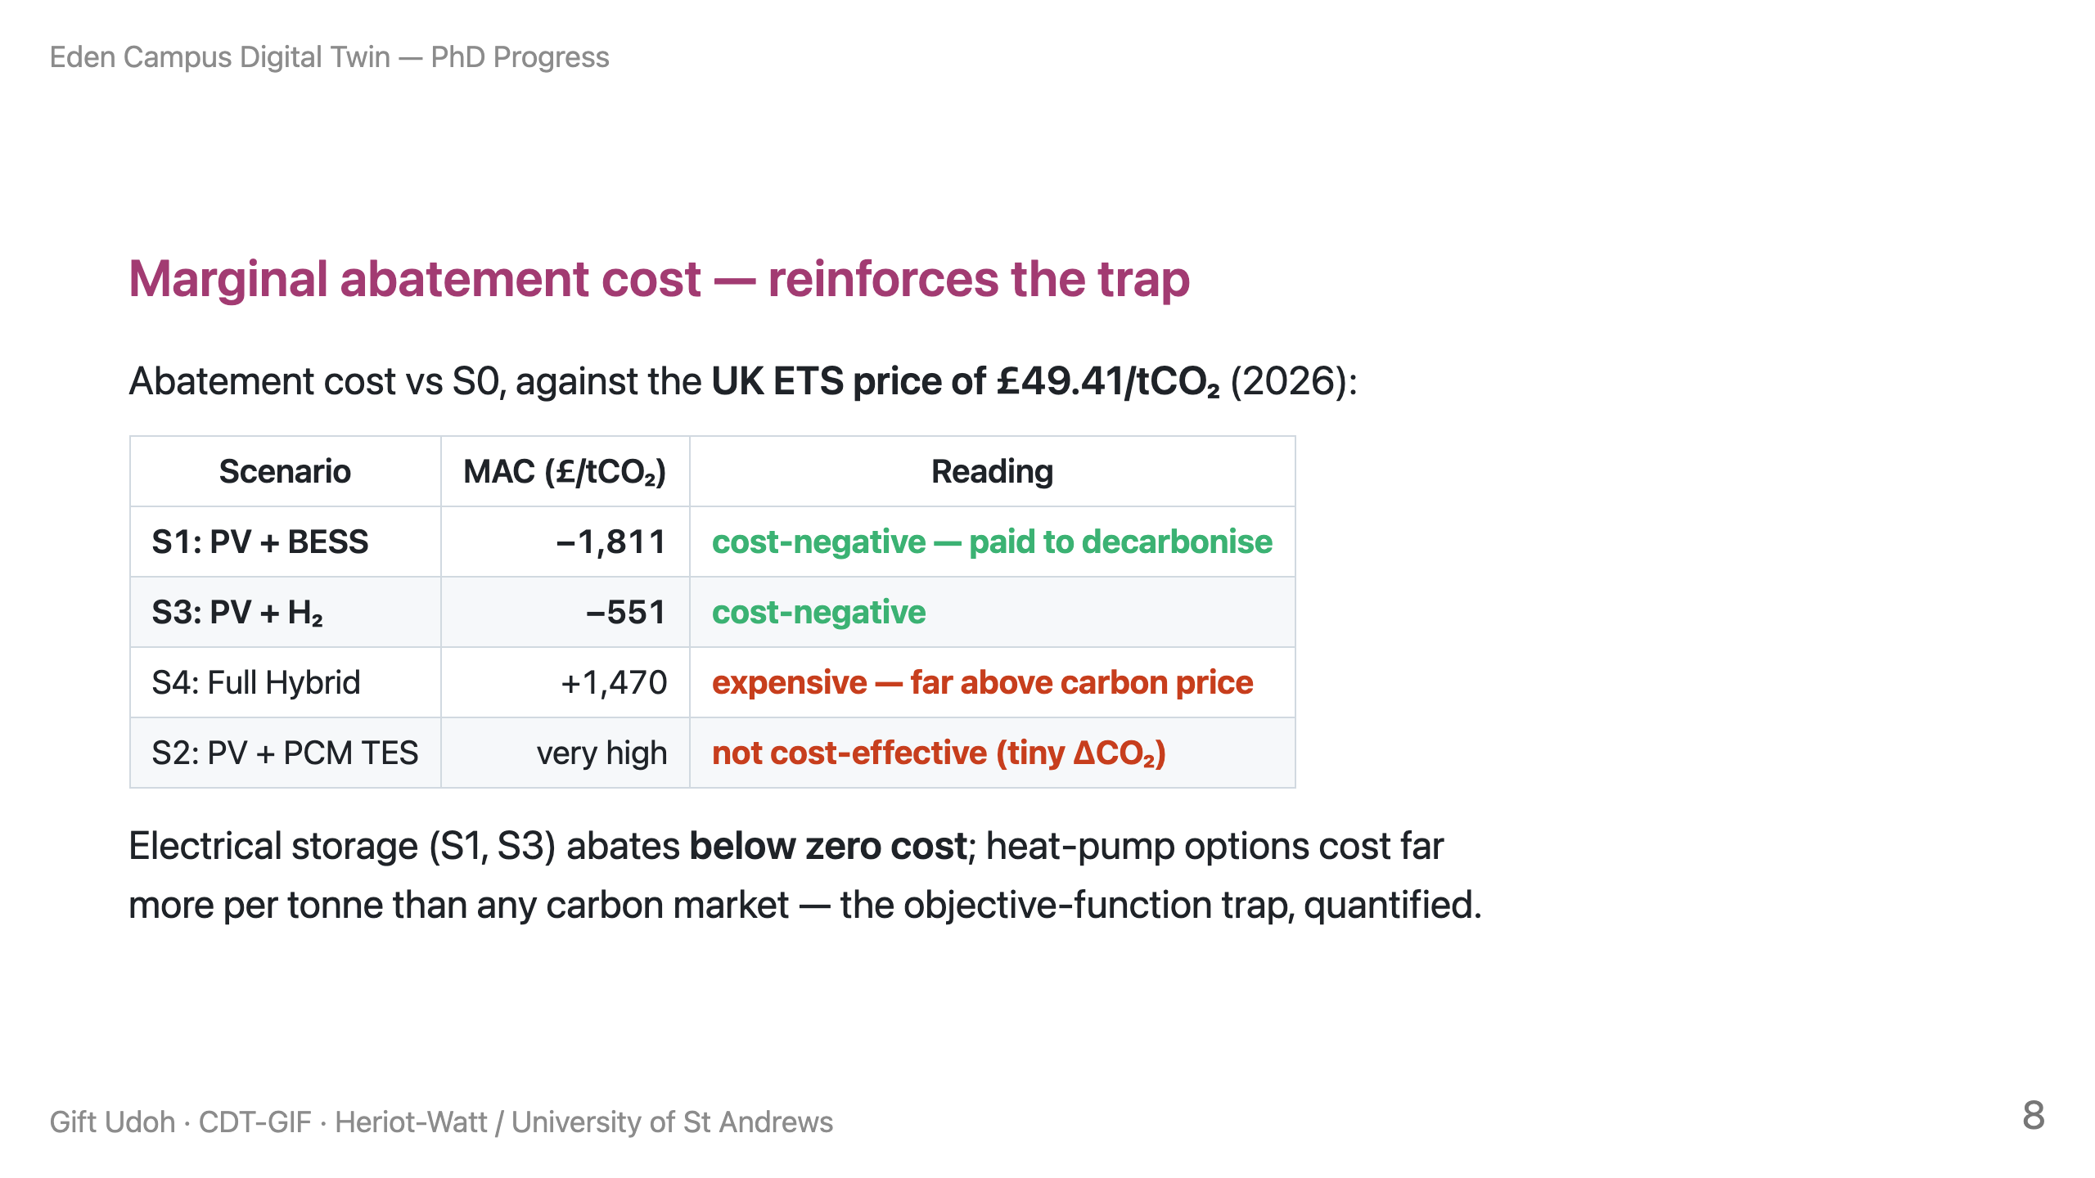
Notes:
SPEAKER NOTE: Don't claim "all beat the ETS price" — that's wrong and they may know
it. The split IS the story. Source: MAC_recomputed.md, UK ETS £49.41 from gov.uk.

Slide 9
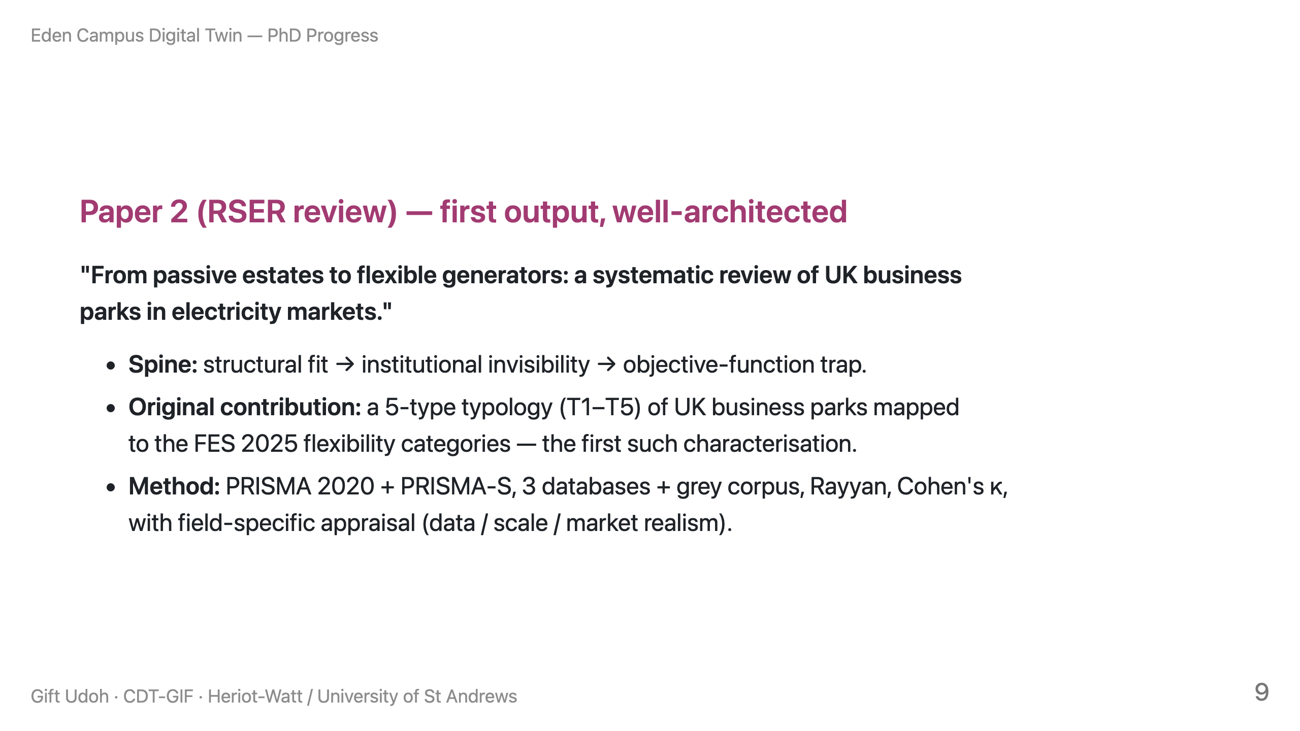
Notes:
SPEAKER NOTE: Frame honestly as "architected, entering the evidence phase." Don't
imply the screening is done. Strengths: the argument and the typology.

Slide 10
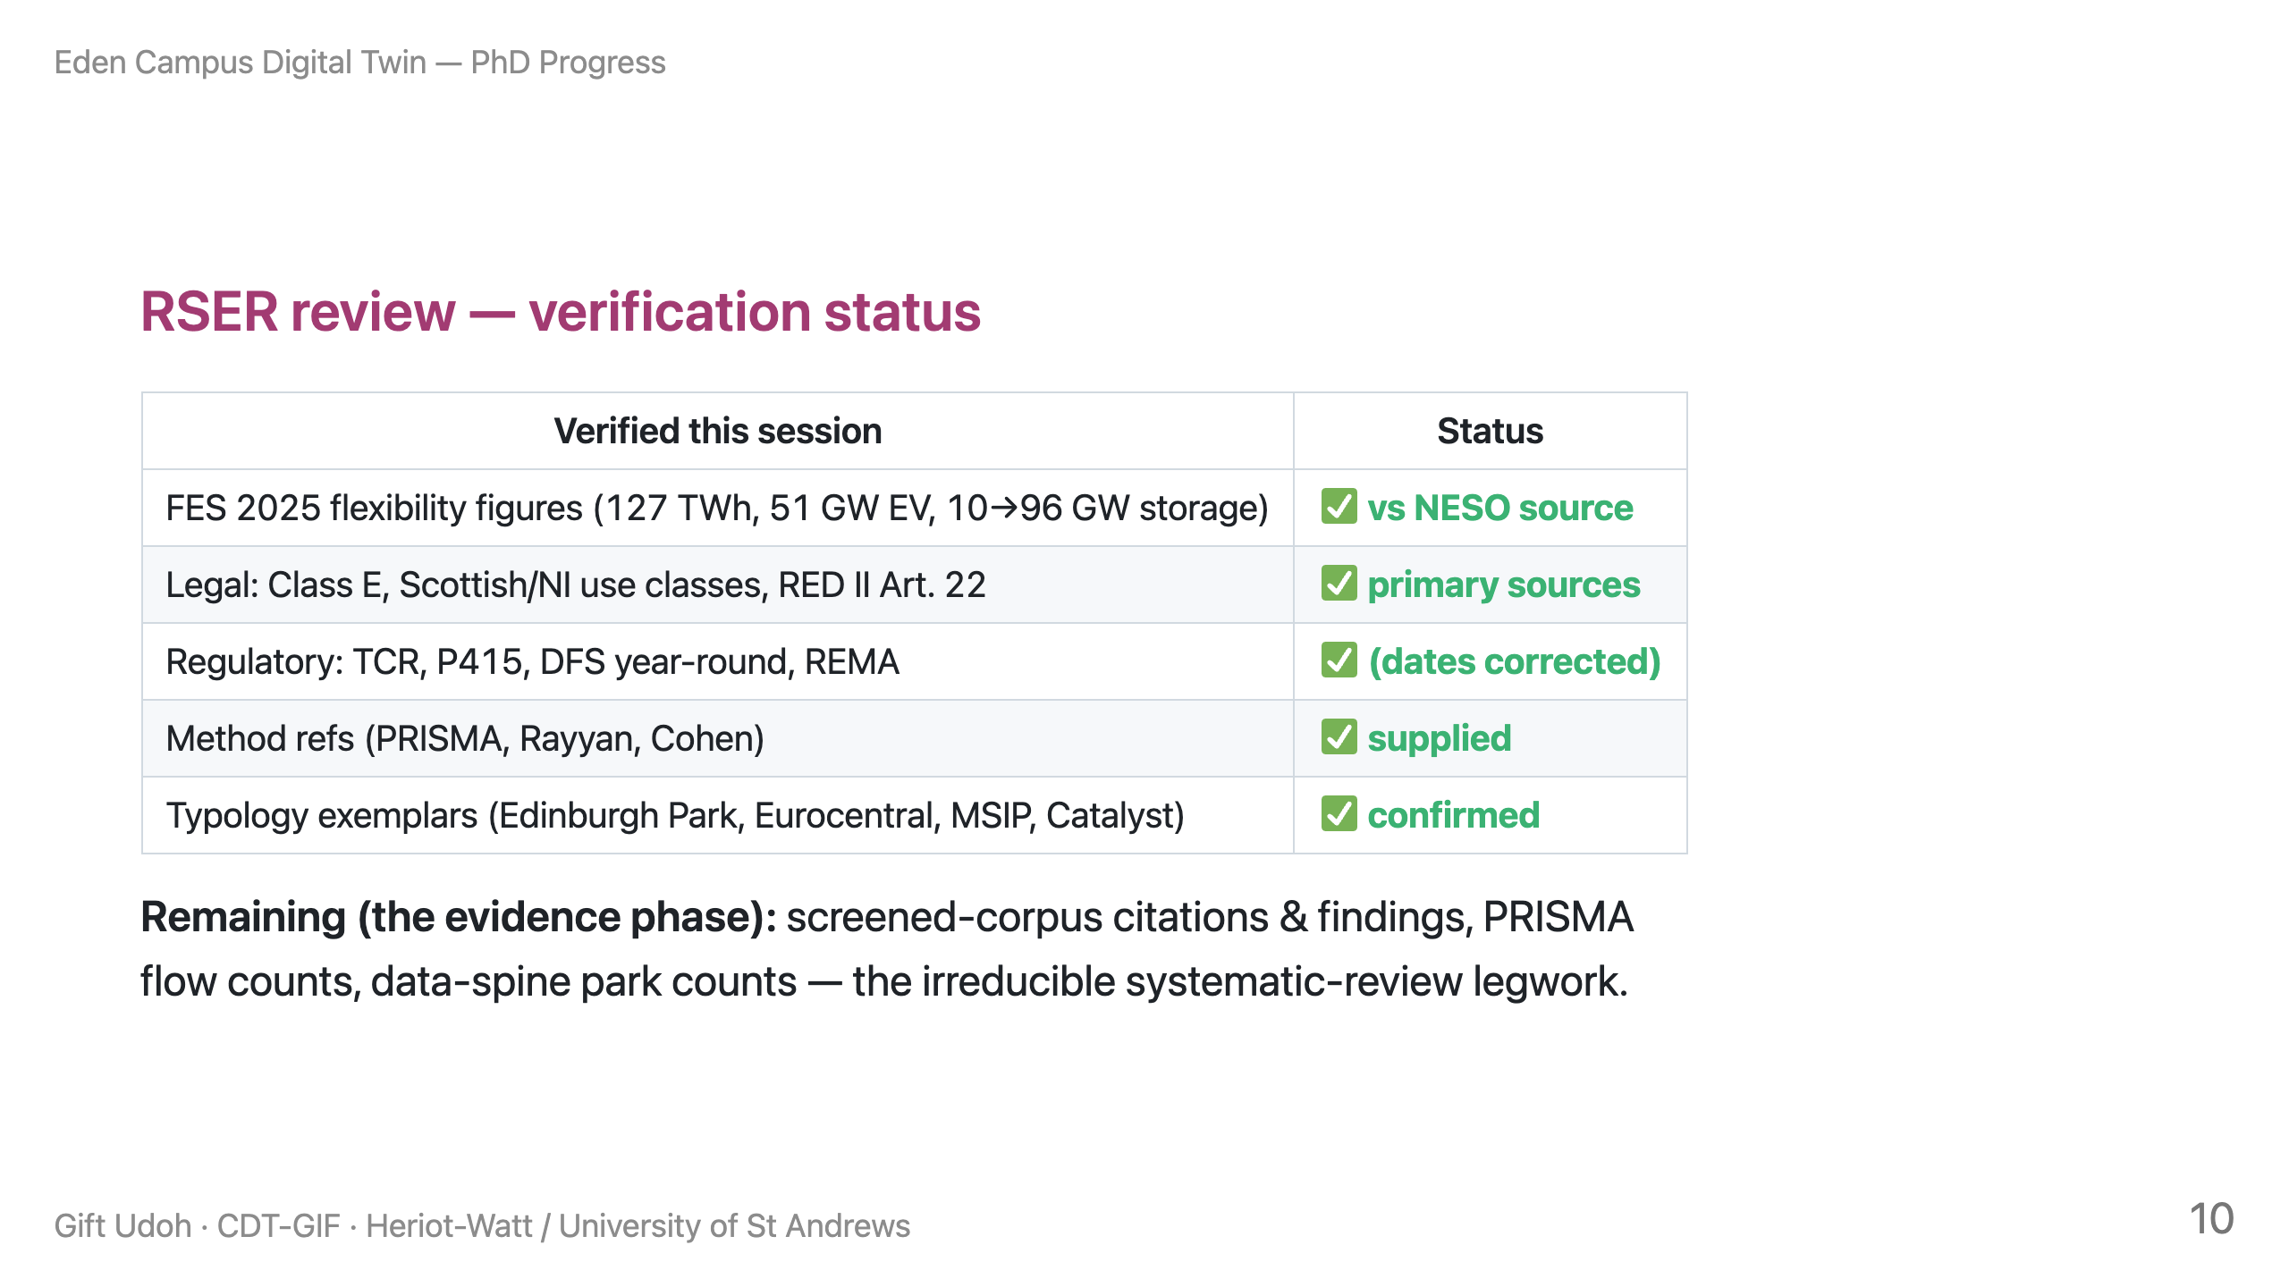
Notes:
SPEAKER NOTE: This shows rigour — every fact-checkable claim is already verified,
with a committed record (LEGAL_REGULATORY_VERIFIED.md). The honest gap is the
corpus screening, which is the actual review work.

Slide 11
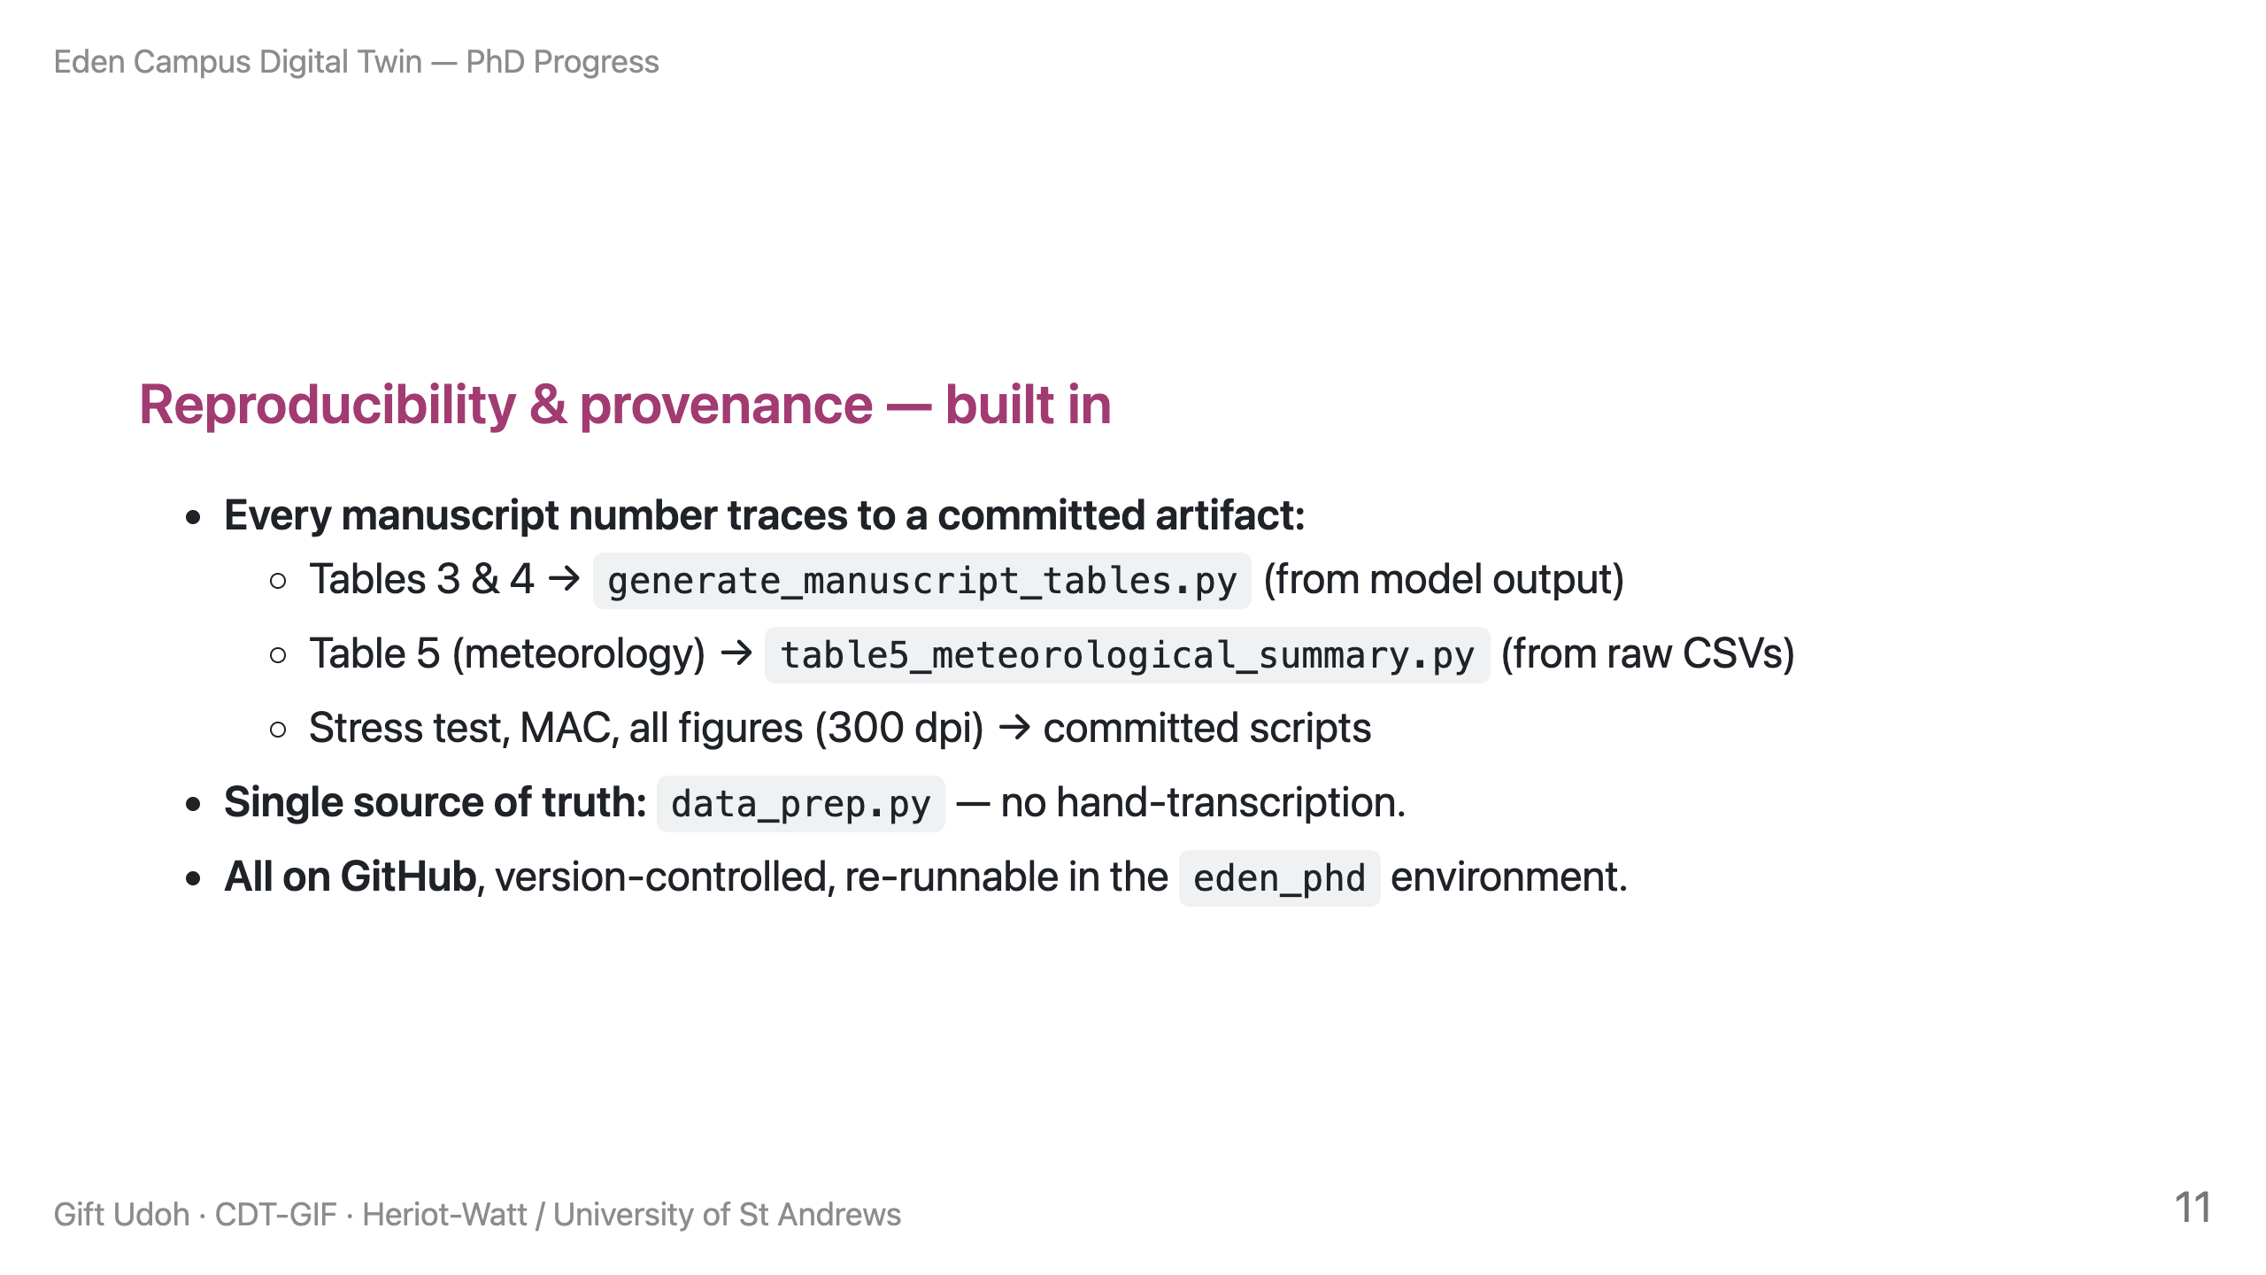
Notes:
SPEAKER NOTE: This is a quiet strength that separates good from great PhD work.
A dataset-holder can literally re-run and check. Say "nothing in the paper is a
number I can't regenerate."

Slide 12
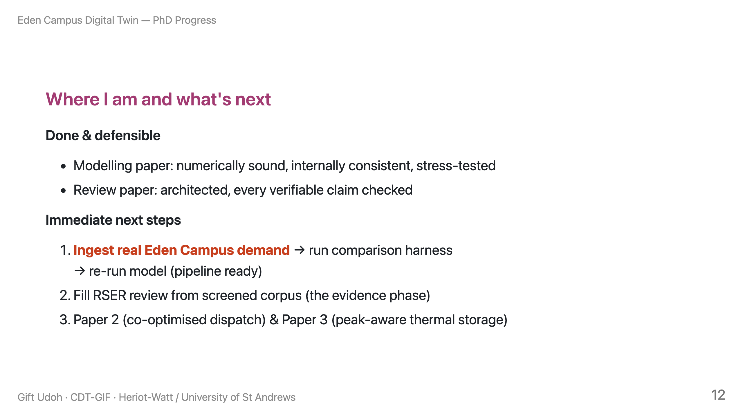
Notes:
SPEAKER NOTE: End on forward momentum. The real data is the natural next milestone
and you're ready for it — invite them to share it. Close in ~30 seconds.

Slide 13
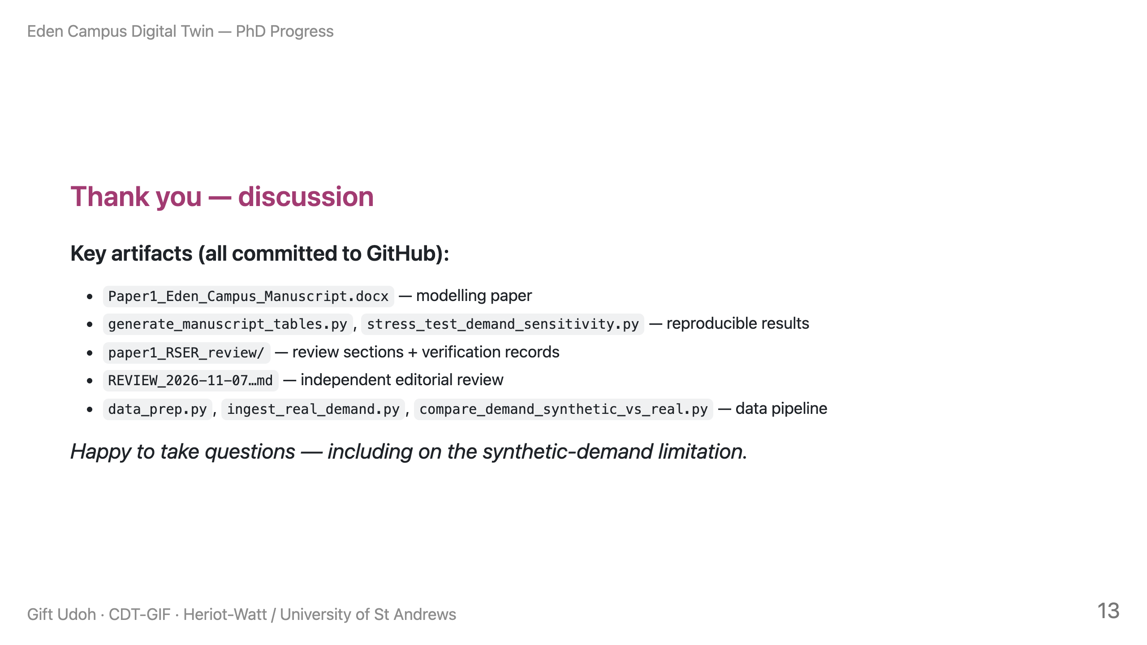
Notes:
SPEAKER NOTE: Inviting the hardest question signals confidence. See the Q&A annex
below (not part of the rendered deck in presenter mode) for prepared answers.

Slide 14
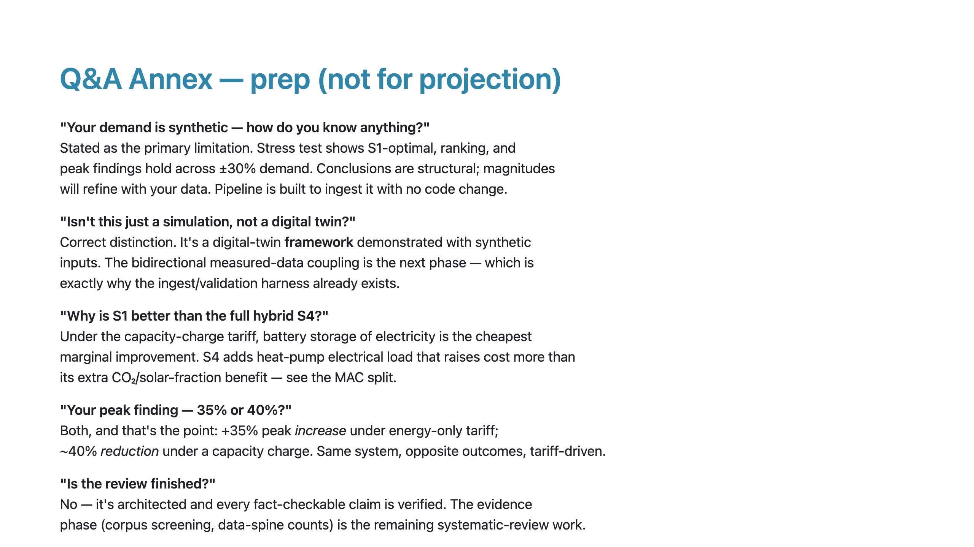
Notes:
SPEAKER NOTE: This annex renders as slides but is marked "not for projection" —
either delete before presenting or keep as your private crib. Every answer maps to
a committed artifact so you can show evidence live if challenged.

