Slide 1



www.groundgurus.com

Slide 2


Slide 3


Slide 4
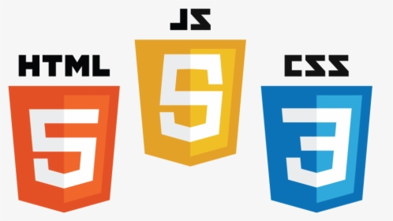

Slide 5

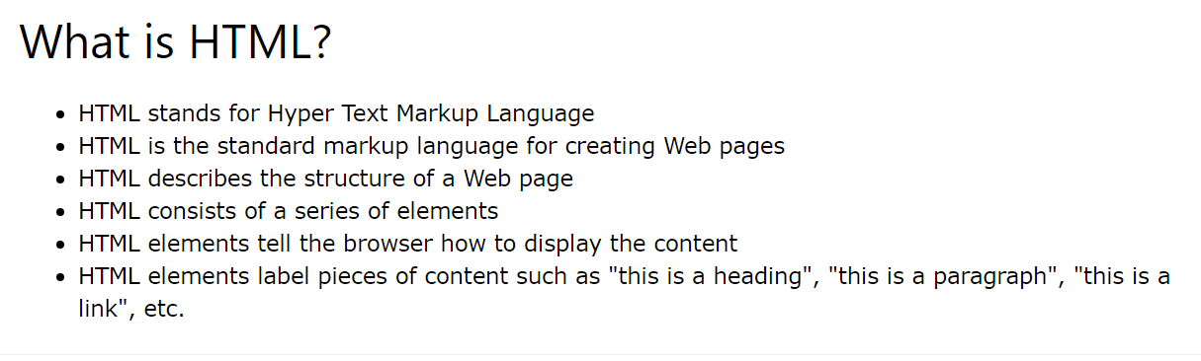

Slide 6
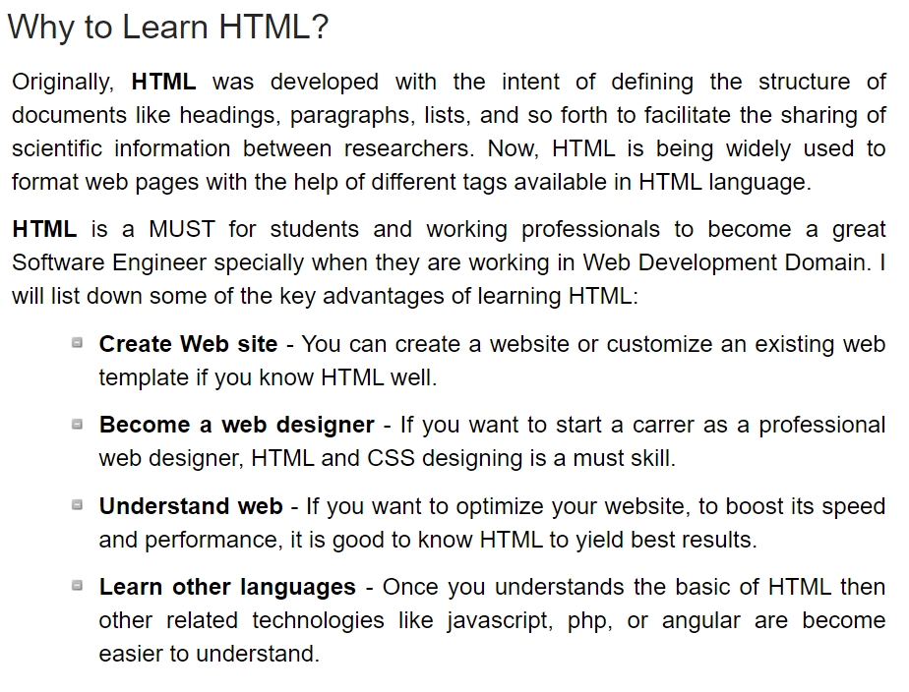

Slide 7
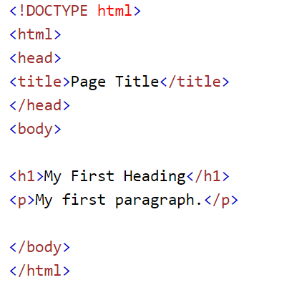
Html Basic Structure

Slide 8

Html Document Type
Common Tags
Heading Tags <h>
Paragraph Tag <p>
Image Tag <img>
Division <div>
Break </br>
and more

Slide 9
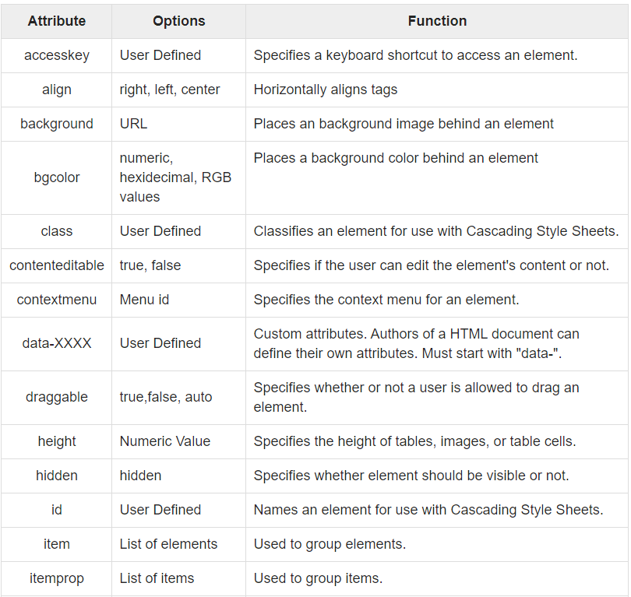
Html Attributes

Slide 10
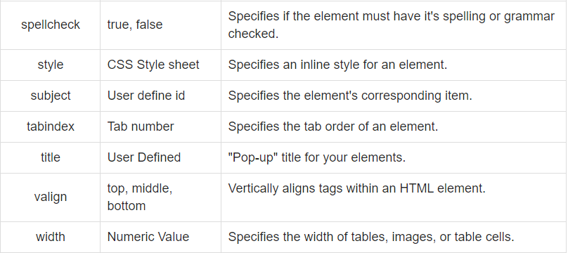
Html Attributes

Slide 11
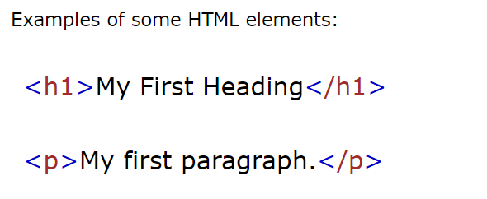
An HTML element is defined by a starting tag. If the element contains other content, it ends with a closing tag, where the element name is preceded by a forward slash as shown below with few tags −
Elements

Slide 12
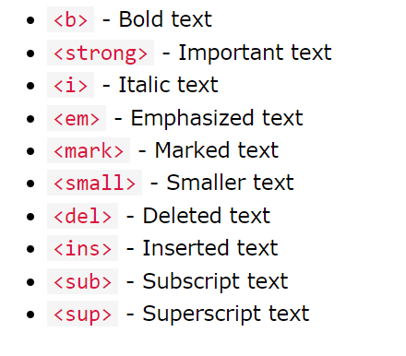
Formatting Elements
Formatting elements were designed to display special types of text:

Slide 13
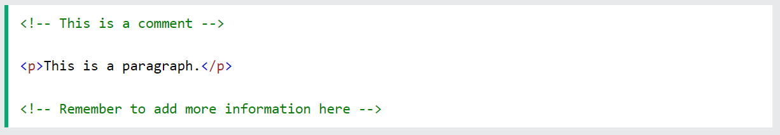
Add Comments
With comments you can place notifications and reminders in your HTML code:

Slide 14

CSS is acronym of Cascading Style Sheets. It helps to define the presentation of HTML elements as a separate file known as CSS file having .css extension.
CSS helps to change formatting of any HTML element by just making changes at one place. All changes made would be reflected automatically to all of the web pages of the website in which that element appeared.

Slide 15

CSS Rules
CSS Rules are the styles that we have to create in order to create style sheets. These rules define appearance of associated HTML element. The general form of CSS syntax is as follows:

Slide 16
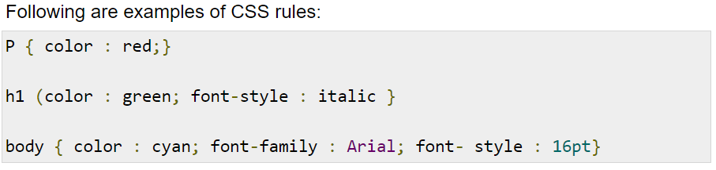
CSS Rules
CSS Rules are the styles that we have to create in order to create style sheets. These rules define appearance of associated HTML element. The general form of CSS syntax is as follows:

Slide 17
Methods to embed CSS to HTML
Following are the four methods to add CSS to HTML documents.
Inline Style Sheets
2.Embedded Style Sheets
3.External Style Sheets
4.Imported Style Sheets

Slide 18

Methods to embed CSS to HTML
Inline Style Sheets are included with HTML element i.e. they are placed inline with the element. To add inline CSS, we have to declare style attribute which can contain any CSS property.

Slide 19
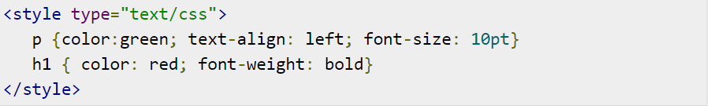
Methods to embed CSS to HTML
Embedded Style Sheets are used to apply same appearance to all occurrence of a specific element. These are defined in <head> element by using the <style> element.
The <style> element must include type attribute. The value of type attribute specifies what type of syntax it includes when rendered by the browser.

Slide 20
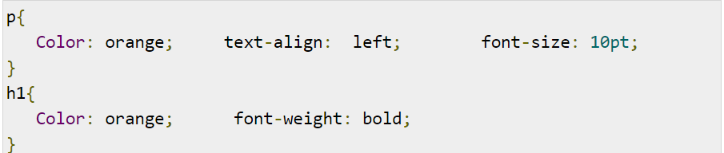
Methods to embed CSS to HTML
External Style Sheets are the separate .css files that contain the CSS rules. These files can be linked to any HTML documents using <link> tag with rel attribute.
In order to create external css and link it to HTML document, follow the following steps:
First of all, create a CSS file and define all CSS rules for several HTML elements. Let’s name this file as external.css.

Slide 21
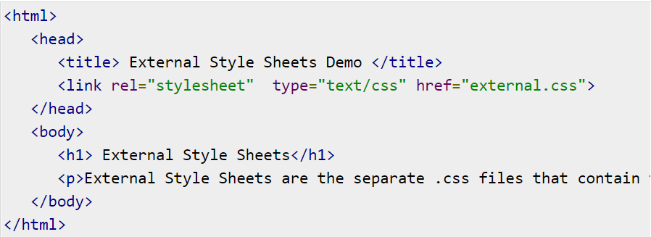
Methods to embed CSS to HTML

Slide 22
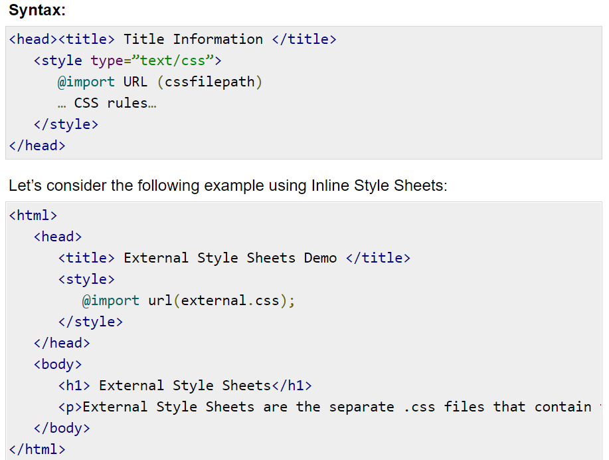
Methods to embed CSS to HTML
Imported Style Sheets allow us to import style rules from other style sheets. To import CSS rules we have to use @import before all the rules in a style sheet.

Slide 23
Session 1 Recap
HTML Structure
HTML Elements
CSS Embedding Methods
Inline
Embedded Style
External
Web Hosting
GoDaddy
Smarterasp.net
000webhost
Freelancing Web Sites
https://gyantastic.com/best-freelance-websites/
Cloud Technology
In demand skills that does not require much coding

Slide 24
Session 2 Overview
More CSS and HTML Tags
Javascript
GitHub Web Page Publishing

Slide 25
Other useful HTML attributes and tags
The <span> tag is an inline container used to mark up a part of a text, or a part of a document.
The HTML <section> element represents a standalone section — which doesn't have a more specific semantic element to represent it — contained within an HTML document. Typically, but not always, sections have a heading.
The HTML <ul> element represents an unordered list of items, typically rendered as a bulleted list <li>.

Slide 26
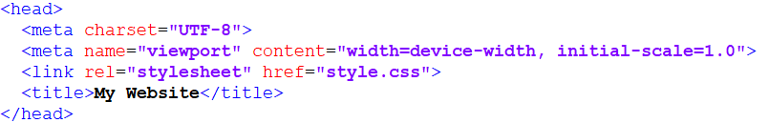
HTML Responsiveness
An HTML Tag that allows the Web Page to adapt to the size of the device (PC, Mobile, Tablet)

Slide 27
HTML Icons
Web Designer / Developers can directly access commonly used Icons on the following sites :
https://icons8.com/
https://fontawesome.com/v4.7.0/icons/

Slide 28
CSS Templates
Float
Flexbox
Grid
Top Navigation
Side Navigation

Slide 29
Javascript Topics :
Output
Syntax
Variables
Data Types
Conditionals
Functions
Scopes
Closures
Loops / Iterations
Objects and Arrays
Looping

Slide 30

JavaScript is a lightweight, interpreted programming language. It is designed for creating network-centric applications. It is complimentary to and integrated with Java. JavaScript is very easy to implement because it is integrated with HTML. It is open and cross-platform.

Slide 31
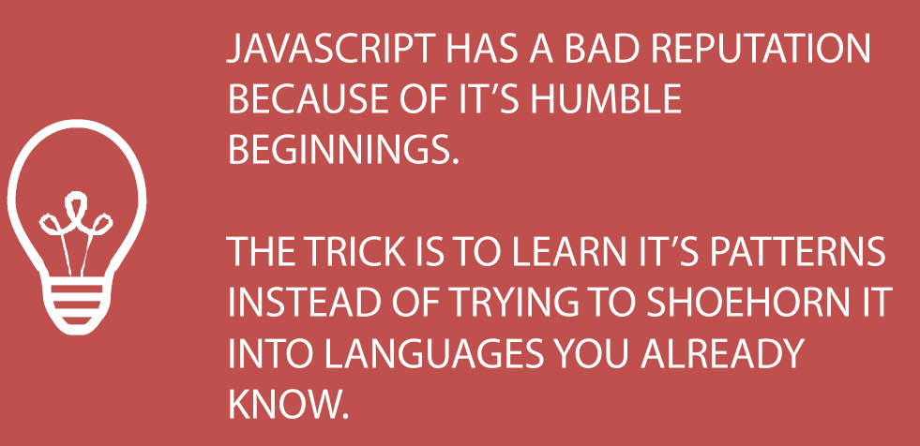

Slide 32
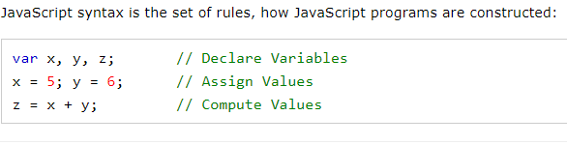
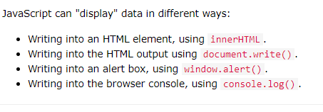
Javascript Syntax and Output

Slide 33
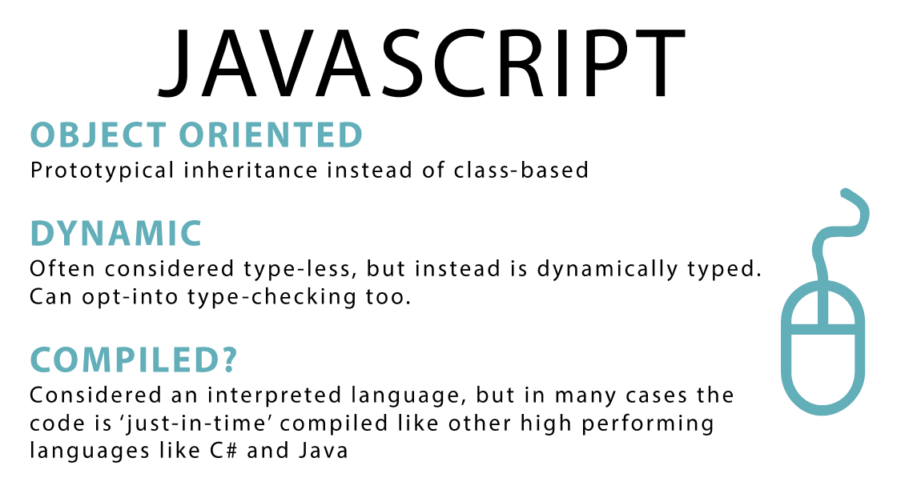

Slide 34


