Slide 1



www.groundgurus.com

Slide 2


Slide 3


Slide 4
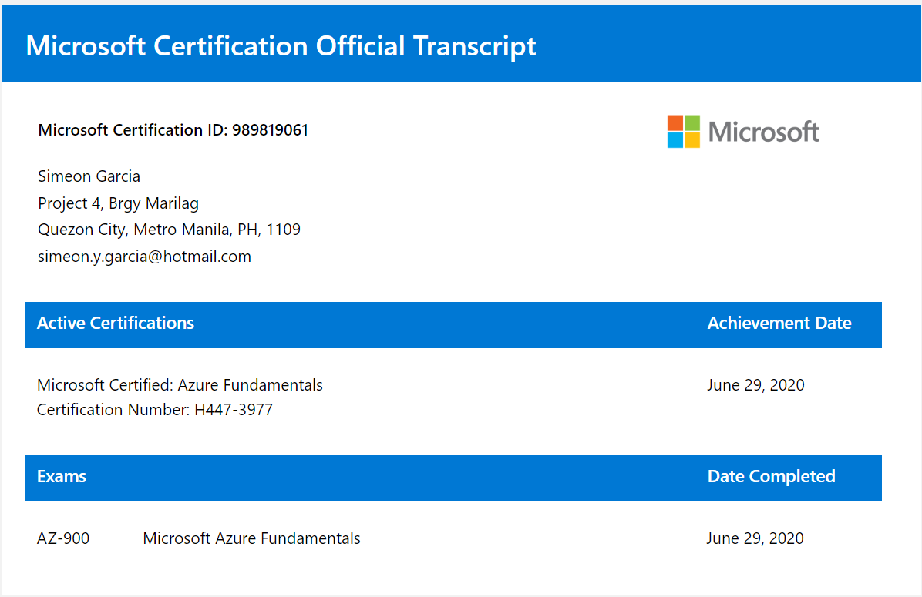

Slide 5


Slide 6
assumption
Concept of Web Programming
Basic HTML / CSS / JavaScript
Knows how Database works
WILLINGNESS and EAGERNESS to learn

Slide 7
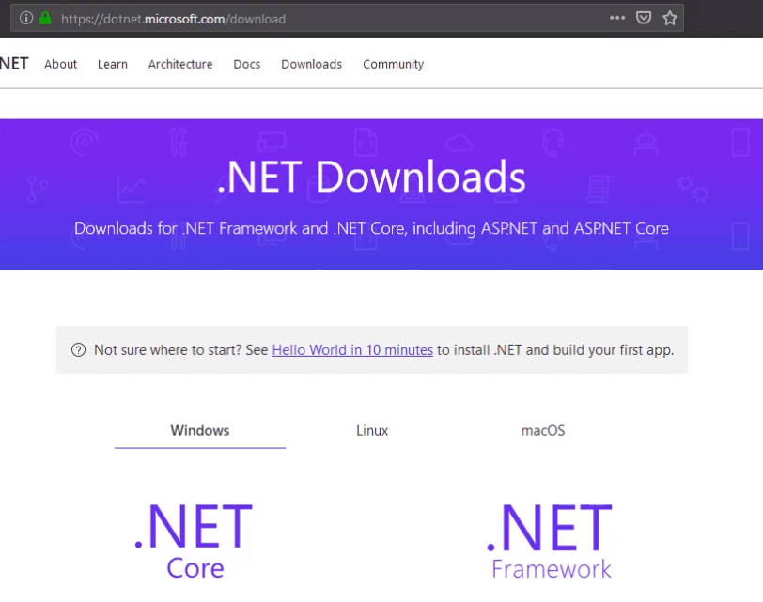

Slide 8
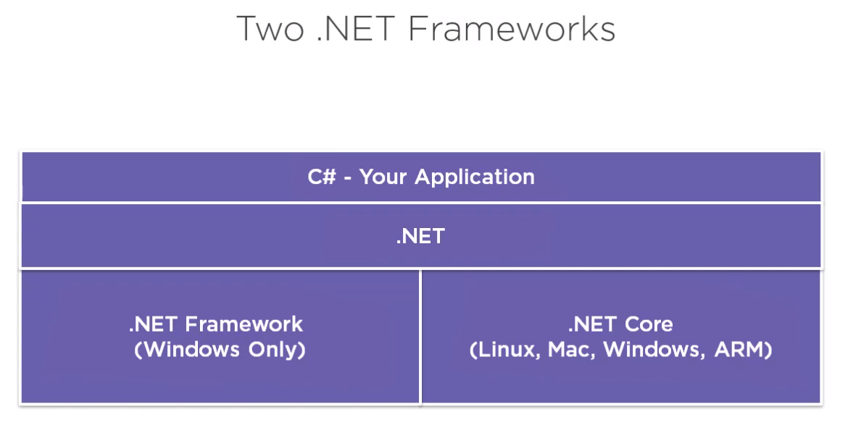

Slide 9
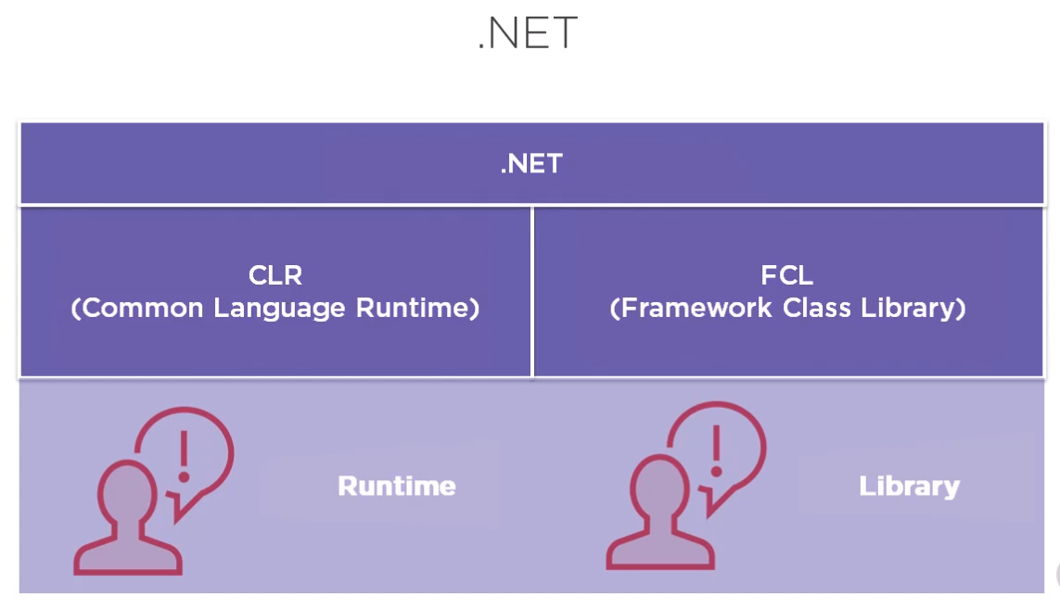

Slide 10
C# in a Nutshell
C# is a simple & powerful object-oriented programming language developed by Microsoft. C# can be used to create various types of applications, such as web, windows, console applications, or other types of applications using Visual Studio or Visual Studio Code.

Slide 11
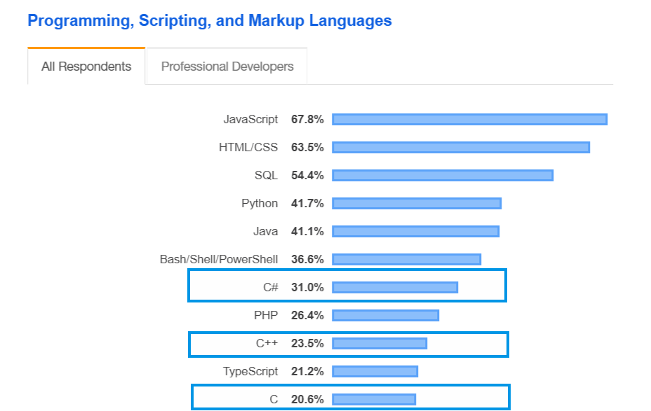

Slide 12
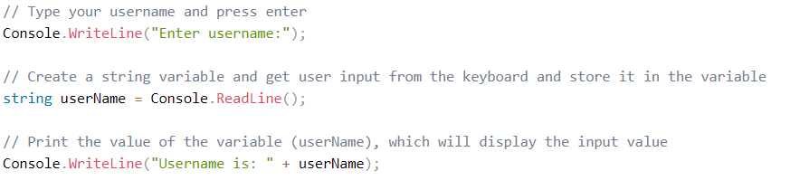
C# console input / output

Slide 13
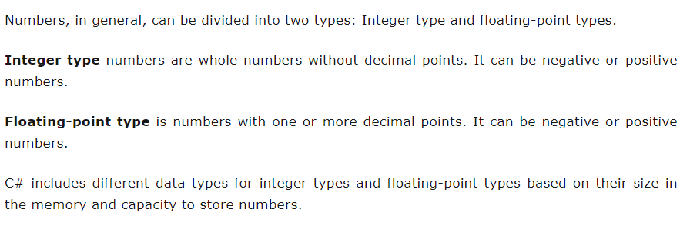
c# number data types

Slide 14
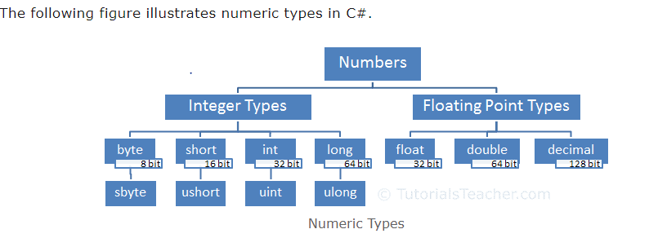
c# number data types

Slide 15
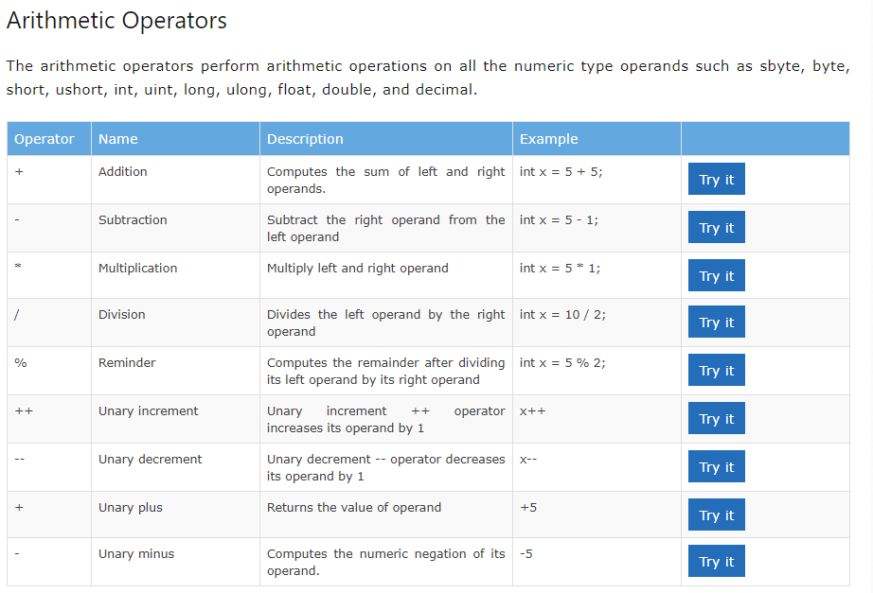
c# operators

Slide 16
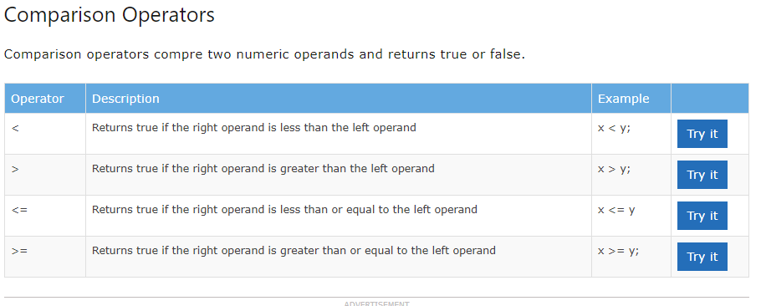
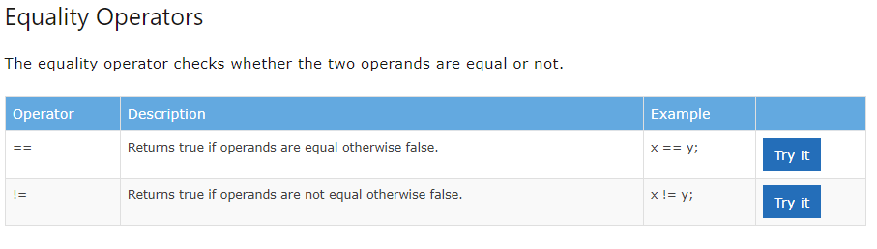
C# operators

Slide 17
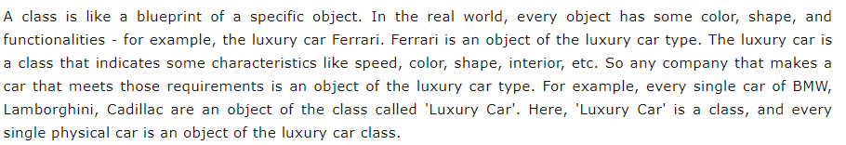
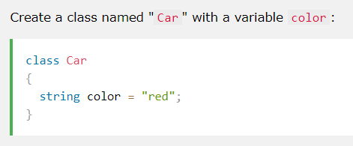
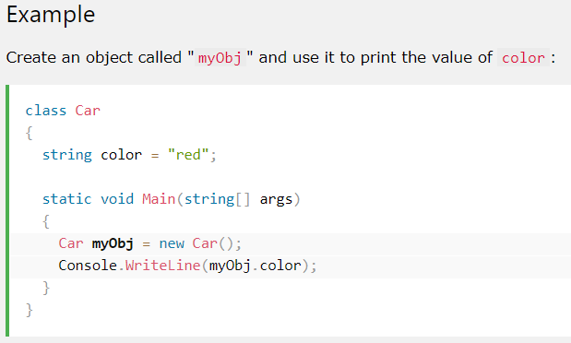
C# Class / object

Slide 18
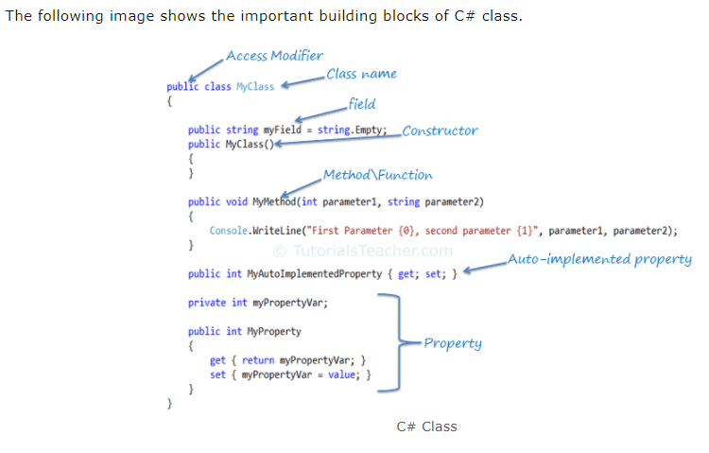
C# Class

Slide 19
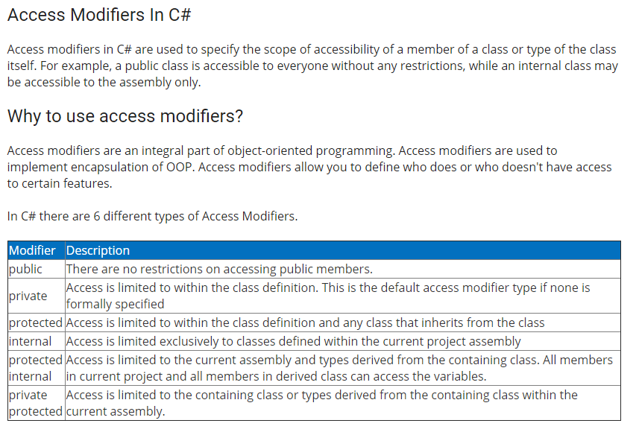
C# Class

Slide 20
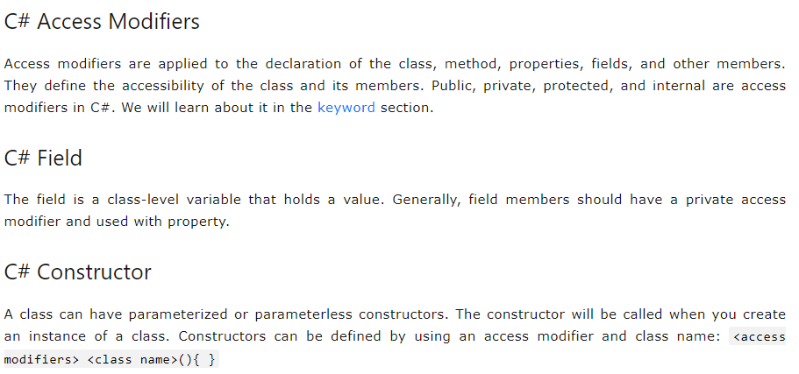
C# Class

Slide 21
Conditional statements and loops

Slide 22
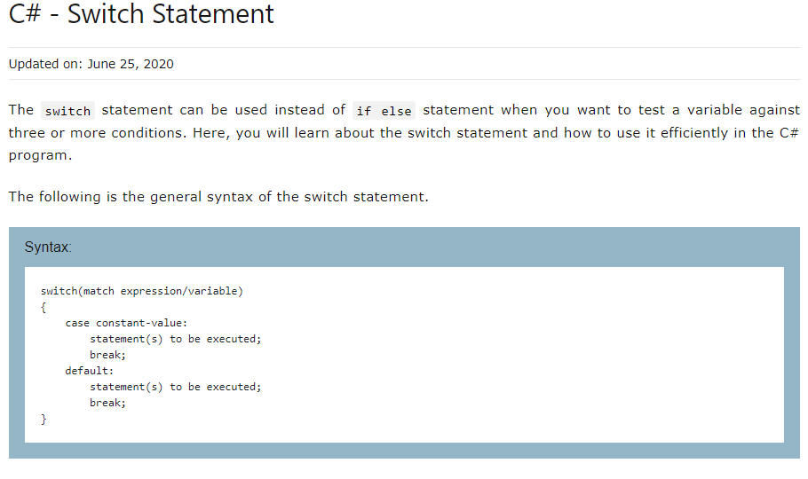
Conditional statements

Slide 23
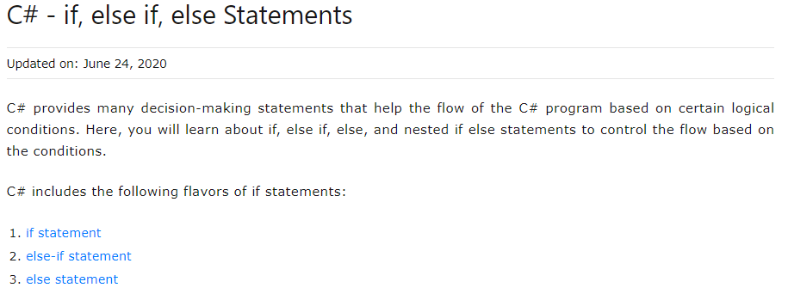
Conditional statements

Slide 24
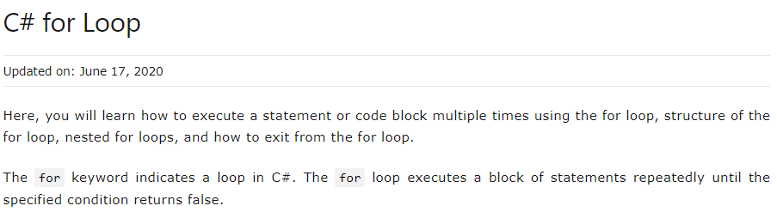
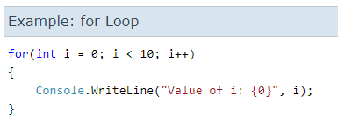
loops

Slide 25
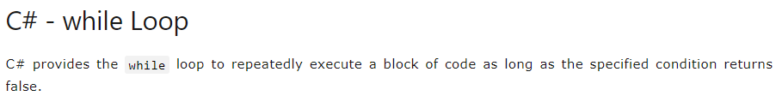
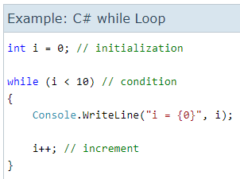
loops

Slide 26
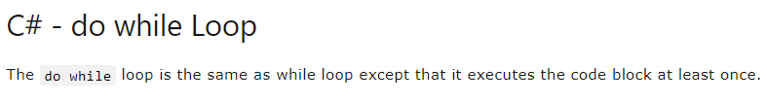
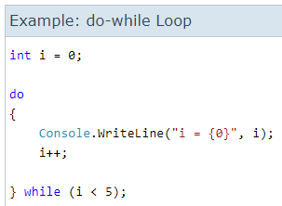
loops

Slide 27
Arrays and collections

Slide 28
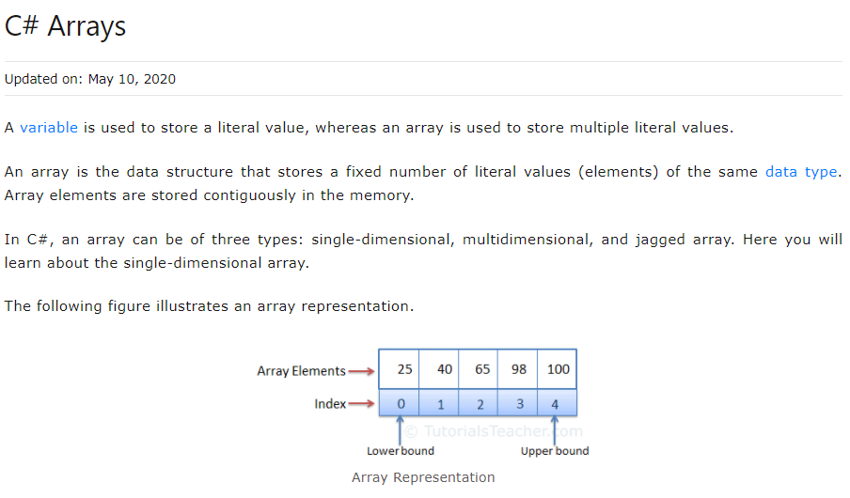
arrays

Slide 29
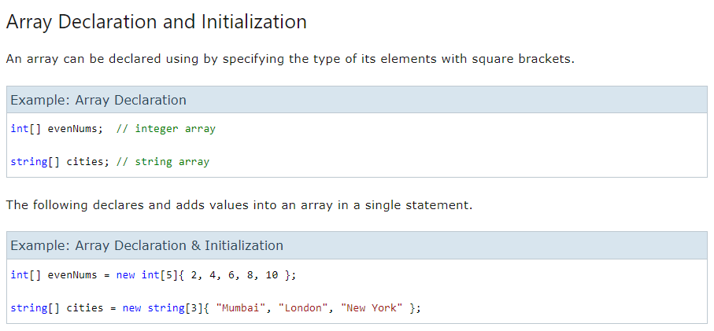
arrays

Slide 30
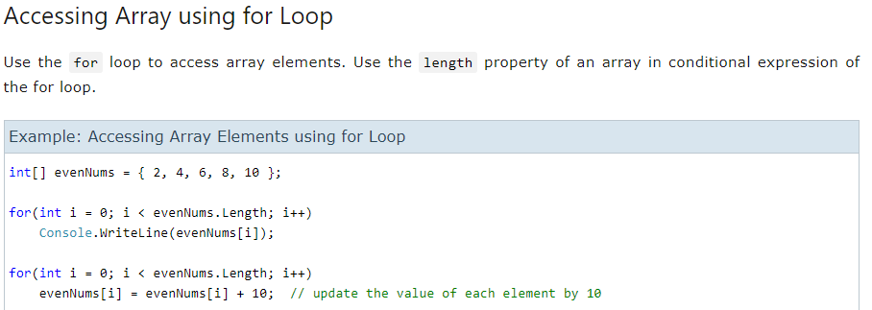
arrays

Slide 31
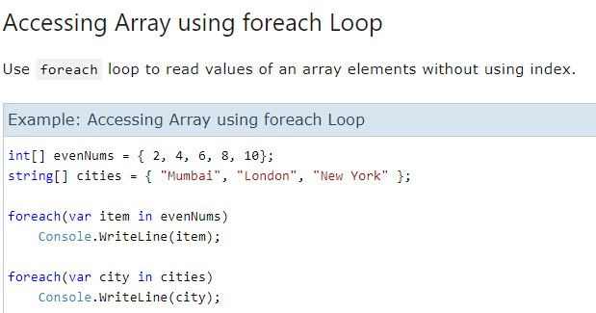
arrays

Slide 32
Non-generic collection - ArrayList - List - Dictionary (Not applicable) - HashTable (not applicable)

Slide 33
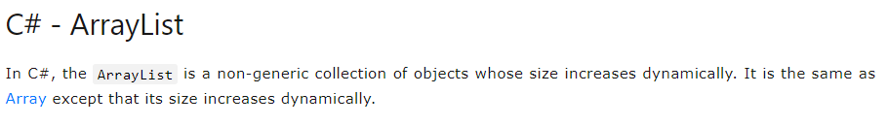
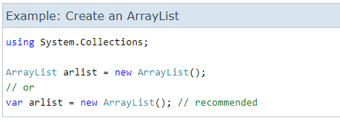
arraylist

Slide 34
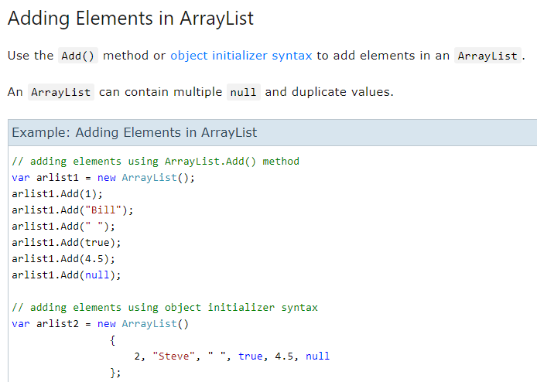
arraylist

Slide 35
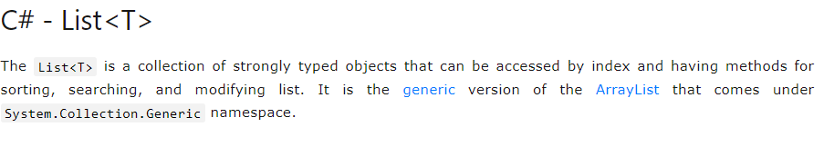
list

Slide 36
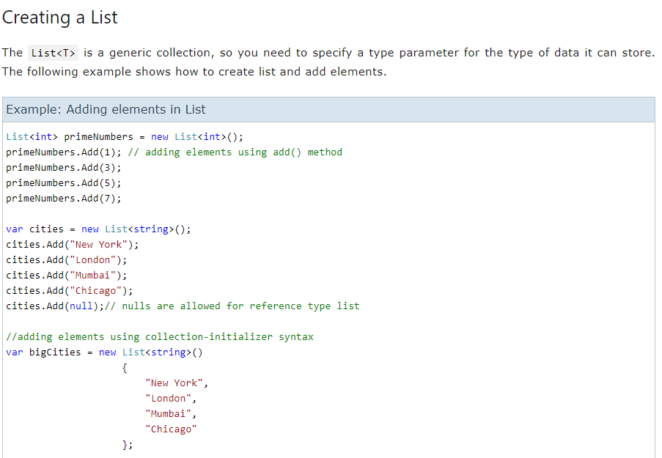
list

Slide 37
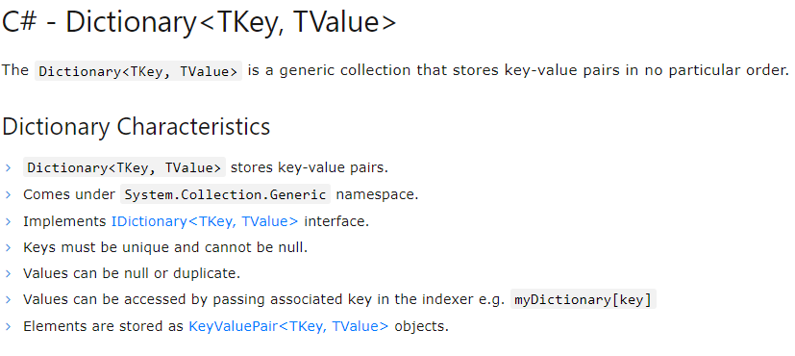
dictionary

Slide 38
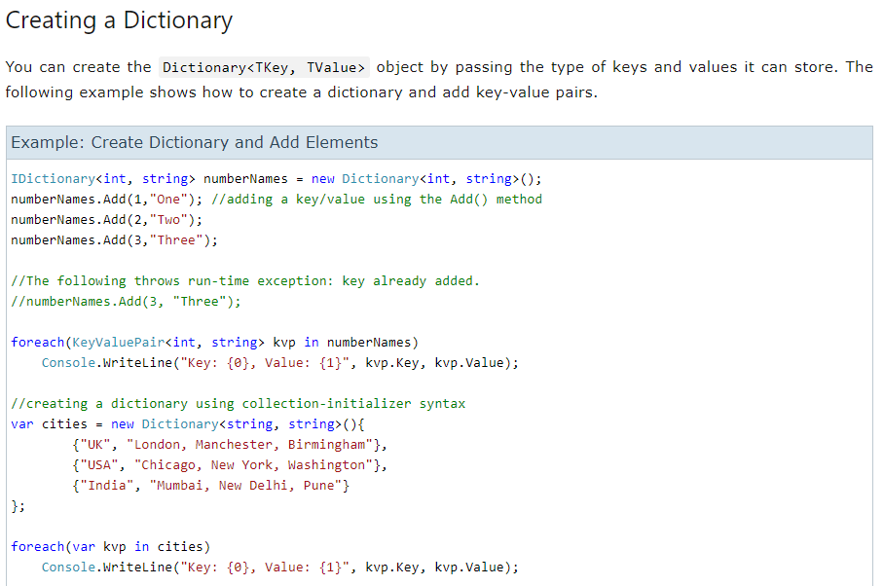
dictionary

Slide 39
Object oriented programming (OOP) in C#
Object Oriented Programming (OOP) in C#. OOPs is a concept of modern programming language that allows programmers to organize entities and objects. Four key concepts of OOPs are
Abstraction
Encapsulation
Inheritance
Polymorphism

Slide 40
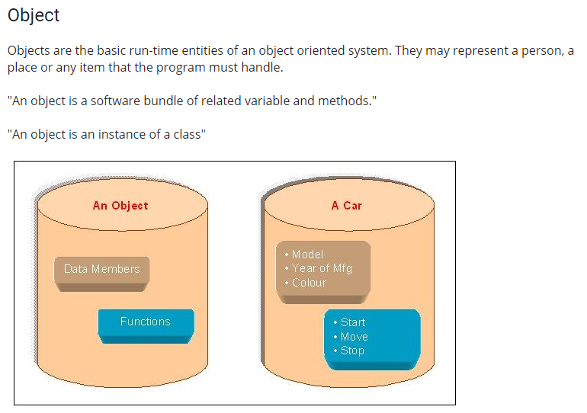

Slide 41
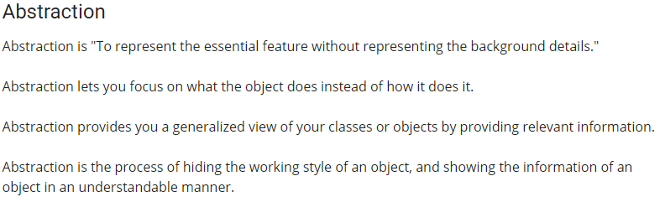
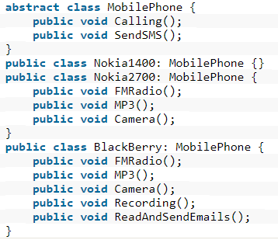

Slide 42
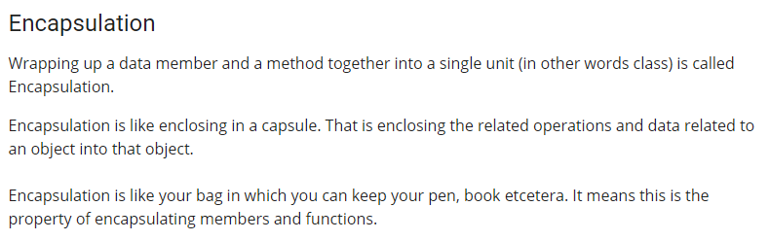
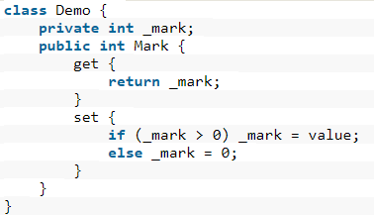

Slide 43
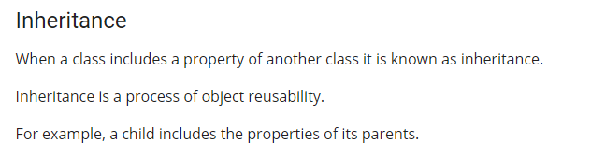
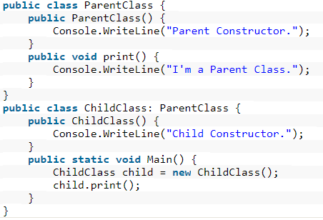

Slide 44
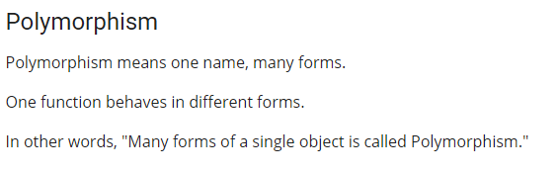
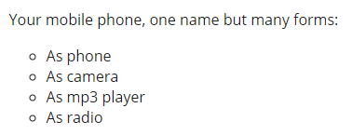

Slide 45


