Slide 1

Hello!
Jireh Capao
Web Developer
@ Kayweb Holdings Pty Limited, AU

Slide 2
Web Designer vs. Web Developer

Slide 3
Role
WEB DESIGNER
is a person who creative in the design of a web project, how it will look like, what colors will use, what fonts, and what amount of spacing, alignments, positions and other assets of a website.
WEB DEVELOPER
is a person who takes the design and transforms it into functional Web applications, they are coded and study the programming languages that they will use for a Web project.
- The Structure of a Web Application usually consists of frontend(the interface) and backend(the infrastructure).

Slide 4
Tools
WEB DESIGNER
Photoshop, sketch, Innerface Design tool, Figma, Adobe XD, and other graphics design software.
WEB DEVELOPER
IDE:
Atom, notepad, Sublime, Netbeans, Visual Studio, Php Storm
Languages:
Client Side: HTML, CSS, JavaScript
Server Side:
PHP, Ruby, .Net, Python, C++
Database Technologies:
MySQL, PostgreSQL, SQLite, MSSQL, Oracle, MongoDB

Slide 5

Illustration
A House
- The Architect is seems to Web Designer and then the house builder is a Web Developer.

Slide 6
Sample Work

Slide 7


WEB DESIGNER
Sample Graphics

Slide 8
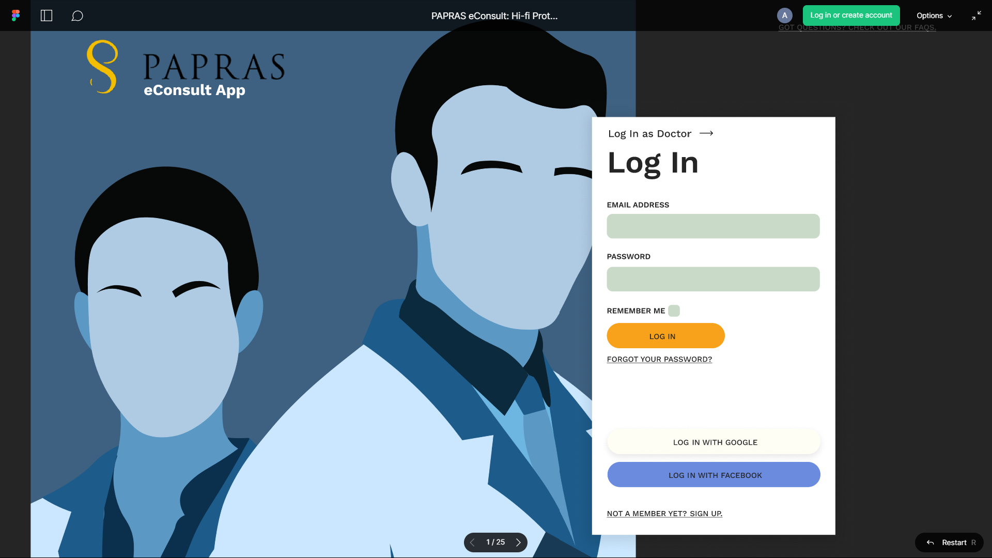
WEB DESIGNER
Sample Prototype

Slide 9
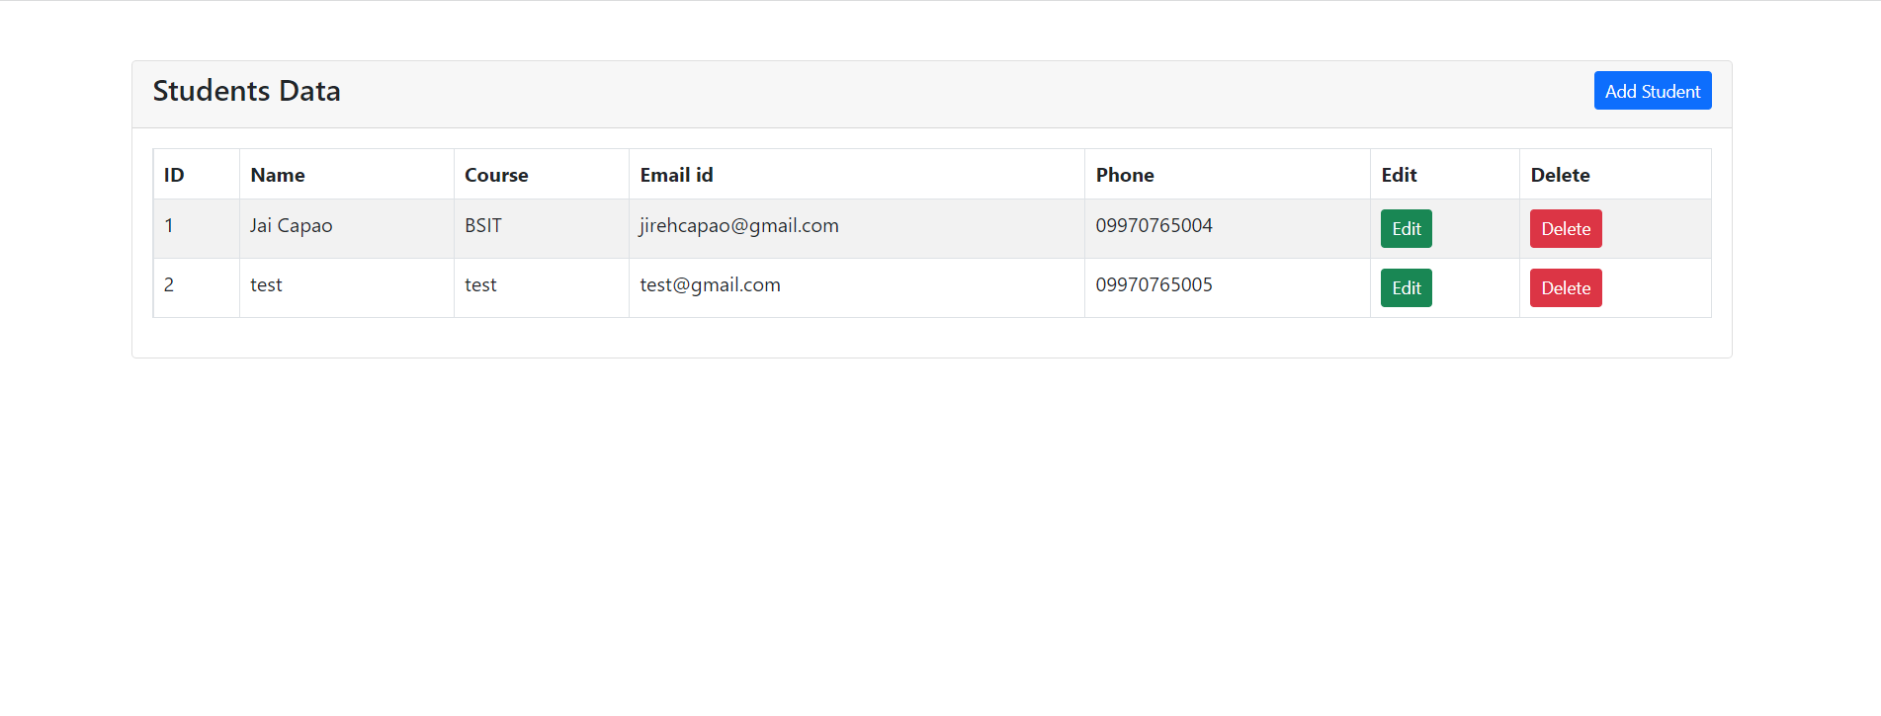
WEB DEVELOPER
Sample Web Application

Slide 10
Which one is better for me?

Slide 11
Thanks!
Any questions?

