Slide 1
Automation with Gwen
Introduction

Slide 2
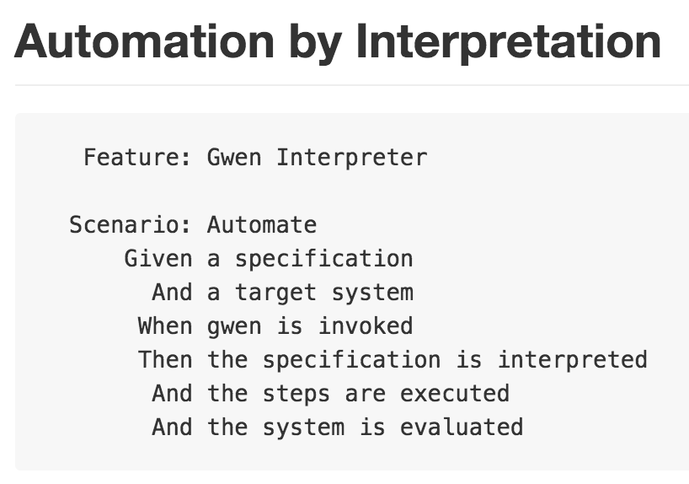

Gwen
GWEN = Given When Then
Given conditions
When actions
Then expectations
Open Source
https://github.com/gwen-interpreter
Apache v2 license
Written in Scala (compiled to Java bytecode)
Java 6 or 7 (8 coming soon)

Slide 3
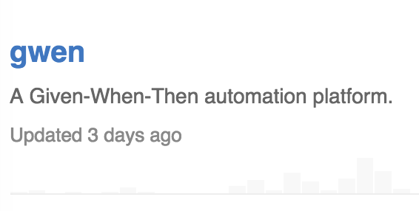
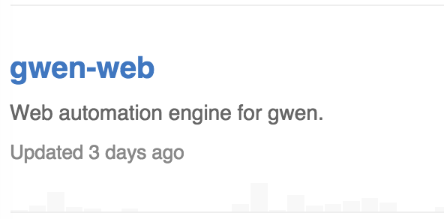
Automation Platform
Gwen is a Gherkin DSL Interpreter
Reads, parses, and validates plain text specifications
Dispatches steps to a mixed in engine for execution
Provides REPL
Generates reports
https://github.com/gwen-interpreter/gwen
Automation Engines
gwen-web for automating the web (uses Selenium Web Driver)
https://github.com/gwen-interpreter/gwen-web

Slide 4
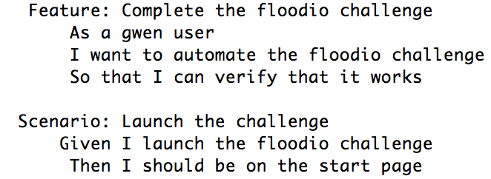





Web Automation
Traditionally
Automation meant writing lots of code (Page Objects)
It was difficult to automate across browsers
Lots of Gotcha’s (waits, syncs, etc..)
Now with gwen-web
Web Driver API is hidden
Coding page objects is never required
Gotcha’s are taken care of
Automation is driven by plain text specifications
--dry-run to validate specifications

Slide 5
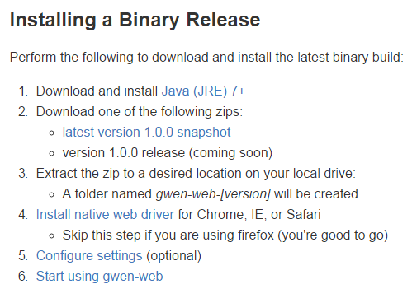
Tooling
Java runtime environment
JRE 7+
Web browser
Firefox, Chrome, Safari, IE
gwen-web distributable
single ZIP download
Plain text editor
Command line shell

Slide 6
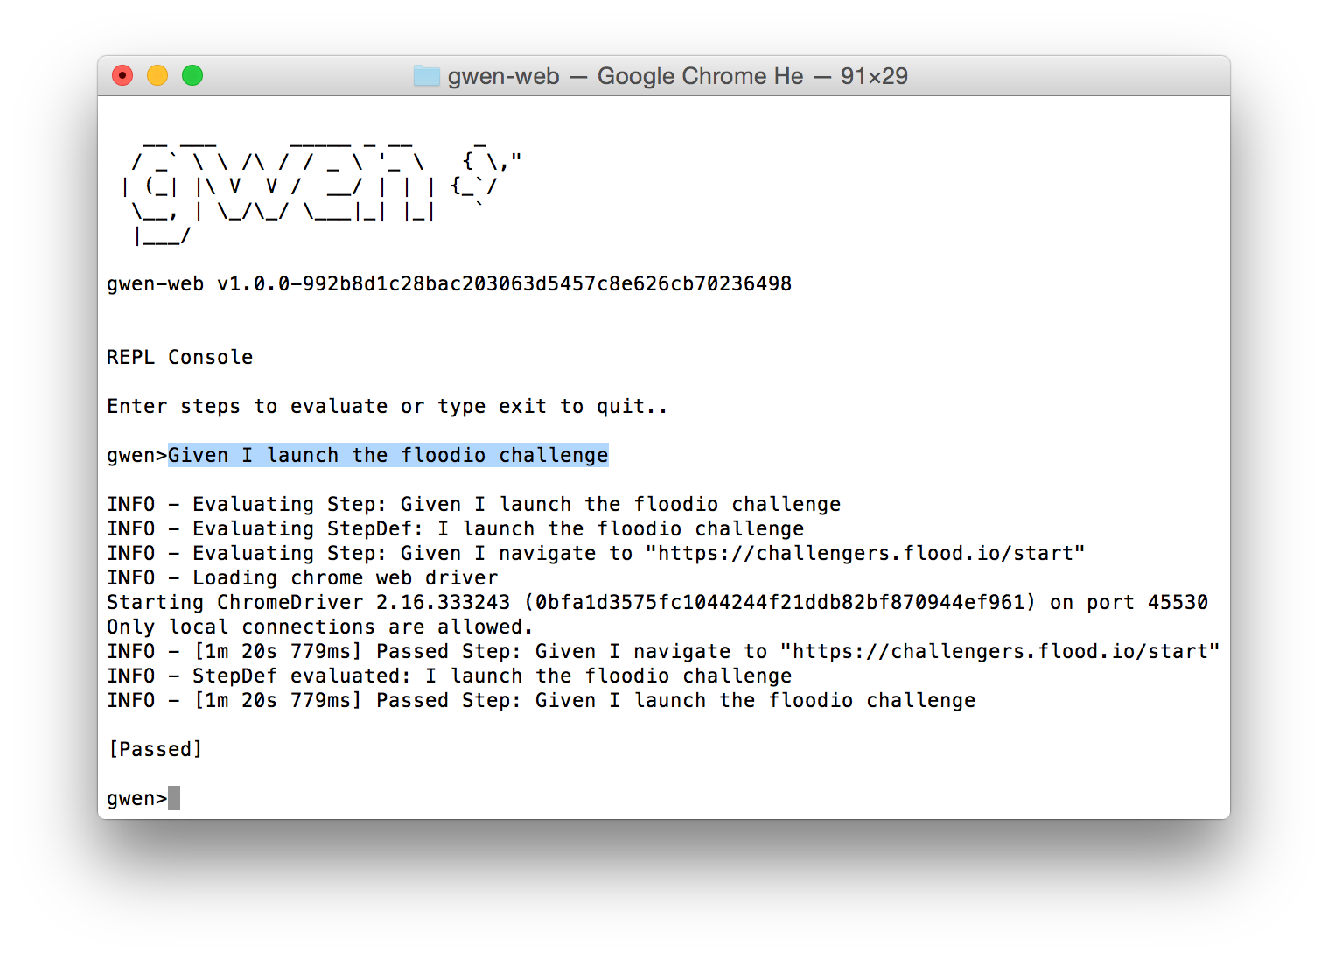
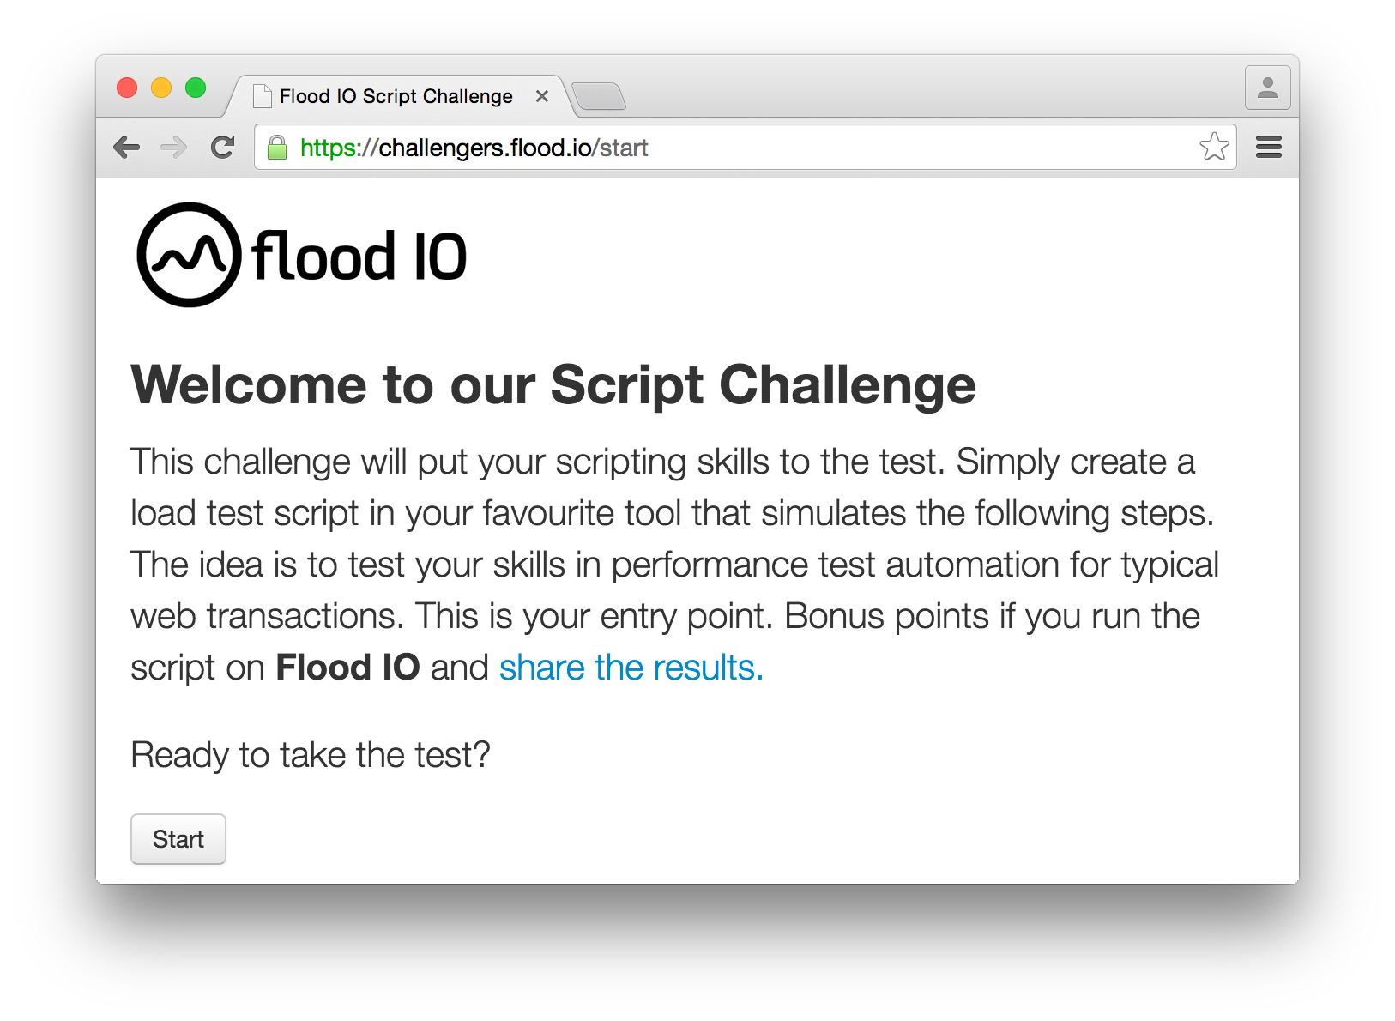
Interactive REPL
REPL (Read Eval Print Loop)
Command line shell for Gwen
Interacts with browser
Type steps, hit enter, watch them execute
Tab completion
Commands for inspecting runtime environment
Experiment with and verify your features

Slide 7
Batch Execution
For non interactive batch execution
Executes features and then exits
Run on build server
Individual feature files
Suites of feature files in directories
Steps execute in rapid succession
Configurable throttle (default = 200 msecs)
Feature File
Feature File
Feature File
Feature File
Feature File

Slide 8
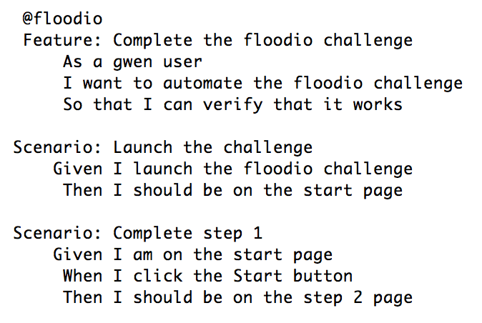
Features
Executable specifications
Business readable
Non technical
Written in Gherkin
Files have .feature extension
https://github.com/cucumber/cucumber/wiki/Feature-Introduction

Slide 9
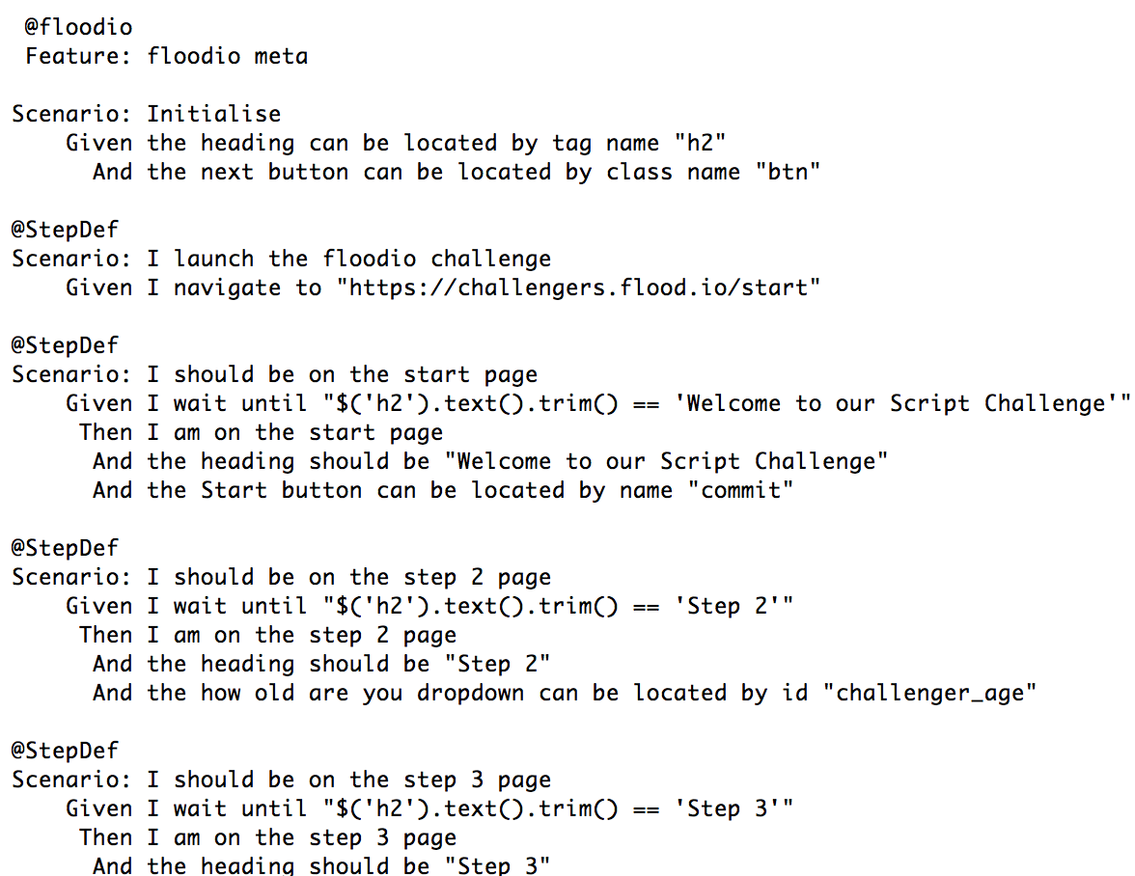
Meta
Technical automation glue
Captures all bindings
Web element locators
Environment properties
Step definitions (custom DSL)
Eliminates redundancy
Separation of concerns
Written in Gherkin
Files have .meta extension

Slide 10
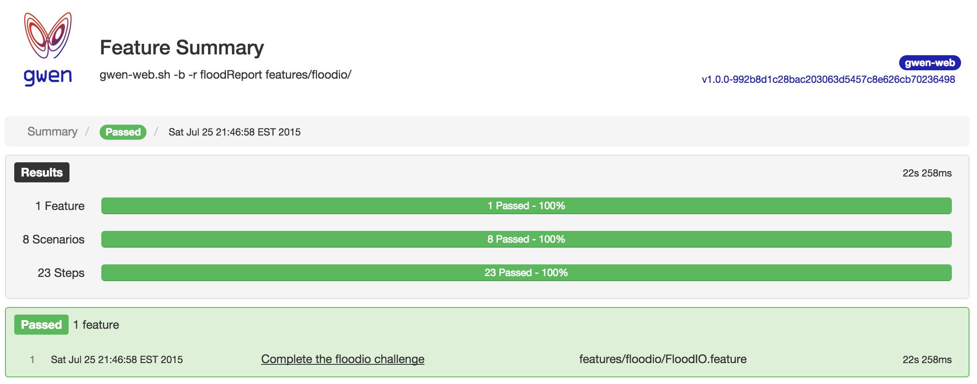
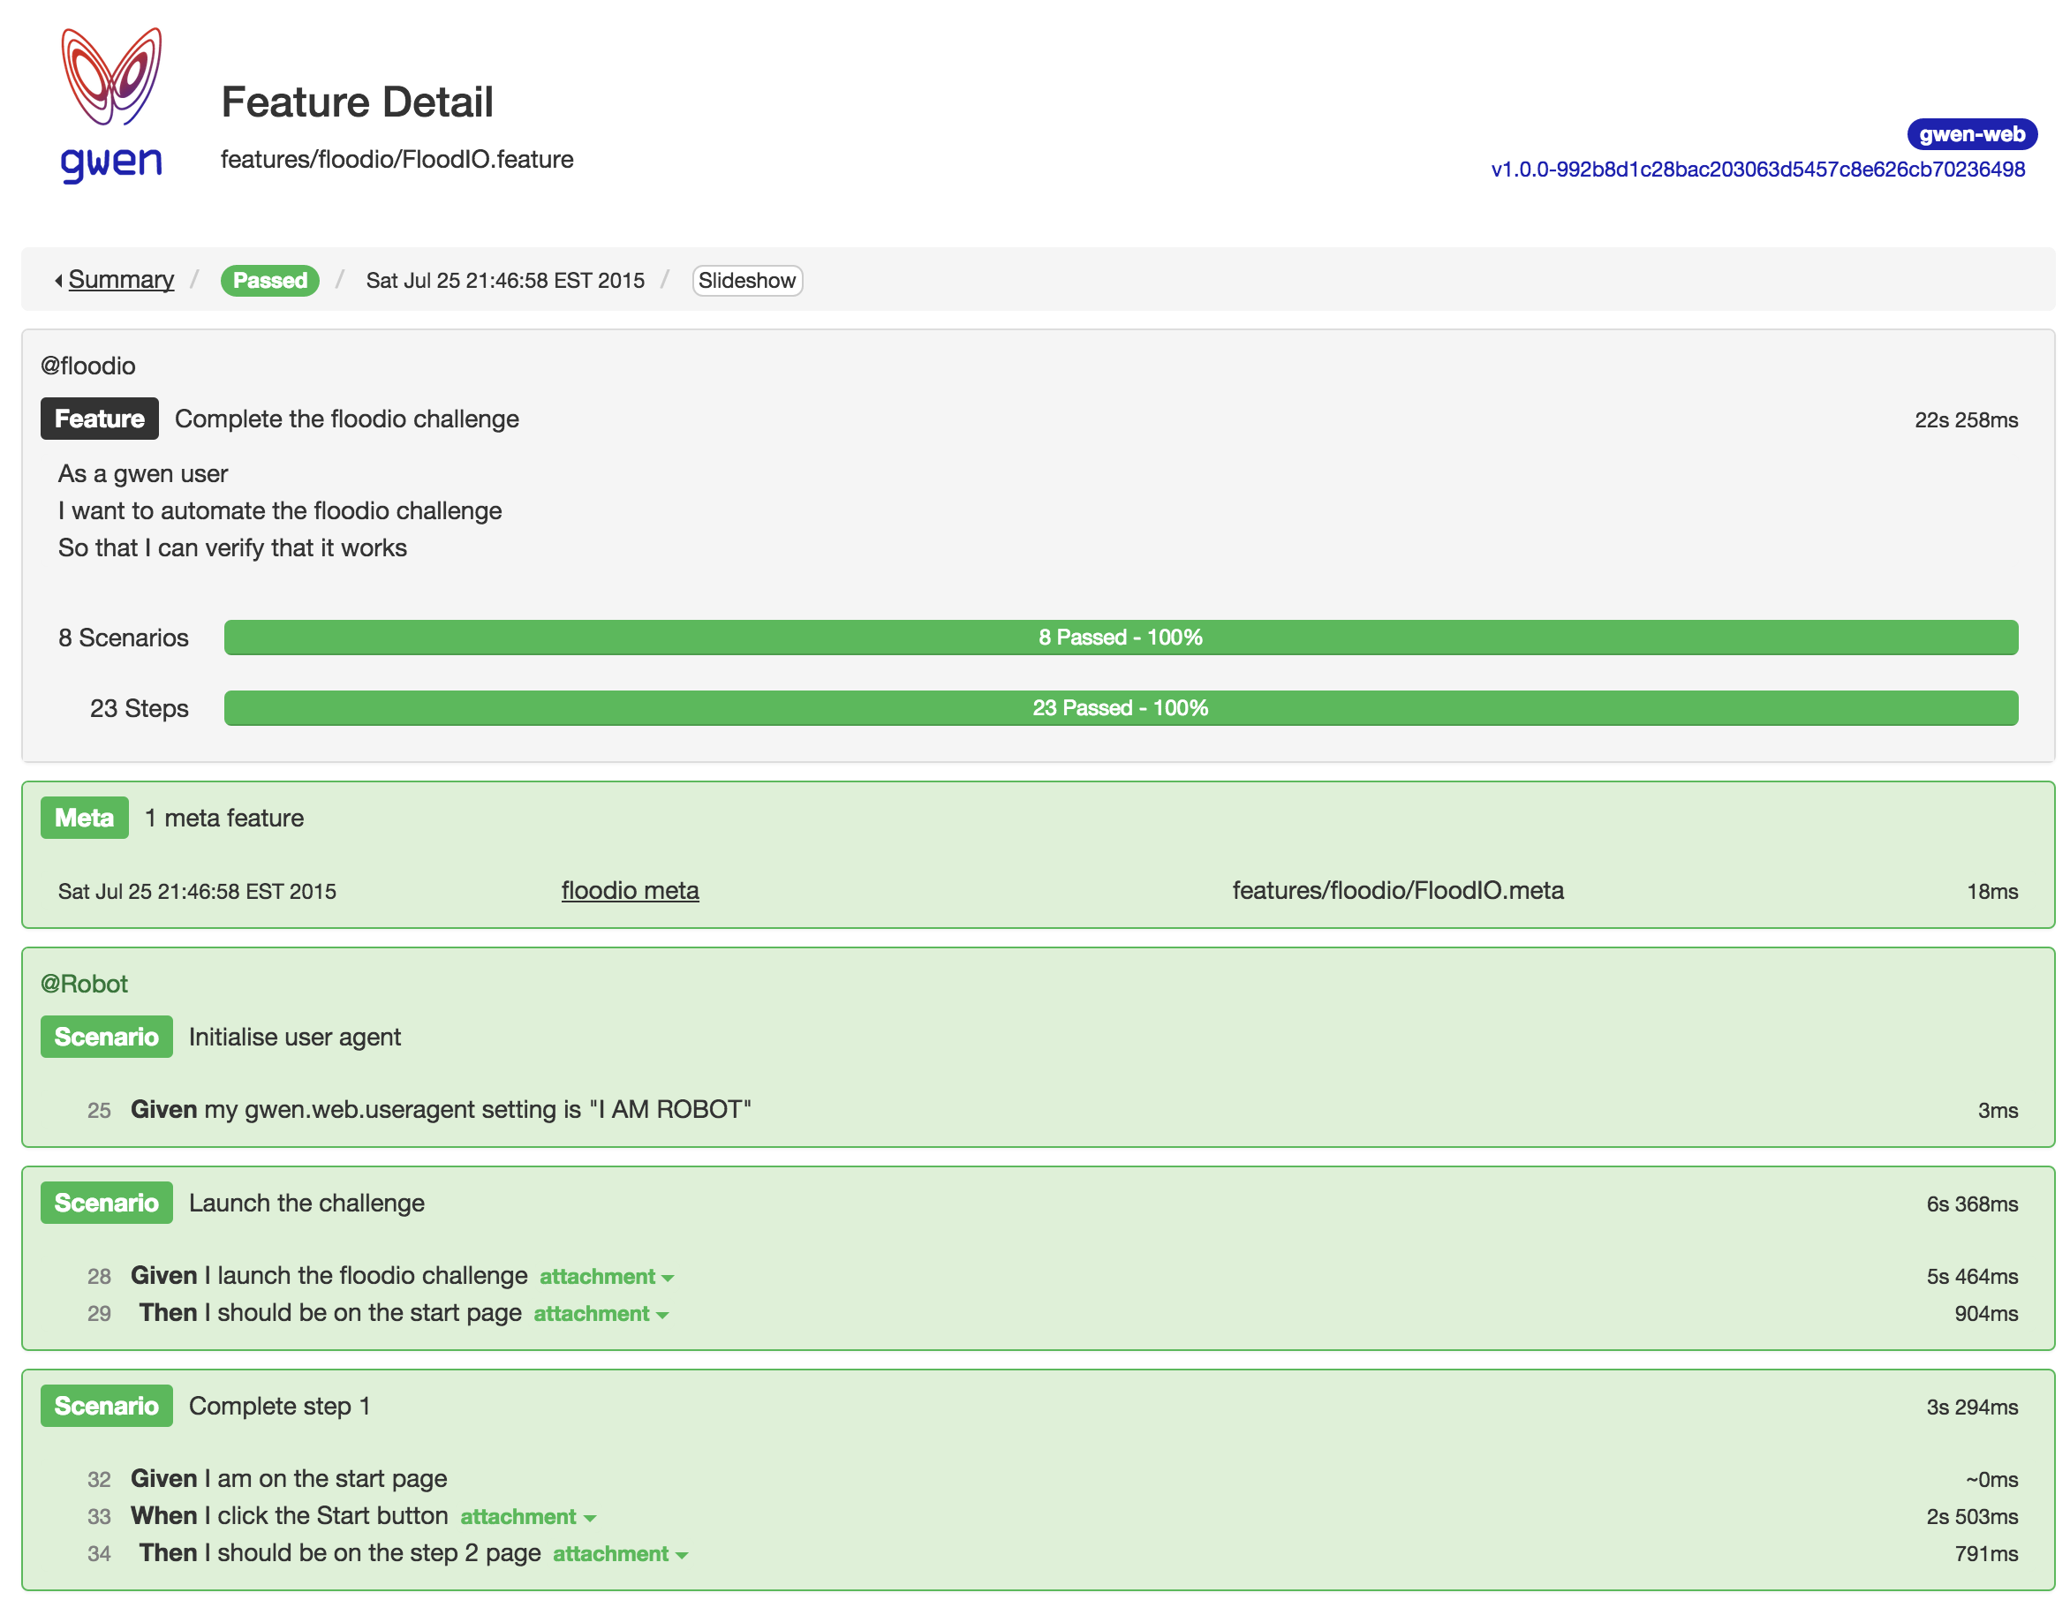
Evaluation Reports
Summary report (one per execution)
Lists all evaluated features
Detail report (one per feature file)
Lists all evaluated steps
All Reports include
Evaluation status
Timings and statistics
On error:
Environment and screenshots are captured
Slide shows (optional)

Slide 11
Resources
Gherkin
https://github.com/cucumber/cucumber/wiki/Gherkin
Gwen
https://github.com/gwen-interpreter
Cheat Sheet
https://github.com/gwen-interpreter/gwen-web/blob/master/doc/CHEATSHEET.md
Blogs
https://warpedjavaguy.wordpress.com/tag/gwen-interpreter
https://quietachievingtester.wordpress.com

Slide 12
Questions?

