Slide 1
proposal
To build a Core Web Automation Framework that will support testing via automation of EFORMS Web and Windows UI

Slide 2
CHOICE OF TOOLS TO USE
Factors/Tools | COST | Automate Web Components | Automate Windows Component | Easy of Use | Interoperability
Appium WebDriver | £0.00 | Yes | Yes | Moderate Learning Curve for QA Engineers | Should be easy to instal and use in CI/CD process
Silk4J | Very Expensive | Yes | Yes | Moderate Learning Curve for QA Engineers | Should be easy to instal and use in CI/CD process
Selenium | £0.00 | Yes | No | Easy Learning Curve for QA Engineers | Difficult to get approval to open COM ports for Automation

Slide 3
PROPOSED Testing stack
Java SDK ➔ For Test Hosting Development
Appium WebDriver ➔ To Test Web /Windows Components
AssertJ Fluent Assertions ➔ For Test Assertion
Extent Reports ➔ For Test Reporting
Cucumber Java ➔ For Test Specification

Slide 4


PLUS
The Appium Driver(Open Source) supports testing of
Web / Windows UI Components
Uses the same wire protocol as Selenium
Cucumber Java Plugins
The generator that can turn Gherkin specifications into executable test classes, available.
The runtime required for executing the generated tests. There are different runtime assemblies compiled for different target platforms.

Slide 5
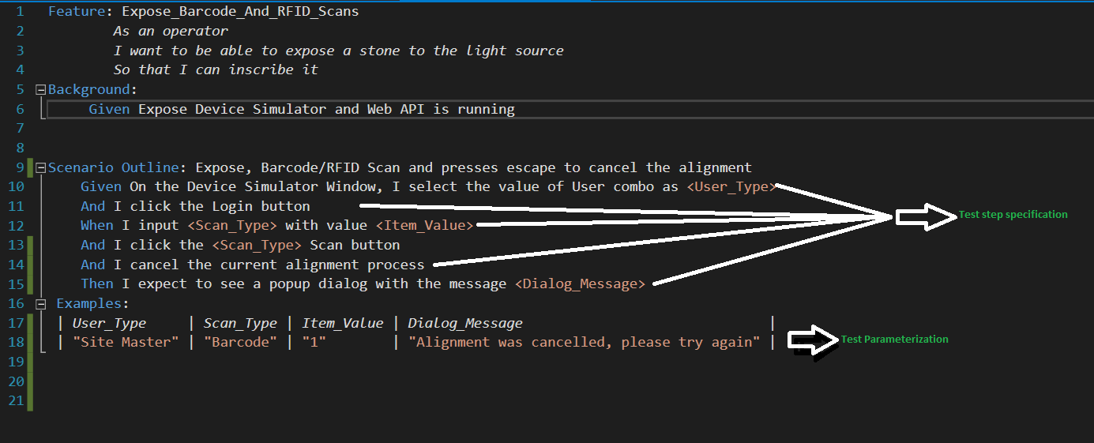
A Specification By Example

Slide 6
Live Demo run a simple scenario

Slide 7
What is not accomplished yet
Code refactor and git repository creation
Building framework to support robust ui testing
QA TEAM KNOWLEDGE TRANSFER AND SUPPORTING DOCUMEMTATION
CONTINIOUS INTEGRATION + CONTINIOUS DELIVERY

Slide 8

questions
Questions ?

