Slide 1



Mini Project In C Language
University of Hassan II Casablanca
Ben M’Sik Faculty of Science
The Bank
Produced by:
Khouna Rida
El Ahrach Otmane
Kilani Hassan
El Chaabi Abdelaziz

Slide 2

Mini Project In C Language: Plan
Mini project specifications (bank)
The stages of implementation
The obstacles
Compilation de programme

Slide 3
“Mini project specifications”

Slide 4
Mini project specifications
The mini project consists in creating two structures one contains the information on the customers (Customer ID, Last name, First name, Profession and Telephone number) and the second contains the information on the accounts of the customers, and to implement the functionalities and the treatments which will be called through the following menus:
GENERAL MENU
Customer management Account management Operations management Quit

Slide 5
Mini project specifications
Id_customer : Lastname : Firstname : Profession : Phone_number : Return
CUSTOMER MANAGEMENT MENU
Add customer Edit customer Delete customer Search GENERAL MENU
Lastname : Firstname : Profession : Phone_number : Return
One by one All
By id_customer By lastname

Slide 6
Mini project specifications
ACCOUNT MANAGEMENT MENU
New account Consultation Account closure GENERAL MENU
Id_account : Id_customer : Basic balance : Opening date :
Id_customer :
Id_customer : | Lastname & Firstname : | Basic balance | Operations carried out/ date
… … …

Slide 7
Mini project specifications
Id_account : Id_customer : Withdrawn Amount :
OPERATIONS MANAGEMENT MENU
Withdrawal Transfer GENERAL MENU
Id_account : Id_customer : Paid Amount:

Slide 8
Mini project specifications
<< Customer management >>
You cannot add a customer who already exists.
Modification and Deletion are done by id_customer.
The deletion must be confirmed (Delete Y / N?).
<< Account management >>
You cannot add an account that already exists.
A customer can have multiple accounts.
The closing of the account is done by id_account.
The deletion must be confirmed (Delete Y / N?).
The basic balance must be greater than 1000 DH.
<< Operations management >>
The withdrawal must not exceed 700 DH.

Slide 9
“The stages of implementation ”

Slide 10
The stages of implementation
<< 1st stage >>
Analysis of the project to get an overview
Clarified the idea of the project
formalized the purpose of the project
Definition of the scope and objectives of the project
<< 2nd stage >>
Study of the specifications
Documentation Research on the meadows received for the realization
General structure of the program
Build the action plan

Slide 11
The stages of implementation
<< 3rd stage >>
Breakdown of the project and distribution of tasks
Cordinations between the team members
Editing according to the logical sequence
Compiling and Testing the Program
Solve the problems
<< 4th stage >>
Decoration
Evaluation and realization of the project report

Slide 12
“ The obstacles ”

Slide 13
Les Obstacles
Among the obstacles that made us suffer:
The use of notions of file and structure.
Modifying a structure inside a file.
The design of a function that generates an id randomly.
Compliance with the specifications.
Poor time management estimate for the completion of the project.
Difficulties related to the manipulation of work tools (Codeblocks).

Slide 14
“ Production ”

Slide 15
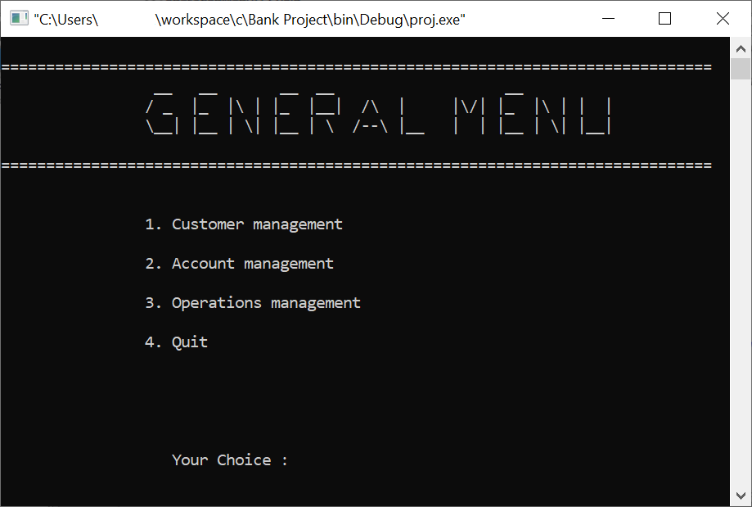
Production
The general menu which contains the submenus, is made up of four choices indicated on the surface above.

Slide 16
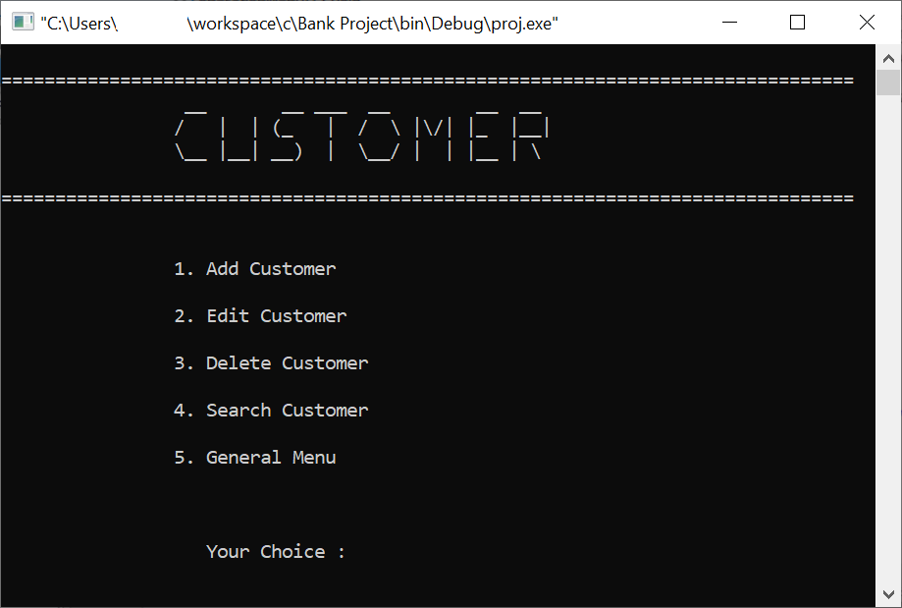
Production
The customer menu which contains the options that can be performed (add-edit-delete-search) indicate on the surface above.

Slide 17
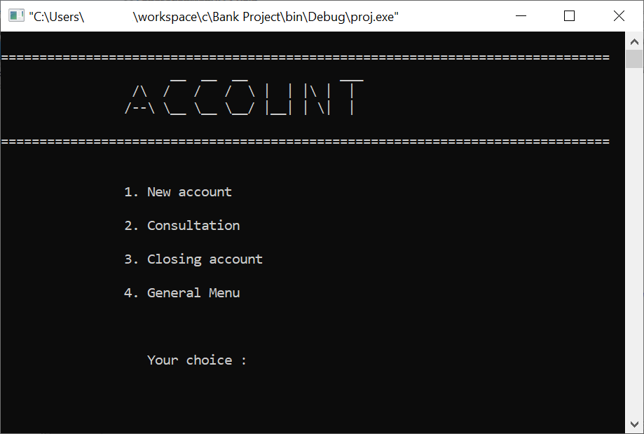
Production
The accounts menu which contains the options that can be performed (add-consult-close) indicate on the surface above.

Slide 18
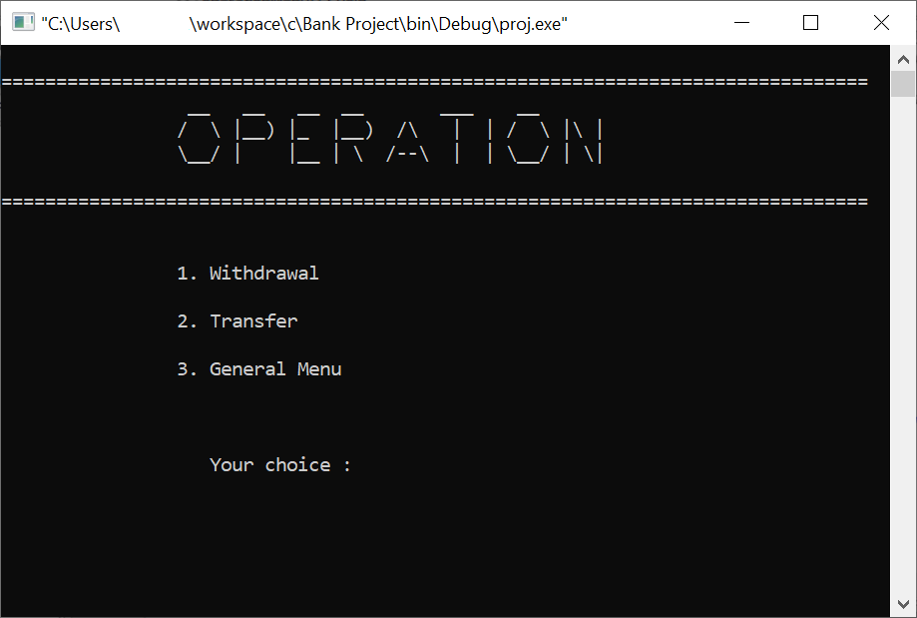
Production
The operations menu which contains the options that can be performed (withdrawal-transfer) indicate on the surface above.

Slide 19
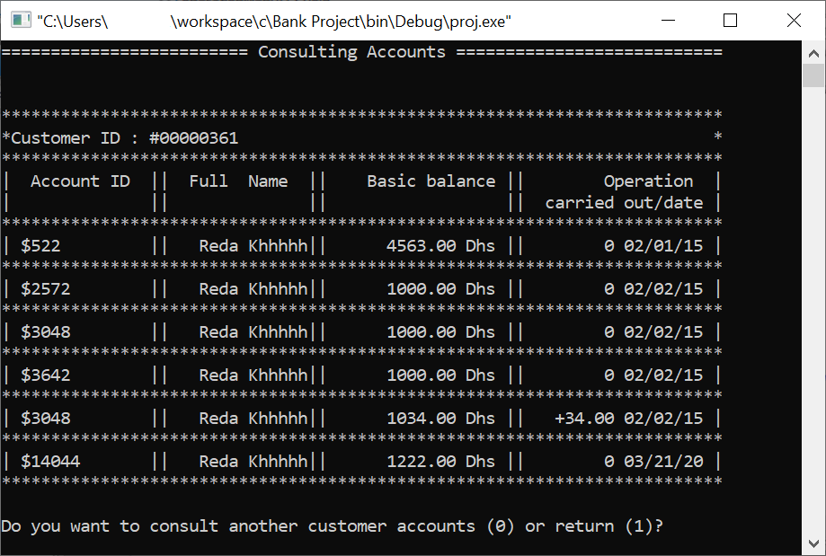
Production
Consulting accounts which contains a table of history of operations performed by a customer.

Slide 20
Mini Project In C Language
The Bank
Thank you for your attention

