Slide 1

Conception & Production of a mobile Stock Management application
Realized by :
      KHOUNA RIDA
      KILANIHASSAN

Slide 2
Plan

Slide 3
General context
Problematic
Adopted Solution
Needs Analysis and Specification
Conception
Production
Conclusion et perspectives

Slide 5

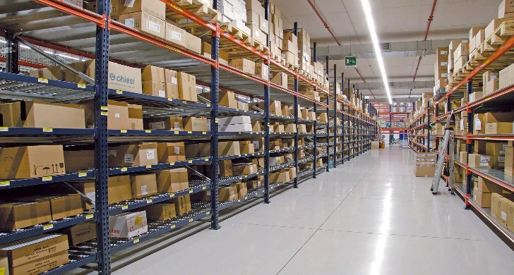


Introduction
Stock
Evaluation
Problèmes

Slide 7
Problems
Coupling
Offline Mode
Evolution
Response time
Notes:
The company works with an office inventory management application which connects to the server with a local network which implies
functionality issues:
firstly - we have the coupling: if the server is down then no operations will be available on the program since all the data is in the server.
secondly - we are evolving: lately we can see that the office programs are outmoded because of sales.
smartphones have surpassed desktop sales.
which left programmers more interested in mobile programming.
thirdly --- the response time: the employee wastes a lot of time because he writes the stock reports in paper
then he enters them in the program.
fourth --- offline mode: for example if the employee is not in the workspace then he has no way of finding out about the stock.

Slide 9
Adopted Solution
Save all the Stock on your Smartphone to always have them with you.
The possibility of performing operations on the stock data without
the connection to the database server.
Solution
Notes:
then the solution that we proposed consists in recording the stock on a smartphone to have them always on you, in order to have the possibility of carrying out operations on the stock data.

Slide 10
Topic
Development of a mobile Stock Management application
The main objectives:
Allow the User to control several Establishments
Consult the Stock in different ways
Stock Search
Print inventory
The possibility of performing all kinds of operations in offline mode
Notes:
which brings us to a precise subject, it is to develop a mobile application of stock management, of which it has the following objective:
** allow the user to control several establishments.
** consult the stock in different ways so to apply some modifications in there.
** search for items in the stock in order to display its information.
** print inventory
** and at the end of performing operations in offline mode as much as online mode

Slide 11
Planning of the provisional project
Notes:
As part of the project management, the realization of a schedule to follow throughout the end of study internship
stands out. Thus, the internship started on Tuesday March 01, 2016. Suddenly, a meeting was held to define
the project schedule in front of you.
as you can see The corresponding project planning is represented by the Gantt chart which starts with
a functional study phase, followed by the technical study, then implementation. And ends with a phase of
tests and validation.

Slide 13
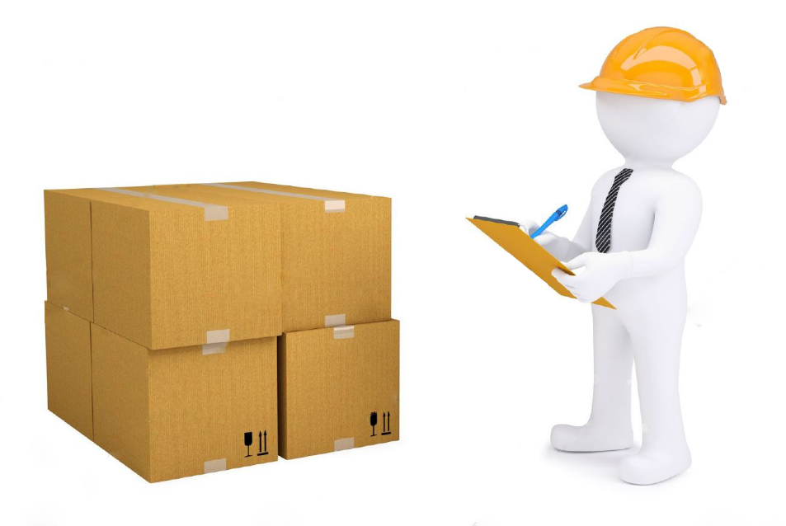
System actors
Storekeepers
Notes:
we will start with the actors of the system. indeed we have only one actor, it is the stockkeeper of the stock.

Slide 14
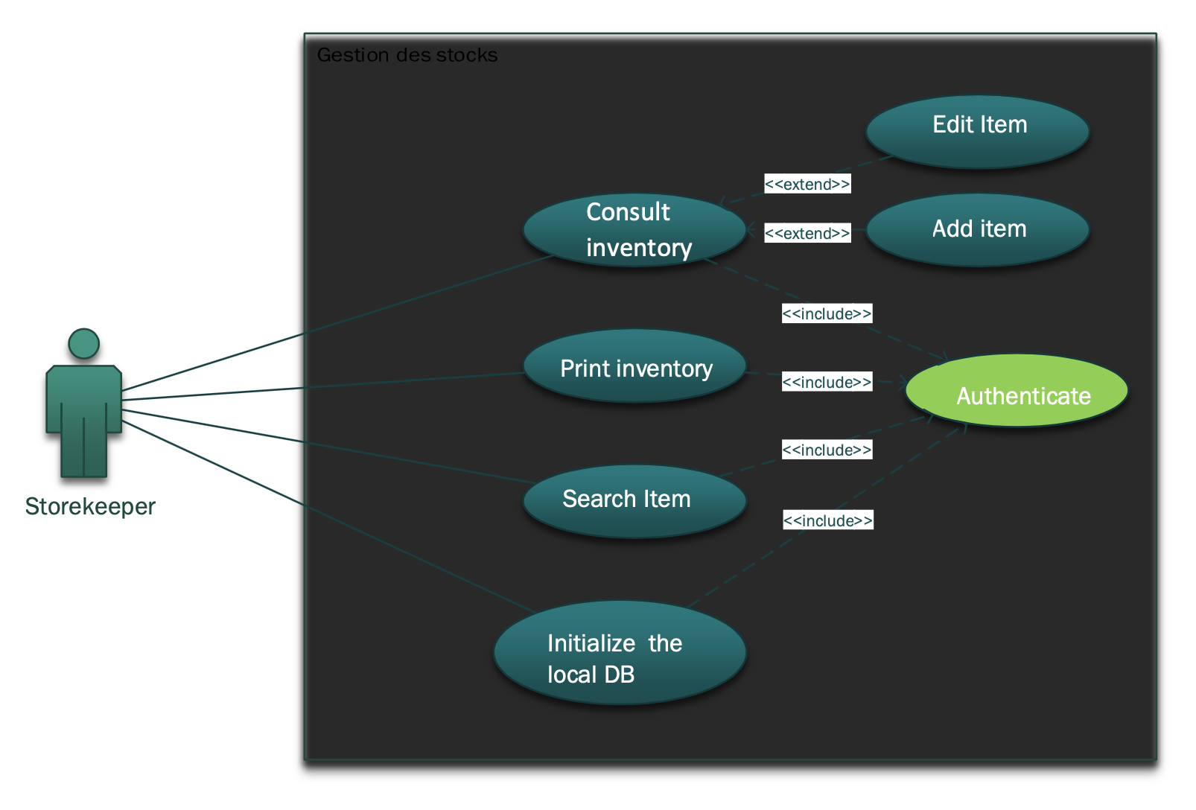
Functional needs: Use Case
Notes:
we will specify the functional requirements from the global use case diagram.
as we can see the storekeeper can consult the inventory in order to be able to modify or add an item,
it can print the inventory, search for an Item, initialize the local database (and all these tasks include user authentication).

Slide 15

Specifications of non-functional requirements
Compatibility
Security
Extensibility
Ergonomics
Notes:
then we have the non-functional needs:
*** compatibility: ensure that the version of the application is compatible with any
version of the system.
*** security: our application must guarantee the security of the data exchanged.
*** extensibility: it allows the questioned addition of new modules.
*** ergonomics: our application must offer a user-friendly and ergonomic interface that can be used
by the user.

Slide 17
User authentication
Notes:
we start with this authentication scenario.
after the user has entered the data, the system sends its data to the server for authentication,
if the latter returns a success, the system saves the data for the next use and displays the menu interface.
otherwise the system displays an error message

Slide 18
Search Item
Notes:
Now let's go to the search sequence diagram
The storekeeper can perform a search
If the item has a bar code the storekeeper scans this code otherwise he enters the item code then the warehouse code in order that the system is updated from the server
And displays the item information if it is found otherwise it displays article not found

Slide 19
Activity diagram: Authentication
Notes:
the authentication process can be summarized in the following activity diagram

Slide 20
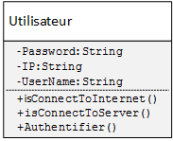
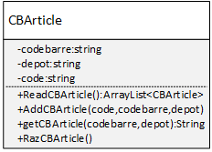
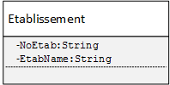
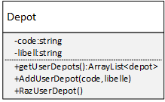
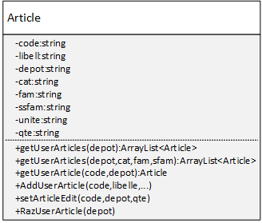
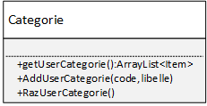
Class diagram
Notes:
The overall class diagram of the system shows a set of classes, objects and the relationships between them. We will focus on the most important.
- the 1st user class represents the storekeeper by specifying his identification information.
the latter can manage one or more establishments which are made up of one or more deposits. the deposit contains 1 or more categories,
the category have 1 or more Families, the family includes 1 or more Sub Families, and the sub family has 1 or more Articles.
and finally Articles can have a barcode.

Slide 22







System Architecture
MyStock
Local DB
Server INFOR
SOAP(XML)
Notes:
system architecture: our application contains a local database which queries the server with an HTTP request via the soap webservice

Slide 23





Technical environment

Slide 24

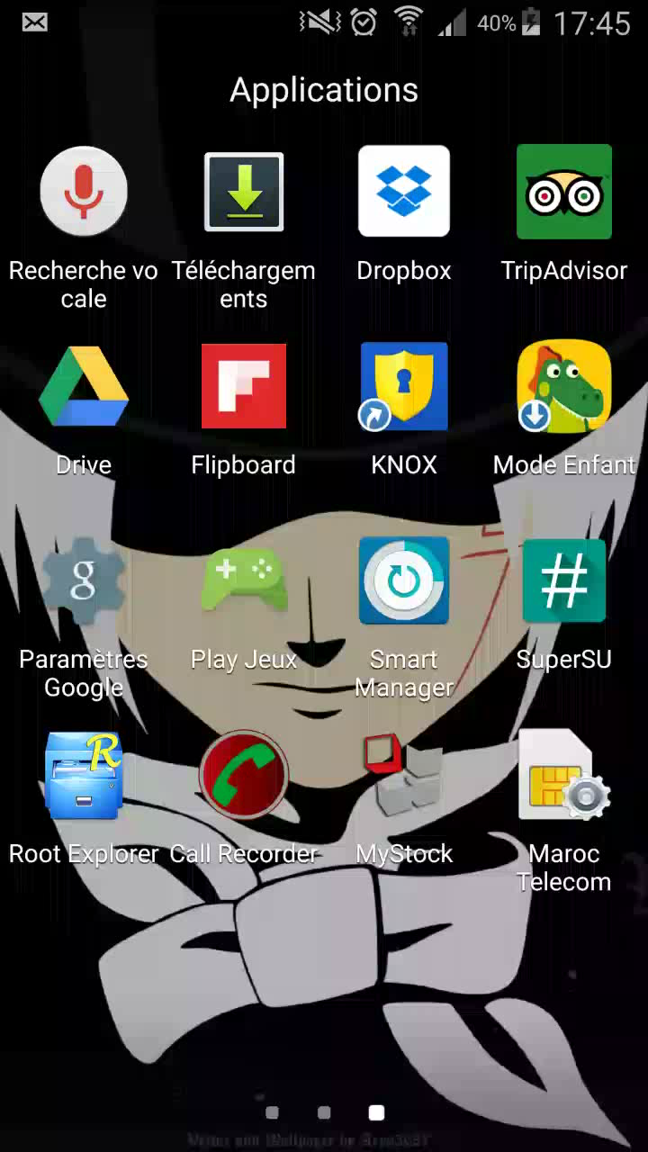
Online Mode

Slide 25
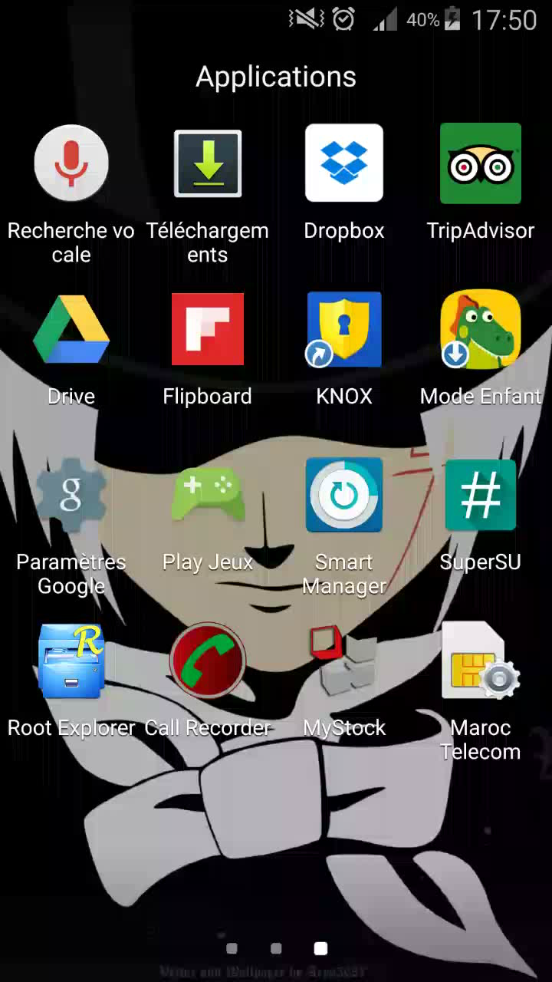
Offline Mode

Slide 27
Thank you for your attention

