Slide 1
Explicit Congestion Notification (ECN)
RFC 3168
CISC 856 –TCP/IP, Fall 2007
Special thanks to:
Dr. Paul Amer
Justin Yackoski, Namratha Hundigopal & Preethi Natarajan (for slides)

Slide 2
Overview
The problem - Congestion
Existing solutions -
  TCP’s basic congestion mechanisms
  Active Queue Management (AQM)
Explicit Congestion Notification (ECN)
Additional fields in IP & TCP headers
ECN - Sequence of events
Advantages of ECN

Slide 3
What is congestion?
In real life?
  When resource demand exceeds the capacity of a system. Ex: Rush hour traffic on I-95
In a network?
  When the number of packets being transmitted approaches the packet handling capacity of the network
Having a closer look –
  Congestion occurs at a router when the output capacity is less than the total sum of inputs from multiple streams

Slide 4
At the congested router …
Router’s buffer gets filled up because input > output
Consequences?
  End-to-End delay increases as buffer fills up
  When buffer is full, router drops packets using the “tail-drop” approach → packet loss
Sender
Receiver
Packets being dropped

Slide 5
Current TCP (without ECN)
TCP sender treats network as a “black-box” and assumes packet loss as an indication of congestion
Congestion detection
  Retransmit timeout
  3 duplicate acks
Congestion avoidance
  Happens after congestion has already occurred (Multiplicative decrease of cwnd AFTER loss)
  Current TCP does something like congestion recovery!!
What could go wrong with this approach??

Slide 6
What could go wrong?
Global synchronization – The flows’ congestion avoidance get synchronized
  All flows reduce the sending rate at the same time, channel is under-utilized
  The flows start retransmission and start increasing their sending rate in a similar fashion
  Slowly congestion builds up again – This cycle repeats
Full buffers – If network is operating at capacity, the buffers stay full
  End-to-End delay is increased due to queuing delays

Slide 7
What could go wrong? (cont’d)
Lockout – Queue space is monopolized by a few connections & other connections are locked out
Sender-1
Sender-2
Sender-3
Sender-4

Slide 8
Active Queue Management (AQM)
Detects and notifies incipient (early/initial) congestion (what is early congestion?)
Tries to maintain average queue size in “good” range between min & max thresholds
Randomly chooses IP-PDUs to notify congestion (how? )
Receiver
Sender
th_{max}
th_{min}
Average Queue size lies between these thresholds

Slide 9
Is AQM good enough?
AQM is restricted to using packet drops to indicate congestion – not efficient
Potential for excessive delays due to retransmissions after packet losses
BAD for interactive traffic such as telnet, web-browsing etc – which are sensitive to packet losses
Can we do better??

Slide 10
Explicit Congestion Notification
ECN is an AQM mechanism
Routers notify TCP senders/receivers about incipient congestion – without packet drops
How?
  Through IP and TCP headers
TCP treats ECN signals exactly the same as when a single dropped packet is detected – but packets are not actually dropped

Slide 11
ECN bits in IP header
Differentiated Services Codepoints
6 bits
Reserved
2 bits
ECN
2 bits
VER
4 bits
HLEN
4 bits
DS
8 bits
Total Length
16 bits
Identification
16 bits
Flags
3 bits
Fragmentation offset
13 bits
Time to Live
8 bits
Protocol
8 bits
Header Checksum
16 bits
Source IP address
32 bits
Destination IP address
32 bits
Options (if any)
Data

Slide 12
ECN bits in IP header (cont’d)
ECN Field
ECT: ECN Capable Transport
CE: Congestion Experienced
ECT
CE
2 bits = 4 ECN Codepoints
ECT | CE | Names for the ECN bits
0 | 0 | Not-ECT (Not ECN Capable Transport)
0 | 1 | ECT(1) (ECN Capable Transport (1))
1 | 0 | ECT(0) (ECN Capable Transport(0))
1 | 1 | CE (Congestion Experienced)

Slide 13
ECN bits in TCP header
Reserved
4 bits
CWR
ECE
URG
ACK
PSH
RST
SYN
FIN
Reserved
6 bits
Source port address
16 bits
Destination port address
16 bits
CWR: Congestion Window Reduced Flag
ECE: ECN-Echo Flag
Sequence Number
32 bits
Acknowledgement Number
32 bits
URG
ACK
PSH
RST
SYN
HLEN
4 bits
Reserved
6 bits
FIN
Window size
16 bits
Checksum
16 bits
Urgent pointer
16 bits
Options (if any)
Data

Slide 14
ECN negotiation between TCP end hosts
Sender
Receiver
ECN-Setup SYN
CWR=1
ECE=1
SYN=1
ECN-Setup SYN-ACK
SYN=1
ACK=1
ECE=1
CWR=0
ACK
ACK=1
A host must not set ECT in SYN or SYN-ACK (why?)

Slide 15


Typical sequence of events
Event-1
ECN Capability negotiated during Connection Establishment
N-PDU
ECT set in IP header
ECN Capable Sender
ECN Capable Receiver
ECN Capable Router

Slide 16
Typical sequence of events
Event-2
Incipient Congestion, set CE
N-PDU
N-PDU
ECT set in IP header
CE set in IP header
ECN Capable Sender
ECN Capable Receiver
ECN Capable Router

Slide 17
Typical sequence of events
Event-3
Congestion!! Let me inform the TCP sender
CE set in IP header
N-PDU
N-PDU
ECT set in IP header
N-PDU
ECN Capable Sender
ECN Capable Receiver
ECE set in TCP header
ECN Capable Router

Slide 18
Typical sequence of events
Event-4
Congestion!! Reduce cwnd
ECT set in IP header
CE set in IP header
N-PDU
N-PDU
N-PDU
N-PDU
ECN Capable Sender
ECN Capable Receiver
ECE set in TCP header
ECE set in TCP header
ECN Capable Router

Slide 19
Typical sequence of events
Event-5
Congestion!! Reduce cwnd, set CWR in TCP header
N-PDU
CWR set in TCP header
ECN Capable Sender
ECN Capable Receiver
ECN Capable Router

Slide 20
Typical sequence of events
Event-6
Sender has reduced cwnd, stop setting ECE flag
CWR set in TCP header
N-PDU
N-PDU
CWR set in TCP header
N-PDU
ECN Capable Sender
ECN Capable Receiver
ECE set in TCP header
ECN Capable Router

Slide 21
Advantages of ECN
Prevents unnecessary packet drops at routers → less retransmissions → improvement in the “GOODPUT”
Avoids timeouts by getting faster notification to end hosts
Less time to identify congestion
  Non-ECN flows infer congestion from 3 duplicate ACKs or even worse from timeouts as opposed to ECN flows that get congestion notification in the first ACK
Fewer retransmissions also means less traffic on the network

Slide 22
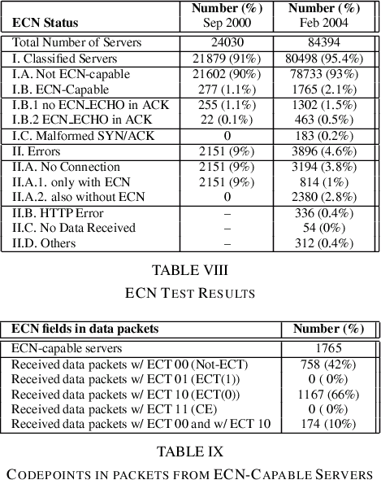
Is ECN used?
Implemented in Linux 2.4+, Solaris 9+, and Cisco routers since 12.2(8)T

Slide 23
References
RFC 3168 – The Addition of Explicit Congestion Notification (ECN) to IP
RFC 2309 – Active Queue Management
http://www.icir.org/floyd/ecn.html
RFC 2884 – Performance Evaluation of ECN in IP Networks
Slides from David Wetherall on “Robust Congestion Signalling”
Slides from Justin Yackoski, Namratha Hundigopal and Preethi Natarajan

Slide 24

Questions?

Slide 25
Quick Question
Q: Why is the congestion experienced information maintained in the “regular headers” of an IP PDU? Why isn’t the IP options field used to incorporate this information?
A: That’s because many routers process the “regular headers” in IP PDUs more efficiently than they process the header information in IP options.

