Slide 1
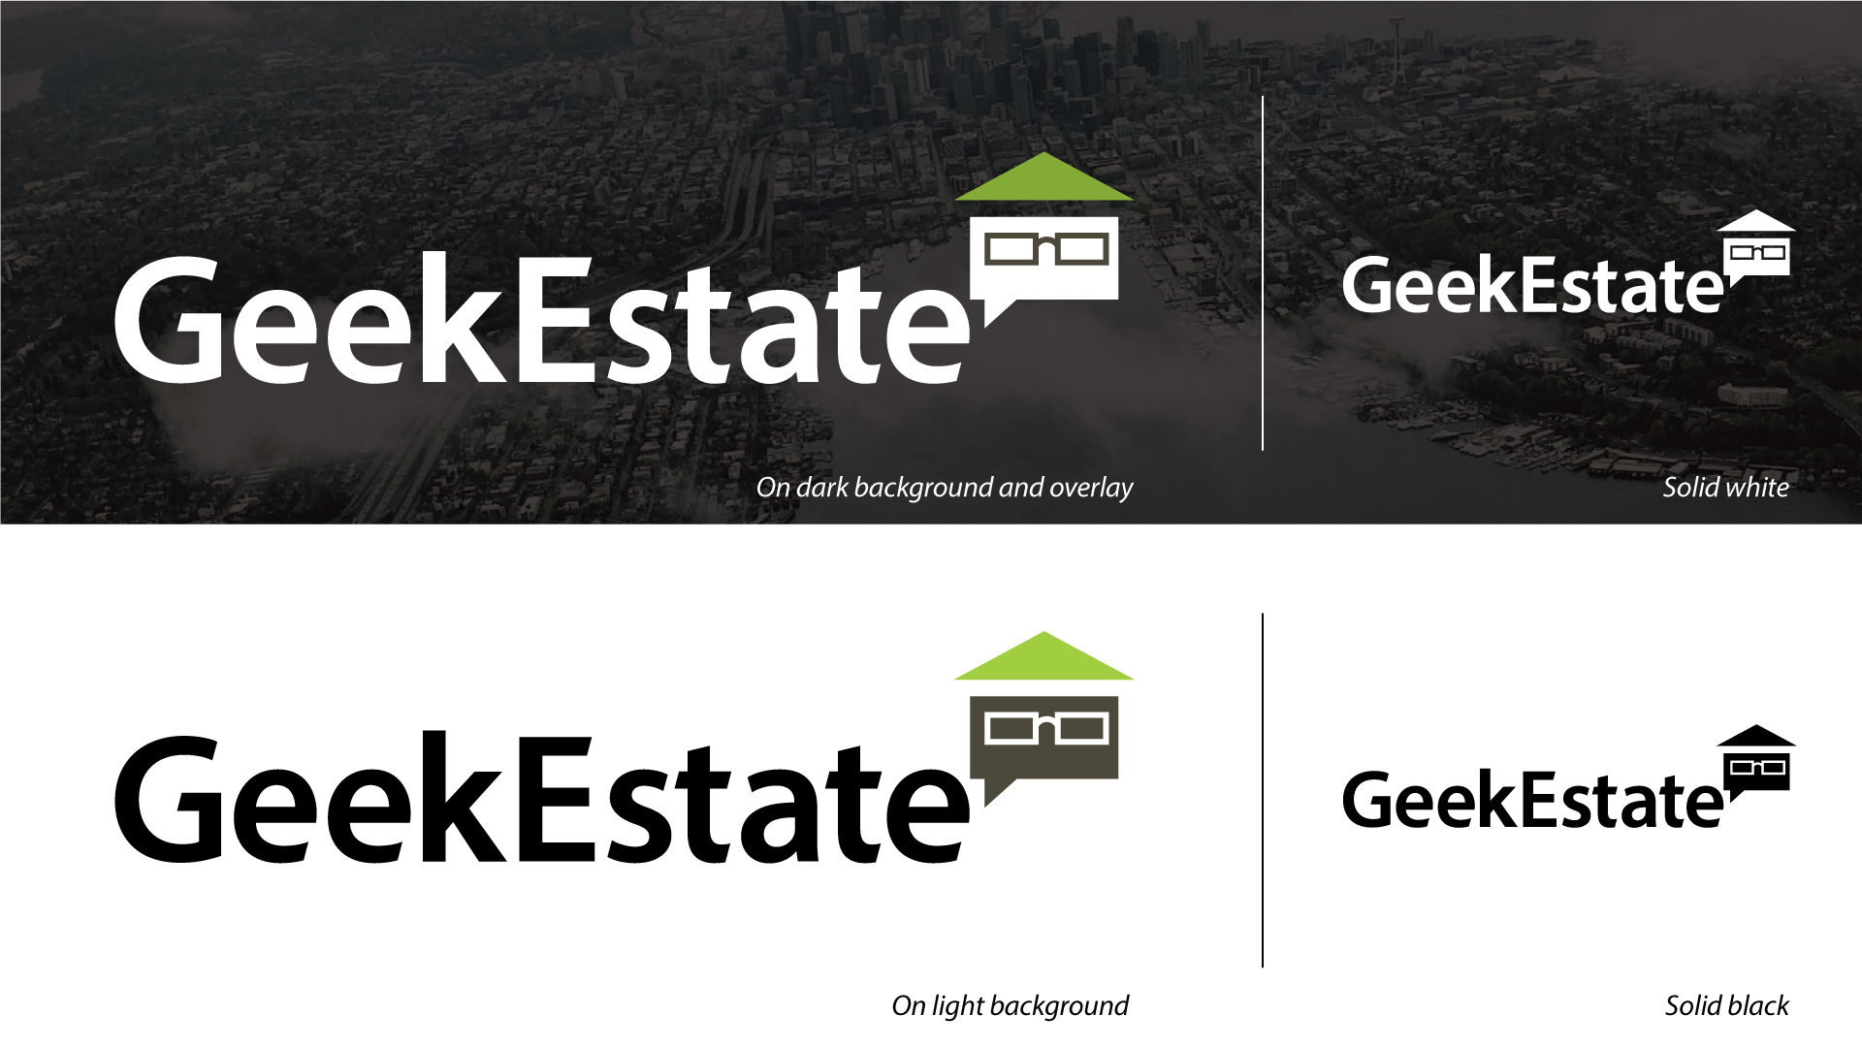

Slide 2
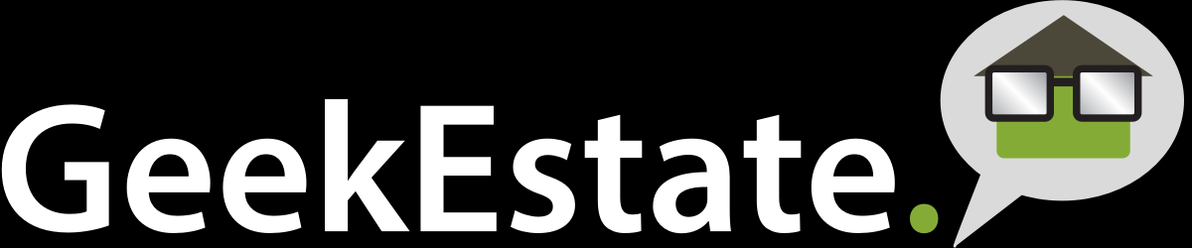
Note:
Typeface: Myriad Pro
The original logo was design with ‘Myriad Pro’ Semi bold font as default, without any adjustment/ customization to the original font.
What I have done with the clean up is add a little(red dotted line indication) personality/ character to the font with adjustment made to the characters tracking, trim the edges adjusting the characters width for uniformity (most noticeable).
Removed period, and simplified the favicon on the right with the roof adjustment to also indicate arrowhead pointing up award as a symbol of growth/ success.

Slide 3
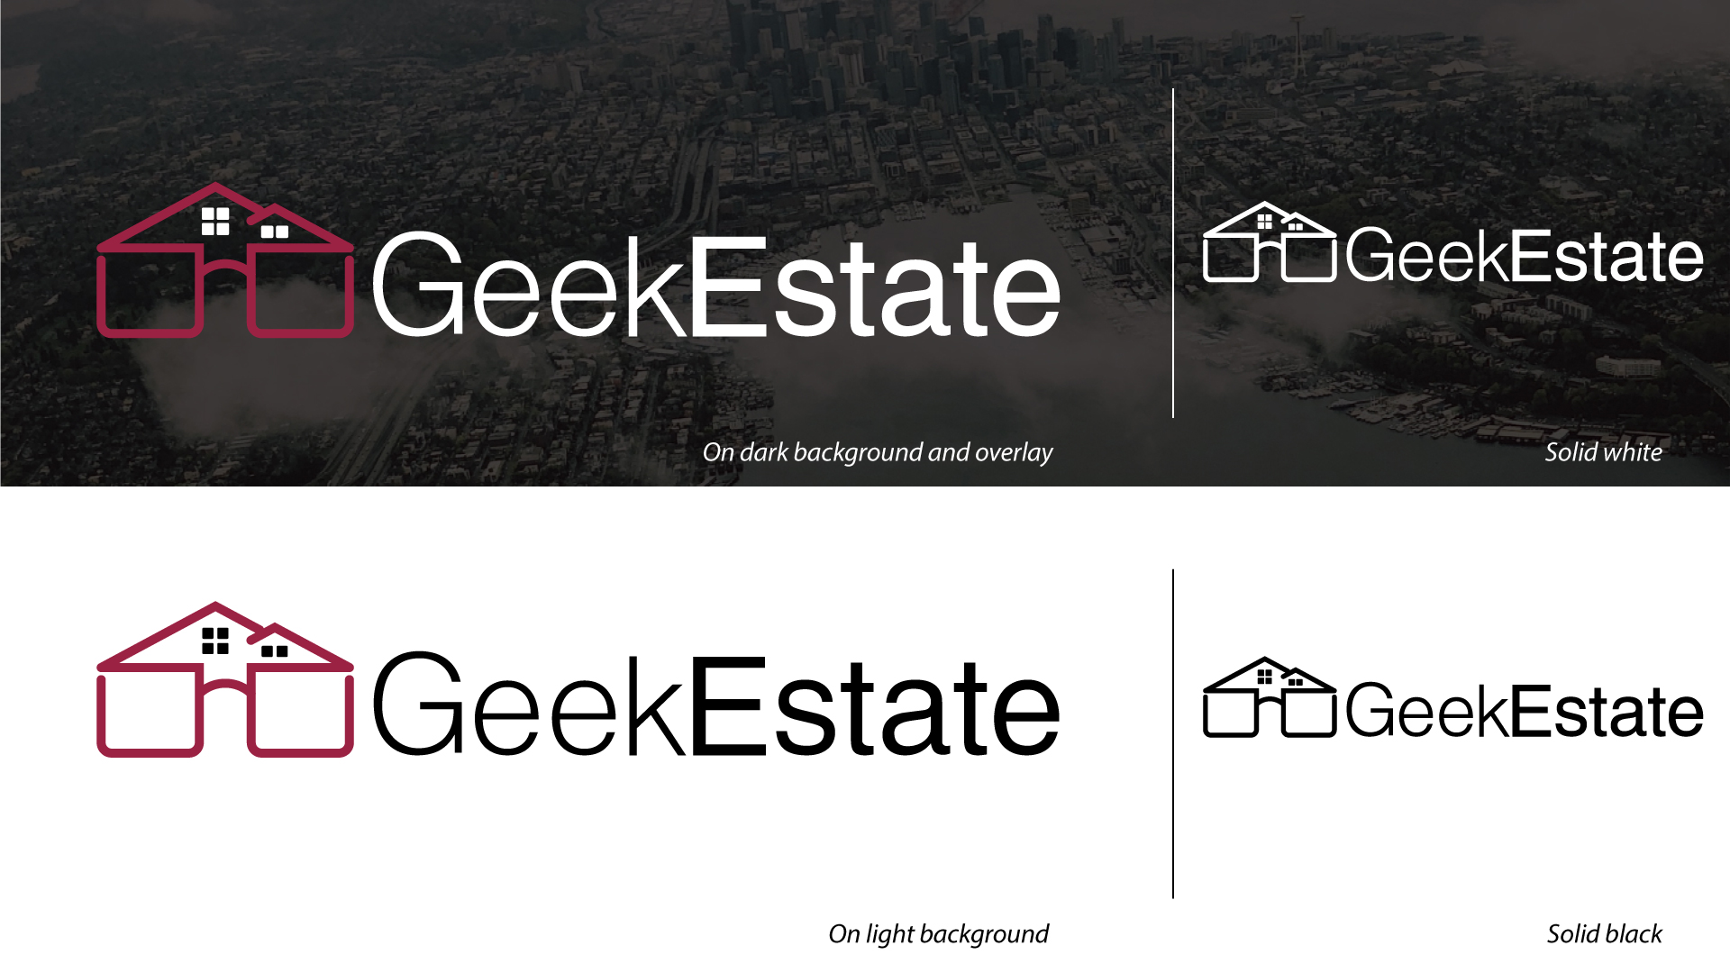

Slide 4
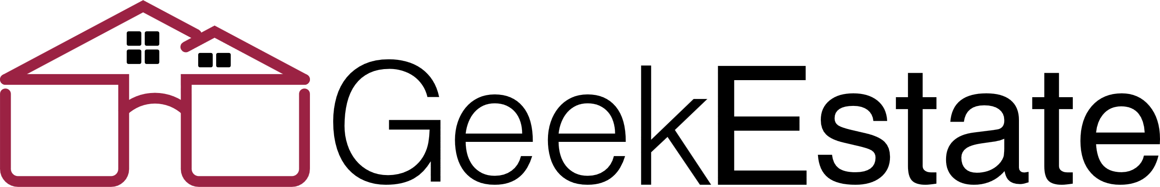
Note:
Typeface: Helvetica
Conceptually this logo’s favicon consist of two visual elements, spectacle to represent geek and house with windows for the estate, hidden within the spectacle.
To achieve this visual concept (yellow dotted circle), I make use of the temples and temple tips of the spec’ to visualize the roof and in the negative space I added windows for the house hidden withing the spectacle.
Minimal and clean.

Slide 5
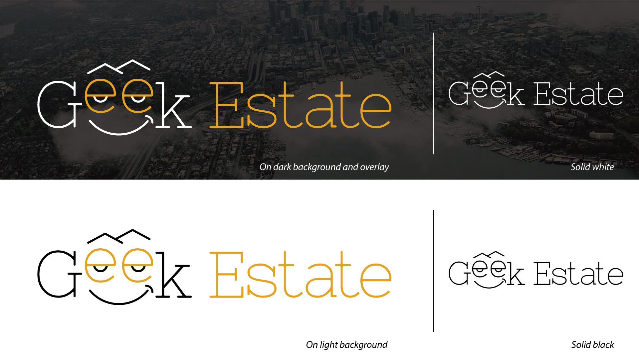

Slide 6
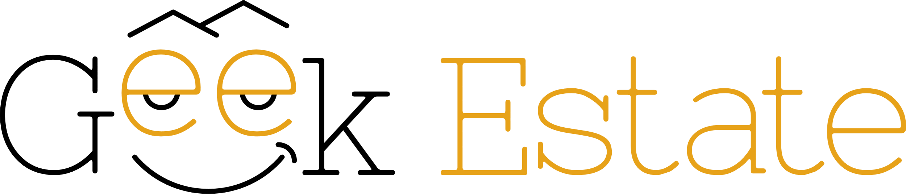
Note:
Typeface: Nixie one
A different approach on the typography, making use of the letter ‘e’ as spectacle and roof top outline for the eyebrow.

