Slide 1
Trees
this
is
a
tree
Trees
Notes:
Trees

Slide 2
What is a Tree
In computer science, a tree is an abstract model of a hierarchical structure
A tree consists of nodes with a parent-child relationship
Applications:
  Organization charts
  File systems
  Programming environments
Computers”R”Us
Sales
Manufacturing
R&D
US
International
Laptops
Desktops
Europe
Asia
Canada
Trees

Slide 3
What is a Tree
A connected acyclic graph is a tree.
A tree T is a set of nodes in a parent-child relationship with the following properties:
  T has a special node r, called the root of T, with no parent node
  Each node v of T, different from r, has a unique parent node u
A tree cannot be empty, since it must have at least one node – the root.
Trees

Slide 4
Tree Terminology
Root: node without parent (A)
Internal node: node with at least one child (A, B, C, F)
External node (Leaf ): node without children (E, I, J, K, G, H, D)
Ancestors of a node: parent, grandparent, grand-grandparent, etc.
Descendants of a node: child, grandchild, grand-grandchild, etc.
Depth of a node: number of ancestors, excluding the node itself
Height of a tree: maximum depth of any node (3)
Siblings: two nodes that are children of the same parent
Subtree: tree consisting of a node and its descendants
A
subtree
B
C
D
E
F
G
H
I
J
K
Trees

Slide 5
Depth and Height
The depth of a node v can be recursively defined as follows
  If v is the root, then the depth of v is 0.
  Otherwise, the depth of v is one plus the depth of the parent of v
  Algorithm depth(T, v)
  if T.isRoot(v) then
  return 0
  else
  return 1 + depth(T, T.parent(v))
  Running time: O(1 + d_{v}), d_{v} is depth of v in T
  In worst case O(n), n is the number of nodes in T
Trees

Slide 6
Depth and Height
The height of a node v can be recursively defined as follows
  If v is a leaf node, then the height of v is 0.
  Otherwise, the height of v is one plus the maximum height of a child of v
The height of a tree T is the height of the root of T
The height of a tree T is equal to the maximum depth of a leaf node of T
Trees

Slide 7
Depth and Height
  Algorithm height1(T)
  h = 0
  for each v εT.positions(v) do
  if T.isExternal(v) then
  h = max(h, depth(T, v))
  return h
  Running time: O(n + Σ_{v ε E} (1 + d_{v})), where d_{v} is depth of v in T, E is the set of leaves in T
  In worst case O(n²), n is the number of nodes in T
Trees

Slide 8
Depth and Height
  Algorithm height2(T, v)
  if T.isExternal(v) then
  return 0
  else
  h = 0
  for each w ε T.children(v) do
  h = max(h, height2(T, w))
  return 1 + h
  Running time: O(Σ_{v ε T} (1 + c_{v})), where c_{v} is the number of children of v in T
  Since Σ_{v ε T} c_{v =} n - 1, we have O(Σ_{v ε T} (1 + c_{v})) = O(n).
The height of tree T is obtained by calling height2(T, r).
Trees

Slide 9
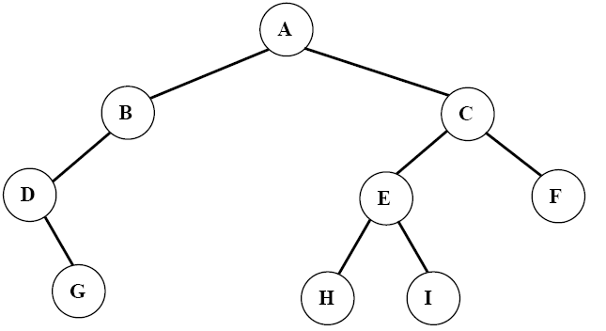
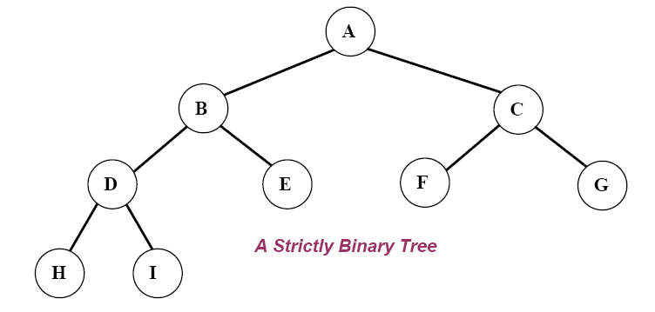
Ordered Trees
A tree is ordered if there is a linear ordering defined for each child of each node.
A binary tree is an ordered tree in which every node has at most two children.
If each node of a tree has either zero or two children, the tree is called a proper (strictly) binary tree.
Trees

Slide 10
Traversal of Trees
A traversal of a tree T is a systematic way of visiting all the nodes of T
Traversing a tree involves visiting the root and traversing its subtrees
There are the following traversal methods:
  Preorder Traversal
  Postorder Traversal
  Inorder Traversal (of a binary tree)
Trees

Slide 11
Preorder Traversal
In a preorder traversal, a node is visited before its descendants
If a tree is ordered, then the subtrees are traversed according to the order of the children
Algorithm preOrder(v)
  visit(v)
  for each child w of v
  preorder (w)
1
A
2
9
5
B
C
D
3
4
6
7
8
E
F
I
G
H
Preorder: ABEFCIGHD
Trees

Slide 12
Postorder Traversal
In a postorder traversal, a node is visited after its descendants
Algorithm postOrder(v)
  for each child w of v
  postOrder (w)
  visit(v)
A
9
3
8
B
7
C
D
1
2
6
4
5
E
F
I
G
H
Postorder: EFBIGHCDA
Trees

Slide 13
Inorder Traversal
In an inorder traversal a node is visited after its left subtree and before its right subtree
Algorithm inOrder(v)
  if isInternal (v)
    inOrder (leftChild (v))
  visit(v)
  if isInternal (v)
    inOrder (rightChild (v))
6
2
8
1
4
7
9
3
5
Trees

Slide 14
Inorder Traversal
Traversing a binary tree in inorder
  1. Traverse the left subtree in inorder.
  2. Visit the root.
  3. Traverse the right subtree in inorder.
Inorder: DGBAHEICF
Trees

Slide 15
Level Order Traversal
In a level order traversal, every node on a level is visited before going to a lower level
1
A
2
4
3
B
C
D
5
6
7
8
9
E
F
I
G
H
Level order: ABCDEFIGH
Trees

Slide 16
Euler Tour Traversal
Generic traversal of a binary tree
Includes a special cases the preorder, postorder and inorder traversals
Walk around the tree and visit each node three times:
  on the left (preorder)
  from below (inorder)
  on the right (postorder)
+
L
×
R
×
B
2
−
3
2
5
1
Trees

Slide 17
(Proper) Binary Tree
A (proper) binary tree is a tree with the following properties:
  Each internal node has two children
  The children of a node are an ordered pair
We call the children of an internal node left child and right child
Alternative recursive definition: a (proper) binary tree is either
  a tree consisting of a single node, or
  a tree whose root has an ordered pair of children, each of which is a binary tree
Applications:
  arithmetic expressions
  decision processes
  searching
A
B
C
D
E
F
G
H
I
Trees

Slide 18
Arithmetic Expression Tree
Binary tree associated with an arithmetic expression
  internal nodes: operators
  external nodes: operands
Example: arithmetic expression tree for the expression (2 × (a − 1) + (3 × b))
+
×
×
2
−
3
b
a
1
Trees

Slide 19
Decision Tree
Binary tree associated with a decision process
  internal nodes: questions with yes/no answer
  external nodes: decisions
Example: dining decision
Want a fast meal?
Yes
No
How about coffee?
On expense account?
Yes
No
Yes
No
Starbucks
Spike’s
Al Forno
Café Paragon
Trees

Slide 20
Properties of Binary Trees
Let T be a (proper) binary tree with n nodes, and let h denote the height of T. Then T has the following properties.
  The number of external (leaf) nodes in T is at least h+1 and at most 2^{h}.
  The number of internal nodes in T is at least h and at most 2^{h}-1.
  The number of nodes in T is at least 2h+1 and at most 2^{h+1}-1.
  The height h of T satisfies log(n+1) ≤ h ≤ (n-1)/2.
Proof:
Trees

Slide 21
Properties of Binary Trees
In a (proper) binary tree T, the number of external nodes is 1 more than the number of internal nodes.
Proof:
u
v
z
w
Trees

Slide 22
BinaryTree ADT
The BinaryTree ADT extends the Tree ADT, i.e., it inherits all the methods of the Tree ADT
Additional methods:
  position leftChild(v): returns the left child of v
  position rightChild(v) : returns the right child of v
  position sibling(v) : returns the sibling of node v
Trees

Slide 23
Linked Structure for Binary Trees
A node is represented by an object storing
  Element
  Parent node
  Left child node
  Right child node
∅
B
∅
∅
B
A
D
A
D
∅
∅
∅
∅
C
E
C
E
Trees

Slide 24
Linked Structure for General Trees
A node is represented by an object storing
  Element
  Parent node
  Children Container: Sequence of children nodes
∅
B
∅
∅
A
D
F
B
A
D
F
C
E
∅
∅
C
E
Trees

Slide 25
Print Arithmetic Expressions
Specialization of an inorder traversal
  print operand or operator when visiting node
  print “(“ before traversing left subtree
  print “)“ after traversing right subtree
Algorithm printExpression(v)
  if hasLeft (v)
  print(“(’’)
    inOrder (left(v))
  print(v.element ())
  if hasRight (v)
    inOrder (right(v))
  print (“)’’)
+
×
×
2
−
3
b
((2 × (a − 1)) + (3 × b))
a
1
Trees

Slide 26
Evaluate Arithmetic Expressions
Specialization of a postorder traversal
  recursive method returning the value of a subtree
  when visiting an internal node, combine the values of the subtrees
Algorithm evalExpr(v)
  if isExternal (v)
    return v.element ()
  else
  x ← evalExpr(leftChild (v))
  y ← evalExpr(rightChild (v))
  ◊ ← operator stored at v
    return x ◊ y
+
×
×
2
−
3
2
5
1
Trees

