Slide 1
Binary Trees

Slide 2
Parts of a binary tree
A binary tree is composed of zero or more nodes
  In Java, a reference to a binary tree may be null
Each node contains:
  A value (some sort of data item)
  A reference or pointer to a left child (may be null), and
  A reference or pointer to a right child (may be null)
A binary tree may be empty (contain no nodes)
If not empty, a binary tree has a root node
  Every node in the binary tree is reachable from the root node by a unique path
A node with no left child and no right child is called a leaf
  In some binary trees, only the leaves contain a value

Slide 3
Picture of a binary tree
The root is drawn at the top
a
b
c
d
e
f
g
h
i
j
k
l

Slide 4
Left ≠ Right
The following two binary trees are different:
A
A
B
B
In the first binary tree, node A has a left child but no right child; in the second, node A has a right child but no left child
Put another way: Left and right are not relative terms

Slide 5
More terminology
Node A is the parent of node B if node B is a child of A
Node A is an ancestor of node B if A is a parent of B, or if some child of A is an ancestor of B
  In less formal terms, A is an ancestor of B if B is a child of A, or a child of a child of A, or a child of a child of a child of A, etc.
Node B is a descendant of A if A is an ancestor of B
Nodes A and B are siblings if they have the same parent

Slide 6
Size and depth
The size of a binary tree is the number of nodes in it
  This tree has size 12
The depth of a node is its distance from the root
  a is at depth zero
  e is at depth 2
The depth of a binary tree is the depth of its deepest node
  This tree has depth 4
a
b
c
d
e
f
g
h
i
j
k
l

Slide 7
Balance
a
a
b
c
b
c
e
d
e
f
g
d
f
h
i
j
g
h
A balanced binary tree
i
j
An unbalanced binary tree
In most applications, a reasonably balanced binary tree is desirable

Slide 8
Definitions of “balanced”
a
Define the height of a node as the largest distance from that node to a leaf
b
c
d
e
f
g
h
i
j
A balanced binary tree
A binary tree is balanced if every level above the lowest is “full” (contains 2^{n} nodes
A binary tree is balanced if the height of each node differs by at most 1 from the heights of its sibling

Slide 9
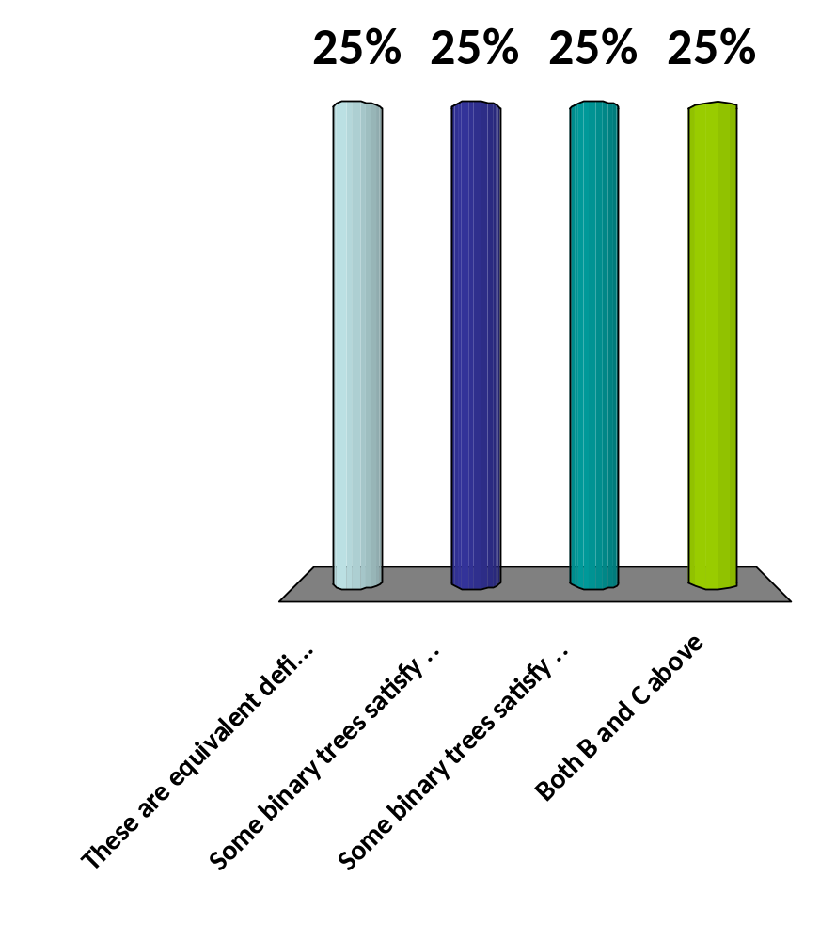
1. A binary tree is balanced if every level above the lowest is “full” (contains 2^{n} nodes
2. A binary tree is balanced if the height of each node differs by at most 1 from the heights of its siblings
These are equivalent definitions
Some binary trees satisfy #1 but not #2
Some binary trees satisfy #2 but not #1
Both B and C above

Slide 10
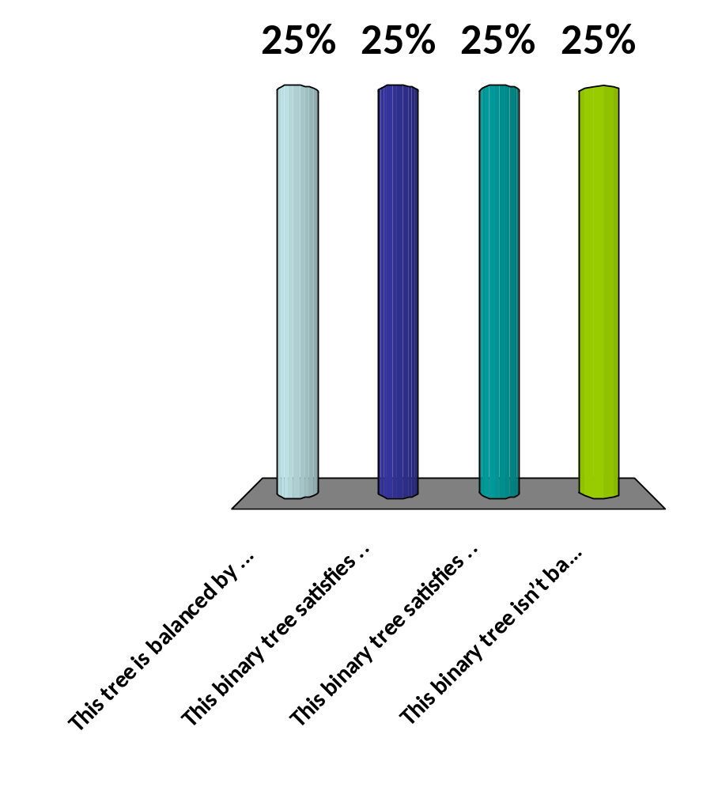
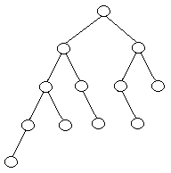
1. A binary tree is balanced if every level above the lowest is “full” (contains 2^{n} nodes
2. A binary tree is balanced if the height of each node differs by at most 1 from the heights of its siblings
This tree is balanced by both definitions
This binary tree satisfies #1 but not #2
This binary tree satisfies #2 but not #1
This binary tree isn’t balanced

Slide 11
Sorted binary trees
A binary tree is sorted if every node in the tree is larger than (or equal to) its left descendants, and smaller than (or equal to) its right descendants
Equal nodes can go either on the left or the right (but it has to be consistent)
10
8
15
4
12
20
17

Slide 12
Binary search in a sorted array
Look at array location (lo + hi)/2
Searching for 5:
(0+6)/2 = 3
Using a binary search tree
hi = 2;
(0 + 2)/2 = 1
lo = 2;
(2+2)/2=2
7
3
13
0 1 2 3 4 5 6
2
3
5
7
11
13
17
2
5
11
17

Slide 13
Tree traversals
A binary tree is defined recursively: it consists of a root, a left subtree, and a right subtree
To traverse (or walk) the binary tree is to visit each node in the binary tree exactly once
Tree traversals are naturally recursive
Since a binary tree has three “parts,” there are six possible ways to traverse the binary tree:
  root, left, right
  left, root, right
  left, right, root
  root, right, left
  right, root, left
  right, left, root

Slide 14
class BinaryTree
class BinaryTree<V> {
V value;
BinaryTree<V> leftChild;
BinaryTree<V> rightChild;
// Assorted methods…
}
A constructor for a binary tree should have three parameters, corresponding to the three fields
An “empty” binary tree is just a value of null
  Therefore, we can’t have an isEmpty() method (why not?)

Slide 15
Preorder traversal
In preorder, the root is visited first
Here’s a preorder traversal to print out all the elements in the binary tree:
public void preorderPrint(BinaryTree bt) {
if (bt == null) return;
System.out.println(bt.value);
preorderPrint(bt.leftChild);
preorderPrint(bt.rightChild);
}

Slide 16
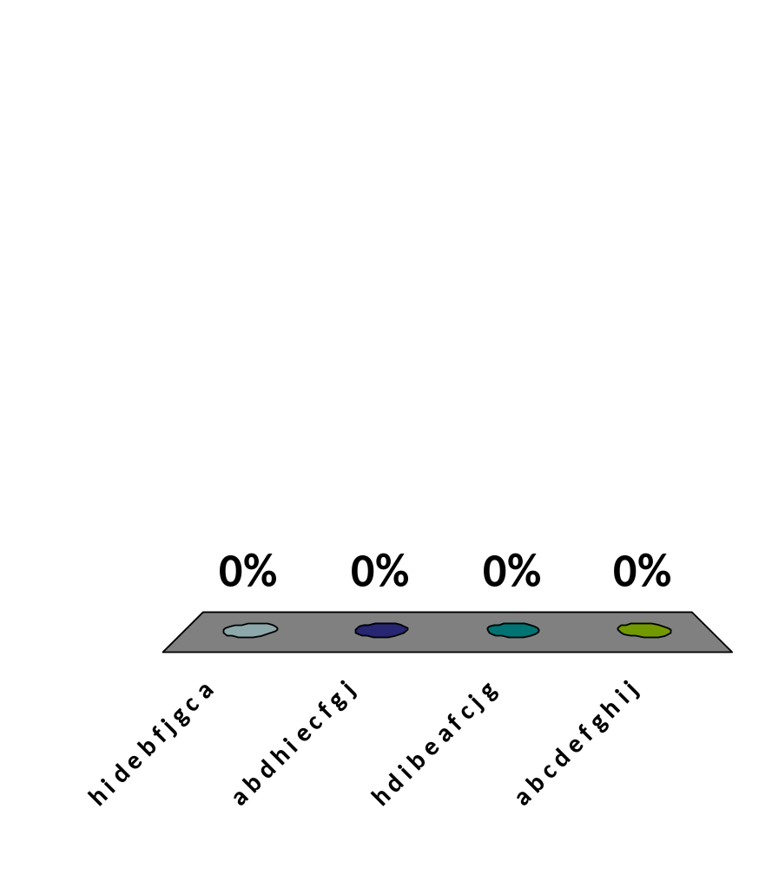
Traverse in preorder
a
b
c
d
e
f
g
h
i
j
h i d e b f j g c a
a b d h i e c f g j
h d i b e a f c j g
a b c d e f g h i j

Slide 17
Inorder traversal
In inorder, the root is visited in the middle
Here’s an inorder traversal to print out all the elements in the binary tree:
public void inorderPrint(BinaryTree bt) {
if (bt == null) return;
inorderPrint(bt.leftChild);
System.out.println(bt.value);
inorderPrint(bt.rightChild);
}

Slide 18
Postorder traversal
In postorder, the root is visited last
Here’s a postorder traversal to print out all the elements in the binary tree:
public void postorderPrint(BinaryTree bt) {
if (bt == null) return;
postorderPrint(bt.leftChild);
postorderPrint(bt.rightChild);
System.out.println(bt.value);
}

Slide 19
Tree traversals using “flags”
The order in which the nodes are visited during a tree traversal can be easily determined by imagining there is a “flag” attached to each node, as follows:
preorder
inorder
postorder
To traverse the tree, collect the flags:
A
A
A
B
C
B
C
B
C
D
E
F
G
D
E
F
G
D
E
F
G
A B D E C F G
D B E A F C G
D E B F G C A

Slide 20
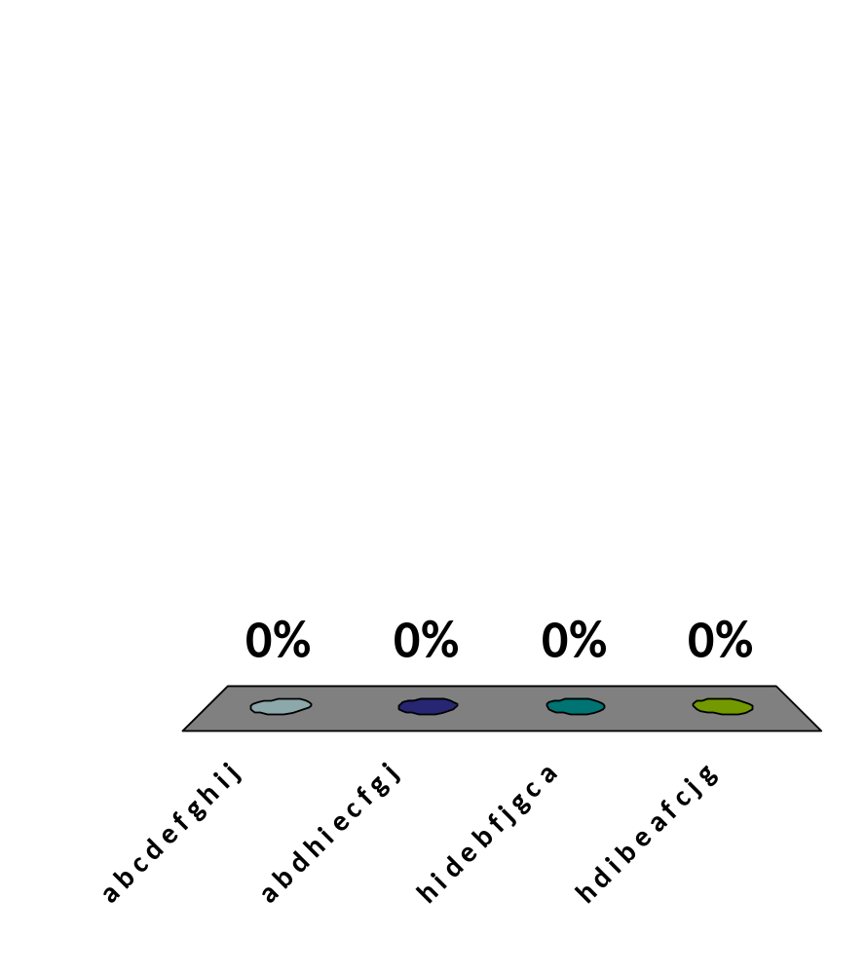
Traverse in preorder
a
b
c
d
e
f
g
h
i
j
a b c d e f g h i j
a b d h i e c f g j
h i d e b f j g c a
h d i b e a f c j g

Slide 21
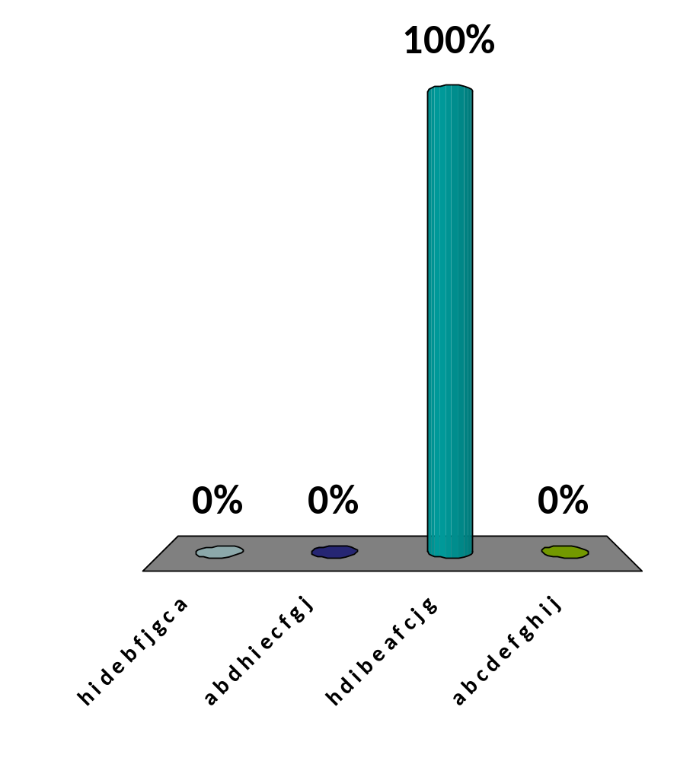
Traverse in postorder
a
b
c
d
e
f
g
h
i
j
h i d e b f j g c a
a b d h i e c f g j
h d i b e a f c j g
a b c d e f g h i j

Slide 22
Copying a binary tree
In postorder, the root is visited last
Here’s a postorder traversal to make a complete copy of a given binary tree:
public static BinaryTree copyTree(BinaryTree bt) {
if (bt == null) return null;
BinaryTree left = copyTree(bt.leftChild);
BinaryTree right = copyTree(bt.rightChild);
return new BinaryTree(bt.value, left, right);
}

Slide 23
Copying a binary tree
Many programs use copy constructors—a constructor that constructs a new object that is a copy of the given object
Here’s a copy constructor for nonempty binary trees:
  public BinaryTree(BinaryTree bt) {
  value = bt.value;
  if (bt.leftChild != null) {
  leftChild = new BinaryTree(bt.leftChild);
  }
  if (bt.rightChild != null) {
  rightChild = new BinaryTree(bt.rightChild);
  };
  }
Notice the tests to avoid nullPointerExceptions!

Slide 24
Other traversals
The other traversals are the reverse of these three standard ones
  That is, the right subtree is traversed before the left subtree is traversed
Reverse preorder: root, right subtree, left subtree
Reverse inorder: right subtree, root, left subtree
Reverse postorder: right subtree, left subtree, root

Slide 25
The End

