Slide 1
Introduction
Notes:
Page <number>

Slide 2
Course Objectives
To help you gain a general understanding of the principles and concepts governing the operations of computer networks;
To provide you with the opportunity to become skillful in the implementation and use of communication protocols;

Slide 3
Topics
Overview of network layers and protocols
The Physical Layer
- transmission media
- the Nyquist limit and the Shannon limit
* The Data Link Layer
- framing
- error detecting and correcting codes
- sliding window protocols
* The Medium Access Control Layer
- ALOHA
- IEEE 802.3
- IEEE 802.11
* The Network Layer
- routing algorithms
- congestion control
- IP
* The Transport Layer
- connection establishment/termination
- multiplexing
- flow control
- TCP and UDP
Utility Protocols

Slide 4
Protocols
Basically, a protocol is an agreement between the communicating peers on how communication is to proceed.

Slide 5
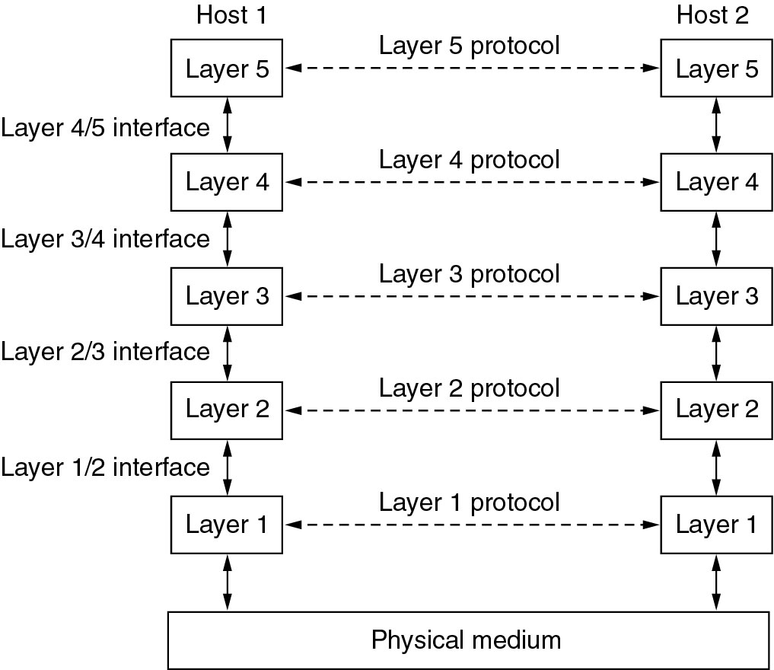
The layering Principle (1)

Slide 6
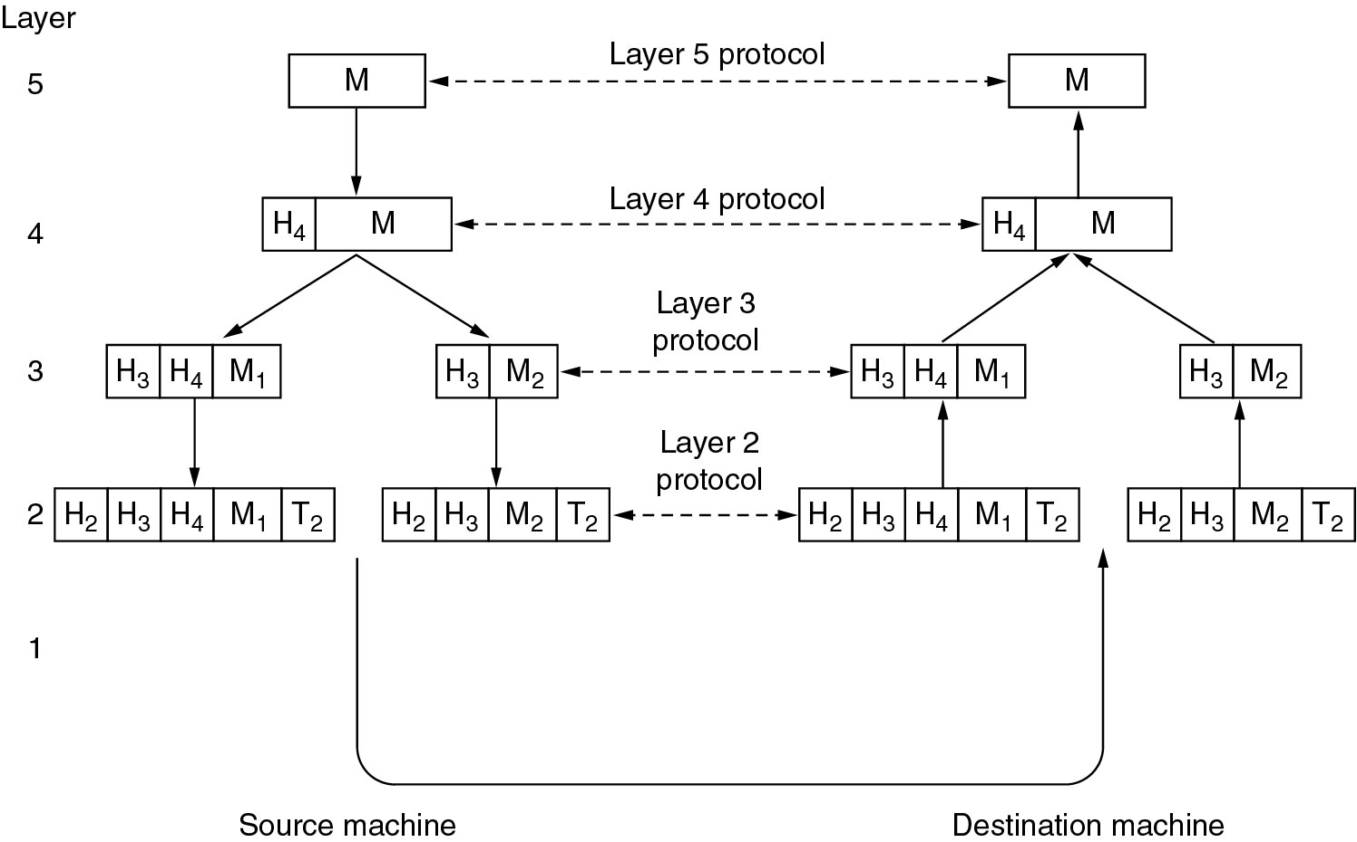
The layering Principle (2)

Slide 7
Connection-Oriented vs. Connectionless
?

Slide 8
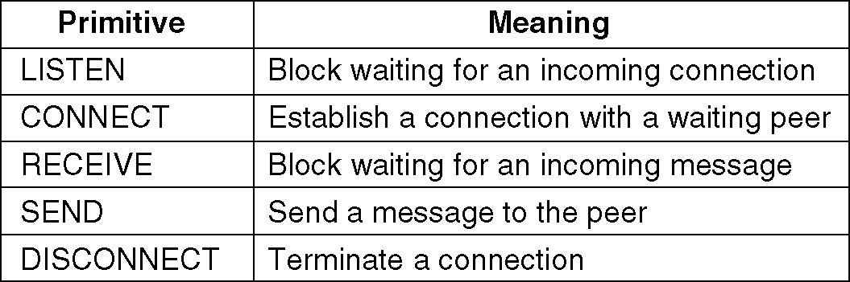
Service Primitives
A service is formally specified by a set of primitives (basic operations) available to a user or other entity to access the service.
Example: five service primitives for implementing a simple connection-oriented service.
Notes:
Page <number>
Another example with html

Slide 9
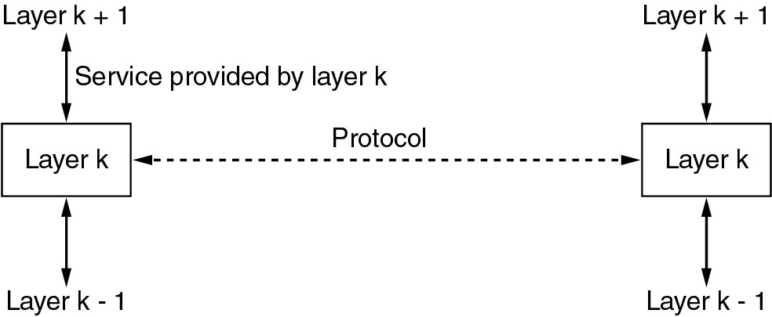
The relationship of Service

Slide 10
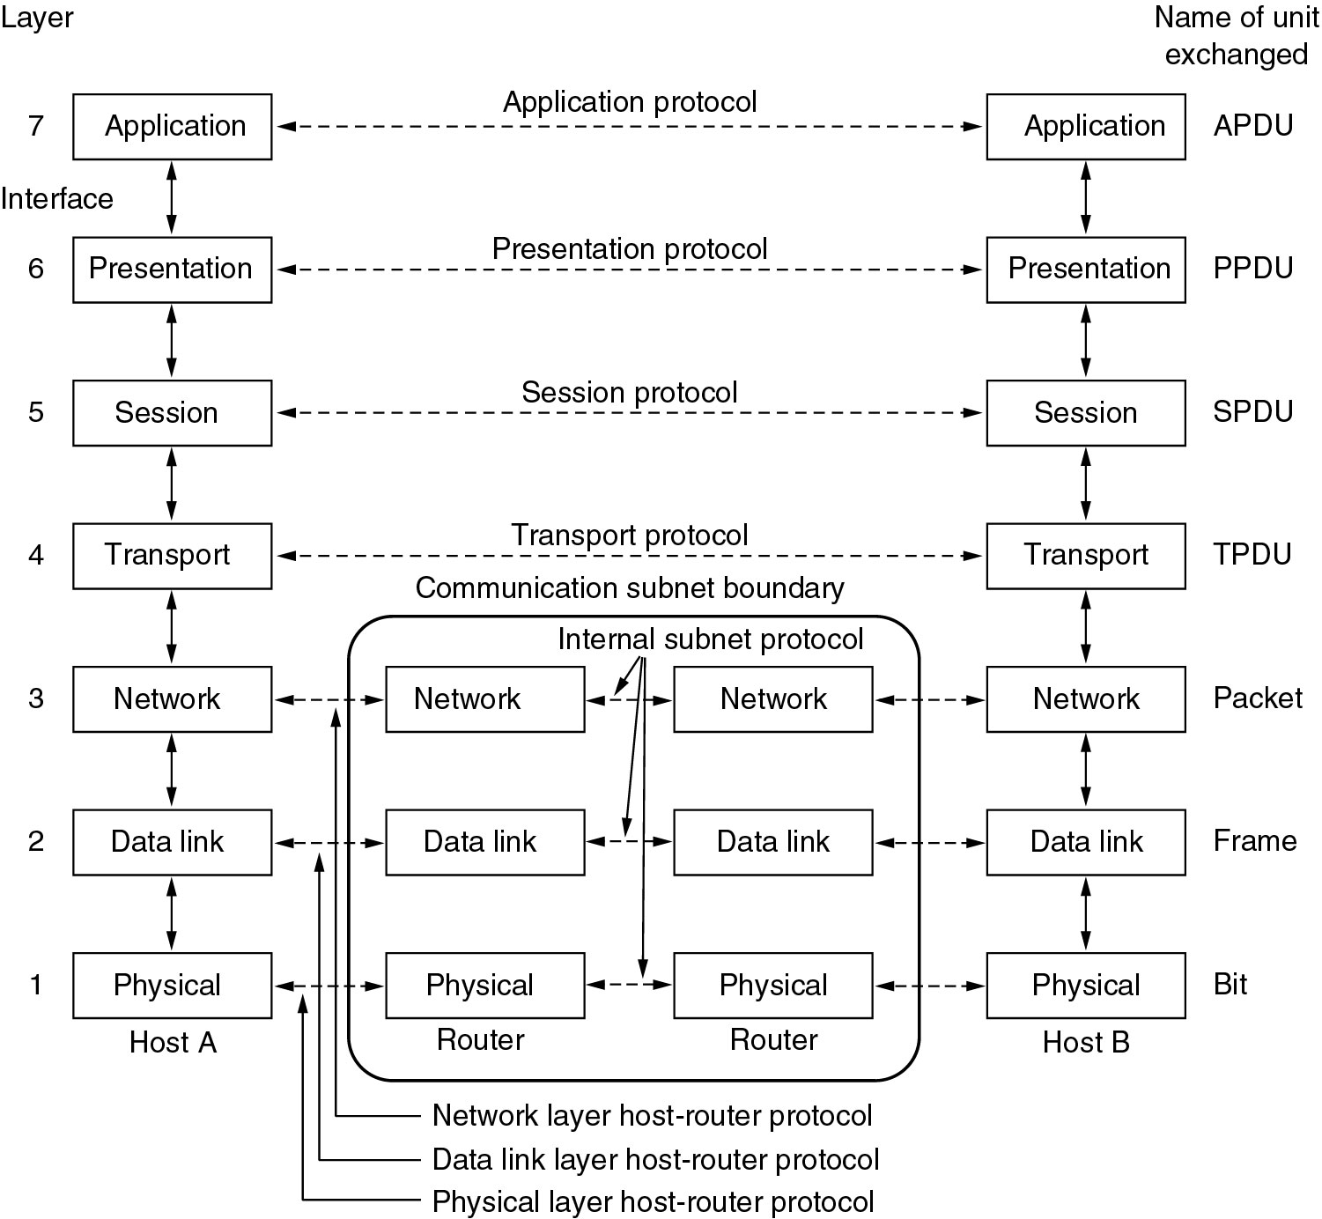
The OSI Reference Model

Slide 11
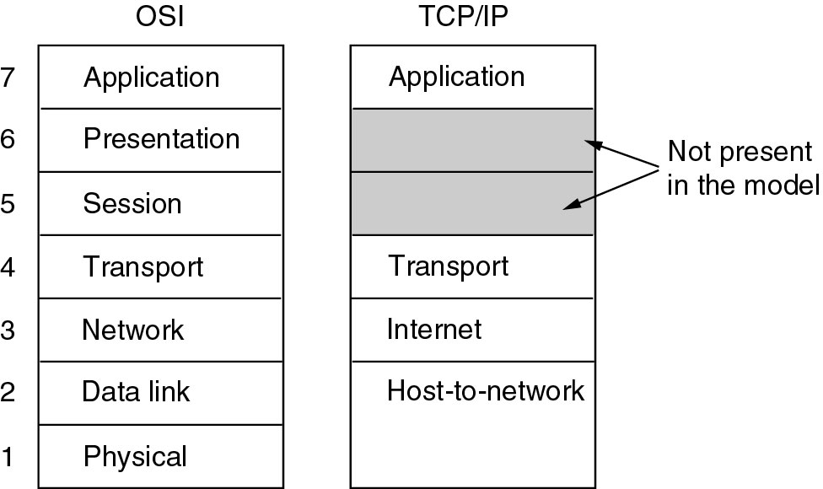
The TCP/IP Reference Model

Slide 12
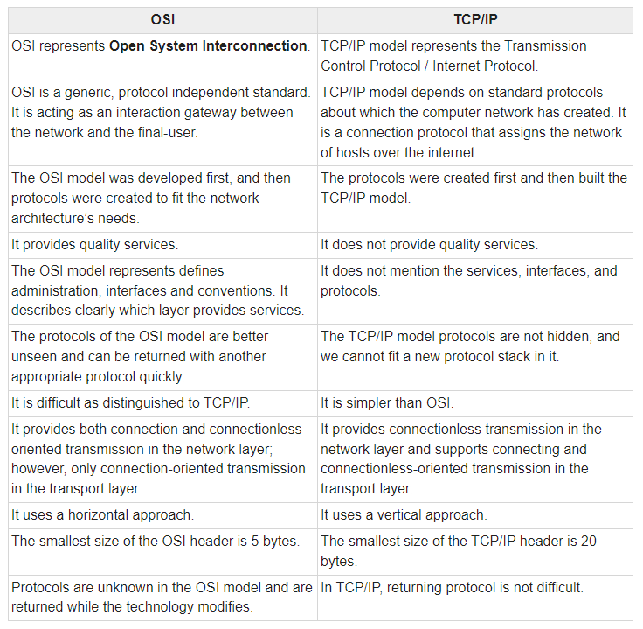
The OSI vs TCP/IP Model

Slide 13
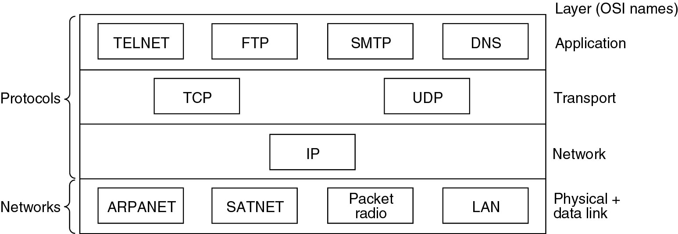
The TCP/IP Reference Model
Protocols and networks in the TCP/IP model initially.

