Slide 1
MLPC 2026 Task 5 Sound Event Detection Challenge
Group: Quantized Transformers
Aleksandr Masiev • Aleksandar Cvetkovic
Non-bonus solution — precomputed audio features only

Slide 2
1. Task & Final System Architecture
• Goal: detect 15 domestic sound events with onsets/offsets in recordings of any length
• Dataset: 3704 train / 999 val / 1007 hidden test; 960 precomputed features per 1s segment (hop 0.5s)
• Pipeline: 1s segments → standardize → multi-label classifier → per-second activity
• → median-filter smoothing → merge consecutive seconds into onset/offset intervals
• Metric: official segment-based Macro F1 (1s resolution), evaluated with evaluate.py
• Honest protocol: tune on dev-validation, report on a held-out non-hidden test split

Slide 3
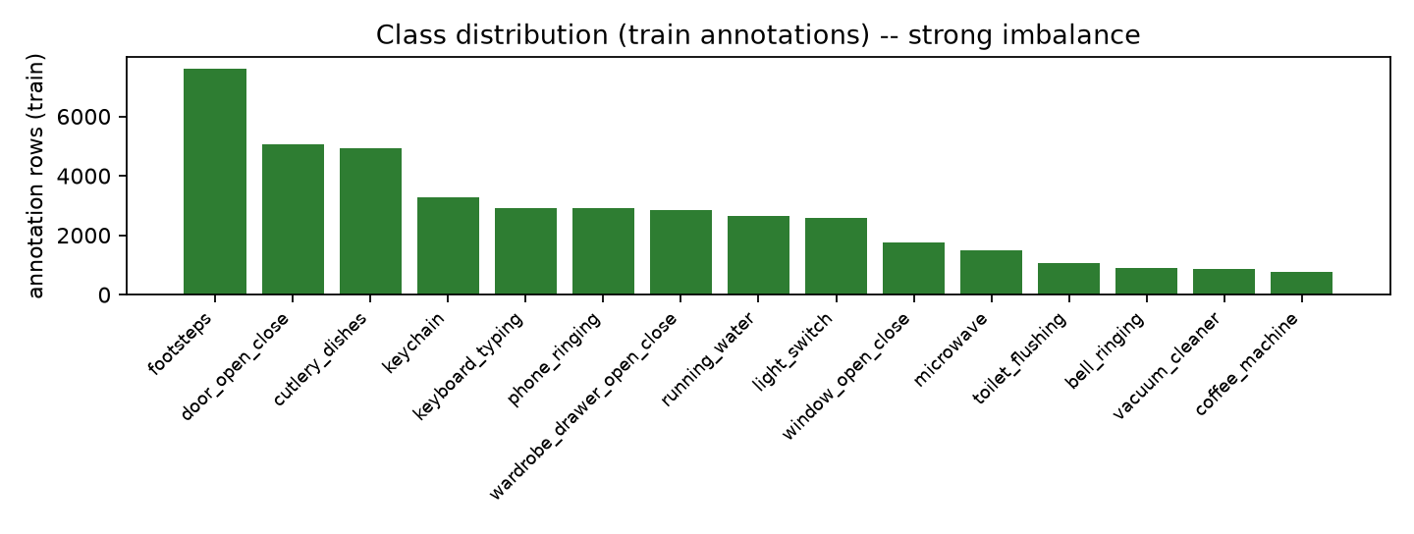
2. Baseline Reproduction
• Per-class DecisionTree (max_depth=20, max_features='sqrt'), MultiOutputClassifier
• Trained on 50k subsampled raw segments — reproduced exactly (seed 42)
• Non-hidden test Macro F1 = 0.316
• Best on loud/sustained classes (running_water, vacuum_cleaner, phone_ringing)
• Weak on short/rare events (window_open_close, wardrobe_drawer, light_switch)
• Limits: no class co-occurrence, 1s resolution, under-fit on 960-dim imbalanced data

Slide 4
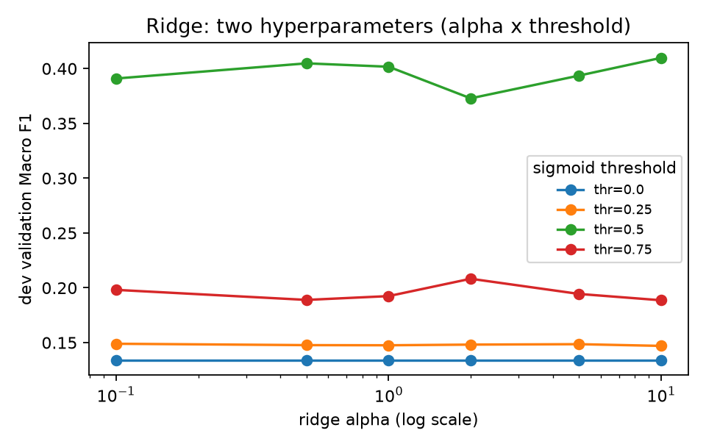
3. Classical Classifiers & Hyperparameters
• Start from Task 4 best: one-vs-rest linear ridge (closed-form, balanced weights)
• Tuned 2+ hyperparameters: ridge alpha {0.1..10} × sigmoid threshold {0..0.75}
• Also: logistic regression (C, class_weight) and RandomForest (depth)
• Best classical: logistic (C=1.0,class_weight=None), threshold 0.3
• Non-hidden test Macro F1 = 0.436 (baseline 0.316, +0.120)

Slide 5
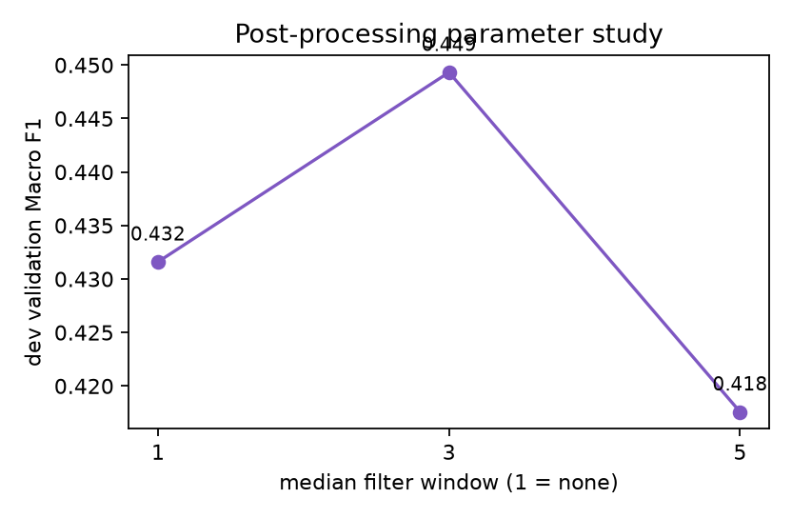
4. Post-Processing (Median Filter)
• Per-class temporal median filter on per-second predictions (window 1 = none)
• Removes isolated false-positive blips; fills single-second gaps
• Window selected on dev-validation; evaluated once on non-hidden test
• Selected window = 3
• Non-hidden test: 0.436 → 0.446 (+0.010)

Slide 6
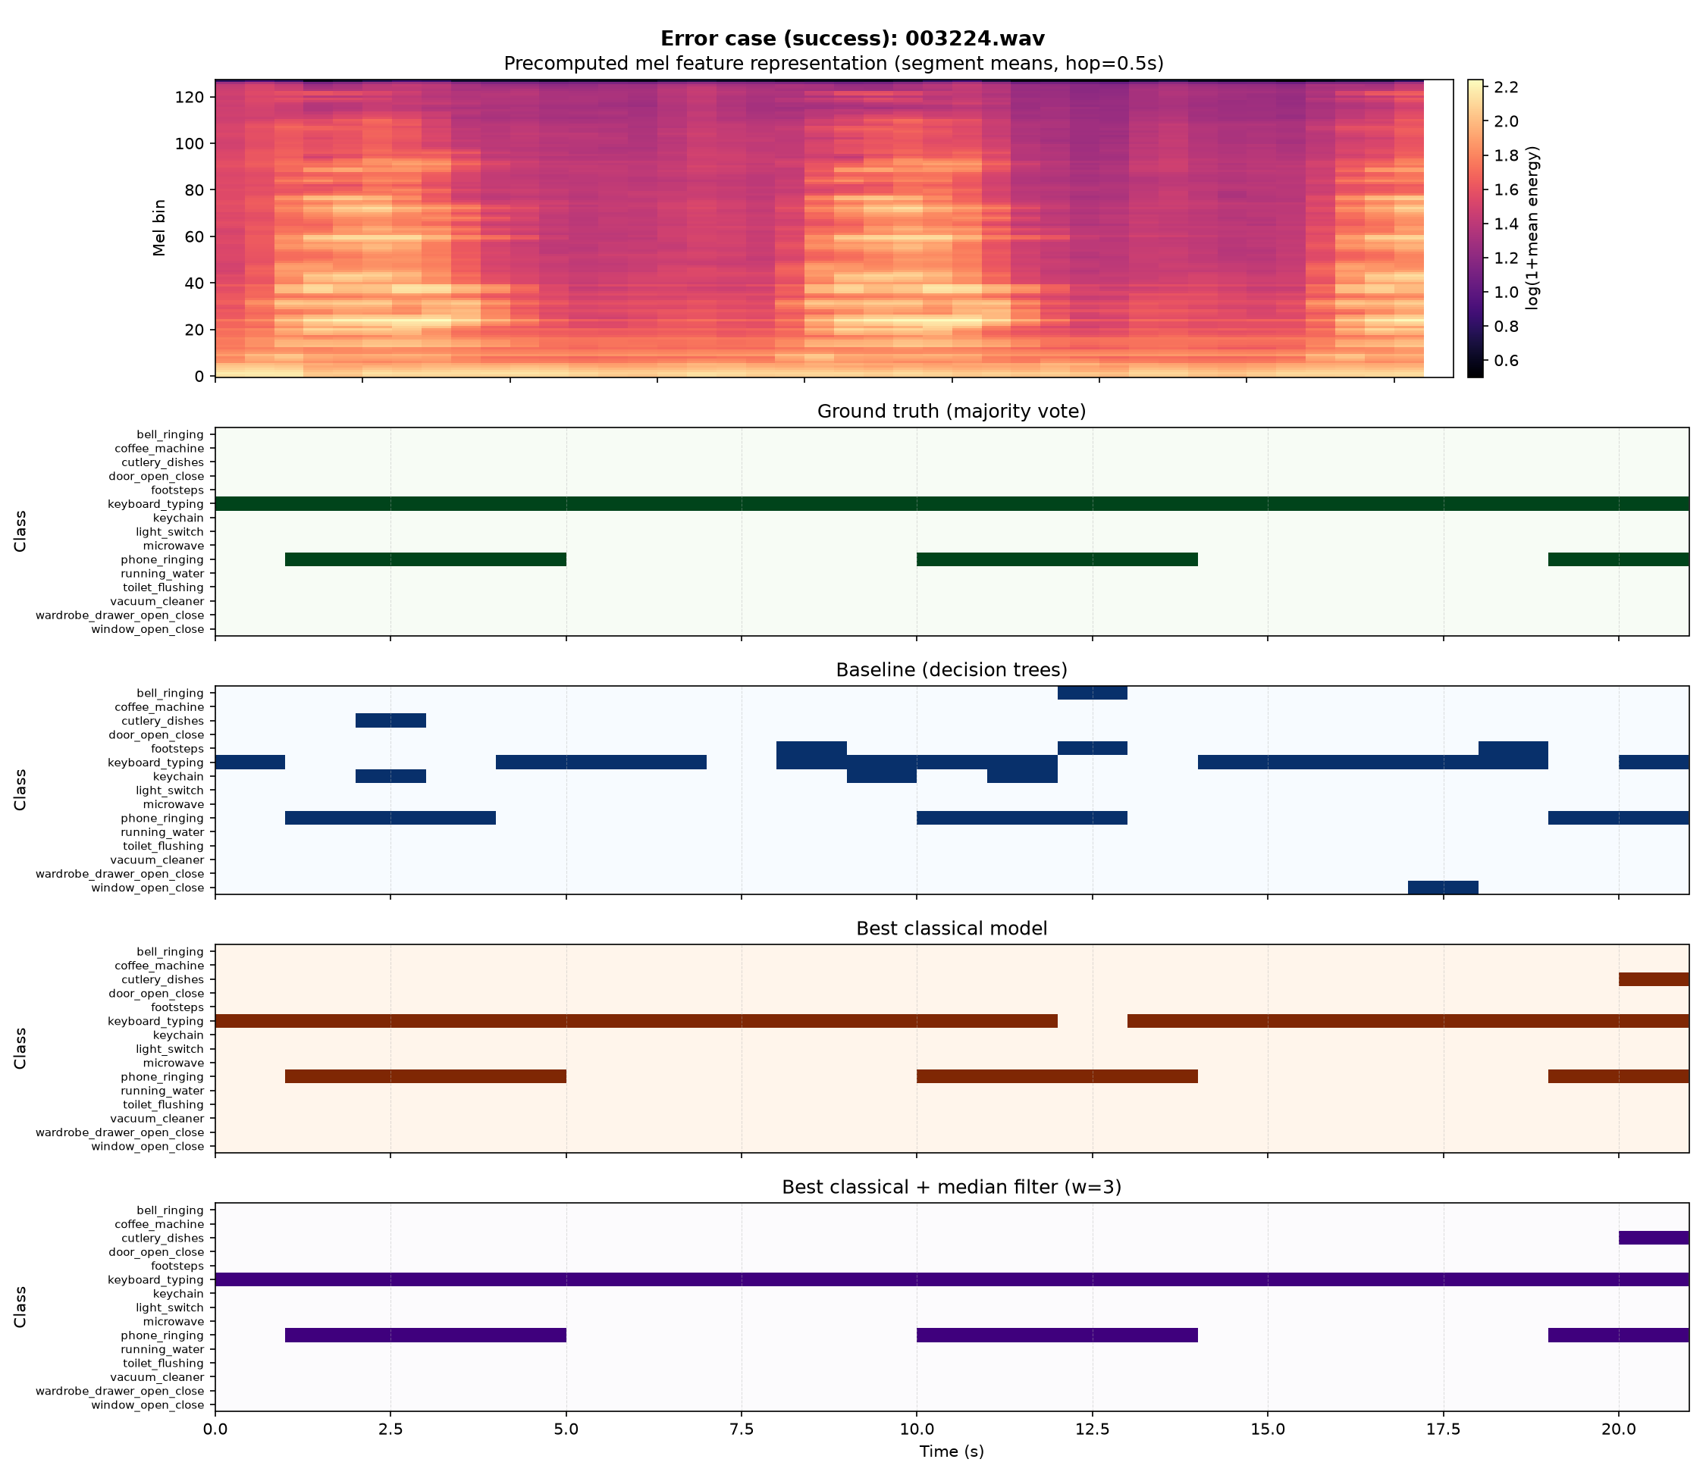
5. Qualitative Error Analysis
• Success: dominant sustained events detected with good temporal overlap
• False positives: extra short transients from acoustically similar onsets
• Misses: short/rare events lost at 1s resolution; boundary timing shifts
• Visuals use the precomputed mel feature representation (no raw waveform)

Slide 7
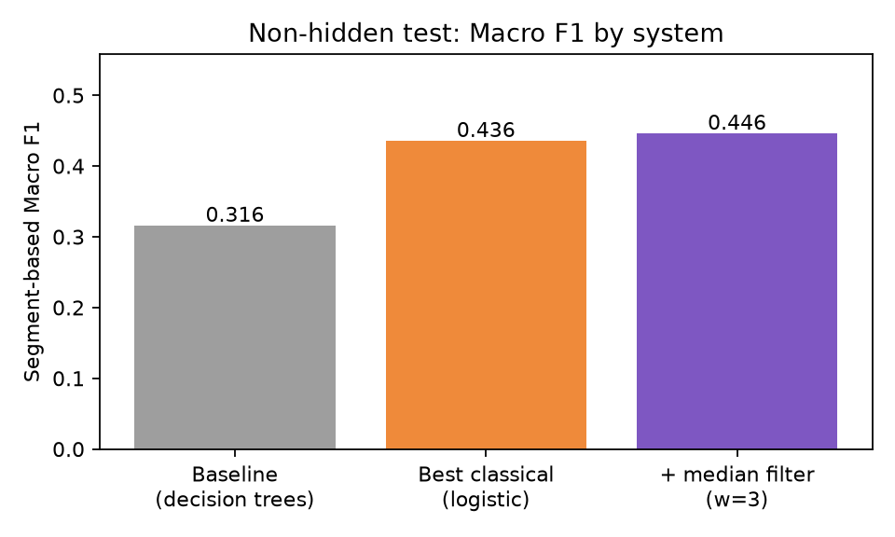
6. Final System, Limits & Deployment
• Final system: logistic + median filter (w=3); retrained on train + full validation for the hidden test CSV
• Cheap & low-latency (one matrix multiply per second) — good for on-device smart-home use
• Limits: independent per-class linear models, 1s resolution, label noise, imbalance
• Future: temporal CNN/CRNN, per-class threshold calibration, hysteresis smoothing
• Deployment: precision matters (false alarms erode trust); validate across rooms/devices

