Slide 1





....and other creepy things from John Vlissides

Slide 2
The Visitor Pattern EXISTS!
And its INTENT is to represent an operation to be performed on the elements of an object structure.

Slide 3

How?
By letting the user define a new operation without changing the classes of the elements on which it operates!

Slide 4
Motivation
Consider a compiler with abstract syntax trees...

Slide 5

Abstract Syntax Trees
Compiler may need to define
operations for:
Type-Checking
Code Optimization
Flow Analysis
Variable Checking
...and more!

Slide 6
Meaning....
There will be one class for every single thing that needs to be performed...
Distributing operations amongst various node classes is hard to understand, maintain and change!
Adding a new operation would be a pain in the butt

Slide 7
What we want...
Each new operation should be added separately
All of the node classes to be independent of their operations

Slide 8

The Solution
Package related operations from each class in a separate object, and pass it to elements of the abstract syntax tree as it is traversed.
We call this object...

Slide 9
On a serious note
When an element accepts a visitor, it sends a request to it that encodes the element’s class.
It also includes the element as an argument.
The visitor is left to execute the operation for that element, which used to be in the class of the element.

Slide 10
This is important too
To make visitors work for more than just type-checking, we need an abstract parent NodeVisitor class for all visitors of an abstract syntax tree.

Slide 11
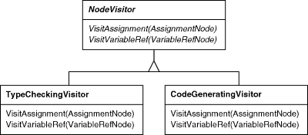
NodeVisitor
NodeVisitor must declare an operation for each node class.

Slide 12
Visitor – Up Close and Personal
There are two class hierarchies with this pattern (page 332 – 333):
Node - for elements being operated on
NodeVisitor - for the visitors that define operations on the elements

Slide 13
Visitor, continued
A new operation is created by adding a new subclass in the visitors class hierarchy.
New functionality can simply be added by defining new NodeVisitor subclasses.

Slide 14
You know you wanna use this when...
An object structure contains many classes of objects with differing interfaces, and you want to perform operations on these objects that depend on their concrete classes.
Many distinct and unrelated operations need to be performed on objects in an object structure and you don’t want to “pollute” their classes with these operations.
The classes defining the object structure rarely change, but you often want to define new operations over the structure.

Slide 15
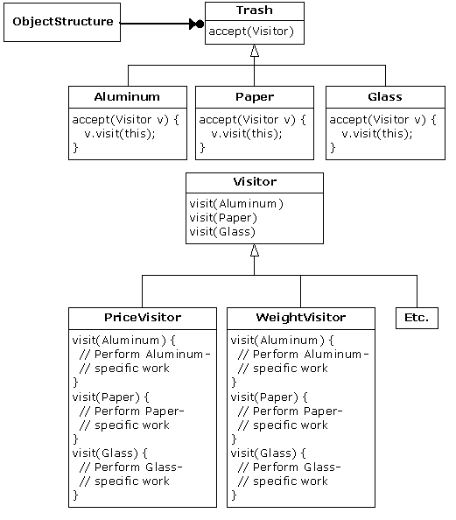

Slide 16

Participants
Visitor – declares a visit operation for each class of ConcreteElement in the object structure
ConcreteVisitor (PriceVisitor) – implements each operation declared by Visitor
Element (Trash) – defines an Accept operation that takes a visitor as an argument

Slide 17
More Participants!
ConcreteElement (Aluminum, Paper, Glass) – implements an Accept operation that takes a visitor as an argument
ObjectStructure (next to Trash)
- can enumerate its elements
- may provide a high-level interface to allow the visitor to visit its elements
- may be a composite or a collection like a set or list.

Slide 18

Collaborations
A client that uses Visitor must create a ConcreteVisitor object and then traverse the object structure, visiting each element with the visitor (page 335)
When an element is visited, it calls the visitor operation that corresponds to its class. The element supplies itself as an argument to this operation to let the visitor access its state, if necessary.

Slide 19


Consequences
1. Visitor makes adding new operations easy!
2. A Visitor gathers related operations and separates unrelated ones, simplifying classes defining elements and algorithms defined by visitors.
3. Adding new ConcreteElement classes is hard.
4. Visitor does not have access restrictions like an iterator does. It can visit objects that don’t have a common parent class, and you can add any type to a visitor interface.
5. Visitors can accumulate state as they visit each element in the object structure.
6. The Visitor pattern often forces you to provide public operations that access an element’s internal state, which may compromise encapsulation.

Slide 20
Technical Details
Double Dispatch – Visitor uses this to let us add operations to classes without changing them. Not all programming languages support it directly (like C++).
It means that operations get executed depending on the kind of request and types of two receivers, NOT one.

Slide 21
Usage
Visitor is not used often, at least according to www.dofactory.com and www.nice.sourceforge.net/visitor.html
The Second site considers it totally useless.
But don’t let that discourage you, because it’s a cool pattern.

Slide 22

Is the Visitor right for you?
The Visitor pattern isn’t
for everyone. Consult
your textbook to find out
if it’s the pattern that
you’re looking for.

Slide 23
Things to Ask Yourself
Is the class hierarchy I’m visiting stable? Or will it be changing like crazy?
“Adding a new kind of Node may force us to change all the classes in the Visitor hierarchy just to add a corresponding visit operation.”
Will the circular dependency between Visitor and Node class hierarchies bother you?
A change to either base class interface is likely to prompt a recompile of both hierarchies.

