Slide 1
Chapter 7. Energy and Energy Balance
1

Slide 2
Introduction
Energy is expensive….
  Effective use of energy is important task for chemical engineers.
Topics of this chapter
  Energy balance
  Energy and energy transfer
    Forms of energy : Kinetic / Potential / Internal Energy
    Energy transfer : Heat and Work
  Using tables of thermodynamic data (steam table)
  Mechanical energy balances
2

Slide 3
Terminology Associated with Energy Balance
System : The quantity of matter or region chosen for study enclosed by boundary
Surroundings : Everything outside the system
Boundary : The surface that separates the system from the surroundings. It may be a real or imaginary surface, either rigid or movable.
Boundary
System
Surroundings
3

Slide 4
Terminology Associated with Energy Balance
Adiabatic System
  A system does not exchange heat with surroundings during a process.
Isothermal System
  A system in which the temperature is invariant during a process
Isobaric System
  A system in which the pressure is constant during a process
Isochoric System
  A system in which the volume is invariant during a process
Q
ΔT
ΔP
ΔV
4

Slide 5
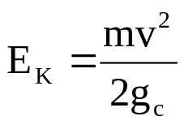
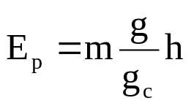
7.1 Forms of Energy
– The First Law of Thermodynamics
Forms of energy
  Kinetic energy : due to the motion of the system
  Potential energy : due to the position of the system
  Internal energy : due to the motion of internal molecules
    Expressed as Temperature
    U : from thermodynamic calculation
Forms of energy transfer
  Heat (Q) : energy flow due to temperature difference
  Work (W) : energy flow due to the driving force other than temperature difference (force, torque, voltage, …)
5

Slide 6

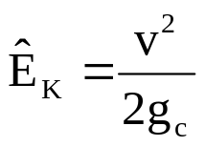
Notation
˙ : rate of energy / energy transfer (energy/time)
^ : specific properties (energy / mass)
Example ) Kinetic Energy
Unit : Joule
Unit : Joule/s
Unit : Joule/kg
6

Slide 7
Unit Conversion
Force
  1 N = 1 kg · m /s², 1 dyne = 1 g cm /s²
  1 lb_{f} = 32.174 lbm · ft /s²
Pressure
  1 atm
  = 1.01325 bar = 1.01325×105 Pa (N/m²) = 101.325 kPa
  = 760 mm Hg = 14.696 lb_{f}/in² (psi ~ pound per square inch)
Energy
  1 J = 1 N · m = 10⁷ dyne · cm = 0.23901 cal = 9.486 × 10⁻⁴ Btu
  1 Btu (British thermal unit) = 1055 J
Power
  1 W = 1 J/s = 1.341 × 10⁻³ hp
7

Slide 8
Example 7.2-1
Water flows into a process unit through a 2-cm ID pipe at a rate of 2.00 m³/h. Calculate E_{k} for this stream in J/s.
8

Slide 9
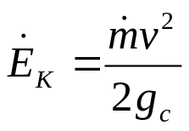
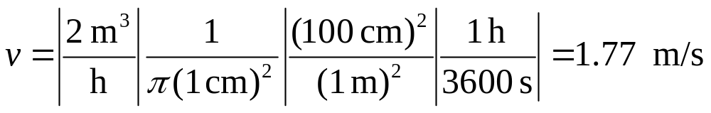
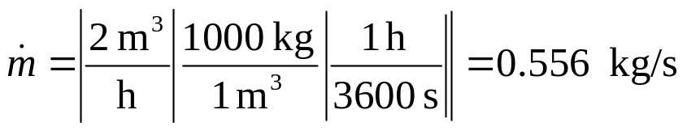
Solve)
선 속도와 질량 유속을 알아야 함.
9

Slide 10
Example 7.2-2
Crude oil is pumped at a rate of 15.0 kg/s from a point 220 meters below the earth’s surface to a point 20 meters above ground level. Calculate the attendant rate of increase of potential energy.
10

Slide 11
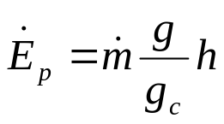

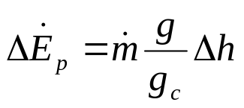

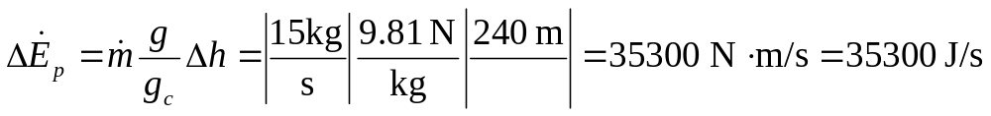
Solve)
g = 9.8066 m / s² = 980 cm/s² = 32.174 ft /s²
11

Slide 12




7.3 Energy balance on closed systems
Balance equation
(Final System Energy) – (Initial System Energy)
= (Net Energy Transfer)
Initial System Energy
Final System Energy
Net Energy Transfer
The first law of thermodynamics for closed systems
Text definition: work is done by the surroundings on the system
12

Slide 13
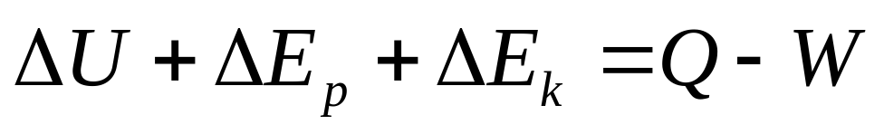
The First Law of Thermodynamics
the universal physical law of the conservation of energy
The increase in the internal energy of a system is equal to the amount of energy added by heating the system, minus the amount lost as a result of the work done by the system on its surroundings
13

Slide 14
Important points
U depends on composition, state, temperature of the system. Nearly independent of pressure for ideal gases, liquids, solids.
If there are no temperature differences,
Q = 0 → Adiabatic process
If there are no moving parts …
W = 0
Potential energy change → due to the changes in height
14

Slide 15
Example 7.3-1
A gas is contained in a cylinder fitted with a movable piston.
The initial gas temperature is 25 ºC.
The cylinder is placed in boiling water with the piston held in a fixed position. Heat in the amount of 2.00 kcal is transferred to the gas, which equilibrates at 100 ºC (and a higher pressure). The piston is then released, and the gas does 100 J of work in moving the piston to its new equilibrium position. The final gas temperature is 100 ºC.
Write the energy balance equation for each of the two stages of this process, and in each case solve for the unknown energy term in the equation. In solving this problem, consider the gas in the cylinder to be the system, neglect the change in potential energy of the gas as the piston moves vertically, and assume the gas behaves ideally. Express all energies in joules. (1 J = 0.239 cal)
15

Slide 16






Solution
Q
W
16

Slide 17

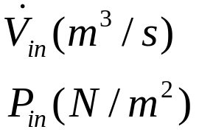
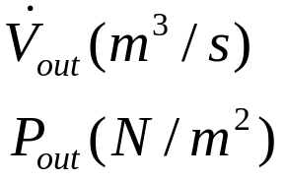

7.4 Energy Balances on
Open Systems at Steady State
Flow work and shaft work
  Flow work : work done on system by the fluid itself at the inlet and the outlet
  Shaft work : work done on the system by a moving part within the system
Process
Unit
17

Slide 18


Specific Properties
Specific properties
  (Property) / (Amount (Mass, Mole number,…))
  Volume , energy, … → Extensive properties
  Specific volume, specific energy, … → Intensive property
  Example)
    Volume : extensive property → depends on system size
    Specific Volume : intensive property → independent of system size
Extensive properties
Intensive properties
18

Slide 19

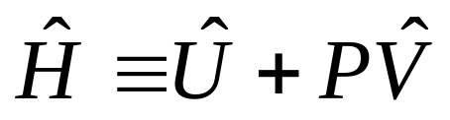
Enthalpy
It is convenient to define the following property for the calculation of energy balance for flowing systems.
  Enthalpy
  Specific Enthalpy
19

Slide 20
Example 7.4-1 Enthalpy Calculation
The specific internal energy of helium at 300 K and 1 atm is 3800 J/mol, and the specific molar volume at the same temperature and pressure is 24.63 L/mol. [ (hint) 0.08206 L·atm/(mol·K) = 8.314 J/(mol·K) ]
Calculate the specific enthalpy of helium at this temperature and pressure
and the rate at which enthalpy is transported by a stream of helium at 300 K and 1 atm with a molar flow rate of 250 kmol/h.
Important Point
Unit conversion methods
Use of Gas constant R
Pressure = Force / Area
Energy
Energy
Pressure × Volume
20

Slide 21
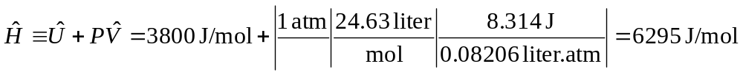
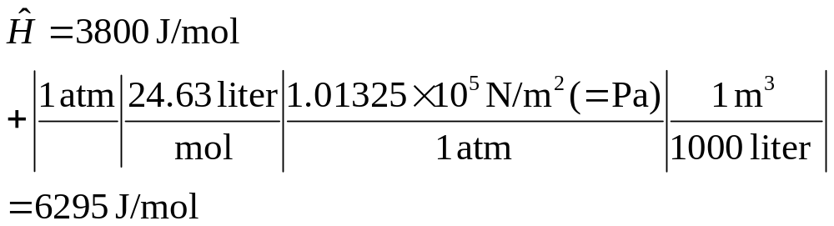
Solution
Method 1 : Use of Gas Constant, R
Method 2 : Pressure = Force / Area
R = 0.08206 l.atm /mol.K = 8.314 J/mol.K
21

Slide 22


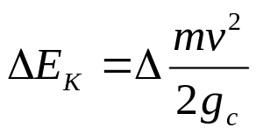
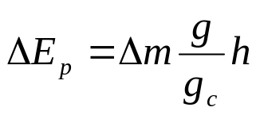


The Steady-State Open System Energy Balance
22

Slide 23
Example 7.4-2
500 kg/h of stream drives a turbine.
The stream enters the turbine at 44 atm and 450 ºC at a linear velocity of 60 m/s and leaves at a point 5 m below the turbine inlet at atmospheric pressure and a velocity of 360 m/s.
The turbine delivers shaft work at a rate of 70 kW, and the heat loss from the turbine is estimated to be 10⁴ kcal/h (1J = 0.239 cal)
Calculate the specific enthalpy changes associated with the process
23

Slide 24


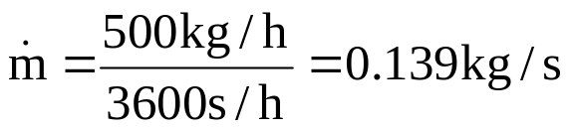
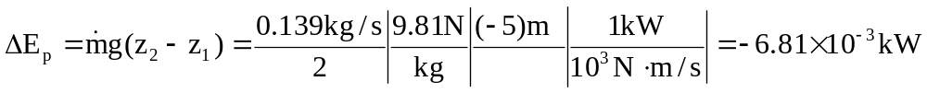
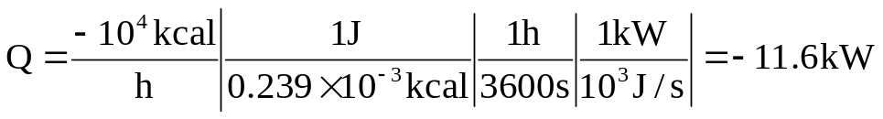

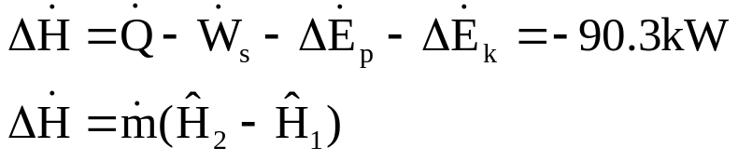
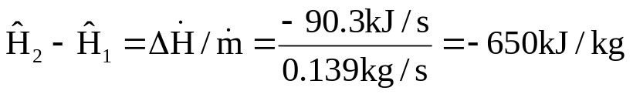
Solution
Q = -10⁴ kcal/h
W = -70 kW
500 kg/h
44 atm, 450ºC
60 m/s
5m
500 kg/h
1 atm
360 m/s
24

Slide 25
7.5 Tables of Thermodynamic Data
U, H, S, V,… → Thermodynamic function
Tables of Thermodynamic Data
  Tabulation of values of thermodynamic functions (U, H, V,..) at various condition (T and P)
  It is impossible to know the absolute values of U , H for process materials → Only changes are important ( ΔU, ΔH,…)
  Reference state
    Choose a T and P as a reference state and measure changes of U and H from this reference state → tabulation
25

Slide 26
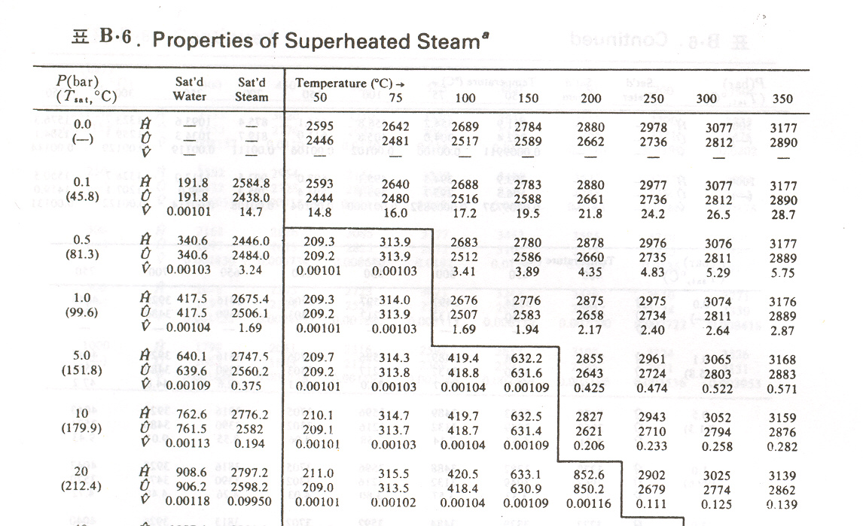
Steam Tables
Compilation of physical properties of water (H, U, V)
Reference state: liquid water at triple point (0.01 ºC, 0.00611 bar)
Table B.7 Properties of Superheated Steam
26

Slide 27


Example 7.5-3
Steam at 10 bar absolute with 190 ºC of superheat is fed to a turbine at a rate m = 2000 kg/h. The turbine operation is adiabatic, and the effluent is saturated steam at 1 bar.
Calculate the work output of the turbine in kW, neglecting kinetic and potential energy changes.
27

Slide 28
Table B.7 Properties of Superheated Steam
370
10 bar, saturated T = 179.9
T = 179.9 + 190 = 369.9
28

Slide 29
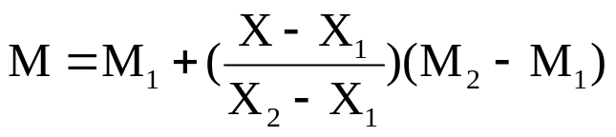
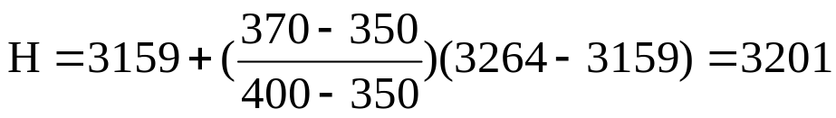
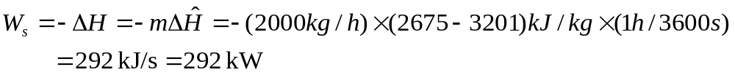
Solution
Interpolation (and Extrapolation) of steam table
29

Slide 30
7.6 Energy Balance Procedures
Solve material balance → Get all the flow rate of streams
Determine the specific enthalpies of each stream components
  Using tabulated data
  Calculation (using heat capacity, C_{p}(T), – Ch.8)
Construct energy balance equation and solve it.
30

Slide 31
Example 7.6-1
Two stream of water are mixed to form the feed to a boiler. Process data are as follows:
  Feed stream 1 : 120 kg/min @ 30 ºC
  Feed stream 2 : 175 kg/min @ 65 ºC
  Boiler pressure : 17 bar (absolute)
The exiting steam emerges from the boiler through a 6-cm ID pipe. Calculate the required heat input to the boiler in kJ/min if the emerging steam is saturated at the boiler pressure.
Neglect the kinetic energies of the liquid inlet streams.
31

Slide 32

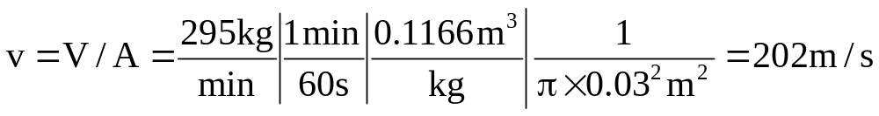
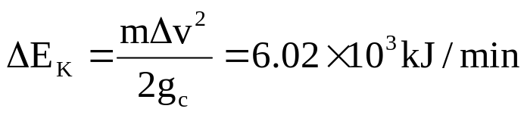
Solution
120 kg H2O/min
30 ºC H = 125.7 kJ/kg
295 kg H2O/min
175 kg H2O/min
17 bar, saturated steam (204 ºC)
H = 2793 kJ/kg (V = 0.1166m³)
6cm ID pipe
65 ºC H = 271.9 kJ/kg
Q kJ/min
32

Slide 33
Example 7.6-3 Material balance + Energy balance
Saturated steam at 1 atm is discharged from a turbine at a rate of 1150 kg/h. Superheated steam at 300 ºC and 1 atm is needed as a feed to a heat exchanger.
To produce it, the turbine discharge stream is mixed with superheated steam available from a second source at 400 ºC and 1 atm.
The mixing unit operates adiabatically.
Calculate the amount of superheated steam at 300 ºC produced and the required volumetric flow rate of the 400 ºC steam.
33

Slide 34
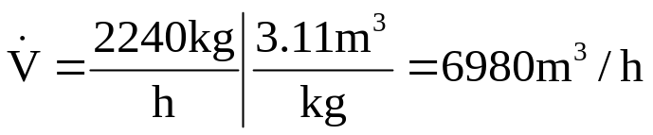
Solution
1150 kg H2O/hr
1 atm, sat (100 ºC)
H = 2676 kJ/kg
m2 (kg H2O/hr)
m1 (kg H2O/hr)
1 atm, 300 ºC
H = 3074 kJ/kg
1 atm, 400 ºC
H = 3278 kJ/kg
Material Balance
1150 + m₁ = m₂
Two equation
Two unknown
Energy Balance
1150×2676 + m₁×3278 = m₂×3074
m₁=2240 kg/h
m₂=339z0 kg/h
The specific volume of steam at 400 ºC and 1 atm is 3.11 m3/kg (Table B.7)
34

Slide 35


7.7 Mechanical Energy Balances
Chemical equipment (Reactor, Distillation column, Evaporator, Heat exchanger,…)
  Heat flow, internal energy changes (enthalpy change) are most important
  Shaft work, kinetic energy, potential energy changes are negligible
Mechanical equipment (Pump, Reservoir, Pipes, Wells, Tanks, Waste Discharge,…)
  Heat flow, internal energy changes are negligible
  Shaft work, kinetic energy, potential energy changes are most important
35

Slide 36

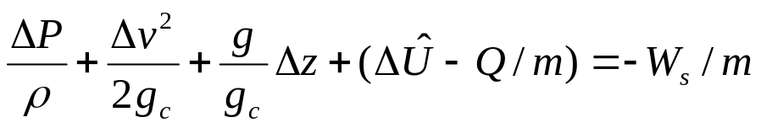

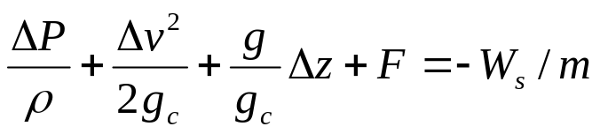

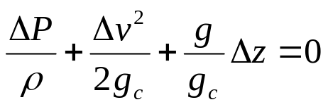
Mechanical Energy Balances
W= W_{fl} + W_{s}
W_{fl} = Δ(PV)
Bernoulli Equation
Important equation for the calculation
of equipments consist of pipes, tanks and pumps
equation 1
36

Slide 37
Example 7.7-1 The Bernoulli equation
Water flows through the system shown here at a rate of 20 l/min. Estimate the pressure required at point 1 if friction losses are negligible.
(2)
1 cm ID pipe
P2 = 1 atm
50 m
(1)
0.5 cm ID pipe
20 liter /min H2O
P1 = ?
37

Slide 38
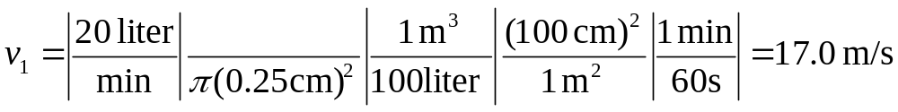


Solution
(2)
1 cm ID pipe
P2 = 1 atm
50 m
(1)
0.5 cm ID pipe
20 liter /min H2O
P1 = ?
38

Slide 39
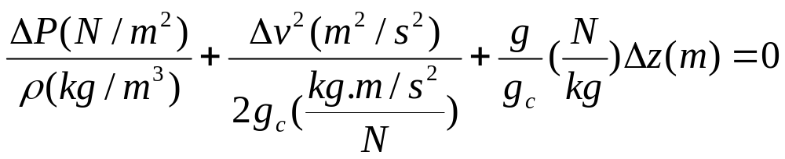
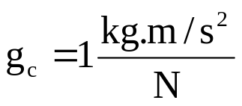


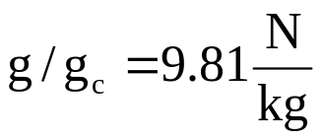

Solution
39

