Slide 1
STUDENT STUDY PLANNER
AWS Cloud Infrastructure & CI/CD Deployment Showcase
DevOps Capstone Project Presentation — Phase 5
Azubi Africa Capstone Team:
Edmund (GeekKwame)
Kwame Opoku
Priscilla
Winnifred
Esther
Infrastructure Lead
DevOps Engineer
DevOps Engineer
DevOps Engineer
DevOps Engineer

Slide 2
Problem & Solution Overview
THE ACADEMIC PROBLEM
OUR PURPOSE-BUILT SOLUTION
Academic Overload: Students juggle multiple courses, assignments, and study tasks without structured pathways.
Frictionless Task Management: Create tasks with key academic metadata (subjects, custom priorities, due dates).
Generic Tool Deficit: Existing general-purpose productivity apps lack academic context (priorities, subject tags).
Motivating Feedback Loop: Dynamic progress bars track completions; randomized motivational quotes refresh on load.
High Friction & Loss: Paper planners are easily lost; heavyweight digital tools have steep learning curves.
Resilient Client State: Client-side storage (localStorage) allows full offline usage with zero load latency.
AWS DevOps Capstone Project | Student Study Planner
{slide_num} / {slide_num}

Slide 3
Traffic Flow: Client to Web Origin
1
2
3
4
DNS & Edge
Load Balancing
Auto Scaling
EC2 & Nginx
Namecheap DNS routes apex and www requests. CloudFront CDN serves cached static assets globally at 400+ Edge locations, reducing latency.
CloudFront forwards cache misses to the Application Load Balancer (ALB). ALB terminates HTTP and runs health checks.
The ASG maintains a cluster (1-3 nodes) in private subnets, dynamically scaling up/down in response to traffic load.
EC2 t3.micro nodes running Nginx serve the core HTML, CSS, and JS web app files locally and securely.
AWS DevOps Capstone Project | Student Study Planner
{slide_num} / {slide_num}

Slide 4
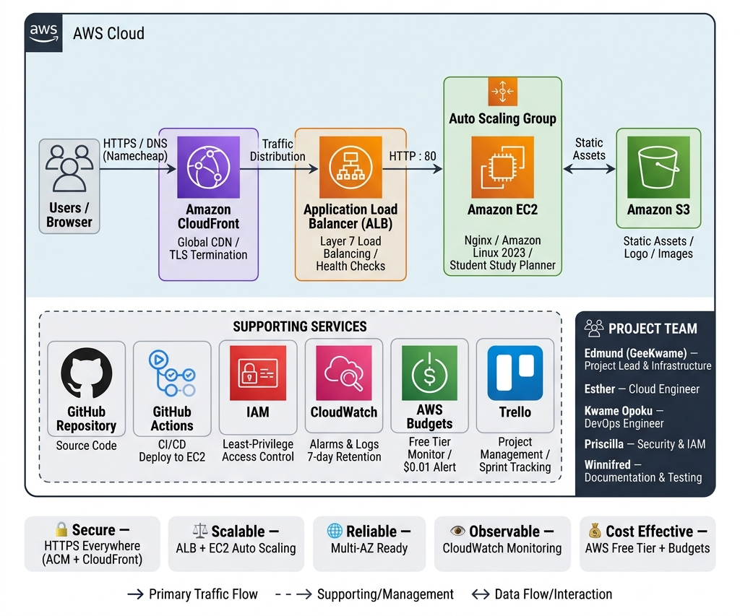
Infrastructure Architecture Diagram
AWS DevOps Capstone Project | Student Study Planner
{slide_num} / {slide_num}

Slide 5
Security Hardening & Decisions
Identity & Access Management (IAM)
Network Segregation
Group-based access control via AWS CloudCapstoneTeam group.
EC2 Security Groups restrict ingress strictly to HTTP/HTTPS.
Principle of least privilege: six scoped AWS-managed policies instead of root/administrator privileges.
SSH access is restricted to eddie-key.pem and not publicly open.
No programmatic credentials in source control; kept in local config.
Isolated target groups ensure only ALB can communicate directly with the backend nodes.
Transport Security
CI/CD & Observability Secrets
Enforced HTTPS across the entire network.
Deployment credentials stored securely as encrypted GitHub Secrets.
CloudFront handles HTTP -> HTTPS redirection automatically.
AWS Budgets Free-Tier alert at $0.01 prevents unexpected charges.
AWS Certificate Manager (ACM) provisions DNS-validated TLS certificates with automated renewals.
Nginx logs streamed to CloudWatch for active auditing and retention.
AWS DevOps Capstone Project | Student Study Planner
{slide_num} / {slide_num}

Slide 6
Continuous Integration & Deployment (CI/CD)
DEPLOYMENT PIPELINE FLOW
PIPELINE ADVANTAGES & SECURITY
1. Code Push: Developer pushes changes to the main branch.
Security-First
All deployment keys (SSH Private Key, Host IP, and Username) are stored encrypted in GitHub Secrets; no credentials ever touch the repository.
2. Pipeline Trigger: GitHub Actions runner reads .github/workflows/deploy.yml.
Zero Downtime
Nginx reloads its configuration dynamically in milliseconds, meaning active users experience no connection loss or server interruptions.
3. Remote SSH: Secure login to EC2 instance using appleboy/ssh-action.
Consistency & Reliability
4. Deploy Script: Runs git pull, copies files, checks nginx -t, and reloads Nginx.
Eliminates human error from manual file transfer processes. The server state matches the main branch state exactly after every run.
AWS DevOps Capstone Project | Student Study Planner
{slide_num} / {slide_num}

Slide 7
Project Management & Kanban Board
TRELLO KANBAN STRUCTURE
SPRINT PROGRESSION BY PHASE
Backlog: Planned tasks and configurations not yet started.
Phase 1: Setup & Foundation
Provisioned basic compute nodes (EC2), security roles (IAM), object storage (S3), and requested TLS certificate.
In Progress: Active development or deployment configurations in progress.
Phase 2: App & Compute Configuration
Configured Nginx web server, Application Load Balancer routing, Target Group health checks, and Auto Scaling templates.
Peer Review: Completed tasks waiting for review and approval by other team members.
Phase 3: CDN & Custom Domain Go-Live
Deployed CloudFront distribution, Namecheap DNS record routing, and HTTPS redirect verification.
Done: 100% completed tasks, verified, merged, and active on production environment.
Phase 4: Observation & CI/CD Pipeline
Wrote GitHub Actions workflow script, attached CloudWatch logs/alarms, and configured Budget monitoring limits.
AWS DevOps Capstone Project | Student Study Planner
{slide_num} / {slide_num}

Slide 8
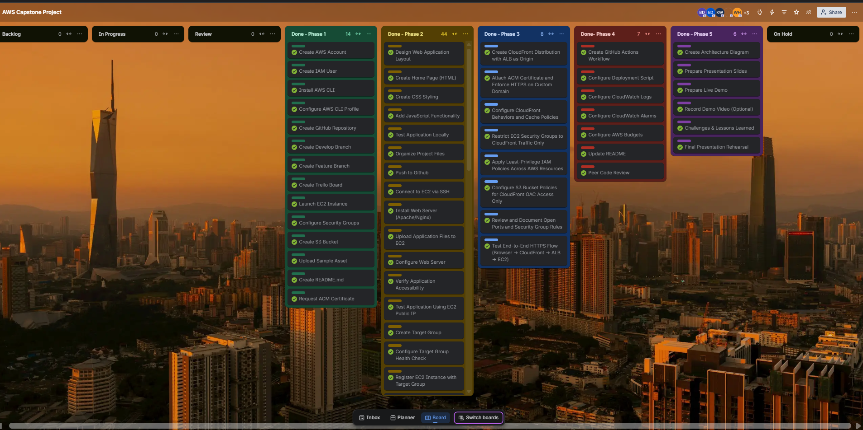
Trello Kanban Board Showcase
AWS DevOps Capstone Project | Student Study Planner
{slide_num} / {slide_num}

Slide 9
Live Application Demo
SECURE PRODUCTION DEPLOYMENT URL
https://www.studentstudyplannerxyz.xyz/
STEP-BY-STEP LIVE DEMO GUIDE
DEMO RESOURCES & METRICS
1. SSL/TLS Verification: Check lock icon in the browser address bar to show DNS-validated certificate (issued via AWS ACM).
🎥 DEMO RECORDING LINK
https://drive.google.com/file/d/1DXGpDX82FUIWEva6sP-sFRv0VPGFDekr/view?usp=sharing
2. Functional Testing: Enter study tasks with subjects, set urgency priorities, and specify academic due dates.
3. Dynamic Progress Indicator: Mark tasks complete to watch progress bar percentage increase in real time.
⚙️ PERFORMANCE SPECS
4. Local Storage Persistence: Refresh page or toggle offline mode to verify data remains saved on the client browser.
• Edge delivery: Served in under 50ms worldwide via CDN caching.
• Failover capability: Auto-scales across availability zones automatically.
• Scalability: ASG group configuration supports up to 300 active connections.
5. Headers Verification: Verify X-Cache: Hit from cloudfront header in DevTools network tab.
AWS DevOps Capstone Project | Student Study Planner
{slide_num} / {slide_num}

Slide 10
Challenges & Resolutions — DevOps & Server
1
GitHub Actions Workflow Parser Error
2
Starter Template Node.js Commands Failure
Root Cause: Indentation syntax bug: on: and jobs: definitions in deploy.yml had 3 leading spaces instead of 0 column boundary, which is invalid YAML syntax.
Root Cause: The default starter script attempted to run node-specific commands like npm install and pm2 restart on the server. However, our study planner application is a static site that only needs Nginx.
Resolution: Corrected indentation to meet standard YAML specifications (aligned jobs/on to root). Re-pushed and pipeline successfully initialized.
Resolution: Replaced node server logic in workflow script with git pull, file copy (cp), directory ownership adjustments (chown), Nginx syntax checks (nginx -t), and zero-downtime reloads.
3
CloudFront 502 Bad Gateway Origin Mismatch
4
EC2 Amazon Linux 2023 Base Lacks Git
Root Cause: CloudFront origin was configured to communicate with the ALB over HTTPS only. However, the ALB was configured with an HTTP listener on port 80, causing connection handshake failures.
Root Cause: Amazon Linux 2023 minimal AMI does not include a Git binary pre-installed. The initial GitHub actions runner failed to pull code from repository.
Resolution: Updated the CloudFront distribution origin protocol policy to HTTP-Only to match the ALB listener configuration. Traffic forwarded correctly.
Resolution: Manually logged into the EC2 host and executed sudo dnf install -y git. Performed initial clone, allowing subsequent SSH pulls to run automatically.
AWS DevOps Capstone Project | Student Study Planner
{slide_num} / {slide_num}

Slide 11
Challenges & Resolutions — DNS & Security
5
Domain Apex (@) Resolution Fail
6
ACM TLS Certificate Stuck in Pending
7
CloudFront Serving Cache Misses (X-Cache: Miss)
Root Cause:
Standard CNAME records cannot be attached directly to domain apex (studentstudyplannerxyz.xyz) according to DNS specs.
Root Cause:
DNS CNAME verification records provided by AWS ACM were not added to domain registrar settings, blocking verification.
Root Cause:
Distribution caching configuration was set to CachingDisabled policy during early debugging, preventing edge cache storage.
Resolution:
Configured an ALIAS record (mapping @ to CloudFront domain) using Namecheap Advanced DNS server settings.
Resolution:
Copied ACM-generated CNAME validation record names and values and added them to Namecheap DNS records. Issued in 5 minutes.
Resolution:
Adjusted default TTL and verified caching behaviors to ensure static assets store on CloudFront edge locations, while dynamic ALB bypasses.
AWS DevOps Capstone Project | Student Study Planner
{slide_num} / {slide_num}

Slide 12
Lessons & Future Enhancements
WHAT WORKED WELL
WHAT WE WOULD DO DIFFERENTLY
Layered AWS Architecture: Decoupling CDN, Application Load Balancer, and ASG compute nodes protected backend EC2 IPs and isolated layer configurations.
Infrastructure as Code (IaC): Transition from Console clicks to writing reusable and versioned Terraform or CloudFormation modules to spawn infrastructures.
Active Observability & Budget Guardrails: Budget alerting at $0.01 threshold gave our team high confidence to experiment without worrying about runaway AWS fees.
Containerization & Serverless: Host static app code files on S3 buckets or run compute nodes as AWS ECS Fargate tasks to completely avoid VM server maintenance.
CI/CD Pipeline Integration: GitHub Actions workflow automation successfully reduced code update deployment times from 5 minutes to under 30 seconds.
RDS Persistent Backend: Connect RDS (PostgreSQL) or DynamoDB tables to synchronize study planner tasks, replacing browser-isolated localStorage.
AWS DevOps Capstone Project | Student Study Planner
{slide_num} / {slide_num}

Slide 13
THANK YOU!
Questions & Discussion
PROJECT RESOURCES
GitHub Repository:
https://github.com/GeekKwame/aws-capstone-project
Live Deployment URL:
https://www.studentstudyplannerxyz.xyz/

