Slide 1

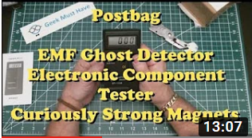
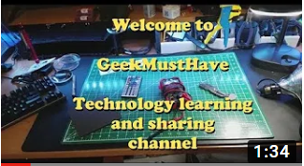


Video Catalog
Search
GMH-002 PostBag.MP4
Here are some goodies from China. Electromagnetic Radiation Detector, Electronic Computer identifier, and Neodymium magnets. This is my first video with “Charlotte” my overhead camera rig. Using a Logitech C630 webcam set at 720p. I am not happy with the quality of this video. I will be looking into alternative cameras, Special shout out to Julian Lett whose channel has been both educational and an inspiration for me to try something like it. Please visit and support his channel at https://www.youtube.com/user/julius2
Download
GMH-001 Introduction.MP4
This is the introduction to Geek and his channel about learning and building stuff. Technology of all flavors from the useful to the absurd. There is a companion blog at http://GeekMustHave.com. Please click on the Subscribe button, the Geek likes to be liked.
Download
<<
<
Page 1 of 12
>
>>

Slide 2
Content
Description
GMH-001 Introduction.txt
GMH-002 Postbag.txt
Thumbnail
GMH-001 Introduction.png
GMH-002 Postbag.png
Video
GMH-001 Introduction.png
GMH-002 Postbag.png

