Slide 1
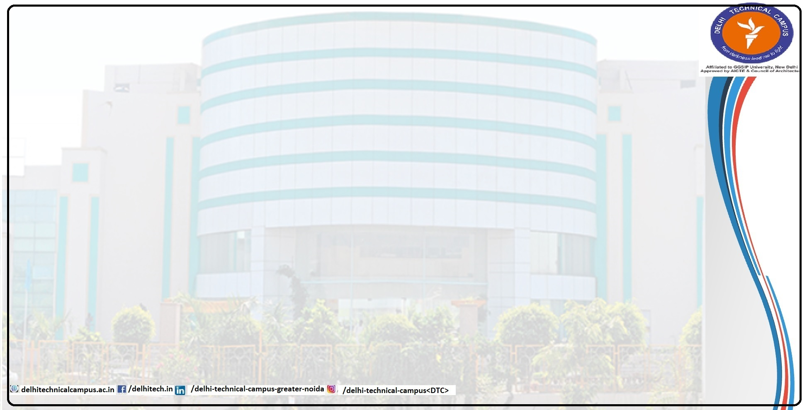
MedCureAI: Skin Disease Detection and Treatment Susceptibility
Presented By
Group No. 27
Atul (02918002720)
Sakshi Singh (09718002720)
Ayush Goel (03018002720)

Slide 2
Content
1. Introduction
  Problem Statement.
  Feasibility Study
  Need and Significance
  Objectives
2. Literature Survey
  Existing Theoretical and Methodological contributions to the proposed work.
  3.Design Analysis
  Flowchart, ER Diagram, Use case Diagram (if any)
4. Proposed Methodology
  Hardware and Software Requirements
  Proposed Model/ Methodology
  Scope of the project

Slide 3
Introduction
The biggest organ of the body is human skin. Its weight lies between six and nine pounds and surface area is about two square yards. Inner part of body is separated by skin from the outer environment. It provides protection against fungal infection, bacteria, allergy, viruses and controls temperature of body. Situations that frustrate, change texture of the skin, or damage the skin can produce symptoms like swelling, burning, redness and itching.
To get an improved image or to get meaningful information from an image, it is necessary to convert an image into digital form and then perform functions onto that image. It is a part of signal processing. The input is an image and it may be a video, a photograph and output is also another image having same characteristics as input image. Mostly Image Processing models take input samples as 2-D signals and after that they apply fixed signal processing methods to them.

Slide 4
Problem Statement

