Slide 1
</>
CodeCampus
A Full-Stack Online Coding & Assessment Platform
Practice • Proctored tests • Hiring • Plagiarism • Pattern-based Code Coach
React 19
Spring Boot 3.4
MySQL
JWT
Tailwind CSS
Java 21
Built by Adarsh Kumar | 2026

Slide 2
Table of Contents
Presentation Overview
01
Project Overview & Objectives
08
Data Seeding (problems.json)
02
Tech Stack — Frontend
09
Proctoring System & Anti-Cheating
03
Tech Stack — Backend & Database
10
Plagiarism Detection Engine
04
System Architecture & Flow Diagram
11
Coding Tests, Contests & Hiring
05
User Roles & Permissions (4 Roles)
12
Database Schema & Models
06
Role Access Matrix
13
Key API Endpoints
07
Code Execution Engine (Local, No API)
14
Features Summary

Slide 3
Project Overview
What is CodeCampus?
CodeCampus is a full-stack online coding platform designed for colleges and companies. It provides a LeetCode / GeeksForGeeks-style environment where students practice coding problems, teachers create & proctor exams, companies conduct hiring tests, and admins manage the entire system.
All code execution happens locally on the server using installed compilers (gcc, g++, javac, python, node) — no paid judge API required. Pattern-based Code Coach hints ship with every Run/Submit (no external LLM). Notifications on accepted submissions; Judge0 Docker path documented for future scale.
Practice
Assess
Secure
Integrity
190+ problems in C, C++,
Java, Python, JavaScript.
Monaco code editor.
Teachers & companies create
timed, proctored coding
tests with access codes.
Camera monitoring, tab
tracking, fullscreen lock,
copy-paste detection.
Plagiarism detection with
Jaccard, N-gram & LCS
algorithms (70% threshold).

Slide 4
Tech Stack — Frontend
Client-side technologies powering the UI
R
React 19
V
Vite 6
Component-based UI library for interactive, dynamic views
Lightning-fast dev server with hot module replacement
T
Tailwind CSS 3
M
Monaco Editor
Utility-first CSS framework for responsive, dark-theme design
VS Code’s code editor embedded in-browser (syntax highlighting, IntelliSense)
RR
React Router 7
Ax
Axios
Client-side routing with role-based ProtectedRoute component
HTTP client with JWT token interceptors for all API calls
Li
Lucide React
HT
React Hot Toast
Modern, consistent SVG icon library
Toast notification system for success/error/warning feedback

Slide 5
Tech Stack — Backend & Database
Server-side technologies
SB
Spring Boot 3.4
J
Java 21 (JDK 25)
Java framework: auto-config, embedded Tomcat, REST controllers
Modern Java with records, sealed classes, pattern matching
SS
Spring Security
JWT
JWT (jjwt 0.12.6)
Authentication & authorization framework with role-based access (RBAC)
Stateless token-based auth — HS256, 24-hour expiry
JPA
Spring Data JPA
DB
MySQL 8+
ORM layer (Hibernate) for entity mapping & repository pattern
Production relational database (H2 in-memory for development)
Mv
Maven 3.9
Jk
Jackson
Build tool & dependency management via pom.xml
JSON serialization — parses problems.json for data seeding

Slide 6
System Architecture & Flow Diagram
End-to-end request lifecycle
🌐 Browser (Client)
⚙ REST API Layer
🔧 Service Layer
🗄 Database Layer
React 19 + Vite
Tailwind CSS
Monaco Editor
Axios + JWT Token
Port: 5173
AuthController
CodeController
TestController
QuestionController
Admin / Company / Proctoring
AuthService
CodeExecutionService
CodingTestService
PlagiarismService
ProctoringService
MySQL 8+ / H2
Spring Data JPA
Hibernate ORM
8 Entity Tables
Port: 3306
Request Flow: How a Code Submission Works
1
2
3
4
5
6
7
8
User writes
code in Monaco
Editor
›
Click "Run" sends
POST /api/code
+ JWT header
›
JwtFilter
validates token
& loads user
›
CodeController
calls
CodeExecutionService
›
Code written to
temp file,
compiled locally
›
Run against
all test cases,
compare output
›
Save Submission
to DB with
score & status
›
JSON response
returned to
React UI

Slide 7
User Roles & Permissions
4 distinct roles with different capabilities
ADMIN
TEACHER
STUDENT
COMPANY
admin / admin123
teacher / teacher123
student / student123
company / company123
▸ Full platform control & monitoring
▸ View all users, questions, tests, submissions
▸ Change user roles (promote / demote)
▸ Enable / disable user accounts
▸ Dashboard: total users, questions, tests stats
▸ Access teacher & company dashboards
▸ Create questions & tests
▸ Create coding questions with test cases
▸ Create & publish timed coding tests
▸ Configure proctoring (camera, tabs, fullscreen)
▸ View student submissions & scores
▸ Run plagiarism checks on test submissions
▸ View proctoring reports & trust scores
▸ Manage leaderboards for tests
▸ Browse & solve 190+ coding problems
▸ Use online compiler (5 languages)
▸ Take timed, proctored coding tests
▸ View personal dashboard & progress
▸ Track progress with study plans
▸ View leaderboard & rankings
▸ Edit profile (bio, social links, avatar)
▸ Create hiring tests for recruitment
▸ Create custom coding questions
▸ View candidate results & rankings
▸ Auto-shortlist candidates (≥ 60% score)
▸ Run plagiarism checks on submissions
▸ View proctoring reports for candidates
▸ Company branding on test pages

Slide 8
Role Access Matrix
Who can access what — at a glance
Feature
Admin
Teacher
Student
Company
Solve Problems / Practice
✓
✓
✓
✗
Online Compiler (5 Languages)
✓
✓
✓
✗
Study Plans
✓
✓
✓
✗
Take Coding Tests
✓
✓
✓
✗
Create Questions
✓
✓
✗
✓
Create / Publish Tests
✓
✓
✗
✗
Create Hiring Tests
✗
✗
✗
✓
View Student Submissions
✓
✓
✗
✗
Proctoring Reports
✓
✓
✗
✓
Plagiarism Detection
✓
✓
✗
✓
Manage Users
✓
✗
✗
✗
View Candidate Results
✓
✗
✗
✓
Change User Roles
✓
✗
✗
✗
Dashboard Analytics
✓
✓
✓
✓

Slide 9
Code Execution Engine
100% local execution — no external API used
⚠ IMPORTANT: CodeCampus does NOT use any external compiler API (Judge0, Sphere Engine, etc.). All code compilation and execution happens locally on the server machine using installed compilers (gcc, g++, javac, python, node). Code is written to temp directory, compiled, executed against test cases, and cleaned up.
1
2
3
4
5
Receive
Code
→
Write to
Temp File
→
Compile
Code
→
Run Against
Test Cases
→
Score &
Save
Frontend sends code,
language, question ID
via POST request
Code written to temp
directory as Main.java,
Main.py, etc.
gcc / g++ / javac
compiles the code.
Python & JS skip.
Execute with each input,
compare stdout with
expected output.
Calculate pass ratio,
save Submission entity
to database.
Supported Languages:
C — gcc
C++ — g++
Java — javac + java
Python — python3
JavaScript — node

Slide 10
Data Seeding — Where Do Problems Come From?
Pre-loaded from a local JSON file, not an external API
All 190+ coding problems are stored locally in: server/src/main/resources/problems.json (29,576 lines)
On server startup, DataInitializer → ProblemSeeder reads this JSON file using Jackson ObjectMapper and inserts each problem (with title, description, tags, difficulty, test cases) into the database.
No external API is called. Data is also NOT scraped — it is hand-curated in the JSON file.
problems.json
ProblemSeeder.java
DataInitializer.java
MySQL Database
29,576 lines of JSON data
190+ curated problems
Easy / Medium / Hard
5-15 test cases each
Reads JSON via Jackson
Parses title, desc, tags
Creates Question entities
Maps TestCase objects
Runs on app startup
(CommandLineRunner)
Seeds users + problems
Skips if already seeded
questions table
test_cases table
question_tags table
Ready for students!
→
→
→
Each problem includes: title, description, input/output format, constraints, difficulty, tags, sample I/O, explanation, and hidden test cases.

Slide 11
Proctoring System & Anti-Cheating
Real-time exam monitoring built into the platform
Camera Monitoring
Tab Switch Tracking
Fullscreen Lock
Copy-Paste Detection
Webcam captures periodic snapshots
via browser MediaDevices API.
Detects: no face, multiple faces,
camera blocked.
Tracks visibility changes using
visibilitychange API. After max
switches (default 3), test auto-submits.
Forces fullscreen mode via
Fullscreen API. Logs every exit.
Warning modal on exit.
Detects copy, paste, and
right-click events. All events
logged to ProctoringLog table.
Trust Score Calculation
All Proctoring Event Types
▸ Base Score: 100 points
▸ Tab Switch: −10 points each
▸ Fullscreen Exit: −15 points each
▸ Copy/Paste Detected: −20 points each
▸ Minimum Score: 0 points
▸ TEST_STARTED, TEST_SUBMITTED
▸ TAB_SWITCH, FULLSCREEN_EXIT
▸ CAMERA_SNAPSHOT, CAMERA_BLOCKED
▸ COPY_PASTE_DETECTED, RIGHT_CLICK_DETECTED
▸ MULTIPLE_FACES, NO_FACE, SUSPICIOUS_ACTIVITY, AUTO_SUBMITTED

Slide 12
Plagiarism Detection Engine
Automated code similarity analysis — fully built in-house
Compares every pair of submissions for the same question within a test. Code is normalized (comments, strings, whitespace removed), then analyzed using 3 algorithms. Threshold: 70% similarity flags a PlagiarismReport. Teachers and companies can review and confirm or dismiss flagged reports.
40%
30%
30%
Jaccard Similarity
N-gram Similarity
LCS Ratio
Compares unique tokens (identifiers,
keywords) between two code files.
Intersection / Union of token sets.
Weight: 40% of final score.
Generates 3-character n-grams from
normalized code. Computes Jaccard
similarity on n-gram sets.
Weight: 30% of final score.
Longest Common Subsequence between
two code strings. Ratio = LCS length /
max(len1, len2). Capped at 2000 chars.
Weight: 30% of final score.
Flow: Normalize code → Remove comments/strings → Tokenize → Run 3 algorithms → Weighted avg → Flag if ≥ 70% → Save PlagiarismReport

Slide 13
Coding Tests, Contests & Hiring Tests
Three types of assessments on one platform
COLLEGE Test
CONTEST / Practice
HIRING Test
Created by teachers for classroom
assessments. Timed with start/end.
Proctoring configurable. Questions
from the question bank.
Access code for enrollment.
Competitive coding contests or
practice tests. Leaderboard-based
ranking. Open to all students.
Real-time score tracking.
Created by companies for recruitment.
Includes job role, experience level.
Candidate results with auto-shortlisting
(≥ 60% score). Company branding.
Common Test Features:
▸ Configurable duration, start time, end time
▸ Access code protection for private tests
▸ Question weightage (custom marks per question)
▸ Real-time leaderboard with ranking by score
▸ Auto-submit on tab limit violation
▸ Test completion tracking (prevents re-submission)

Slide 14
Database Schema & Models
8 JPA Entities mapped to MySQL tables
User
Question
TestCase
Submission
id, username, password, fullName,
email, role, department,
enrollmentNumber, profileImage,
bio, social links, company fields
id, title, description,
inputFormat, outputFormat,
constraints, difficulty, tags,
sampleI/O, timeLimit, memoryLimit
id, input, expectedOutput,
isSample, isHidden,
question (FK)
id, user, question, codingTest,
code, language, status,
testCasesPassed, score,
executionTimeMs
CodingTest
ProctoringLog
PlagiarismReport
TestCompletion
id, title, description,
startTime, endTime, duration,
proctoringSettings, testType,
accessCode, totalMarks
id, user, codingTest,
eventType, details, snapshot,
flagged, tabSwitchCount,
timestamp
id, codingTest, question,
submission1, submission2,
user1, user2, similarity%,
matchedTokens, status
id, user, codingTest,
totalQuestions, questionsAttempted,
questionsAccepted, totalScore,
completedAt

Slide 15
Key REST API Endpoints
Spring Boot controllers exposing RESTful APIs
Auth API
Code Execution
Questions
/api/auth
/api/code
/api/questions
▸ POST /login — Authenticate & get JWT token
▸ POST /register — Create new user account
▸ POST /execute — Run / samples (optional reviewQuestionId)
▸ POST /submit — Full judge + score + codeReview hints
▸ GET /submissions/{qId} — History
▸ GET / — List all questions (filterable)
▸ GET /{id} — Get question by ID
▸ POST / — Create question (Teacher/Admin/Company)
Tests & Contests
Admin
Company
/api/tests
/api/admin
/api/company
▸ GET /active — Get currently active tests
▸ POST / — Create test
▸ GET /{id}/leaderboard — Real-time leaderboard
▸ POST /{id}/submit — Final test submission
▸ GET /dashboard — Platform statistics
▸ GET /users — All users list
▸ PUT /users/{id}/role — Change role
▸ PUT /users/{id}/toggle — Enable/disable
▸ POST /hiring-test — Create hiring test
▸ GET /hiring-test/{id}/candidates — View results
▸ GET /dashboard — Company analytics

Slide 16
Key Features Summary
Everything CodeCampus offers at a glance
</> Online Compiler
Code Coach (pattern hints)
190+ Coding Problems
Write & run code in 5 languages with Monaco Editor
Deterministic hints after Run/Submit — complexity, edge cases, TLE
Pre-seeded from problems.json with hidden test cases
Proctored Exams
Plagiarism Detection
4 User Roles
Camera, tab tracking, fullscreen, copy-paste detection
Jaccard + N-gram + LCS algorithms (70% threshold)
Admin, Teacher, Student, Company with RBAC
Hiring Tests
Real-time Leaderboard
Study Plans
Companies create tests, view results, shortlist candidates
Live ranking during contests and tests
Curated learning paths loaded from studyplans.json
JWT Authentication
Dark Theme UI
Profile System
Stateless, secure auth with Spring Security
Modern, responsive UI with Tailwind CSS
Social links, bio, profile image, university info
Local Execution
No external API — gcc / javac / python / node on server

Slide 17
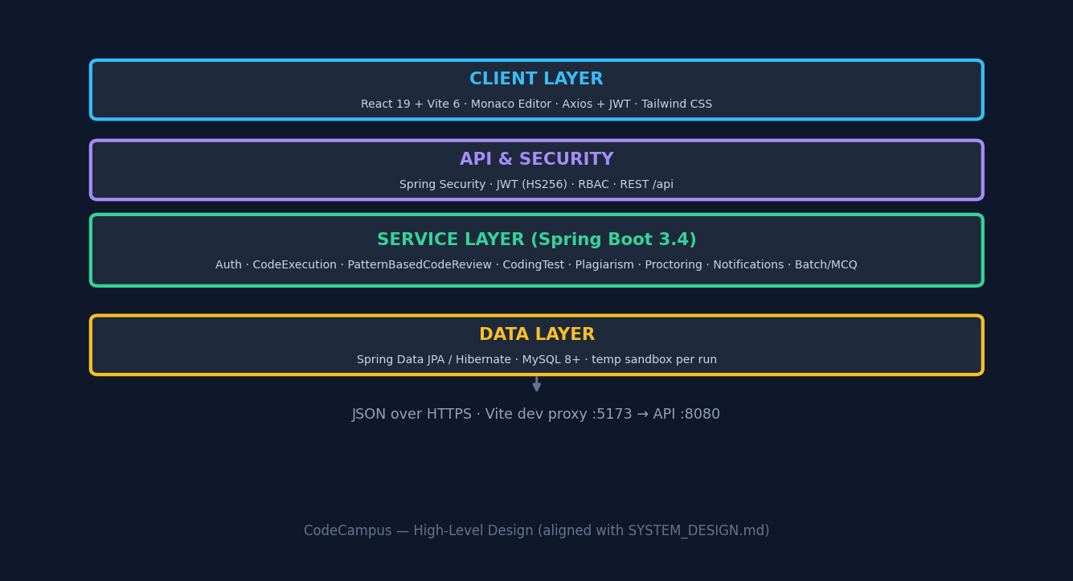
High-Level Design (HLD)
Layered architecture — SYSTEM_DESIGN.md §1
End-to-end: Browser → JWT-secured REST → services (including PatternBasedCodeReview) → JPA → MySQL.

Slide 18
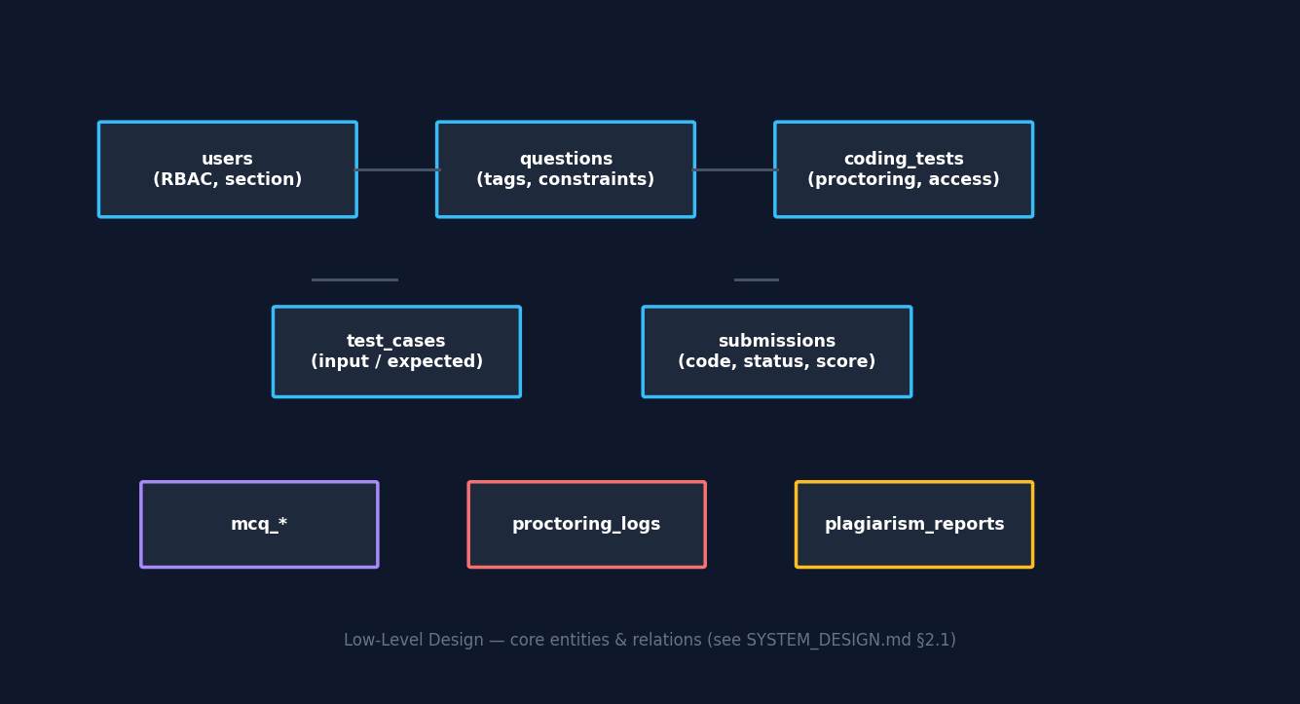
Low-Level Design (LLD)
Data model & components — SYSTEM_DESIGN.md §2
▸ API surface: Auth, Code, Questions, Tests, MCQ, Batch/Section, Admin, Company, Proctoring, Plagiarism
▸ Security: JWT claims (sub, role, userId) · BCrypt passwords · @PreAuthorize RBAC
▸ Indexes on users & submissions for scale — see SYSTEM_DESIGN §2.8

Slide 19
Code Execution & Code Coach
Submit / Run flow + pattern-based review (no external LLM)
▸ Submit: POST /api/code/submit with questionId → all hidden cases → Submission saved → codeReview[] in JSON
▸ Run: POST /api/code/execute + reviewQuestionId → single stdin run → hints use problem tags without judging hidden tests
▸ PatternBasedCodeReviewService: nested loops / TLE / WA / compile & runtime errors · graded vs sample wording
Execution sandbox (SYSTEM_DESIGN §2.5)
Temp dir per run (codecampus_*) · gcc / g++ / javac / python / node · timeout configurable
Optional upgrade path: Judge0 Docker (hooks already noted in CodeExecutionService)
Future: isolated containers per submission, cgroup memory/CPU limits

Slide 20
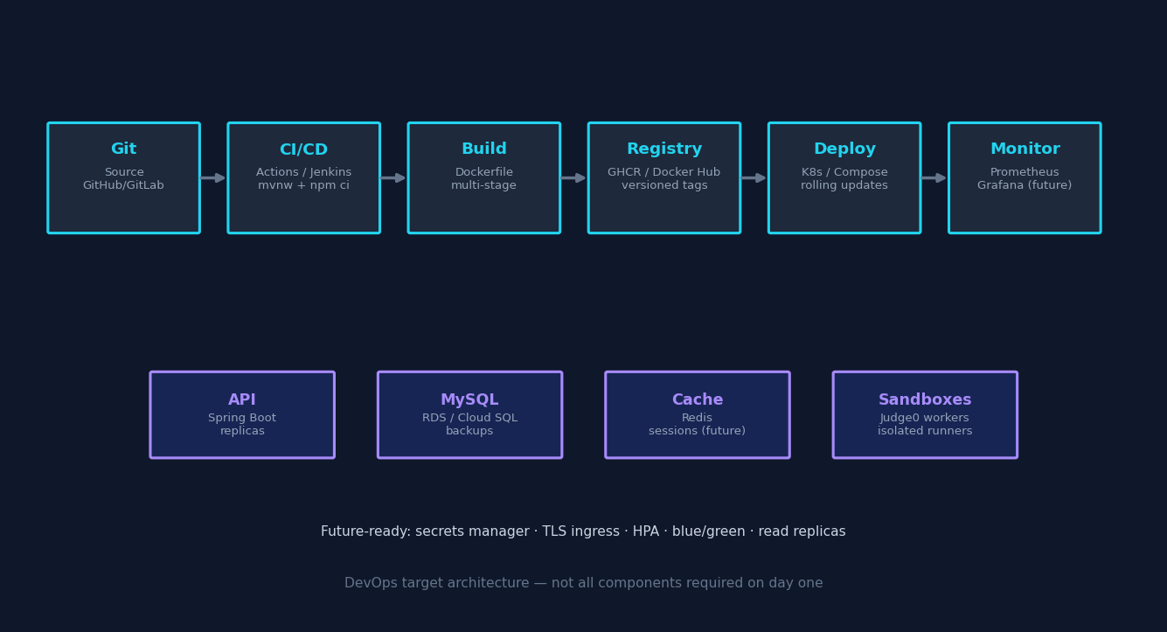
DevOps — Future-Ready Architecture
CI/CD, containers, and production scale-out
▸ Today: single VM or laptop — JAR + static build + local MySQL
▸ Next: pipeline builds immutable images; secrets via vault; health checks + rolling deploy
▸ Scale: stateless API replicas; connection pooling; optional Redis; Judge0 worker pool for code runs

