Slide 1
Secure data hiding in image using steganography
CAPSTONE PROJECT
Presented By:
Student Name : Shubham Sharad Kshirsagar
College Name & Department : Rajarambapu Institute Of Technology, Rajaramnagar (Diploma in Computer Engineering)

Slide 2
OUTLINE
Problem Statement
Technology used
Wow factor
End users
Result
Conclusion
Git-hub Link
Future scope

Slide 3
Problem Statement
The project "Secure Data Hiding in Image Using Steganography" aims to develop a method for embedding sensitive information, such as text or files, into digital images in a way that ensures confidentiality and protection from unauthorized access. By utilizing steganographic techniques, the project will explore efficient algorithms for concealing data within an image's pixels while maintaining the image's visual quality. The system will incorporate encryption methods to enhance security, ensuring that the hidden data remains inaccessible to anyone without the proper decryption key. This project will contribute to secure communication and data storage, particularly in scenarios where privacy is crucial.

Slide 4
Technology used
Steganography
Python Programming Language
Libraries: cv2(OpenCV), os, string
Visual Studio Code
Github

Slide 5
Wow factors
Steganography and Encryption: Combines data hiding with password protection for added security.
Pixel-Level Embedding: Preserves image quality while concealing the message.
Password-Based Decryption: Ensures only authorized access to the hidden data.
User-Friendliness: Simple interface for easy message hiding and retrieval.
Practical Application: Useful for secure communication and data storage.

Slide 6
End users
Privacy-Conscious Individuals: People looking to securely hide sensitive information.
Businesses and Organizations: Companies needing secure data transfer and storage.
Government and Law Enforcement: Agencies requiring secure communication and data protection.
Cybersecurity Professionals: Experts in safeguarding data and preventing unauthorized access.
Digital Forensics Investigators: Professionals detecting hidden data in digital images for investigations.

Slide 7
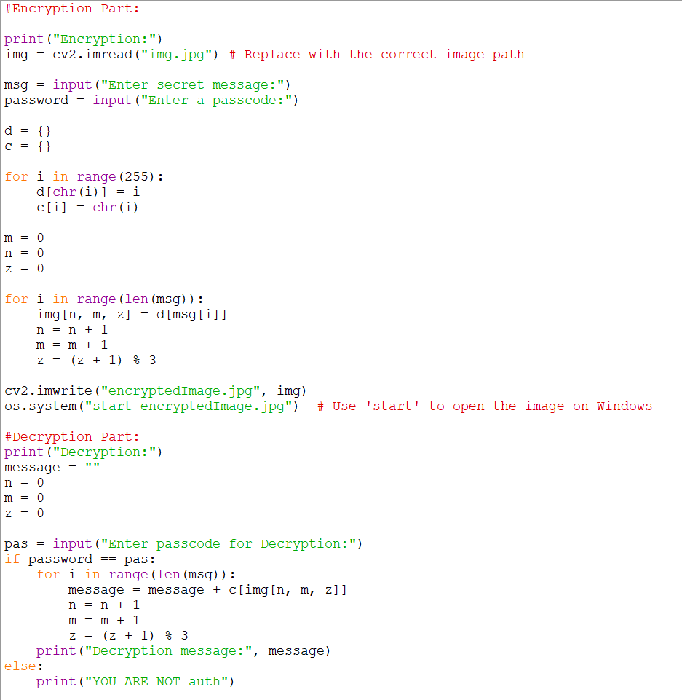
Results

Slide 8
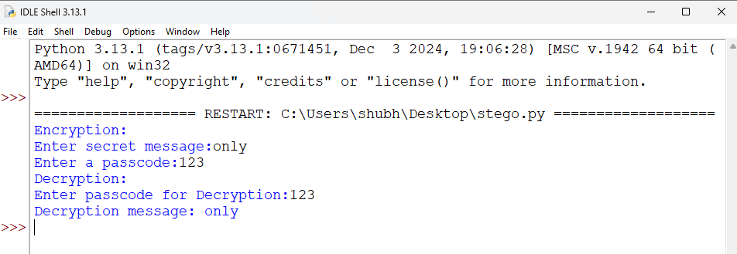

Slide 9
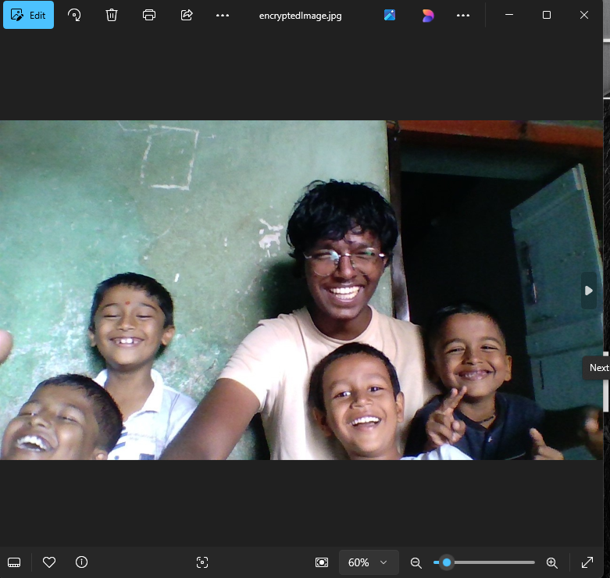

Slide 10
Conclusion
In conclusion, the "Secure Data Hiding in Image Using Steganography" project successfully combines steganography and encryption to offer a secure and efficient method for embedding confidential information within images. By maintaining image quality and implementing password-based decryption, it ensures that hidden messages remain protected from unauthorized access. This project provides a practical solution for secure communication, data storage, and privacy protection, making it valuable for individuals, businesses, and organizations concerned with safeguarding sensitive data in digital form.

Slide 11
GitHub Link
https://github.com/GeeksShubh/Steganography.git

Slide 12
THANK YOU

