Slide 1
ALL
ABOUT ARRAYS

Slide 2
Arrays
What is an Array?
An array is a collection of elements of the same data type stored in contiguous memory locations. Instead of declaring multiple variables, an array allows storing multiple values under a single variable name.
Why Use Arrays?
✔ Efficient storage: Stores multiple elements of the same type together. ✔ Easy access: Elements can be accessed using an index. ✔ Better memory management: No need to declare multiple variables.

Slide 3
Arrays
Advantages of Arrays
✅ Random Access: Elements can be accessed in constant time O(1). ✅ Better Memory Utilization: Uses contiguous memory allocation. ✅ Efficient Data Manipulation: Suitable for sorting, searching, and other operations.
Limitations of Arrays
❌ Fixed Size: Size must be defined at compile-time. ❌ Insertion/Deletion Overhead: Shifting elements is costly. ❌ Wastage of Memory: If size is too large, unused memory is wasted.

Slide 4
Linear Search

Slide 5
Binary Search
Binary Search is an efficient searching algorithm that finds an element in a sorted array by repeatedly dividing the search range in half.
Algorithm
Find the middle element mid = (low + high) / 2.
If arr[mid] == key, return the index.
If arr[mid] > key, search the left half (low to mid-1).
If arr[mid] < key, search the right half (mid+1 to high).
Repeat until low > high, meaning the element is not found.

Slide 6
SORTING

Slide 7
Bubble Sort
Sorting is the process of arranging elements in a specific order (ascending or descending). Let's discuss Bubble Sort, Selection Sort, and Insertion Sort, with their explanations and C++ implementations.
Bubble Sort
Bubble Sort repeatedly swaps adjacent elements if they are in the wrong order. The largest element "bubbles up" to the end in each pass.
Algorithm
Compare adjacent elements.
Swap them if they are in the wrong order.
Repeat until the array is sorted.

Slide 8
Selection Sort
Selection Sort repeatedly selects the smallest element from the unsorted part and swaps it with the first unsorted element.
Algorithm
Find the minimum element in the unsorted part.
Swap it with the first unsorted element.
Move the boundary of the sorted part one step right.

Slide 9
Insertion Sort
Insertion Sort builds the sorted array one element at a time by inserting each new element into its correct position.
Algorithm
Start from the second element (arr[1]).
Compare it with elements before it.
Shift larger elements to the right.
Insert the selected element at the correct position.
Repeat for all elements.

Slide 10
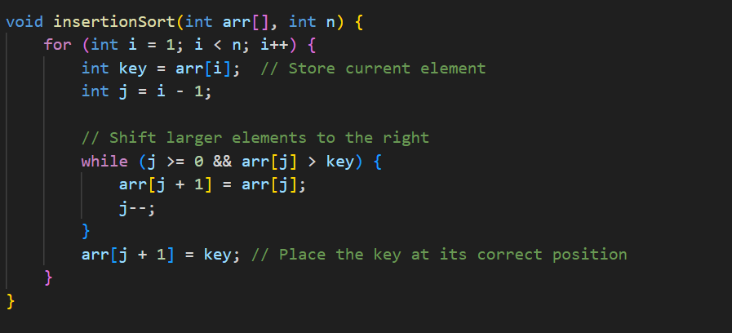

Slide 11
2D Arrays

Slide 12
Time Complexity

