Slide 1
What is JavaScript
High-level, interpreted language – runs directly in the browser without compilation.
Single-threaded – uses a single call stack to execute code.
Synchronous by default – but supports asynchronous programming using callbacks, promises, and async/await.
Dynamically typed – variable types are determined at runtime (no need to specify int, string, etc.).
Multi-paradigm – supports procedural, object-oriented, and functional programming.
Event-driven – uses an event loop to handle asynchronous tasks (setTimeout, fetch, etc.).
Prototype-based – inheritance is implemented using prototypes instead of classical classes (though ES6 classes exist syntactically).
Interpreted by JS engines – like V8 (Chrome/Node.js), SpiderMonkey (Firefox).
Loosely typed – allows implicit type conversions (type coercion).

Slide 2
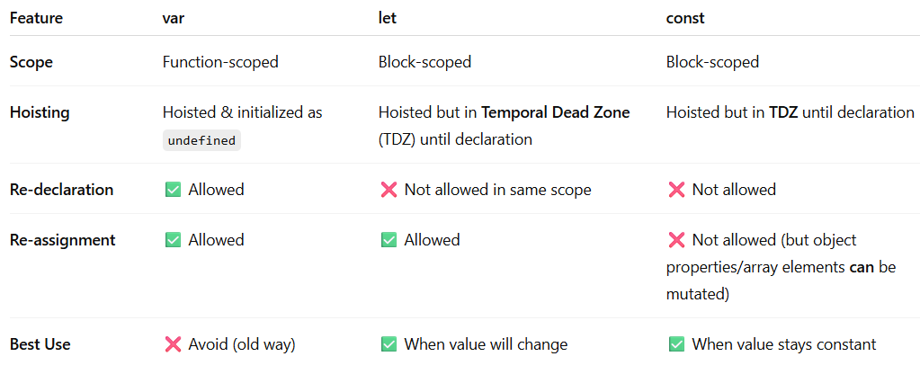
comparison of var, let, and const

Slide 3
Code Example
//Scope
if (true) {
var a = 10; // function scoped
let b = 20; // block scoped
const c = 30; // block scoped
}
console.log(a); // ✅ 10
// console.log(b); ❌ ReferenceError
// console.log(c); ❌ ReferenceError
Re-declaration
var x = 5;
var x = 10; // ✅ Allowed
console.log(x); // 10
// let y = 5;
// let y = 10; ❌ SyntaxError (cannot redeclare in same scope)
//Same for const as it also a block scope variable
Re-assignment
let z = 100;
z = 200; // ✅ Allowed
const PI = 3.14;
// PI = 3.1415; ❌ TypeError (cannot reassign const)
// 4️⃣ Mutating const object/array
const user = { name: "Alice" };
user.name = "Bob"; // ✅ Allowed (property can change)
console.log(user.name); // Bob

Slide 4
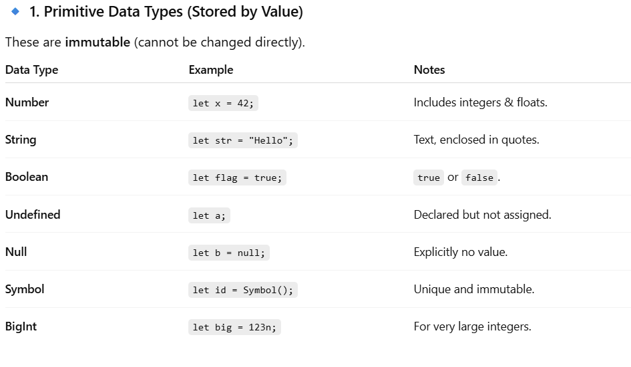
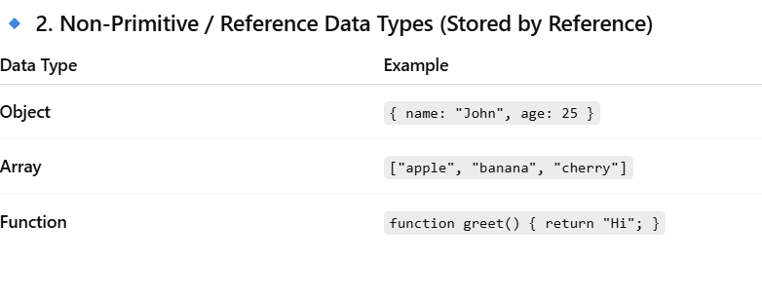
JavaScript Data Types

Slide 5
Important Interview Points
Primitive → copied by value
Objects/Arrays/Functions → copied by reference
typeof null → returns "object" (famous tricky question)
typeof NaN → returns "number"
JS is dynamically typed → variable type can change at runtime.
console.log(typeof NaN); // "number"
console.log(NaN == NaN); // false

Slide 6
Hoisting in JavaScript
Hoisting is JavaScript’s default behavior of moving declarations to the top of their scope (memory allocation phase) before code execution.
This applies to variables and functions, but works differently for each.
Key Points
Function Declarations are fully hoisted (can be called before they are defined).
var variables are hoisted but initialized with undefined.
let and const are hoisted but kept in the Temporal Dead Zone (TDZ) until their line of declaration.
Function Expressions and Arrow Functions are treated like variables (hoisted but not initialized).

Slide 7
Code Examples
// Function Hoisting
sayHello(); // ✅ Works, function is hoisted
function sayHello() {
console.log("Hello, World!");
}
//Variable Hoisting with var
console.log(a); // ✅ undefined (hoisted but not initialized)
var a = 10;
console.log(a); // 10
// Hoisting with let / const (TDZ)
// console.log(b); ❌ ReferenceError (TDZ)
let b = 20;
console.log(b); // 20
// console.log(c); ❌ ReferenceError (TDZ)
const c = 30;
console.log(c); // 30
//Function Expression & Arrow Function
// greet(); ❌ TypeError (greet is undefined at this point)
var greet = function () {
console.log("Hi!");
};
greet(); // ✅ Works after definition
The Temporal Dead Zone is the time between when a variable is hoisted and when it is actually declared in the code, during which you cannot access it — or you’ll get a ReferenceError.

Slide 8
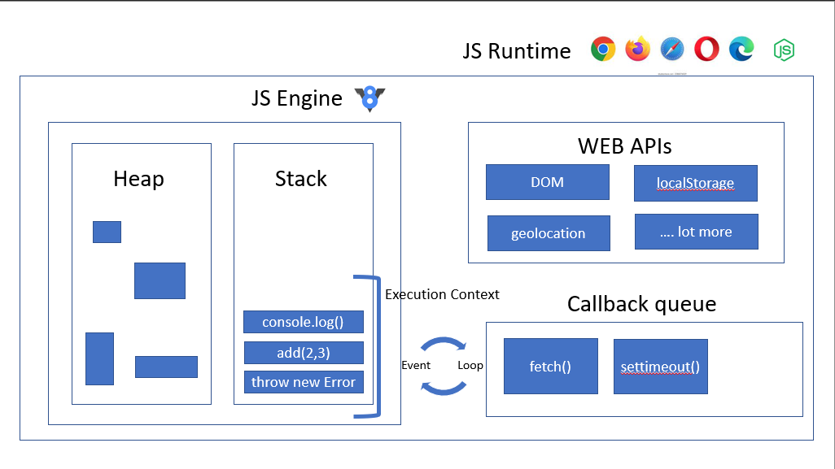
visual representation of the JavaScript Runtime Environment

Slide 9
Explanation of the above Image
2. Web APIs (Right Side)
Provided by the browser (or Node.js), not by JS itself.
Examples: DOM, setTimeout, fetch, localStorage, geolocation.
Main Parts
JS Engine (Left Side) Heap – A place where objects and functions are stored in memory. Stack (Call Stack) – Keeps track of what function is currently running. -> Functions are added here when they are called.
-> Removed when they finish executing. -> Works like a stack of plates (LIFO – last in, first out).
3. Callback Queue (Bottom Right)
Stores callbacks (functions) that are ready to run after Web APIs finish their work.
Example: After setTimeout() finishes waiting, its callback goes here.
4. Event Loop (Middle)
The event loop keeps checking:
“Is the call stack empty?”
If yes, it takes the first callback from the Callback Queue and puts it on the Call Stack to execute.
This is what makes JS asynchronous but non-blocking.

Slide 10
Step-by-Step Example
Easy Analogy
Think of:
Call Stack = Kitchen counter where dishes (functions) are cooked one by one.
Web APIs = Extra helpers doing background tasks (boiling water, baking).
Callback Queue = Wait line for dishes that are ready to be served.
Event Loop = Waiter who serves dishes only when counter is free.
console.log("Start");
setTimeout(() => console.log("Timer Done"), 2000);
console.log("End");
How it runs:
console.log("Start") → goes to Call Stack → runs → removed.
setTimeout() → sent to Web APIs → waits 2 sec → callback moves to Callback Queue.
console.log("End") → runs immediately.
After Call Stack is empty, Event Loop takes callback from Queue → runs → prints "Timer Done".

Slide 11
Objects in JavaScript
Definition: An object is a collection of key-value pairs (properties + methods).
Data Type: Objects are non-primitive and stored in heap memory (reference type).
Key-Value Structure:
Keys are always strings (or Symbols).
Values can be anything: number, string, function, array, or even another object.
Dynamic Nature: You can add, update, or delete properties at runtime.
Methods: Functions inside objects are called methods.
Access: Properties can be accessed using dot notation (obj.key) or bracket notation (obj["key"]).
Iteration: Can be iterated with for...in, Object.keys(), Object.values(), Object.entries().
Shallow vs Deep Copy: Objects are copied by reference, not by value.

Slide 12
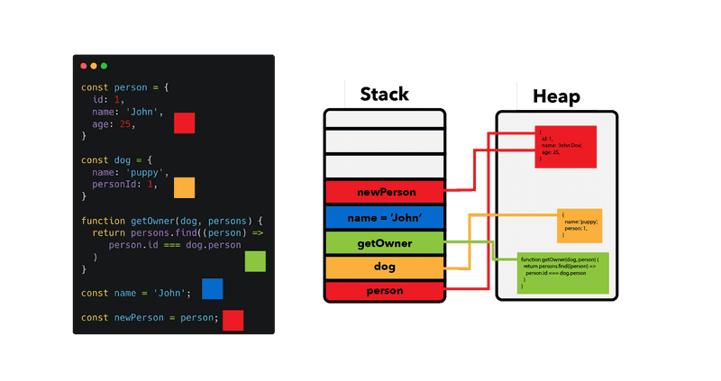
Code Examples on Objects
// Creating & Accessing an Object
const person = {
name: "Alice",
age: 25,
greet: function () {
console.log(`Hello, my name is ${this.name}`);
},
};
console.log(person.name); // Dot notation → Alice
console.log(person["age"]); // Bracket notation → 25
person.greet(); // Method → "Hello, my name is Alice"

Slide 13
Code Examples on Objects
// Adding / Updating / Deleting Properties
person.city = "Delhi"; // Add new property
person.age = 26; // Update property
delete person.city; // Delete property
console.log(person);
// Copying Objects
const obj1 = { a: 1 };
const obj2 = obj1; // Reference copy (both point to same memory)
obj2.a = 10;
console.log(obj1.a); // 10 (changes reflect in both)
const clone = { ...obj1 }; // Spread operator → creates a shallow copy
// Iterating Over an Object
for (let key in person) {
console.log(key, person[key]);
}

Slide 14
Arrays in JavaScript
Definition: Arrays are ordered collections of values (elements).
Data Type: Non-primitive, stored in heap memory.
Indexing: Zero-based (first element is at index 0).
Heterogeneous: Can store mixed data types in a single array.
Dynamic: Size can grow/shrink dynamically.
Access: Elements are accessed using their index (arr[0]).

Slide 15
Code Example on Arrays
// Adding / Removing Elements
const arr = [1, 2, 3];
arr.push(4); // ➕ Adds at end → [1, 2, 3, 4]
arr.pop(); // ➖ Removes from end → [1, 2, 3]
arr.unshift(0); // ➕ Adds at start → [0, 1, 2, 3]
arr.shift(); // ➖ Removes from start → [1, 2, 3]
// Creating Arrays
-> Creating an array using array literal syntax
const numbers = [1, 2, 3, 4];
-> Creating an array using the Array constructor
const fruits = new Array("Apple", "Mango", "Banana");
-> 'numbers' holds numeric values, while 'fruits' holds strings (fruit names)
// Searching
const fruits = ["Apple", "Mango", "Banana"];
console.log(fruits.indexOf("Mango")); // 1 (returns index)
console.log(fruits.includes("Banana")); // true (boolean check)
// Iterating
numbers.forEach(num => console.log(num)); // prints each element

Slide 16
Important Methods of Arrays
const numbers = [1, 2, 3, 4, 5];
/*
map() → Used to transform each element of the array
without changing the original array.
It returns a NEW array of the same length.
*/
const double = numbers.map(num => num * 2); // [2, 4, 6, 8, 10]
const numbers = [1, 2, 3, 4, 5];
/*
filter() → Used to filter elements based on a condition.
It returns a NEW array with only those elements that satisfy the condition.
*/
const even = numbers.filter(num => num % 2 === 0);
// [2, 4]
/*
reduce() → Used to "reduce" the entire array to a single value.
It takes an accumulator and a current value and keeps combining them.
*/
const sum = numbers.reduce((acc, num) => acc + num, 0); // 15

Slide 17
Destructuring
Spread Operator (...)
Destructuring lets you unpack values from arrays or
objects into separate variables.
Think of it as "unboxing" values quickly.
const numbers = [10, 20, 30];
// Traditional way
const first = numbers[0];
const second = numbers[1];
// Using destructuring (short & clean)
const [a, b, c] = numbers;
console.log(a); // 10
console.log(b); // 20
console.log(c); // 30
The spread operator is used to expand or copy values from arrays/objects.
const arr1 = [1, 2, 3];
const arr2 = [4, 5];
// Combine arrays
const combined = [...arr1, ...arr2];
console.log(combined); // [1, 2, 3, 4, 5]
// Copying Arrays
const original = [1, 2, 3];
const copy = [...original]; // Creates a new copy
copy.push(4);
console.log(original); // [1, 2, 3] (unchanged)
console.log(copy); // [1, 2, 3, 4]
// Spreading Objects
const user = { name: "Bob", age: 30 };
const updatedUser = { ...user, age: 31, city: "Delhi" };
console.log(updatedUser); // { name: "Bob", age: 31, city: "Delhi" }

Slide 18
Shallow Copy
Deep Copy
A deep copy copies everything, including nested objects.
It creates completely new references, so changing the copy does not affect the original.
const original = { name: "John", address: { city: "Delhi" } };
// Deep copy using JSON methods
const deepCopy = JSON.parse(JSON.stringify(original));
deepCopy.address.city = "Pune"; // ✅ Only changes copy
console.log(original.address.city); // "Delhi" (safe)
A shallow copy only copies the top-level values.
If the array/object has nested objects, it still points to
the same memory reference.
So, changing nested data in the copy also changes it in
the original.
const original = { name: "John", address: { city: "Delhi" } };
// Shallow copy using spread operator
const shallowCopy = { ...original };
shallowCopy.name = "Mike"; // ✅ Only changes copy
(safe)
shallowCopy.address.city = "Pune"; // ⚠️ Changes original
too (not safe)
console.log(original.address.city); // "Pune" (affected original)

Slide 19
Functions in JavaScript
-> A function is a reusable block of code designed to perform a specific task.
-> JavaScript treats functions as first-class citizens — meaning you can store them in variables, pass them as arguments, and return them from other functions.
Functions create their own execution context and scope.
Function declarations are hoisted, but function expressions are not.
Arrow functions do not have their own this, arguments, or prototype.
Functions can be pure (no side effects) or impure.

Slide 20
Functions create their own Execution Context and Scope
Whenever a function is called, JavaScript creates a new Execution Context for it.
This context has its own memory space (variables) and scope chain.
function greet() {
const message = "Hello"; // This variable is only available inside greet()
console.log(message);
}
greet(); // "Hello"
console.log(message); // ❌ Error: message is not defined

Slide 21
Function Declarations are Hoisted, but Function Expressions are Not
Hoisting means moving declarations to the top of their scope before code executes.
sayHello(); // ✅ Works, because function declarations are hoisted
function sayHello() {
console.log("Hello!");
}
But function expressions are not hoisted (or are hoisted as undefined):
sayHi(); // ❌ TypeError: sayHi is not a function
const sayHi = function() {
console.log("Hi!");
};

Slide 22
Arrow Functions Do Not Have Their Own this, arguments, or prototype
Arrow functions are lexically bound — they use this from the surrounding scope.
const person = {
name: "Alice",
greet: () => {
console.log(this.name); // ❌ undefined, arrow function does not have its own this
}
};
person.greet();
Compare with a regular function:
const person2 = {
name: "Bob",
greet() {
console.log(this.name); // ✅ "Bob"
}
};
person2.greet();

Slide 23
Functions can be Pure (No Side Effects) or Impure
Pure Function: Always returns the same output for the same input and does not change anything outside itself.
Impure Function: May depend on external data or modify it.
// Pure Function
function add(a, b) {
return a + b; // No side effects
}
// Impure Function
let total = 0;
function addToTotal(value) {
total += value; // Changes outer variable (side effect)
}

Slide 24
Functions Can Be Higher-Order
Functions in JS can take other functions as arguments or return them.
These are called higher-order functions.
function greet(name) {
return function(message) {
console.log(`${message}, ${name}!`);
};
}
const greetJohn = greet("John");
greetJohn("Hello"); // "Hello, John!"

Slide 25
Types of Functions in JavaScript
Arrow Function
Shorter syntax for writing functions. Does not have its own this, arguments, or prototype.
const greet = () => console.log("Hello!");
greet();
Function Declaration (Named Function)
Defined using the function keyword with a name. Hoisted (can be called before it’s defined).
function greet() {
console.log("Hello!");
}
greet(); // ✅ Works
Anonymous Function
A function without a name, usually used as a callback.
setTimeout(function () {
console.log("Executed after 2 seconds");
}, 2000);
Function Expression
Function stored in a variable. Not hoisted (must be defined before calling).
const greet = function () {
console.log("Hello!");
};
greet(); // ✅ Works (after definition)

Slide 26
Closure in JavaScript
A closure is created when a function remembers the variables from its outer scope, even after that outer function has finished executing.
In simple words: A function bundled together with its surrounding state (lexical environment).
Key Points
Created every time a function is defined.
Inner function can access variables of outer function even after outer function has returned.
Used for data privacy, encapsulation, and function factories.
Commonly appears in interview questions (like counter example).

Slide 27
Basic Example
function outer() {
let counter = 0;
function inner() {
counter++;
console.log(counter);
}
return inner;
}
const increment = outer(); // outer is executed once
increment(); // 1
increment(); // 2
increment(); // 3
Here, inner() remembers counter even after outer() has finished running → this is closure.

Slide 28
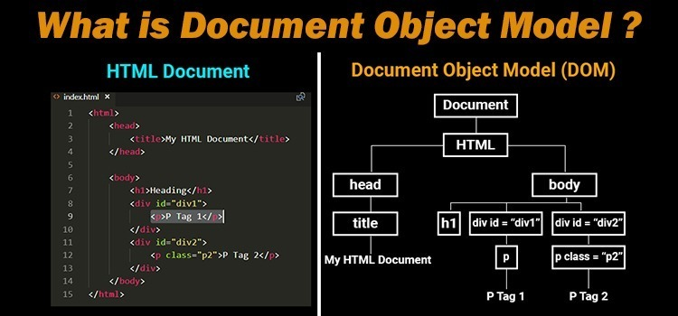
What is DOM?
DOM (Document Object Model) is a tree-like representation of your HTML page.
JavaScript can use DOM to read, change, add, or remove elements dynamically.

Slide 29
DOM Continued…….
Key Points
DOM treats HTML elements as objects.
Browser automatically creates DOM when a page loads.
DOM can be read & manipulated using JavaScript.
DOM has methods & properties to interact with elements.

Slide 30
Accessing Elements in DOM
// 1. By ID (returns single element)
const div = document.getElementById("myDiv");
// 2. By Class Name (returns HTMLCollection)
const texts = document.getElementsByClassName("text");
// 3. By Tag Name (returns HTMLCollection)
const paragraphs = document.getElementsByTagName("p");
// 4. Using Query Selector (returns first match)
const firstText = document.querySelector(".text");
// 5. Using Query Selector All (returns NodeList of all matches)
const allTexts = document.querySelectorAll(".text");
<div id="myDiv" class="box">Hello</div>
<p class="text">First Paragraph</p>
<p class="text">Second Paragraph</p>

Slide 31
Manipulating the DOM
Changing Content
div.textContent = "Hi there!"; // Changes text inside element
div.innerHTML = "<b>Bold Text</b>"; // Can add HTML
Creating & Appending Elements
const newPara = document.createElement("p");
newPara.textContent = "This is a new paragraph!";
document.body.appendChild(newPara); // Adds to the end of <body>
Changing Styles
div.style.color = "red";
div.style.backgroundColor = "yellow";
div.style.fontSize = "20px";
Removing Elements
div.remove(); // Completely removes the element from DOM
Handling Events
div.addEventListener("click", () => {
alert("Div clicked!");
});
Adding / Removing Classes
div.classList.add("active");
div.classList.remove("box");
div.classList.toggle("highlight"); // Adds if not present
, removes if present

Slide 32
alert, prompt, and confirm in JavaScript
prompt()
Shows a popup input box where the user can type something.
Returns the user’s input as a string.
If the user clicks “Cancel”, it returns null.
const name = prompt("Enter your name:");
console.log("Hello " + name);
Use Case: Ask the user for simple input quickly. Example: Getting a username, age, or color preference.
alert()
Shows a popup message to the user.
Only displays information, cannot get input.
Stops code execution until user clicks “OK”.
alert("Hello, Welcome to our site!");
Use Case: Notify users about something important.
Example: “Your form has been submitted successfully.”

Slide 33
confirm()
Shows a popup with “OK” and “Cancel” buttons.
Returns true if user clicks OK, false if Cancel.
const isSure = confirm("Do you want to delete this item?");
if (isSure) {
console.log("Item deleted!");
} else {
console.log("Deletion canceled!");
}
Use Case: Ask the user to confirm an action before proceeding. Example: Deleting a file, logging out, or submitting a form.

Slide 34
Event Handling
<html>
<script>
function myFun() {
document.getElementById(
"web").innerHTML = "Welcome to WebPage";
}
</script>
<body>
<button onclick="myFun()">Click me</button>
<p id="web"></p>
</body>
</html>
JavaScript Events are actions or occurrences that happen in the browser. They can be triggered by various user interactions or by the browser itself.
Event Types
JavaScript supports a variety of event types. Common categories include:
Mouse Events: click, dblclick, mousemove, mouseover, mouseout
Keyboard Events: keydown, keypress, keyup
Form Events: submit, change, focus, blur
Window Events: load, resize, scroll

Slide 35
Event Handling Methods
Inline HTML Handlers
<button onclick="alert('Button clicked!')">Click Me</button>
DOM Property Handlers
let btn = document.getElementById("myButton");
btn.onclick = () => {
alert("Button clicked!");
};
btn.addEventListener("click", () => {
alert("Button clicked using addEventListener!");
});

Slide 36
Event Propagation
When something happens on a webpage (like clicking a button), the browser checks where it happened and tells all the elements about it.
It happens in two steps:
Capturing Phase (Going Down): The event starts from the top of the page (document) and goes down through each parent element until it reaches the exact element you clicked.
Bubbling Phase (Coming Up): After reaching the clicked element, the event travels back up through the parent elements toward the top again.

Slide 37
Preventing Default Behavior
Certain elements have default actions (e.g., links navigating to URLs). Use preventDefault() to override them.
document.querySelector("a").addEventListener("click", (e) => {
e.preventDefault();
console.log("Link click prevented");
});
preventDefault() stops the link from navigating.

Slide 38
<html>
<body>
<h2>Form Validation</h2>
<form id="example">
<input type="text" placeholder="Enter something" id="formInput" />
<button type="submit">Submit</button>
</form>
<script>
document.querySelector("#example").addEventListener("submit", (e) => {
let input = document.querySelector("#formInput");
if (!input.value) {
e.preventDefault();
alert("Input cannot be empty");
}
});
</script>
</body>
</html>

Slide 39
Closure in JavaScript
A closure is a function that retains access to its outer function's variables, even after the outer function has finished executing.
It "remembers" the environment in which it was created, allowing it to access variables outside its immediate scope.
function outer() {
let outerVar = "I'm in the outer scope!";
function inner() {
console.log(outerVar);
outerVar = "Updated"
}
return inner;
}
const closure = outer();
closure();
closure();
Lexical Scoping
Closures are rely on lexical scoping, meaning that a function’s scope is determined by where the function is defined, not where it is executed. This allows inner functions to access variables from their outer function.

Slide 40
Private Variables
Closures allow a function to keep variables hidden and only accessible within that function.
function counter() {
// Private variable
let count = 0;
return function () {
// Access and modify the private variable
count++;
return count;
};
}
const increment = counter();
console.log(increment());

Slide 41
Callbacks and Callback Hell in JavaScript
In JavaScript, callbacks are functions that are passed as arguments from one function to another and are executed after the completion of a certain task. They are commonly used in asynchronous operations, such as reading files, making HTTP requests, or handling user input.
A function can accept another function as a parameter.
Callbacks allow one function to call another at a later time.
A callback function can execute after another function has finished.

Slide 42
JavaScript executes code line by line (synchronously), but sometimes we need to delay execution or wait for a task to complete before running the next function. Callbacks help achieve this by passing a function that is executed later.
function greet(name, callback) {
console.log(`Hello, ${name}!`);
callback(); // calling the callback function
}
function afterGreet() {
console.log('Greeting is complete!');
}
greet('Anjali', afterGreet);

Slide 43
Callback Hell (Pyramid of Doom)
When multiple asynchronous operations depend on each other, callbacks get deeply nested, making the code hard to read and maintain.
function task1(callback) {
setTimeout(() => {
console.log("Task One completed");
callback();
},);
}
function task2(callback) {
setTimeout(() => {
console.log("Task Two completed");
callback();
},);
}
task1(function () {
task2(function () {
console.log("Both tasks completed");
});
});

Slide 44
Solution to Callback Hell
Promises
Promises can help in avoiding the callback hell by providing the structured way to handle the asynchronous operations using the .then() method. Due to which the code becomes more readable by avoiding the deeply neseted callbacks.
Async/await
Async/await can help in avoiding the callback hell by writing the asynchronous code that looks like the synchronous code due to which the code becomes more cleaner and readable and reduces the complexity.

Slide 45
JavaScript Promise
JavaScript Promises make handling asynchronous operations like API calls, file loading, or time delays easier. Think of a Promise as a placeholder for a value that will be available in the future. It can be in one of three states
Pending: The task is in the initial state.
Fulfilled: The task was completed successfully, and the result is available.
Rejected: The task failed, and an error is provided.

Slide 46
let promise = new Promise((resolve, reject) => {
// Perform async operation
if (operationSuccessful) {
resolve("Task successful");
} else {
reject("Task failed");
}
});
resolve(value): Marks the promise as fulfilled and provides a result.
reject(error): Marks the promise as rejected with an error.

Slide 47
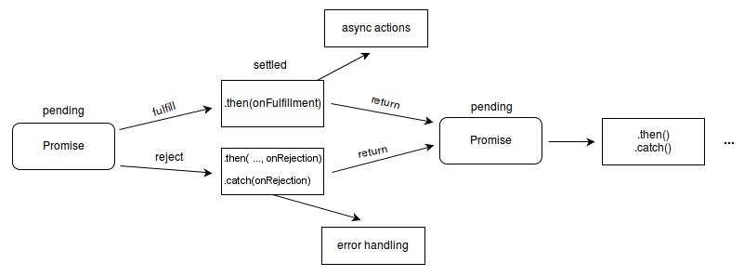

Slide 48
Chained Promises (JavaScript)
then(): Runs when promise is fulfilled (can also take a rejection handler).
catch(): Handles errors (same as then(null, errorHandler) but cleaner).
finally(): Runs code after promise settles (success or error).
Promises can be chained: each then() passes its result to the next.

Slide 49
new Promise((resolve) => setTimeout(() => resolve("foo"), 300))
.then(r => (console.log("A:", r), r + " -> A"))
.then(r => (console.log("B:", r), r + " -> B"))
.then(r => console.log("C:", r))
.catch(e => console.error("Error:", e))
.finally(() => console.log("Done!"));

Slide 50
Promise Utility Methods (JavaScript)
Promise.all() → Waits for all promises to succeed.
Returns an array of results if all succeed.
If any fails, the whole thing rejects.
Promise.race() → Returns result of the first promise to finish.
Can be success or error — whichever settles first.
Promise.allSettled() → Waits for all promises to finish (success or fail).
Returns an array with status + value/reason for each promise.
Promise.any() → Waits for the first successful promise.
Ignores rejections (fails only if all reject).

Slide 51
Async and Await in JavaScript
Async and Await in JavaScript are used to simplify handling asynchronous operations using promises. By enabling asynchronous code to appear synchronous, they enhance code readability and make it easier to manage complex asynchronous flows.
async function functionName() {
try {
const result = await someAsyncFunction();
console.log(result);
} catch (error) {
console.error("Error:", error.message);
}
}

Slide 52
async function fetchData() {
const response = await fetch("https://jsonplaceholder.typicode.com/posts/1");
const data = await response.json();
console.log(data);
}

Slide 53
Async Function
The async function allows us to write promise-based code as if it were synchronous. This ensures that the execution thread is not blocked. Async functions always return a promise. If a value is returned that is not a promise, JavaScript automatically wraps it in a resolved promise.
async function myFunction() {
return "Hello";
}
const getData = async () => {
let data = "Hello World";
return data;
}
getData().then(data => console.log(data));

Slide 54
await Keyword (JavaScript)
Used to wait for a Promise to resolve or reject.
Can only be used inside an async function.
Pauses execution until the Promise settles.
Makes async code look synchronous and cleaner.
Helps avoid complex .then() chaining.
const getData = async () => {
let y = await "Hello World";
console.log(y);
}
console.log(1);
getData();
console.log(2);

Slide 55
Error Handling in Async/Await
JavaScript provides predefined arguments for handling promises: resolve and reject.
resolve: Used when an asynchronous task is completed successfully.
reject: Used when an asynchronous task fails, providing the reason for failure.
async function fetchData() {
try {
let response = await fetch('https://api.example.com/data');
let data = await response.json();
console.log(data);
} catch (error) {
console.error('Error fetching data:', error);
}
}

Slide 56
JavaScript Prototype
Everything is an object → functions, arrays, strings, etc.
JavaScript uses a prototype-based system (not class-based).
Prototype = container for shared methods & properties.
When you add something to a prototype, all instances get access to it.
Acts like a mould – instances are objects made from it.
Used for inheritance, code reuse, and object relationships.

Slide 57
Every object has a prototype – a template containing shared methods & properties.
Prototype = common storage → all instances can use what’s defined here.
Adding a method/property to a prototype makes it available to all objects.
Helps avoid code repetition – define once, reuse everywhere.
Makes code cleaner, efficient, and memory-friendly.
Object.prototype.print = function () {
console.log('I am from object prototype')
}
let b = {
name: 'Pranjal',
age: 21
}
b.print()

Slide 58
How Prototype Works in JavaScript?
Every object has an internal [[Prototype]] that points to another object.
This allows inheritance → objects can use properties & methods from their prototype.
Property Lookup:
JavaScript first checks the object itself.
If not found, it checks the prototype.
Continues up the prototype chain until found or null.
Functions have a prototype property → used to define shared methods/properties.
Objects created using a constructor function inherit from that constructor’s prototype.
You can add new methods or properties to a prototype at any time → all existing and future instances get access.
Benefit: Enables code reuse, avoids duplication, and makes objects share behavior efficiently.
Commonly used to extend built-in objects like Array, Object, etc.

Slide 59
Creating Constructor Functions
A special function used to create and initialize objects.
Typically called with the new keyword.
Sets up properties & methods on the new object.
Allows creation of multiple instances with the same structure.
Instances can share behavior through the constructor’s prototype.
function Person(name) {
this.name = name;
}
Person.prototype.sayHello = function () {
console.log(`Hello, my name is ${this.name}.`);
};
const n = new Person("Sheema");
n.sayHello();

Slide 60
Adding method to prototype
let a1 = [1, 2, 3, 4, 5]
let a2 = [5, 6, 7, 8, 9]
Array.prototype.sum = function () {
let sum = 0
for (let i = 0; i < this.length; i++) {
sum += this[i]
}
return sum
}
console.log(a1.sum())
console.log(a2.sum())
Defines a sum method on Array.prototype.
sum calculates the total of all array elements.
Can be used by any array (because it’s on the prototype).
Calls sum() on two arrays (arr and arr2).
Logs the calculated results to the console.

Slide 61
Prototype Inheritance
function Animal(name) {
this.name = name;
}
Animal.prototype.speak = function () {
console.log(`${this.name} makes a noise.`);
};
function Dog(name) {
Animal.call(this, name); // Call the parent constructor
}
\
Dog.prototype = Object.create(Animal.prototype); // Set up inheritance
Dog.prototype.constructor = Dog;
Dog.prototype.speak = function () {
console.log(`${this.name} barks.`);
};
const dog = new Dog('Rex');
dog.speak();
Child constructor inherits from Parent constructor.
Instances of Child get access to Parent’s prototype methods.
This allows code reuse and shared behavior.
You can add custom methods to the child’s prototype (e.g., caste()), and all child instances can use them.
Creates a prototype chain → lookup goes from child → parent → Object.

Slide 62
Regular expressions
Regular Expressions (RegEx): Patterns used to find, match, or manipulate text in strings.
In JavaScript, RegEx are objects that define these patterns.
Commonly used with:
RegExp methods: exec(), test()
String methods: match(), matchAll(), replace(), replaceAll(), search(), split()
Help with searching, validation, and text manipulation.
Provide a powerful syntax for complex pattern matching.

Slide 63
What is React?
React – a fast, scalable JavaScript library for front-end development.
Built by Facebook to create interactive UIs.
Component-based – encourages reusability and modular design.
SPA support – smooth navigation without page reloads.
Virtual DOM – enables efficient, optimized UI updates.
Faster rendering – delivers a seamless user experience.

Slide 64
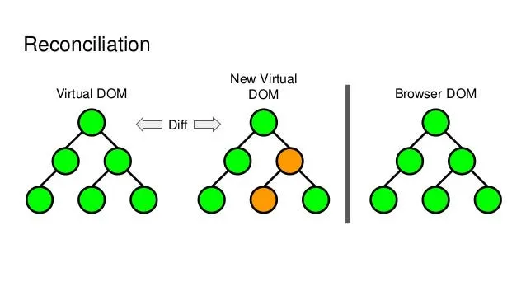

Slide 65
Introduction to Props
Props = "Properties", used to pass data from parent → child component
Read-only (immutable) – cannot be changed by child component
Make components reusable & dynamic
const Welcome = ({ name }) => <h1>Hello, {name}</h1>;
<Welcome name="John" />

Slide 66
Prop Validation & Defaults
Warns in console if wrong type/missing required prop.
Child.propTypes = {
name: PropTypes.string.isRequired,
age: PropTypes.number,
};
Default Props (fallback values):
Default Props (fallback values):
MyComp.defaultProps = {
name: "Guest",
age: 18,
};

Slide 67
React Props
Drilling
const App = () => {
const userName = "John Doe"; // data in the top-level component
return <Parent userName={userName} />;
};
const Parent = ({ userName }) => {
return <Child userName={userName} />;
};
const Child = ({ userName }) => {
return <GrandChild userName={userName} />;
};
const GrandChild = ({ userName }) => {
return <h1>Hello, {userName}</h1>;
};
export default App;

