Slide 1

Notes:
Open on the black box. GuardianOS is a personal safety and evidence OS — not another SOS button. Tagline: Stay protected. Preserve the truth.

Slide 2

Notes:
Name the moment: late meetings, first dates, rideshares. If something happens, people need the record, not guesses.

Slide 3

Notes:
Position against trackers and panic apps. The category is Prevent, Detect, Preserve, Escalate, Reconstruct.

Slide 4

Notes:
Walk the five verbs. Every protected session writes an original, encrypted Guardian Capsule.

Slide 5

Notes:
The product sentence: authorize a session with a check-in time. Guardian records facts and follows the user’s protocol. It does not decide danger.

Slide 6
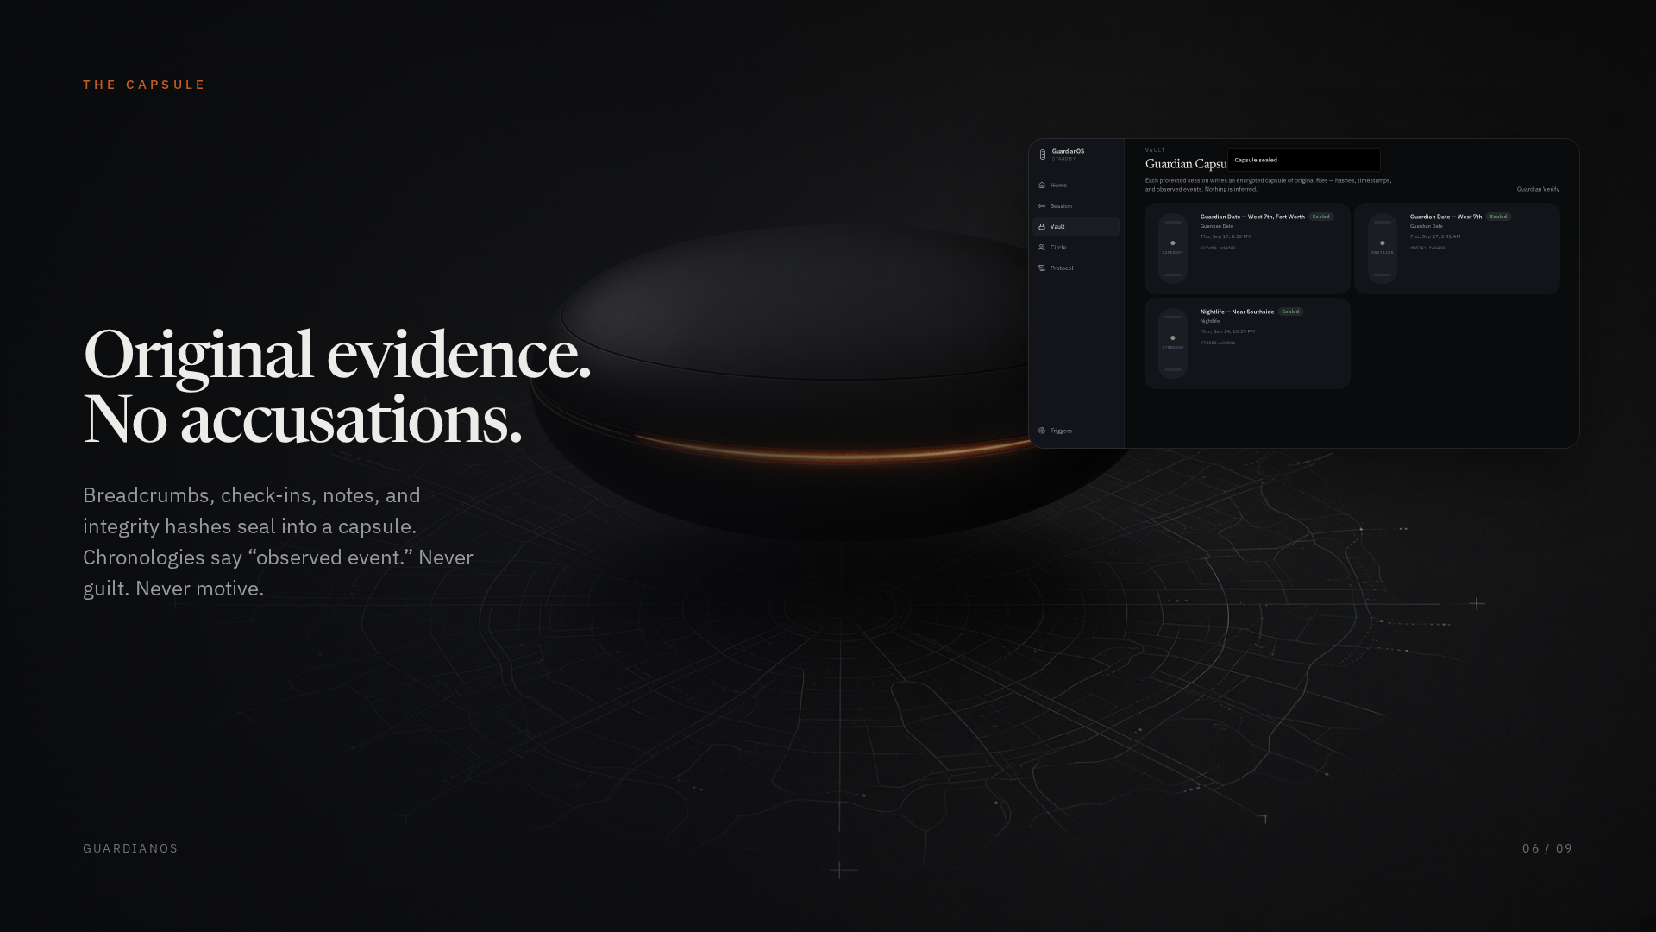
Notes:
The Capsule holds breadcrumbs, check-ins, notes, and integrity hashes. Language is observed event — never a verdict.

Slide 7

Notes:
Circle and protocol. Missed check-ins escalate only as the user authorized, including dead-man evidence escrow.

Slide 8

Notes:
Covert layer: PIN, phrase, gesture; decoy calculator; escrow if the user cannot act.

Slide 9
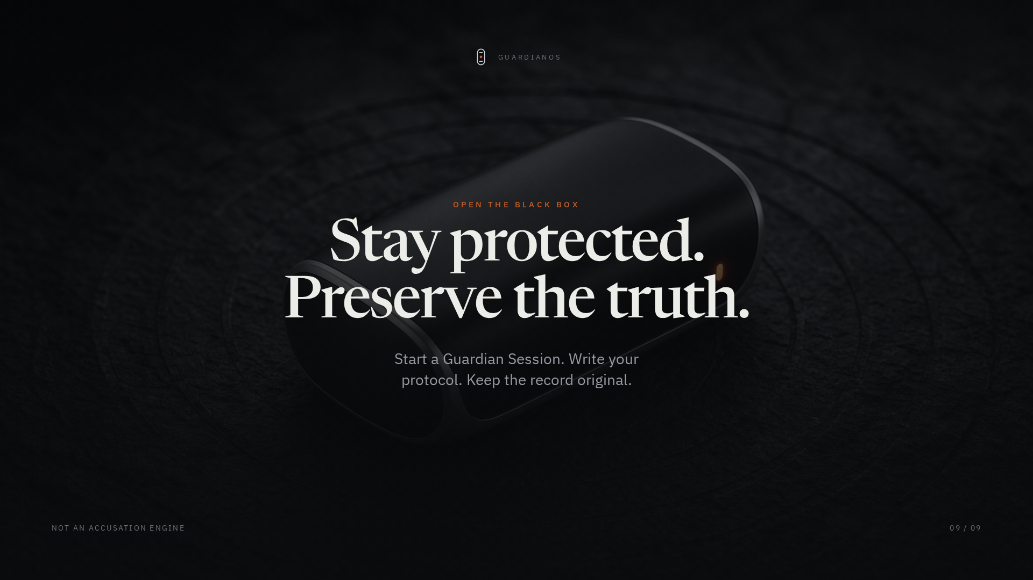
Notes:
Close on the tagline. Call to action: start a Guardian Session. Write your protocol. Keep the record original.

