Slide 1

Notes:
Post 1 — hook. Caption: The black box for your real life. Stay protected. Preserve the truth. Not another SOS button.

Slide 2
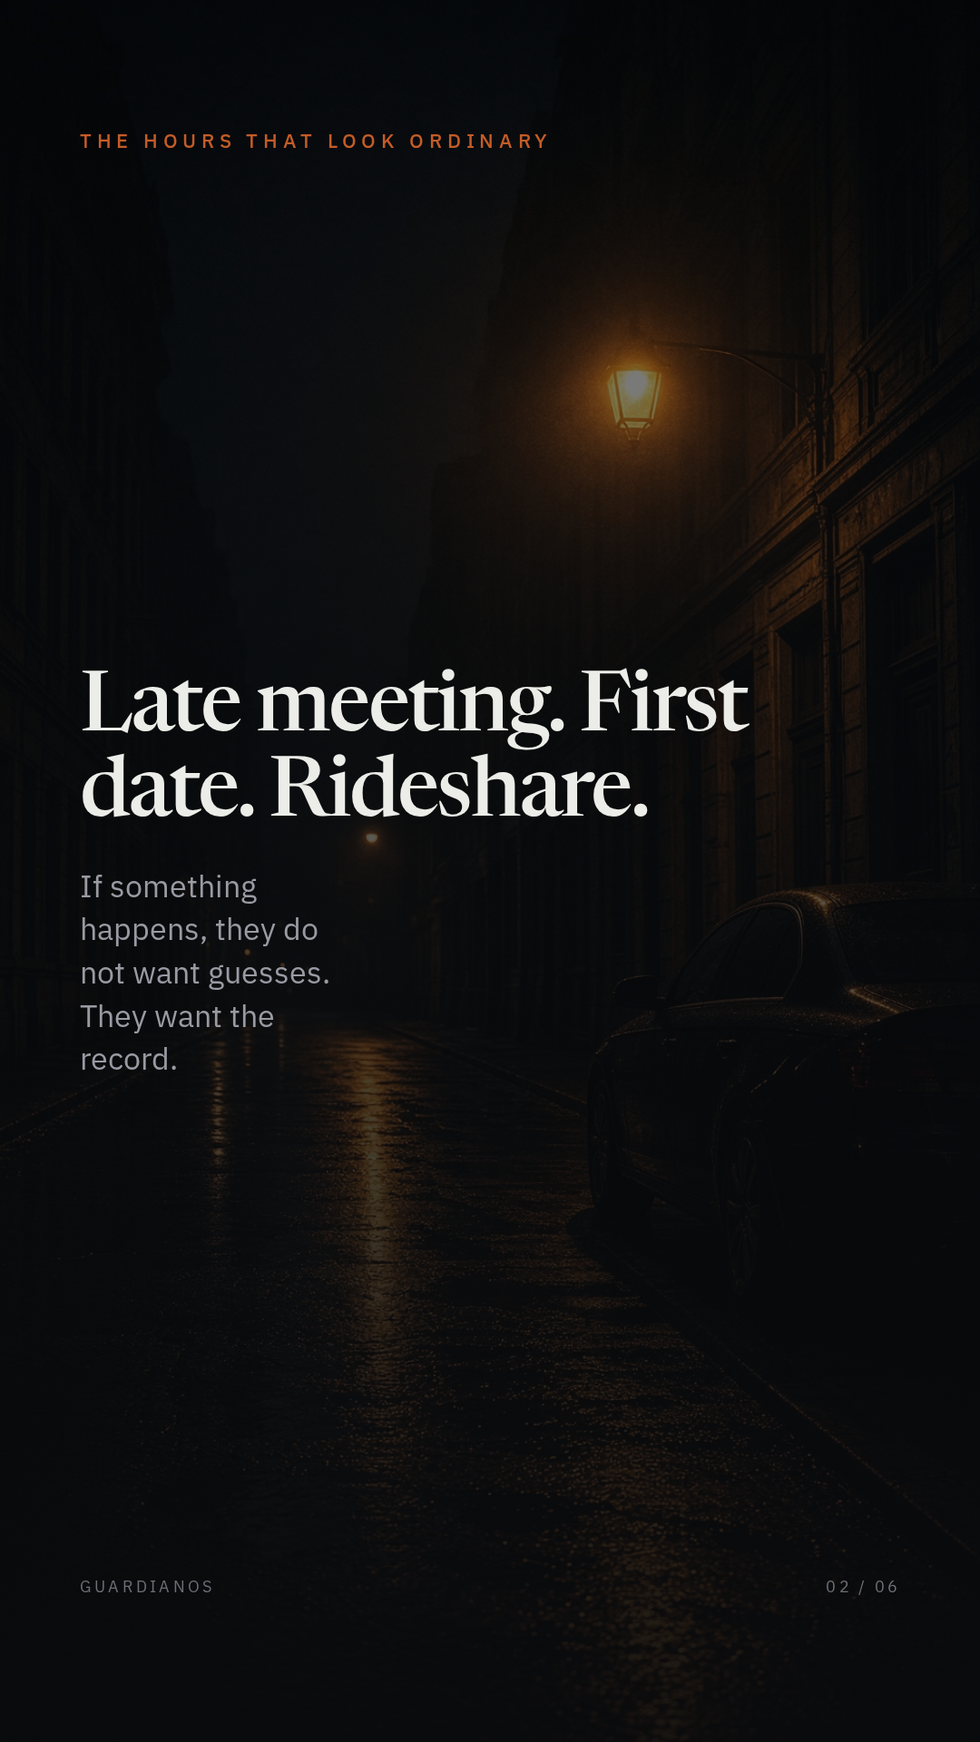
Notes:
Post 2 — the gap. Caption: Late meeting. First date. Rideshare. If something happens, they don’t want guesses. They want the record.

Slide 3
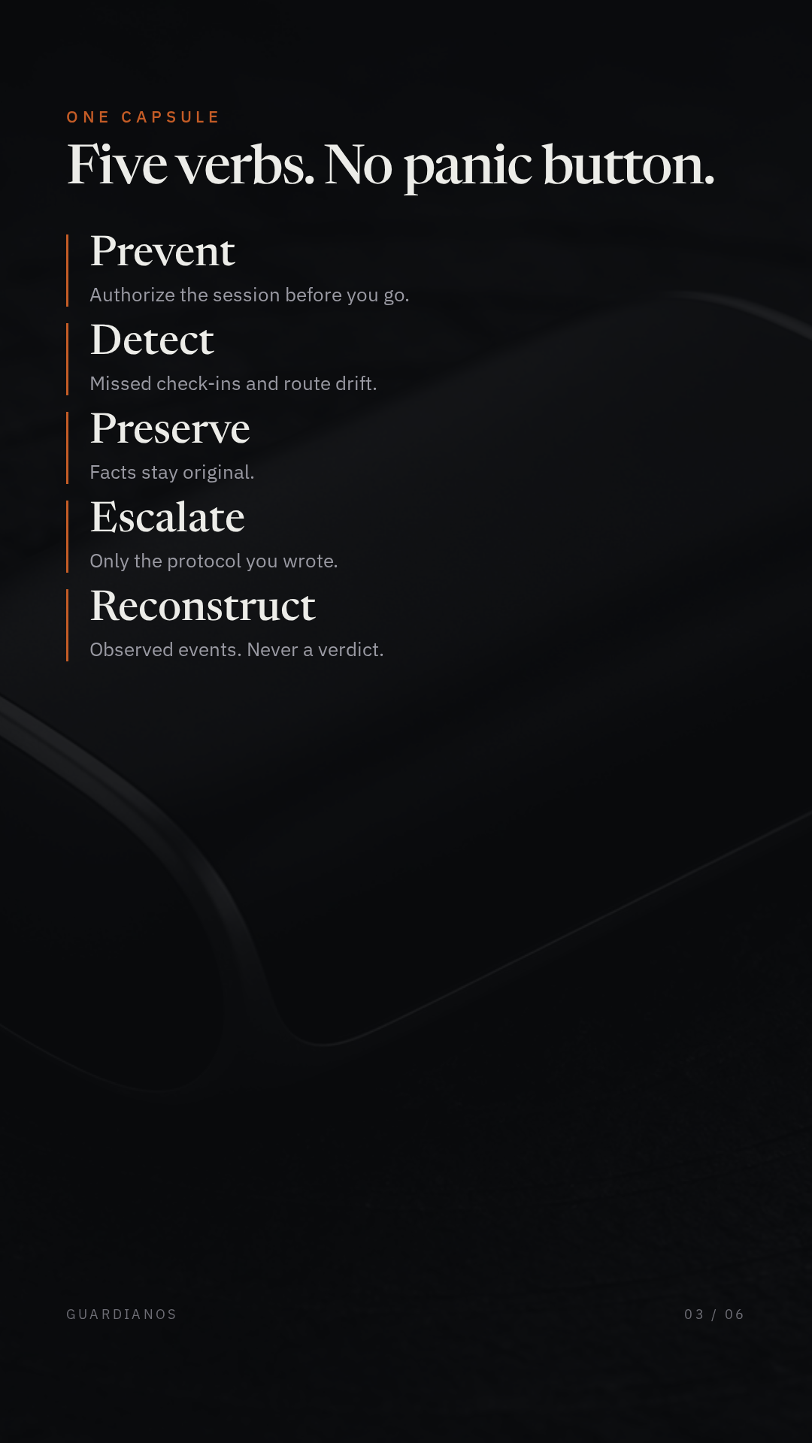
Notes:
Post 3 — the system. Caption: Prevent. Detect. Preserve. Escalate. Reconstruct. One capsule. No panic button.

Slide 4
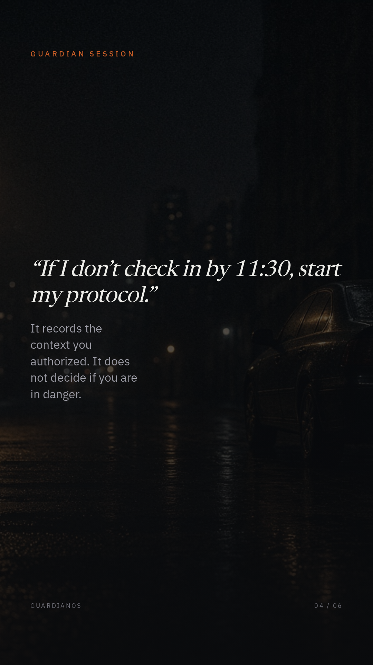
Notes:
Post 4 — the session. Caption: “If I don’t check in, start my protocol.” Guardian records facts. It does not decide danger.

Slide 5
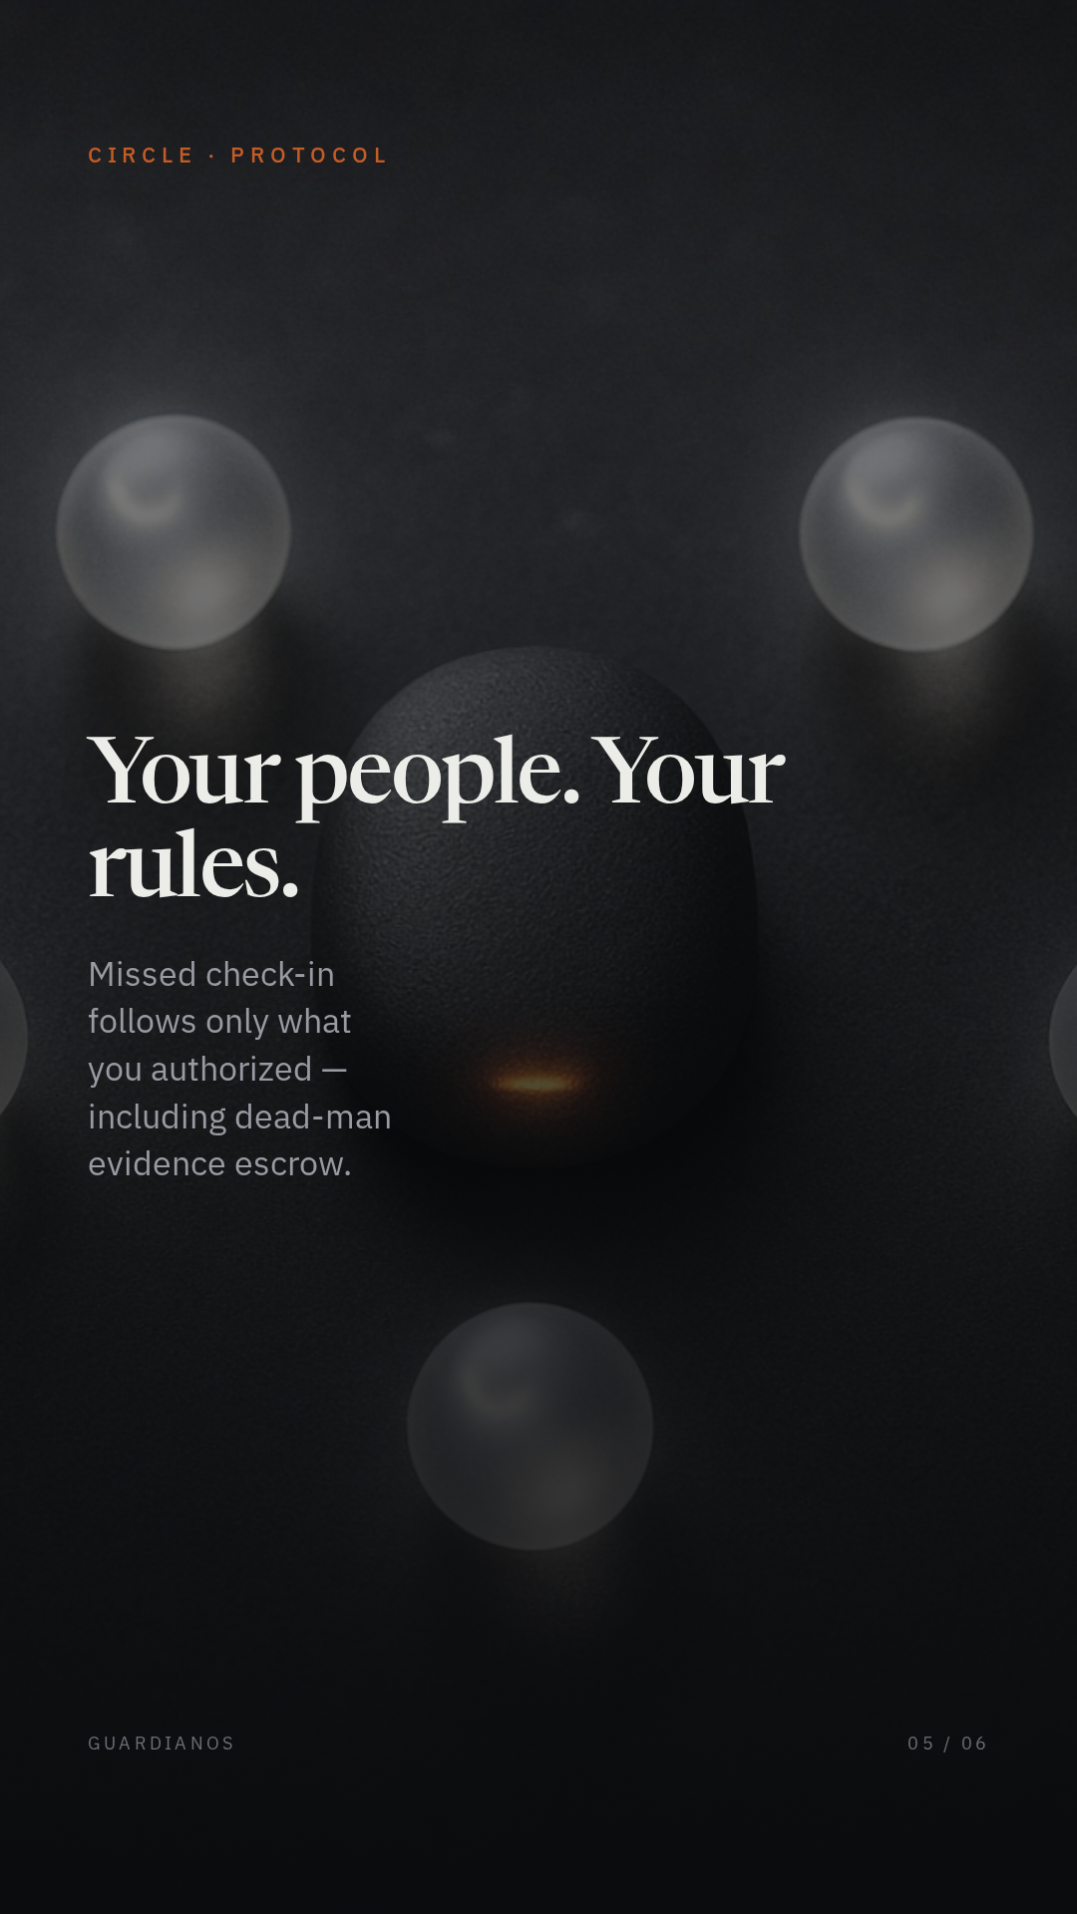
Notes:
Post 5 — circle. Caption: Your people. Your rules. Missed check-ins follow only the protocol you wrote, including dead-man escrow.

Slide 6

Notes:
Post 6 — close. Caption: Start a Guardian Session. Write your protocol. Keep the record original. Observed events. Never a verdict.

