Slide 1



WTI Crude Oil Price Prediction
P-80 TEAM 1
Mentors- Vinod & Deepika
Team members:
Geerath
Joshua
Raghav
Akanksha
Ankita

Slide 2
WTI Crude Oil Price Prediction
Project Information:
Business Problem
Crude Oil Background Research
  Benchmark Bodies
  Factors affecting the price
Project Architecture / Project Flow
Understanding the Features
Dataset & EDA
Cleaning/Interpolation

Slide 3
WTI Crude Oil Price Prediction
Project Information:
Data Visualization & Plots
Models Tested
All Model results and selection – MAPE values
VAR Model – Steps taken
Deployment in Streamlit
Project Challenges
MAPE values

Slide 4
Business Understanding & Research
Business Problem: To develop a machine learning model for predicting oil prices in order to better understand price patterns and assist customers and companies in making informed decisions.
What is crude oil?
Petroleum is also known as crude oil or just oil. It is found under the earth's surface and from this we can extract various other forms of fuels like:
- LPG
- Petrol/Gasoline
- Jet Fuel
- Kerosene
- Diesel fuel etc.
There are benchmark bodies that serve as a price reference for crude oil. 3 Primary ones are:
1. WTI or West Texas Intermediate
2. Brent Blend
3. Dubai Crude.
There are such 195 of them like – OPEC, Tapis Crude traded in Singapore, Bonny Light used in Nigeria, Urals oil used in Russia and Mexico's Isthmus among others.

Slide 5
Business Understanding & Research
Factors affecting the price:
There is price difference in these benchmarks is the change in GRADE of oil which is because of 3 factors:
1. Relative volatility (high API gravity is more valuable)
2. Sweetness/sourness (low sulfur is more valuable)
3. Transportation cost
API Gravity: is a measure of how heavy or light a petroleum liquid is compared to water: if its API gravity is greater than 10, it is lighter and floats on water; if less than 10, it is heavier and sinks.
These are some major factors which greatly influences the oil price as per Research:
Utilization of Oil Refinery Systems
Production and Demand of the oil,
Last Day's Oil Price
Electronic Vehicle Sales
Economical aspects
NYMEX Futures Prices etc.

Slide 6
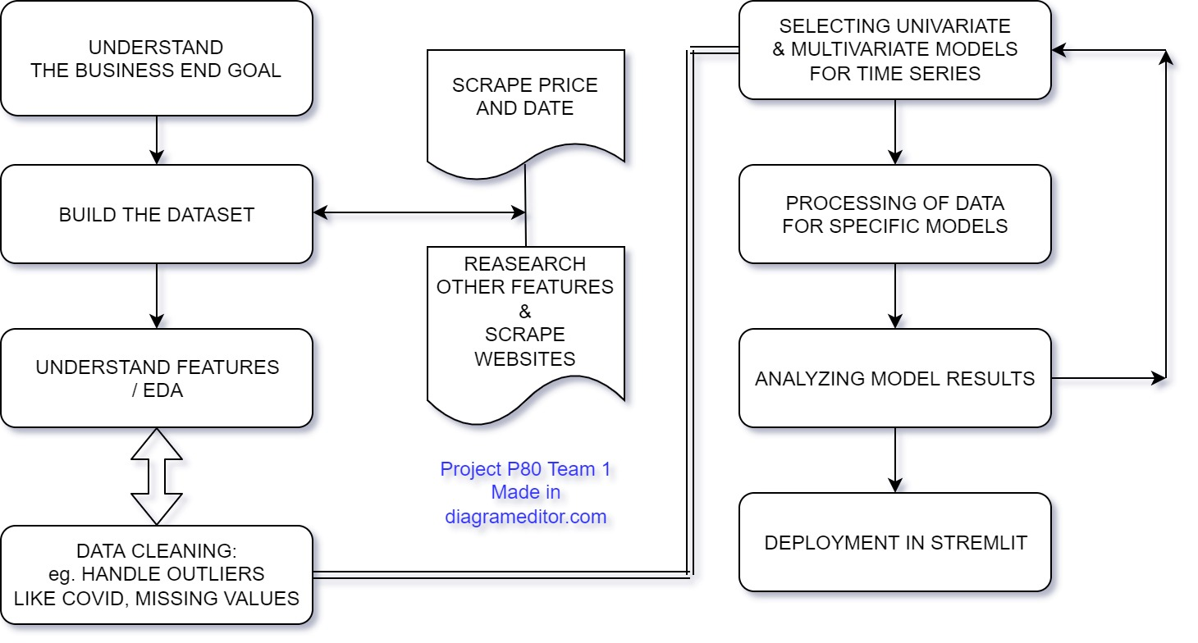
Project Architecture / Project Flow

Slide 7
Creating & Understanding the data/features
FEATURE 1 : Utilization of Refinery in %
Example - Paper to book converter units ( total input paper capacity is 100 papers/hr
but we input 80 papers/hr to convert to book, then its utilization rate is 80/100 = 80%.)
Refinery utilization rates affect crude oil prices based on the ability of refineries to convert crude oil to final products.
FEATURE 2 : Seasonal Demand
There is seasonality in demand for oil, where the demand in colder months is usually higher than in warmer months.
We, therefore, assume two values: ‘1’ to represent the warmer months spanning April to September, and ‘2’ to represent the colder months spanning October to March.
FEATURE 3 : Previous Day Close
The Close price of the previous day is an input for the present day. This attribute is aimed at providing continuality of oil prices throughout the days.

Slide 8
FEATURE 4 : REIF
Random impact factor (REIF): This novel attribute is aimed at accounting for the impact of political, economic and other external events on the oil price market.
With such an effect being "unpredictable", we use random numerical values ranging from 0.1 to 0.5; with 0.5 being a major world event that could impact the oil prices, and 0.1 a minor world event.
FEATURE 5,6,7 : Production, Demand, Gap ( in million tonnes )
Crude oil and NGL production.
Total oil demand.
Supply-Demand gap.
FEATURE 8 : Futures contract prices (4 Contracts for Crude oil.)
FEATURE 9 : Global Electric Car Sales (in millions )

Slide 9
Dataset and EDA
1. New Dataset – Scrapping, Creating Features.
2. Interpolation - Scaling the dataset
3. COVID outlier - smoothing vs taking window values
4. Understanding the features (EDA)
i. Utilization of refinery has moderate linear co-relation
ii. Contract values - multicolinearity issue
iii. EV global sales - least impact on oil price
IV. Production & Demand has positive linear impact on oil price
vi. Decision on Variables
5. pycaret part of anamolies

Slide 10
Dataset and EDA
Rows – 1278 (5 Year Data)
Columns – 9 Features in created dataset + Date & Close Price
Train Test Split – 80% 20%
No Null Values
Missing Values – Some features weekly / yearly. Interpolation was done
No Duplicate Values

Slide 11
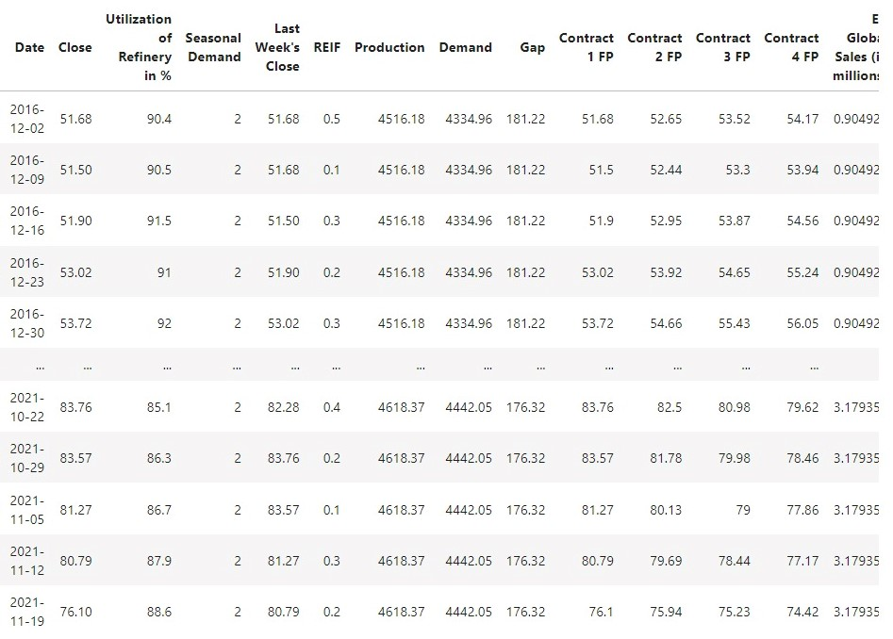
Dataset and EDA
Dataset Look - Daily Data

Slide 12
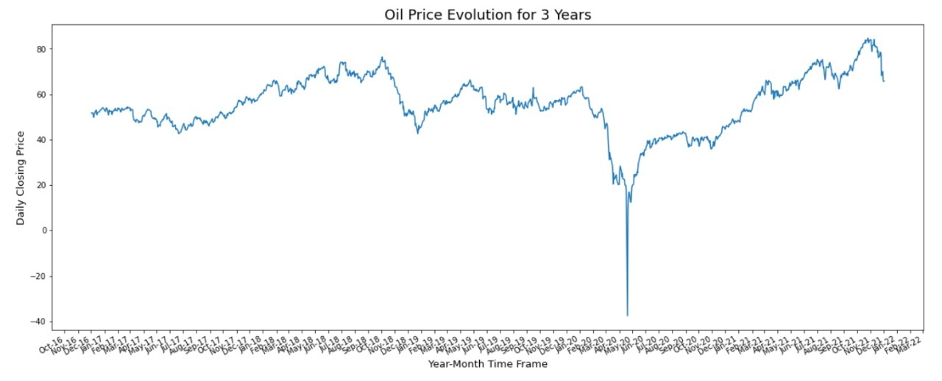
Covid as Outlier
We Removed Covid Part as outlier, since it has high impact on dataset and probability of another occurrence is < 2%
Before Removal

Slide 13
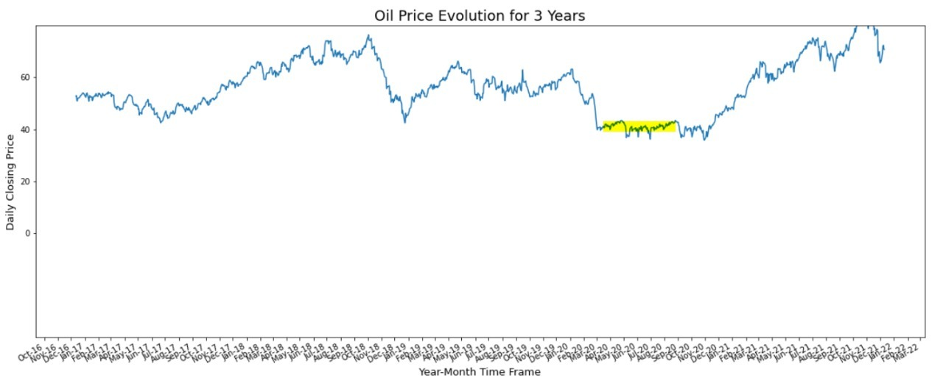
Covid Outlier
After Removal of Covid Part - Rolling is not helping much so we used forward window of timeline to replace the values

Slide 14
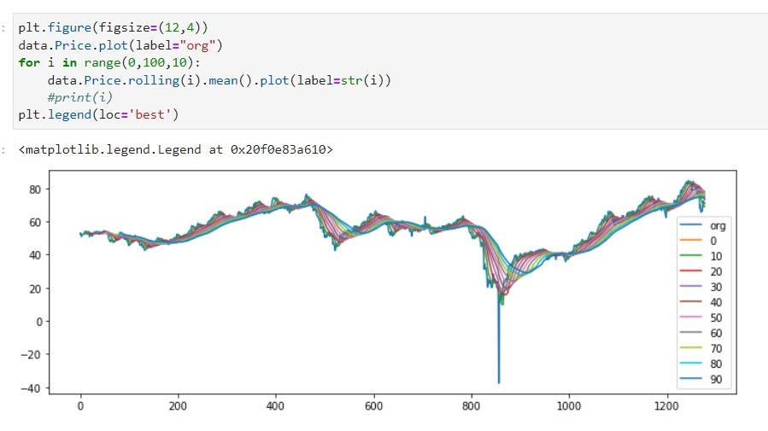
Window Rolling Mean (Moving Average)

Slide 15
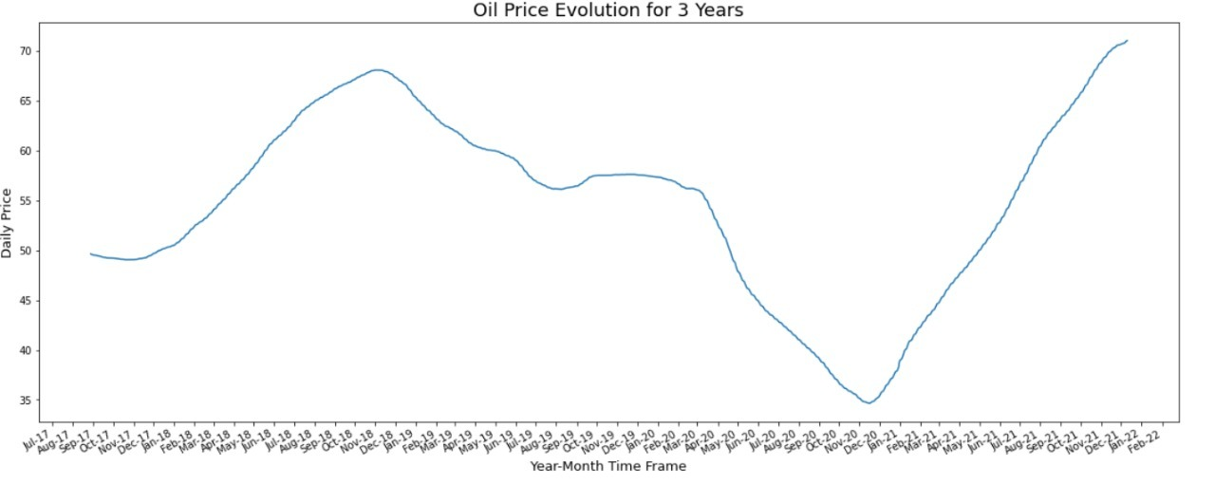
Data Smoothing

Slide 16
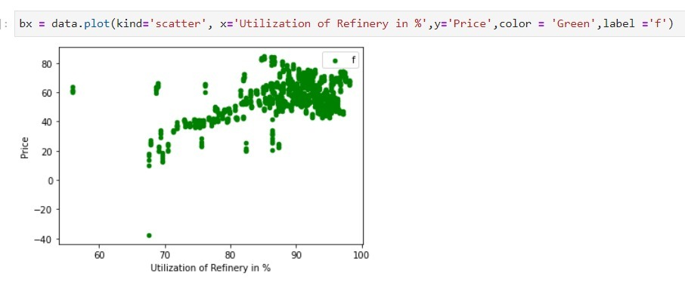
Understanding the features
Linear Analysis :- Utilization of refinery has moderate linear correlation.
Correlation Coefficient is 0.45

Slide 17
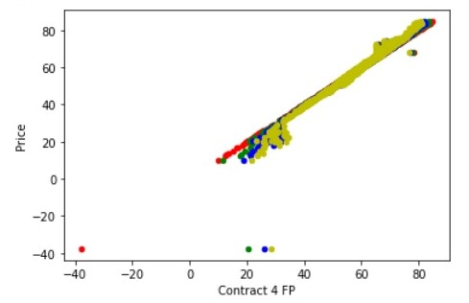
Understanding the features
Linear Analysis :- Contract values has multicollinearity issue.
There is 0.99+ Correlation coefficient between each contract + same information

Slide 18
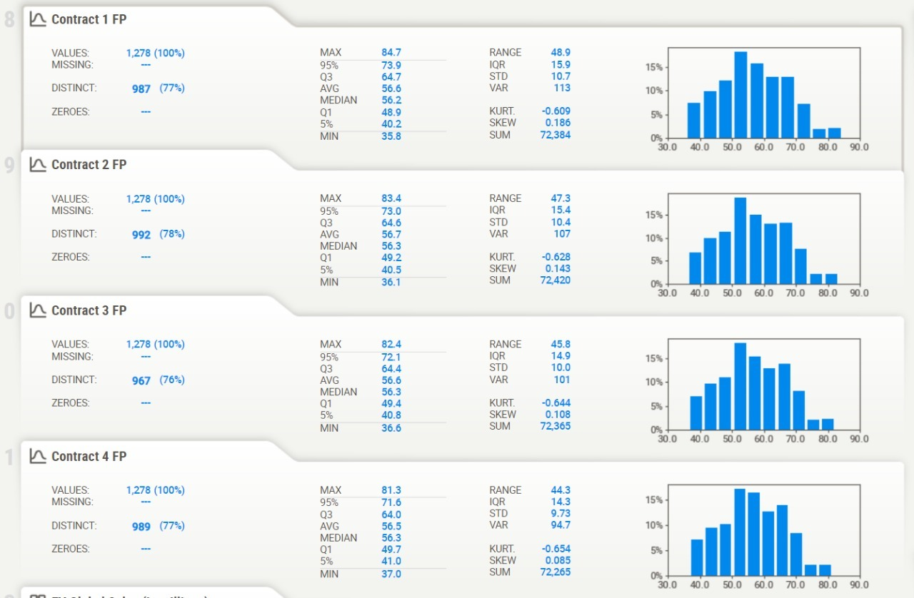
Contract 1, 2, 3 & 4 Details.

Slide 19
Interpolating Values
Seasonal Demand -1,2 ; REIF – 5 values, EV Sales we went for padding.
Last Day's Price, Utilization of Refinery, Production, Demand, gap, 4 contracts – we went for linear interpolation.
Dropping features:
  Gap: Same information as Production-Demand
  Contract 2,3,4 - multicolinearity

Slide 20
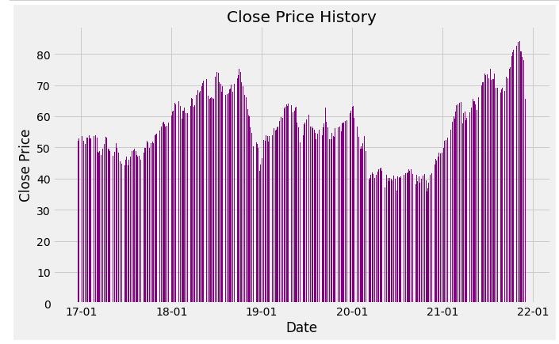
Data Visualization & Plots

Slide 21
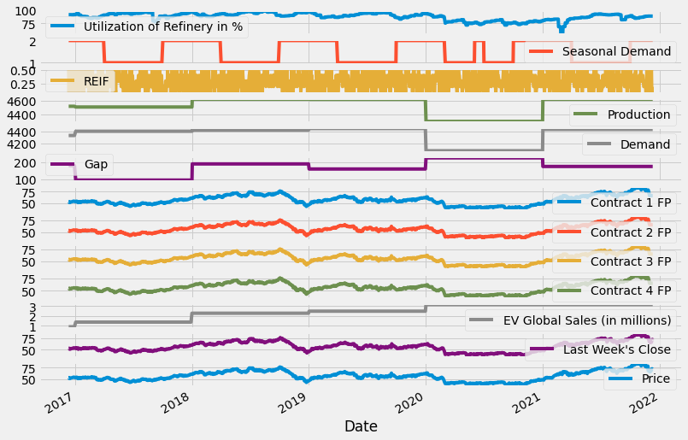

Slide 22
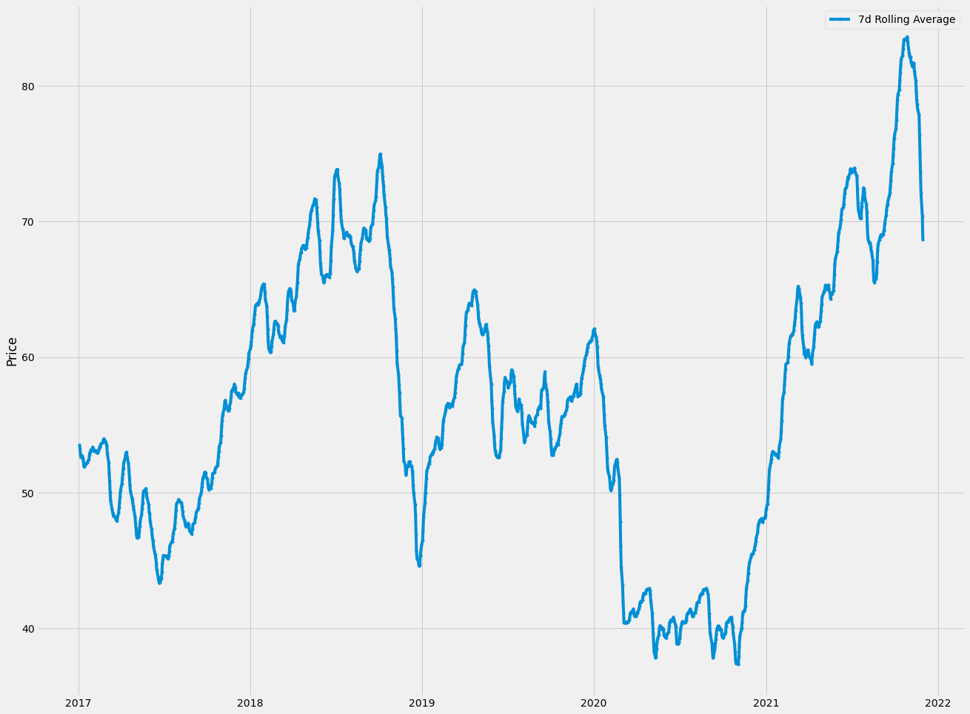
7 day Rolling average

Slide 23
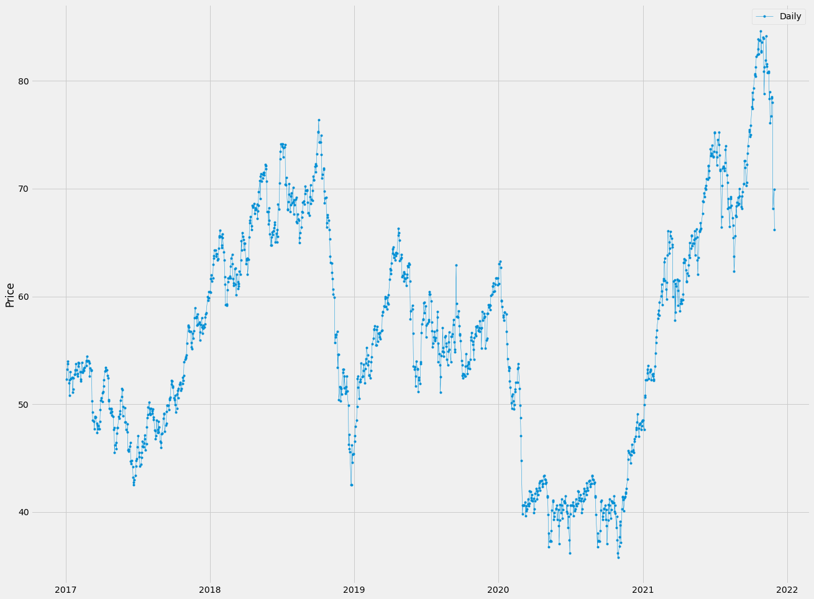
Oil price trend on Daily basis.

Slide 24
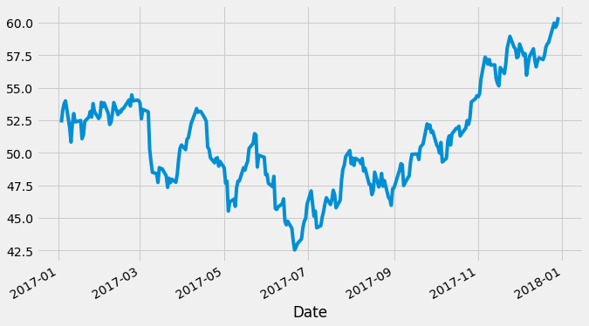
2017 Crude Oil Price Trend

Slide 25
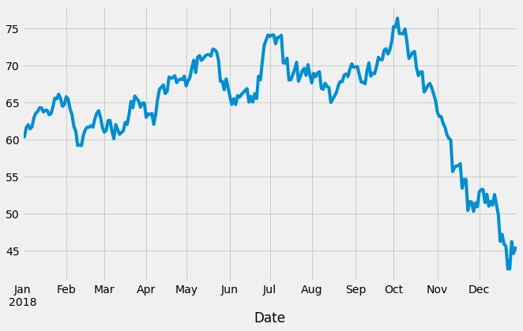
2018 Crude Oil Price Trend

Slide 26
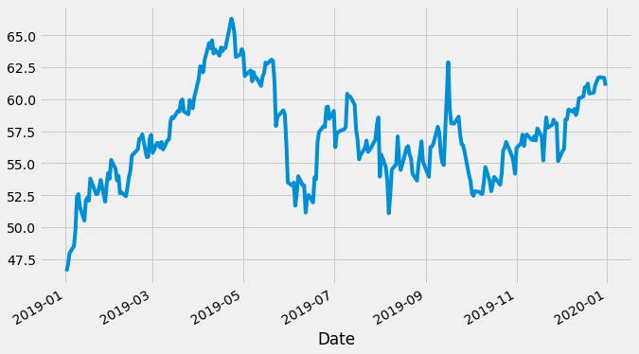
2019 Crude Oil Price Trend

Slide 27
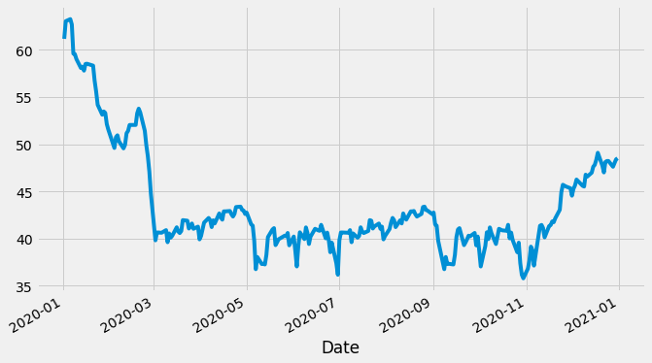
2020 Crude Oil Price Trend

Slide 28
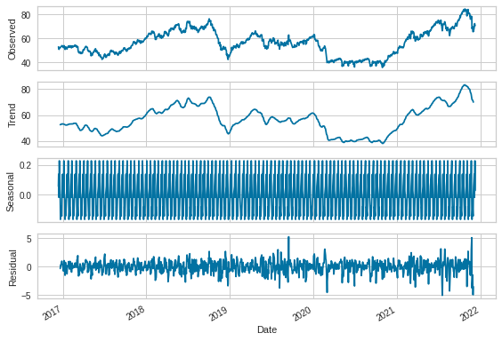
Seasonal trend

Slide 29
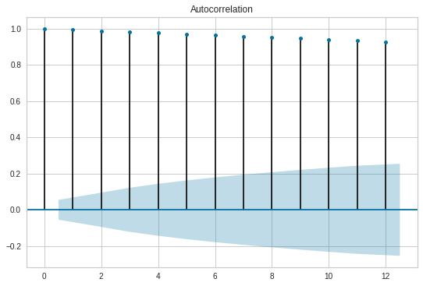
Autocorrelation Plot

Slide 30
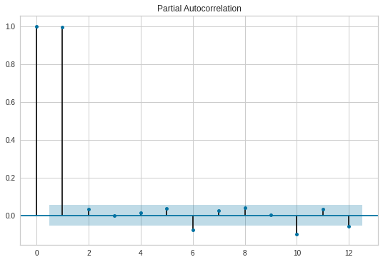
Partial Autocorrelation Plot

Slide 31
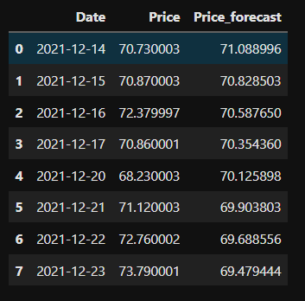
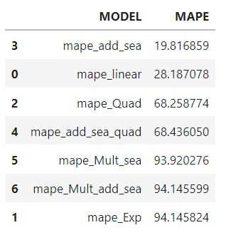
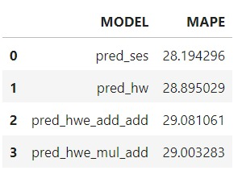
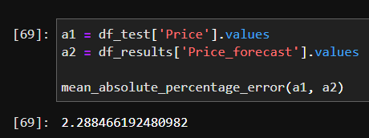
Models Attempted & MAPE: Uni-variate & Multivariate
Train-Test Split - 80% 20%
DATA DRIVEN METHODS & MODEL BASED METHODS – ADDITIVE SEASONALITY – 19.81
LTSM - 6
VAR – 2.2
ARIMA - 12

Slide 32
VAR Steps:
1. Dataset
2. Augmented Dickey Fuller test - check for stationarity
p<0.05 & ADF test statistic, used lag, criteria % etc.
3. Differencing - 1 & log transformation
4. Check ADF test again
p<0.05 & ADF test statistic
5. Stationary? We got, so get the max lag value = 2
for p<0.05
6. Train test split
7. VAR()
8. Select best order from order vs AIC curve - we got 5th degree
9. .fit the model with the order

Slide 33
VAR Steps taken contd.
10. forecast with steps = no.of days to predict, add lag value
11. result is differenced + log but can be checked for MAPE as comparison is between transformed data only
12. MAPE = 2.2
13.Combining the complete dataset

Slide 34
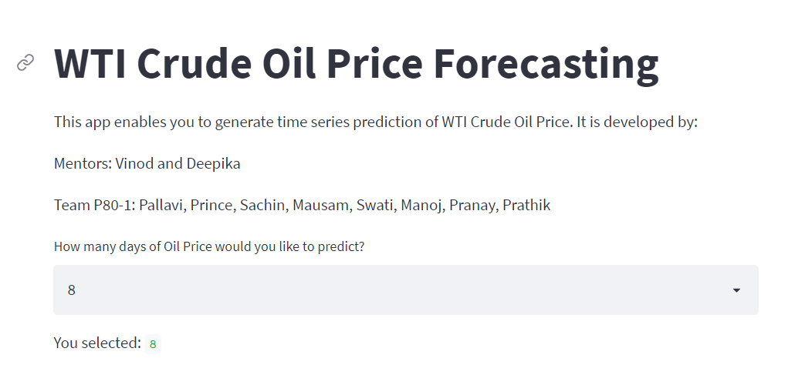
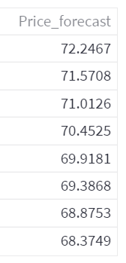
Model Deployment – Platform Streamlit

Slide 35
Project - Challenges
1. Building the Dataset from scratch for the features that affects the WTI oil price was an interesting challenge.
2. Web Scrapping from websites that do not give scrapping permission. Thus to find alternatives for the same was a difficult task.
3. How to handle the Covid time period for our model.
BUT we would like to thank our mentors Vinod and Deepika for the continuous support and help which made us overcome these challenges!

Slide 36
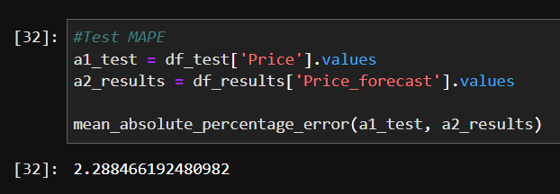
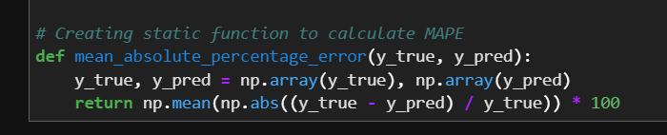
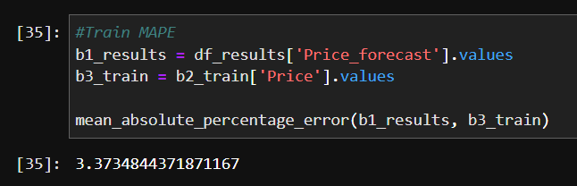
Project MAPE Values
Test MAPE – 2.2
Train MAPE – 3.3

