Slide 1
Accessibility Navigation App
Navigate Without Barriers

Slide 2
The Problem: Inaccessible Navigation
Navigation apps lack accessibility features for wheelchair users and people with disabilities:
  • Missing ramp information
  • Unpredictable elevator availability
  • Hidden stairs on routes
  • Poor sidewalk conditions (potholes, narrow paths)

Slide 3
Project Objectives
Empower users with disabilities through barrier-free navigation.
  • Develop an AI-driven routing engine prioritizing accessibility.
  • Provide real-time data on ramps, elevators, and hazards.
  • Generate Accessibility Scores for locations and paths.
  • Build an intuitive, high-contrast, easy-to-use interface.

Slide 4
Literature Survey
Existing solutions fall short on granular accessibility data:
  • Traditional Maps: Focus on vehicular & basic pedestrian routing.
  • Wheelmap/AccessMap: Rely on crowdsourced data, often incomplete.
  • Gap: Lack of automated, AI-based surface quality assessment and real-time dynamic routing.

Slide 5
System Architecture
A modern, decoupled Microservices Architecture:
  • Frontend (React): Responsive PWA for mobile & desktop.
  • Backend (FastAPI): High-performance API routing and AI inference.
  • Mapping Engine (OpenStreetMap): Base map and spatial data.
  • Database (PostgreSQL/PostGIS): Geospatial data storage.

Slide 6
Dataset Collection
Multi-modal data sourcing for high accuracy:
  • OpenStreetMap (OSM) Tags: Extracting wheelchair=yes, incline, surface type.
  • Crowdsourcing: User-reported hazards and elevator outages.
  • Imagery: Street-level images for computer vision training.
  • Government Open Data: City municipal accessibility datasets.

Slide 7
AI/ML Approach
Leveraging TensorFlow for spatial analysis:
  • Computer Vision: Detecting missing curb ramps and obstacles from street imagery.
  • NLP: Parsing user reviews to extract accessibility insights.
  • Predictive Modeling: Estimating elevator uptime based on historical patterns.

Slide 8
Route Optimization
Custom graph algorithms for safe traversal:
  • Avoidance Routing: Penalize stairs, steep inclines (>8%), and rough surfaces.
  • Multi-Objective A* Algorithm: Balance distance vs. accessibility safety.
  • Dynamic Rerouting: Real-time adjustments based on live hazard reports.

Slide 9
Accessibility Scoring
A standardized metric for inclusive urban mobility:
  • Path Score (1-100): Based on surface smoothness, width, and incline.
  • Venue Score (A-F): Availability of ramps, automated doors, and accessible restrooms.
  • Visualized as a heat map for users to instantly gauge neighborhood accessibility.

Slide 10
Technology Stack
Built with modern, scalable, and robust technologies:
  • Frontend: React.js (accessible UI components)
  • Backend: Python / FastAPI (high performance async API)
  • AI/ML: TensorFlow (image processing & predictive analytics)
  • Data/Mapping: OpenStreetMap & PostgreSQL (PostGIS)

Slide 11
Expected Outcomes
Delivering real-world impact:
  • Increased Independence: Safer, reliable navigation for wheelchair users.
  • Data Democratization: A rich, open database of accessibility metrics.
  • Community Engagement: Gamified crowdsourcing for continuous updates.

Slide 12
Project Timeline
Phased execution plan:
  • Month 1: Requirements, literature review, and UI/UX design.
  • Month 2: Data collection (OSM setup) and database schema.
  • Month 3: AI model training and FastAPI routing engine development.
  • Month 4: React frontend integration, testing, and deployment.

Slide 13
Future Enhancements
Scaling the impact beyond the MVP:
  • Voice Navigation Integration (Google Assistant / Siri).
  • Indoor Navigation for malls and transit hubs.
  • AR (Augmented Reality) wayfinding overlays.
  • IoT Integration with smart city infrastructure.

Slide 14
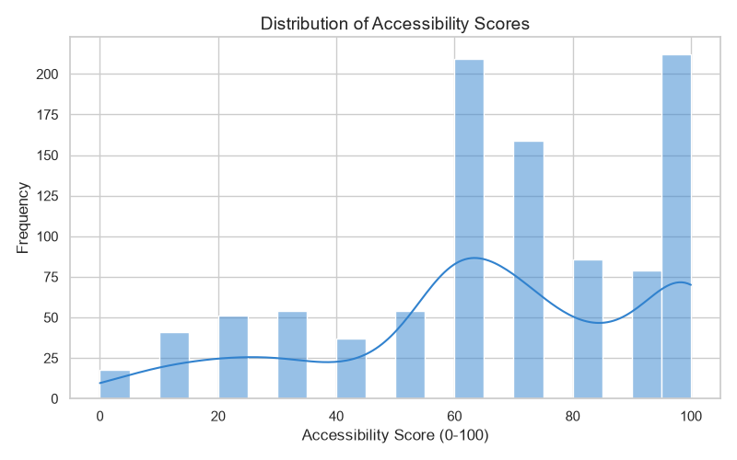
EDA: Accessibility Score Distribution

Slide 15
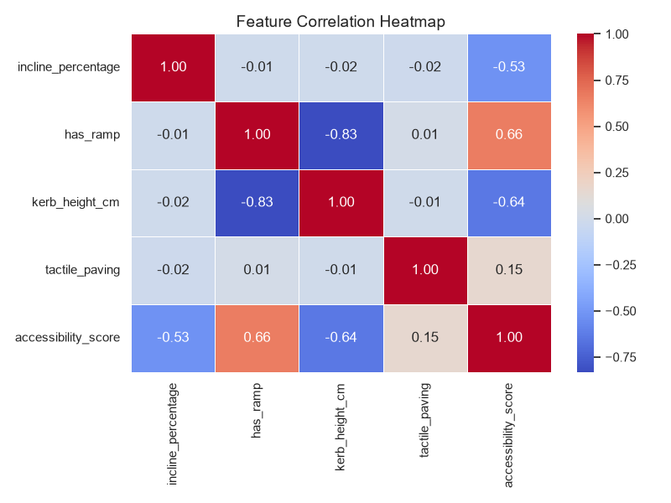
EDA: Feature Correlation Heatmap

Slide 16
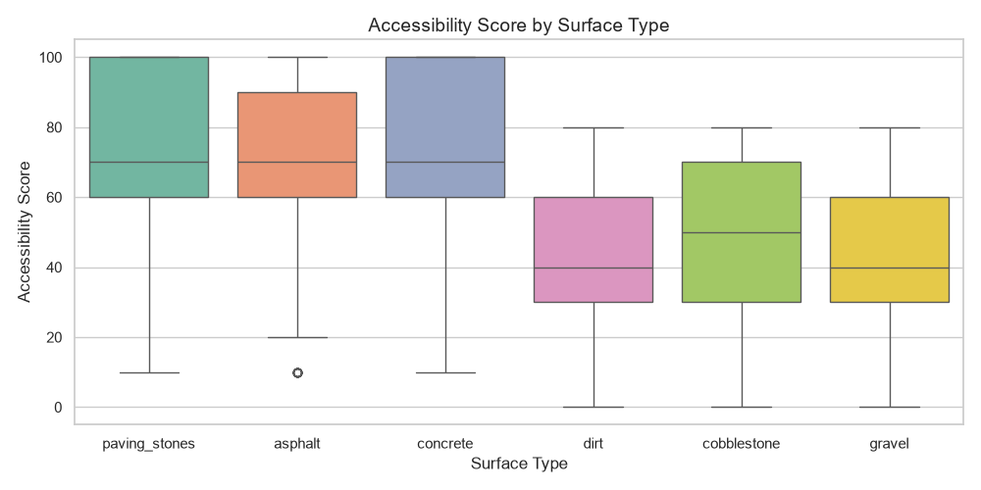
EDA: Accessibility by Surface Type

Slide 17
Thank You
Navigate Without Barriers

