Slide 1

Basic Structure of Computers
Chapter 1
Lecture: 1-6
Book: Carl Hamacher 5e
Course Outcome: Explain the interconnection between functional units of a computer system and various factors that affects the performance of a computer[Level 2: Understanding]

Slide 2

Basic Operational Concepts(T1.3)

Slide 3

Introduction
The basic mechanism through which an instruction gets executed is illustrated.
May be recalled
ALU contains a set of registers, some general-purpose and some special purpose.
First, we briefly explain the functions of the special-purpose registers before we look into some examples.

Slide 4
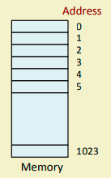

For Interfacing with the Primary Memory
Two special-purpose registers are used:
Memory Address Register (MAR): Holds the address of the memory location to be accessed.
Memory Data Register (MDR): Holds the data that is being written into memory or will receive the data being read out from memory.
Memory considered as a linear array of storage locations (bytes or words) each with unique address.

Slide 5
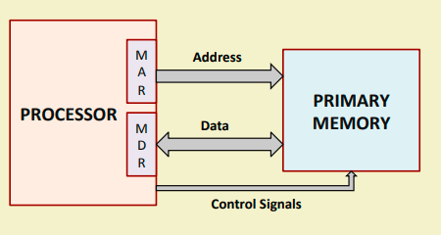

Slide 6


Slide 7
Memory access
To read data from memory
Load the memory address into MAR.
Issue the control signal READ.
The data read from the memory is stored into MDR.
To write data into memory
Load the memory address into MAR.
Load the data to be written into MDR.
Issue the control signal WRITE.

Slide 8
For Keeping Track of Program / Instructions
Two special-purpose registers are used:
Program Counter (PC): Holds the memory address of the next instruction to be executed.
Automatically incremented to point to the next instruction when an instruction is being executed
Instruction Register (IR): Temporarily holds an instruction that has been fetched from memory.
Need to be decoded to find out the instruction type.
Also contains information about the location of the data

Slide 9
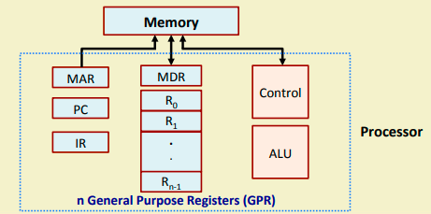
Architecture of the Example Processor

Slide 10
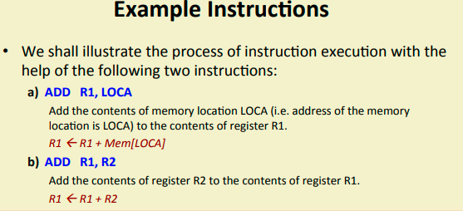

Slide 11
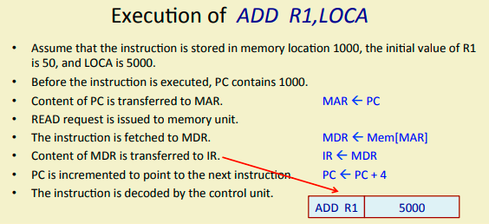

Slide 12
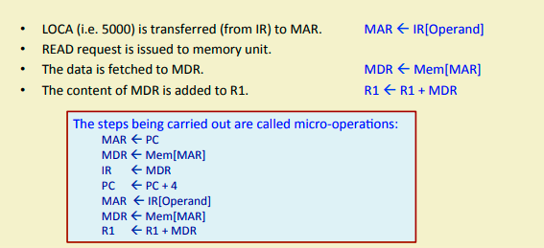

Slide 13
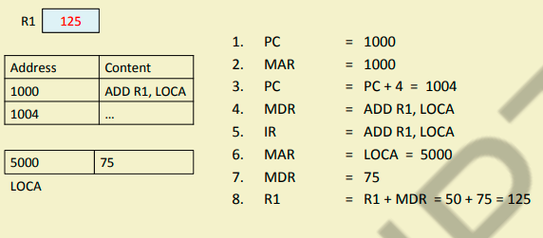

Slide 14
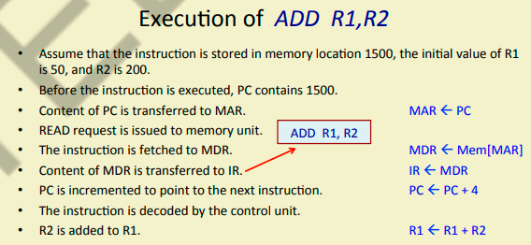

Slide 15
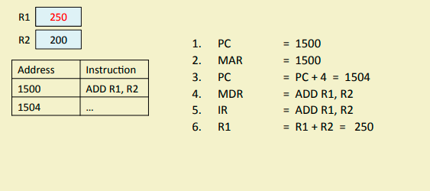

Slide 16

Interrupt
Normal execution of programs may be preempted if some device requires urgent servicing.
The normal execution of the current program must be interrupted – the device raises an interrupt signal.
Interrupt-service routine
Current system information backup and restore (PC, general-purpose registers, control information, specific information)

