Slide 1

Basic Structure of Computers
Chapter 1
Lecture: 1-6
Book: Carl Hamacher 5e
Course Outcome: Explain the interconnection between functional units of a computer system and various factors that affects the performance of a computer[Level 2: Understanding]

Slide 2

Basic Operational Concepts(T1.4, 1.5)

Slide 3
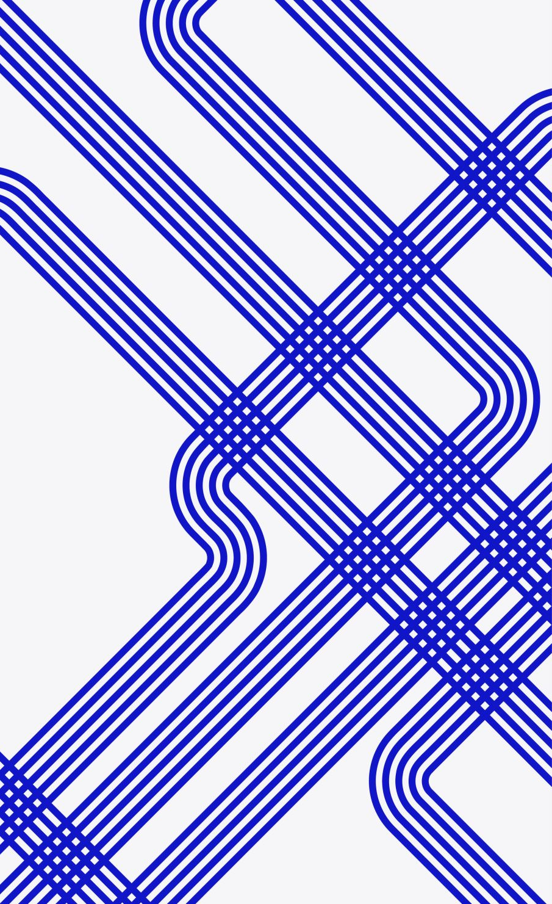
Bus Structures
The different functional modules must be connected in an organized manner to form an operational system.
Bus refers to a group of lines that serves as a connecting path for several devices
The simplest way to connect the functional unit is to use the single bus architecture
Only one data transfer allowed in one clock cycle.
For mulJ-bus architecture, parallelism in data transfer is allowed.

Slide 4
Single-Bus Architecture Inside the Processor
There is a single bus inside the processor.
ALU and the registers are all connected via the single bus.
This bus is internal to the processor and should not be confused with the external bus that connects the processor to the memory and I/O devices.
A typical single-bus processor architecture is shown on the next slide.
Two temporary registers Y and Z are also included
Register Y temporarily holds one of the operands of the ALU.
Register Z temporarily holds the result of the ALU operation.
The multiplexer selects a constant operand 4 during execution of the microoperation:
PC <- PC + 4.

Slide 5
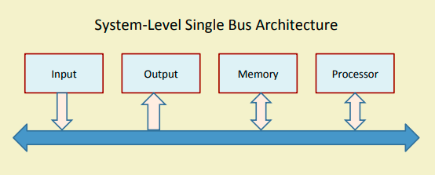

Slide 6
Multi-Bus Architectures
Modern processors have multiple buses that connect the registers and other functional units.
Allows multiple data transfer micro-operations to be executed in the same clock cycle.
Results in overall faster instruction execution.
Results in overall faster instruction execution.
Smaller parasitic capacitance, and hence smaller delay.

Slide 7
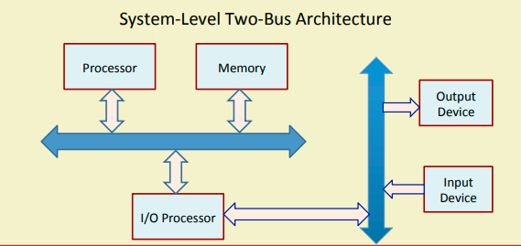

Slide 8
