Slide 1

Basic Structure of Computers
Chapter 1
Lecture: 1-6
Book: Carl Hamacher 5e
Course Outcome: Explain the interconnection between functional units of a computer system and various factors that affects the performance of a computer[Level 2: Understanding]

Slide 2

Performance(T1.6)

Slide 3
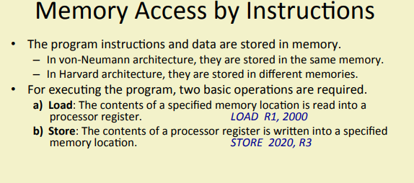

Slide 4
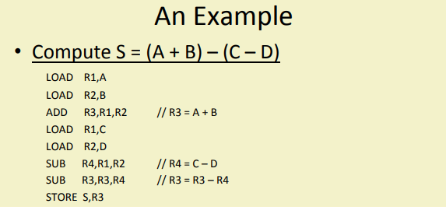

Slide 5
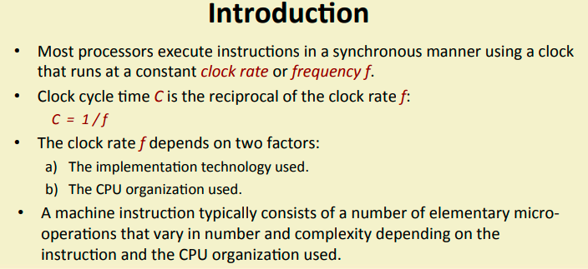

Slide 6
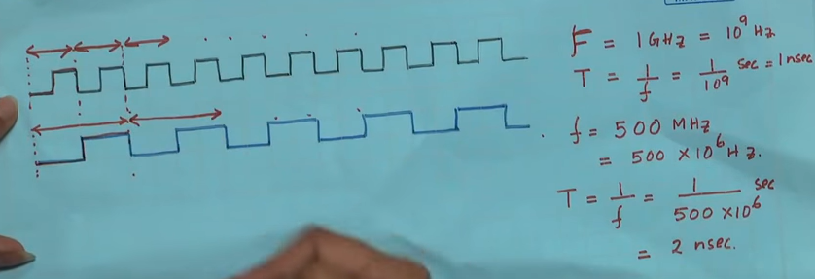

Slide 7
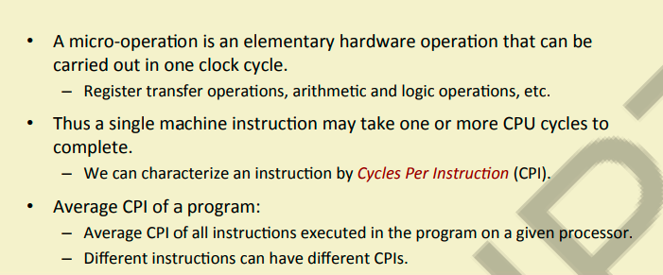

Slide 8
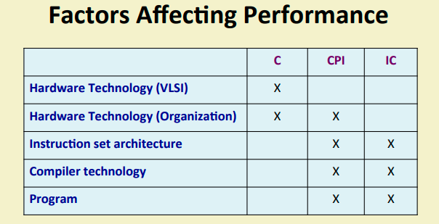

Slide 9
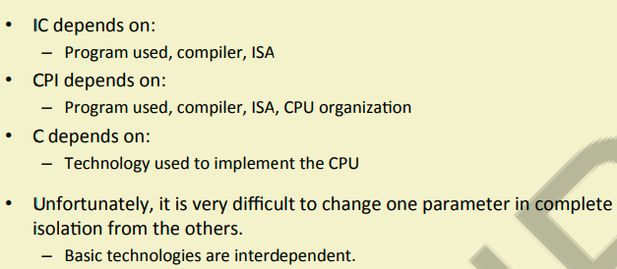

Slide 10
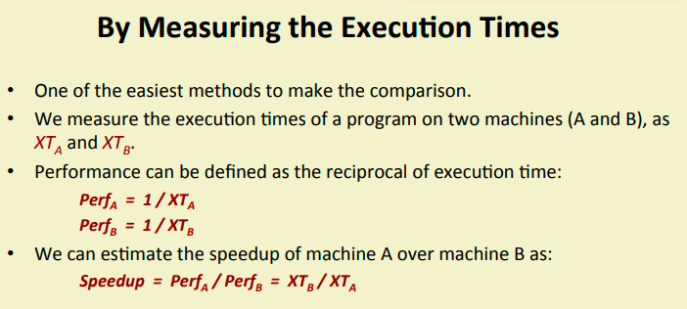

Slide 11
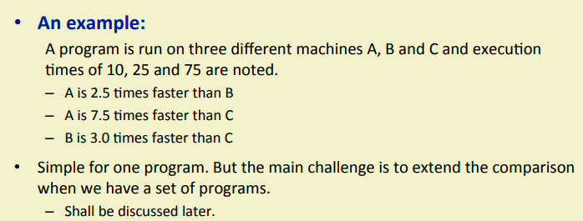

Slide 12
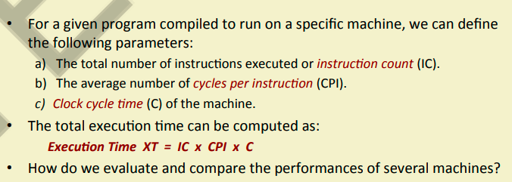

Slide 13
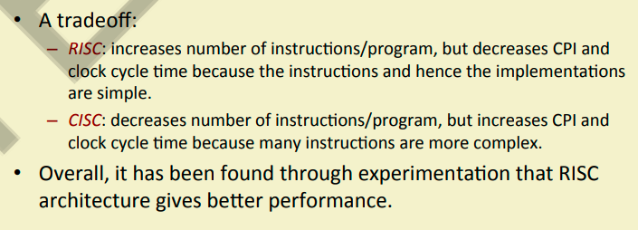

Slide 14

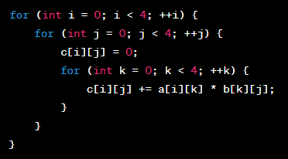
Example or processor performance
Processor A, Processor B, and Processor C—each performing matrix multiplication of two 4x4 matrices. We'll provide examples of machine instructions for each processor to execute the given high-level language (HLL) code.

Slide 15
Processor A: Complex Instructions (Execution Time: 0.64 microseconds)
Execution time: 0.64 microseconds (0.00064 seconds)
CPI for Processor A: 20
Clock speed: 2 GHz (2,000,000,000 Hz)
Number of machine instructions for Processor A: Number of machine instructions = (Execution time) * (Processor clock speed) / (CPI) Number of machine instructions = (0.00064) * (2,000,000,000) / (20) Number of machine instructions = 64,000
Execution time for Processor A: t_A = (Number of machine instructions) * (CPI) / (Processor clock speed) t_A = 64,000 * 20 / 2,000,000,000 t_A = 0.00064 seconds = 0.64 microseconds
Processor B: Intermediate Complexity Instructions (Execution Time: 0.24 microseconds)
Execution time: 0.24 microseconds (0.00024 seconds)
CPI for Processor B: 5
Clock speed: 2 GHz (2,000,000,000 Hz)
Number of machine instructions for Processor B: Number of machine instructions = (Execution time) * (Processor clock speed) / (CPI) Number of machine instructions = (0.00024) * (2,000,000,000) / (5) Number of machine instructions = 96,000
Execution time for Processor B: t_B = (Number of machine instructions) * (CPI) / (Processor clock speed) t_B = 96,000 * 5 / 2,000,000,000 t_B = 0.00024 seconds = 0.24 microseconds
Processor C: Simple Instructions (Execution Time: 0.128 microseconds)
Execution time: 0.128 microseconds (0.000128 seconds)
CPI for Processor C: 2
Clock speed: 2 GHz (2,000,000,000 Hz)
Number of machine instructions for Processor C: Number of machine instructions = (Execution time) * (Processor clock speed) / (CPI) Number of machine instructions = (0.000128) * (2,000,000,000) / (2) Number of machine instructions = 128
Execution time for Processor C: t_C = (Number of machine instructions) * (CPI) / (Processor clock speed) t_C = 128 * 2 / 2,000,000,000 t_C = 0.000000128 seconds = 0.128 microseconds

Slide 16
Performance
The most important measure of a computer is how quickly it can execute programs.
Three factors affect performance:
Hardware design
Instruction set
Compiler

Slide 17
Performance
Processor time to execute a program depends on the hardware involved in the execution of individual machine instructions.
Main
Cache
memory
memory
Processor
Bus
Figure 1.5.
The processor cache.

Slide 18

Performance
The processor and a relatively small cache memory can be fabricated on a single integrated circuit chip.
Speed
Cost
Memory management

Slide 19

Processor Clock
Processor circuits are controlled by a timing signal called a Clock.
The clock defines regular time intervals, called clock cycle.
The execution of each instruction is divided into several steps, each of which completes in one clock cycle.
The length P of one clock cycle affects processor performance.
The clock rate is inverse of P. i.e., R =1/P cycles per second.
If P = 1ns then R will be 1 GHz.
Hertz – cycles per second

Slide 20
Basic Performance Equation
T – processor time required to execute a program that has been prepared in high-level language
N – number of actual machine language instructions needed to complete the execution (note: loop)
S – average number of basic steps needed to execute one machine instruction. Each step completes in one clock cycle
R – clock rate
Note: these are not independent to each other
How to improve T?

Slide 21
Clock Rate
Increase clock rate
Improve the integrated-circuit (IC) technology to make the circuits faster
Reduce the amount of processing done in one basic step (however, this may increase the number of basic steps needed)
Increases in R that are entirely caused by improvements in IC technology affect all aspects of the processor’s operation equally except the time to access the main memory.

Slide 22
Pipeline and Superscalar Operation
Instructions are not necessarily executed one after another.
The value of S doesn’t have to be the number of clock cycles to execute one instruction.
Pipelining – overlapping the execution of successive instructions.
Example: Add R1, R2, R3
Superscalar operation – multiple instruction pipelines are implemented in the processor.
Goal – reduce S (could become <1!)
Issue: Must preserve Logical correctness of the program

Slide 23
CISC and RISC
Tradeoff between N and S
A key consideration is the use of pipelining
S is close to 1 even though the number of basic steps per instruction may be considerably larger
It is much easier to implement efficient pipelining in processor with simple instruction sets
Reduced Instruction Set Computers (RISC)
Complex Instruction Set Computers (CISC)

Slide 24
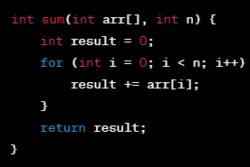
Examples of machine instructions required to execute the given high-level language (HLL) code for calculating the sum of an array on both RISC and CISC architectures.

Slide 25
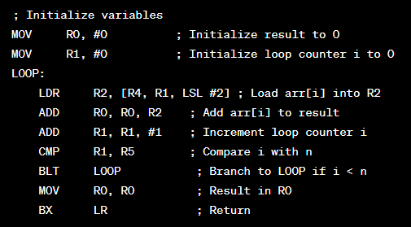
Implementation on RISC Architecture (Example: ARM): For the sake of illustration, let's assume an ARM-based RISC architecture.
Machine Instructions for RISC:
In this example, the loop iteration requires several instructions, including loading from memory and arithmetic operations.

Slide 26
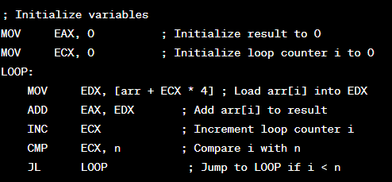
Implementation on CISC Architecture (Example: x86):
Similarly, on the x86 architecture, the loop involves multiple instructions for loading, addition, and comparison.

Slide 27
Comparison:
In this example, the RISC architecture's instructions tend to be more orthogonal and focused on simple operations. The CISC architecture's instructions can be more complex and capable of performing multiple tasks in a single instruction.
However, it's important to note that modern processors often utilize complex optimizations and micro-architectural techniques that can blur the distinction between RISC and CISC in terms of execution efficiency. The examples provided here are simplified representations for illustration purposes.

Slide 28
let's compare the execution times of the examples implemented on RISC and CISC architectures for calculating the sum of an array. We'll assume the following details for comparison:
For simplicity, we'll assume that each instruction takes a fixed amount of time.
We'll consider the execution times of the specific loop portion since that's where the main computation occurs.
We'll use the number of iterations (n) as 1000.
RISC Architecture (ARM):
Loop body instructions: 4 (Load, Add, Add, Compare)
Loop iterations: 1000
Total execution time (RISC) = (Loop body instructions) * (Loop iterations) Total execution time (RISC) = 4 * 1000 = 4000 instructions
CISC Architecture (x86):
Loop body instructions: 5 (Move, Load, Add, Increment, Compare)
Loop iterations: 1000
Total execution time (CISC) = (Loop body instructions) * (Loop iterations) Total execution time (CISC) = 5 * 1000 = 5000 instructions

Slide 29

Discussion
Assuming that both RISC and CISC architectures have similar clock speeds, the comparison between the execution times would suggest that the RISC architecture would generally execute the loop faster due to its slightly shorter loop body instruction sequence.
However, it's essential to understand that the actual execution time can vary significantly due to factors like pipelining, caching, branch prediction, and other micro-architectural optimizations. Additionally, modern processors often employ techniques that make performance comparisons more complex than a simple instruction count analysis.
This comparison highlights the general idea that RISC architectures tend to have simpler instructions and more straightforward execution paths, which can lead to potentially better performance in scenarios where the instruction mix is conducive to efficient pipelining and reduced instruction latency.

Slide 30
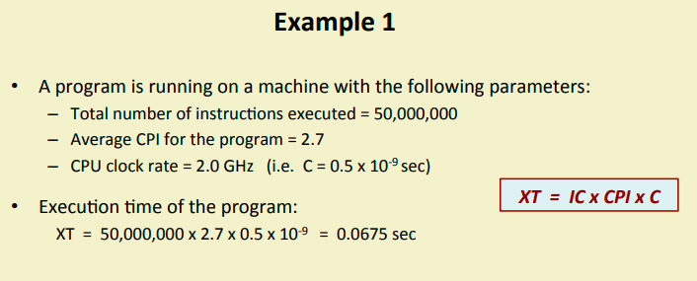

Slide 31
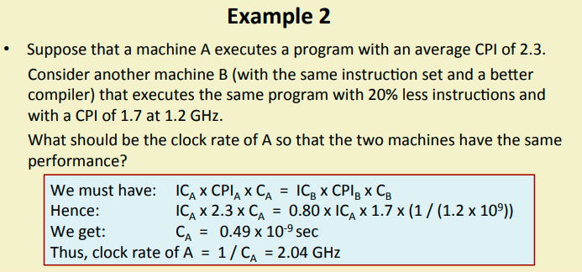

Slide 32
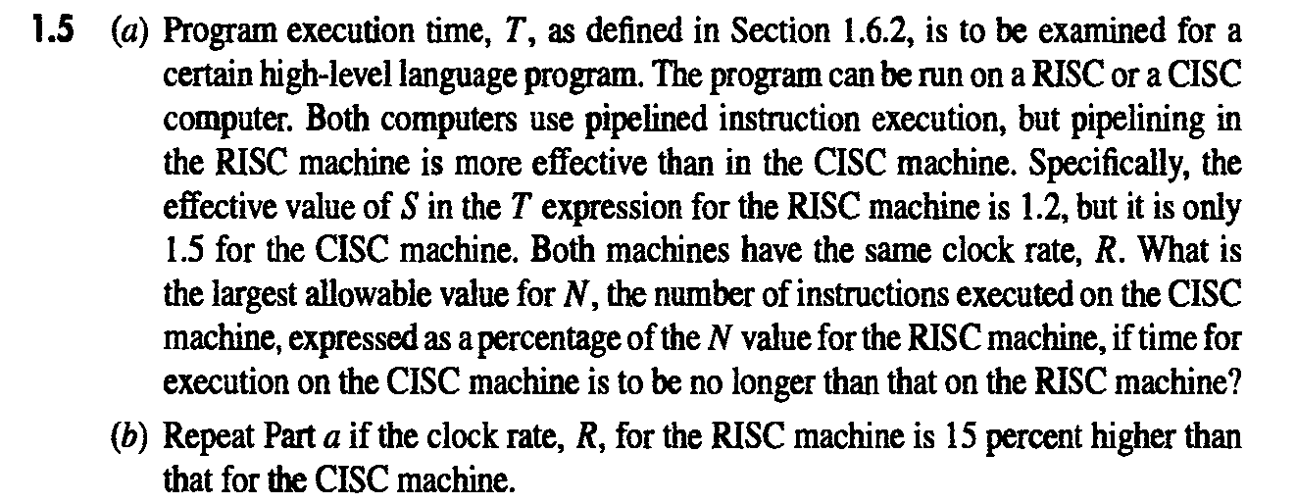

Slide 33
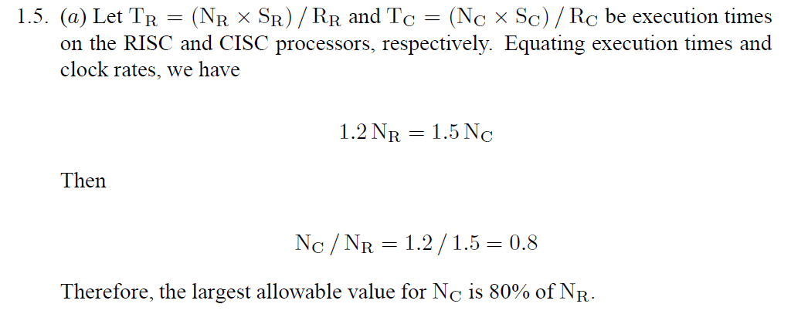

Slide 34
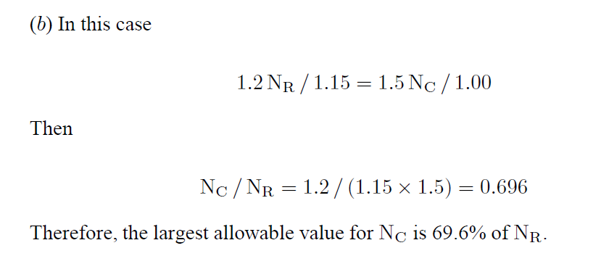

Slide 35
Compiler
A compiler translates a high-level language program into a sequence of machine instructions.
To reduce N, we need a suitable machine instruction set and a compiler that makes good use of it.
Goal – reduce N×S
A compiler may not be designed for a specific processor; however, a high-quality compiler is usually designed for, and with, a specific processor.

Slide 36
Performance Measurement
T is difficult to compute.
Measure computer performance using benchmark programs.
System Performance Evaluation Corporation (SPEC) selects and publishes representative application programs for different application domains, together with test results for many commercially available computers.
Compile and run (no simulation)
Reference computer

