Slide 1
VIRTUALIZATION
A Brief overview of What is Virtualization

Slide 2
What is Virtualization?
Virtualization is the creation of a virtual (rather than actual) version of something, such as an operating system, a server, a storage device or network resources.

Slide 3
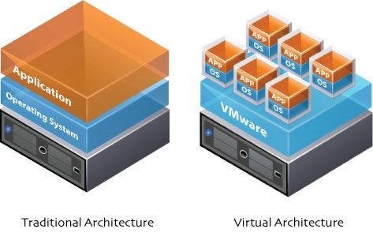
What is Virtualization?

Slide 4
Difference between Virtualization and Partitioning
A partition is the logical division of a hard disk drive to create, in effect, two separate hard drives.
Operating system virtualization is the use of software to allow a piece of hardware to run multiple operating system images at the same time.

Slide 5
Dual boot v/s Virtual machine
Virtualization and dual booting refer to two different ways to run two or more different operating systems on the same hardware.
Achieving multiple usable operating systems on a single computer is known as 'dual boot'. This refers to a custom boot loader configuration on your primary drive which allows you to select an operating system during startup.
Visualization refers to technology that allows for the creation of a virtual computer running "on top" of an existing operating system as if it was just another program.

Slide 6
Dual boot v/s Virtual machine
(Dual Boot)

Slide 7
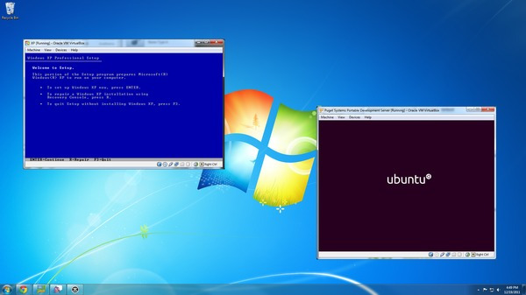
Dual boot v/s Virtual machine
(Virtualization)

Slide 8
Areas Of Virtualization
Network virtualization
Storage virtualization
Server virtualization

Slide 9
Areas Of Virtualization a)Network virtualization
Network virtualization is a method of combining the available resources in a network by splitting up the available bandwidth into channels.
Each channel is independent from the others, and each of which can be assigned to a particular server or device in real time

Slide 10
Areas Of Virtualization b)Storage virtualization
Storage virtualization is the pooling of physical storage from multiple network storage devices into what appears to be a single storage device that is managed from a central console.
Storage virtualization is commonly used in storage area networks (SANs).

Slide 11
Areas Of Virtualization c)Server virtualization
Server virtualization is the masking of server resources from server users.
The intention is to spare the user from having to understand and manage complicated details of server resources while increasing resource sharing and utilization.

Slide 12
Who is Responsible for Virtualization?How?
Each “guest” OS is managed by a Virtual Machine Monitor (VMM), also known as a hypervisor.
Virtualization system sits between the guest and the hardware, it can control the guests’ use of CPU, memory, and storage, even allowing a guest OS to migrate from one machine to another.

Slide 13
Types Of Hypervisors
There are 2 types of Hypervisors:
Bare-Metal Hypervisors
Hosted Hypervisors

Slide 14
Types Of Hypervisors a)Bare-metal Hypervisor
Bare-metal hypervisors, the most commonly deployed type, install directly onto the computing hardware.
The OS installs and runs above the hypervisor.

Slide 15
Types Of Hypervisors b)Hosted Hypervisor
A hosted hypervisor, on the other hand, runs within the OS and allows additional OS and application instances to run on top of it.

Slide 16
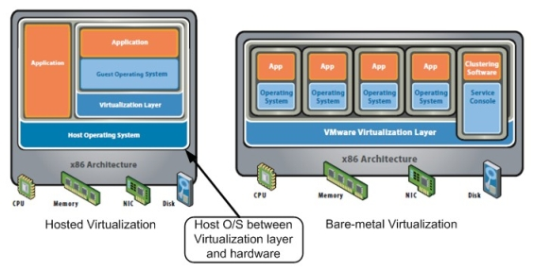
Types Of Hypervisors

Slide 17
Levels Of Virtualization
There are 3 levels of virtualization
Full virtualization
Lightweigh
Paravirtualization

Slide 18
Levels Of Virtualization a)Full virtualization
Here the hypervisor provides a fully emulated machine in which an operating system can run.
VMWare is a good example.

Slide 19
Levels Of Virtualization b)Light-weight virtualization
Here the host OS spawns additional copies of itself.
It is also called as Single Kernel Image (SKI)
This avoid the performance problems with that of pure emulation. While the flexibility still remains a problem.

Slide 20
Levels Of Virtualization c)Paravirtualization
This is known as hardware-assisted virtualization, and improves performance significantly
In order to retain flexibility, the guest OS is not tied to its host OS. Drastically different operating systems can be running in a hypervisor at the same time

Slide 21
Advantages of Virtualization
Improvement of overall resource utilization while providing room for improved performance for preferred applications
More efficient use of existing servers
Ability to perform hardware and software maintenance on secondary systems.
Ability to easily create backups of existing systems can help support business continuity and aid in disaster recovery
Ability to isolate applications in separate virtual environments can simplify support and reduce the likelihood of "application collisions" or incompatibilities created when several applications are hosted on one system

Slide 22
Bibliography
http://searchservervirtualization.techtarget.com/definition/virtualization
http://cats.lsa.umich.edu/Policy-Help/virtual-machines-dual-booting
https://www.pugetsystems.com/labs/articles/Dual-Boot-vs-Virtual-Machines-on-the-Desktop-128/
http://www.redhat.com/f/pdf/virtualization/gunner_virtual_paper2.pdf
https://support.ca.com/phpdocs/0/common/impcd/r11/virtualization/virt_main.htm
http://cdn.ttgtmedia.com/ITKE/uploads/blogs.dir/28/files/2009/10/whatisvirt12.jpg

