Slide 1

Distributed CDN Simulator with Latency-Aware Routing and Adaptive Caching
Mini-project presentation
Computer Networks Laboratory (CSE20110)
Department of Computer Engineering and Technology
More Geet Dattatraya – 1262250006 Shinde Soham Manoj – 1262250009
Jagtap Prasad Sachin – 1262250018 Gaikwad Shreyash Sachin – 1262250005
Group 2 Panel E Batch E-1
Faculty: Dr. Swati
Academic Year: 2026–2027 Presentation date: 21st October 2026
Computer Networks Laboratory CSE20110
15 seconds
Notes:
Suggested time: 15 seconds. Introduce the project title and Group 2 (four members, guided by Dr. Swati). Do not read every PRN.

Slide 2
Problem and Objectives
Problem
A CDN must pick an edge per request: the nearest edge may be overloaded, degraded or down [4].
Latency grows with distance and queueing; caching avoids origin trips but capacity is limited [5].
Objectives
1. Serve content over real HTTP/TCP via UDP resolution, with 6 routing strategies
2. Reduce origin fetches with per-edge LRU / LFU / TTL caches
3. Detect edge failures, reroute, and measure detection and recovery time
Computer Networks Laboratory CSE20110
40 seconds
Notes:
Suggested time: 40 seconds. The problem: choosing an edge that balances latency, load and health, while caching popular content. Scope: a working miniature CDN with one origin and three edges whose behaviour we can measure. Three measurable objectives as listed.

Slide 3
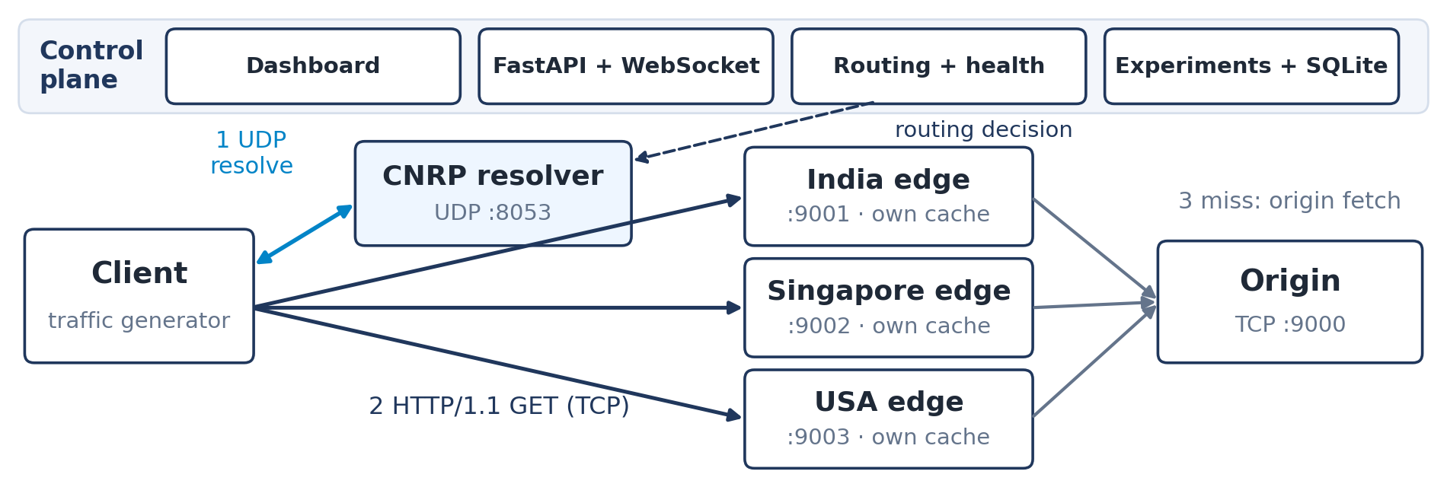
Proposed Design and Tools
Tools: Python 3.13 (asyncio, FastAPI, SQLite), React 18 + Vite, pytest / Vitest
Protocols: HTTP/1.1 over TCP [1]; DNS-inspired CNRP over UDP [2], [3]; WebSocket
Addressing: 127.0.0.1 – API :8000, resolver udp/8053, origin :9000, edges :9001–9003
Computer Networks Laboratory CSE20110
45 seconds
Notes:
Suggested time: 45 seconds. Data plane: the client resolves cdn.sim.local over UDP, then downloads from the selected edge over HTTP/1.1; on a miss the edge fetches from the origin. Each edge is its own process with its own cache. Control plane: FastAPI with the routing engine, health checks, experiments and SQLite, plus the React dashboard. Locations and link conditions are simulated in Local Mode.

Slide 4
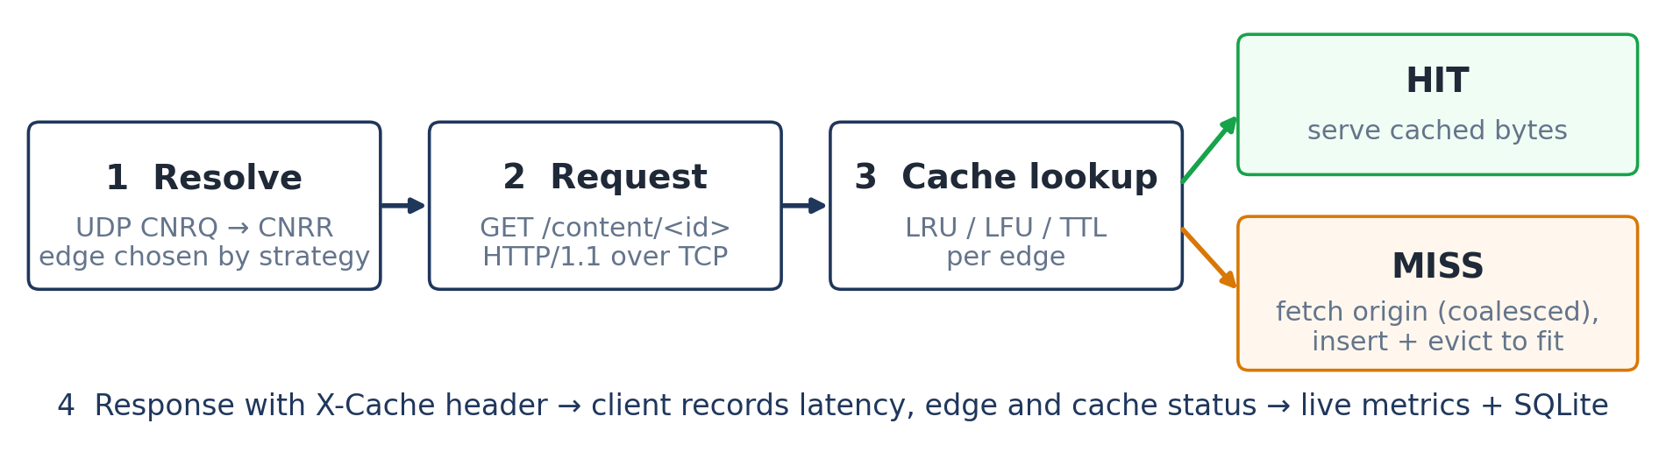
Implementation and Working
Implementation: origin + 3 edge processes, UDP resolver, routing engine, health checks
Working: hybrid score = 0.5·latency + 0.4·load + 0.1·loss; unhealthy edges skipped
Troubleshooting: Windows timer inflated an 18 ms link to ~30 ms; 1 ms timer fix gave 21.6 ms
Computer Networks Laboratory CSE20110
55 seconds
Notes:
Suggested time: 55 seconds. Walk through the request: resolve, request, cache lookup, hit or miss. Concurrent misses for the same object share one origin fetch. Hybrid routing combines measured probe RTT, load and estimated packet loss. Troubleshooting example: asyncio sleeps on Windows were quantised to 15.6 ms; requesting a 1 ms timer (and opting child processes out of timer throttling) fixed the simulated delays, verified by probe RTTs of 21.6 / 46.4 / 114.1 ms for 18 / 42 / 110 ms profiles.

Slide 5
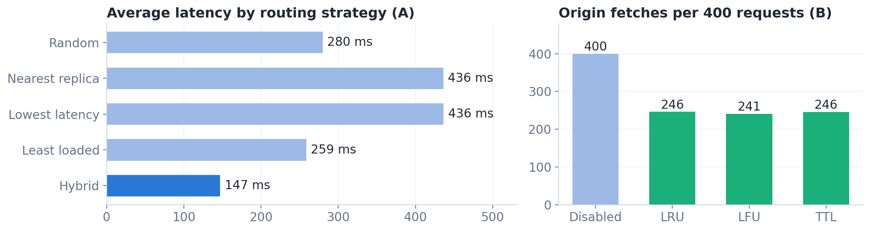
Testing and Results
Test: 89 automated tests + 16 browser checks; 4 experiments, Local Mode, seed 7
Expected: hybrid beats single-metric routing under load; caching cuts origin fetches
Observed: hybrid 147 ms vs nearest 436 ms avg; origin fetches 400 → 241 (LFU); failure detected in 2.1 ms
Objectives achieved: O1–O3 achieved; Mininet run not tested (simulated links)
Computer Networks Laboratory CSE20110
50 seconds
Notes:
Suggested time: 50 seconds. All 89 automated tests pass (79 backend, 10 frontend). Experiment A (400 requests per strategy, concurrency 24, mean of 3): hybrid 147 ms average and 143 req/s versus nearest 436 ms, because the nearest edge has only 8 slots and queues. Experiment B (2 MB caches): origin fetches fell from 400 to about 241. Experiment C: India failure detected passively in 2.1 ms, 8 in-flight requests failed, recovery 882 ms. These are simulator measurements on one machine, not real-CDN claims.

Slide 6
Working Demonstration
Function to demonstrate
Cache miss → hit on one edge, then an edge failure with automatic rerouting
1. Start backend + dashboard: Overview shows Live and 3 healthy edges
2. Routing Lab: select Health-aware failover; send index.html twice
3. Edge Servers: simulate India failure; Routing Lab: send again
Success criterion: request 2 shows X-Cache HIT; after the failure India is Unhealthy and request 3 returns HTTP 200 from Singapore
Computer Networks Laboratory CSE20110
65 seconds
Notes:
Suggested time: 65 seconds. Start the backend and frontend before the timer. Rehearsed on 20 Oct 2026 (submission/evidence/demo_rehearsal.txt): request 1 MISS on india-edge (50.5 ms), request 2 HIT (21.8 ms); after simulating the failure India was marked unhealthy in 2.35 s and request 3 returned HTTP 200 from singapore-edge with reason 'excluded unhealthy: india-edge'. Restore the edge afterwards. Backup: show the Experiments page for the stored failure experiment (identify it as a recorded result).

Slide 7
Conclusion and Contributions
Outcome: working mini-CDN – real TCP/UDP, 6 routing strategies, 3 cache policies
Application: teaching and prototyping CDN routing and DNS-TTL failover
Limitation: one machine; latency and loss are simulated; Mininet not run
Future scope: run on Mininet with tc/netem links and verify in Wireshark
AI use: Claude Code (Anthropic) generated code, tests, docs and drafts; team must review and verify
Computer Networks Laboratory CSE20110
30 seconds
Notes:
Suggested time: 30 seconds. Summarise the outcome, one application, the main limitation (single machine with simulated links) and the next step (Mininet + Wireshark). State each member's actual contribution (to be filled in by the team) and the AI-use declaration.

Slide 8
References
[1] R. Fielding et al., “HTTP Semantics,” IETF RFC 9110, Jun. 2022.
[2] P. Mockapetris, “Domain Names – Implementation and Specification,” IETF RFC 1035, Nov. 1987.
[3] J. Postel, “User Datagram Protocol,” IETF RFC 768, Aug. 1980.
[4] E. Nygren, R. K. Sitaraman, J. Sun, “The Akamai network,” ACM SIGOPS OSR, 44(3), 2010, doi: 10.1145/1842733.1842736.
[5] L. Breslau et al., “Web caching and Zipf-like distributions,” IEEE INFOCOM ’99, pp. 126–134, doi: 10.1109/INFCOM.1999.749260.
[6] B. Lantz, B. Heller, N. McKeown, “A network in a laptop,” ACM HotNets-IX, 2010, doi: 10.1145/1868447.1868466.
Full IEEE reference list, evidence and source: project report and repository docs/
Computer Networks Laboratory CSE20110
Backup slide
Notes:
Backup slide for questions. References cited on slides 2, 3 and 5; the report contains the complete list.

