Slide 1
BETTA-DRIVER

Slide 2
MOTIVATION
LACK OF MONITORING THE QUALITY OF DRIVING IN TRANSPORT AGENCIES IS A MAJOR CAUSE OF ROAD ACCIDENTS.
AROUND 3 MILLION PEOPLE ARE INJURED EVERY YEAR IN ROAD ACCIDENTS.

Slide 3
PROBLEM STATEMENT
QUALITY OF DRIVING IS AN IMPORTANT AND A HARD FACTOR TO GAUGE BY TRANSPORT AGENCIES.
IN BETTA-DRIVER,WE DENOTE THE RASHNESS IN DRIVING OF DRIVERS WITH A NUMERICAL SCORE FOR EVERY RIDE.
THIS SCORE FOLLOWS AN UPHILL/DOWNHILL PATTERN DEPENDING ON THE NUMBER OF HARD BRAKING AND RASH TURNS TAKEN BY A DRIVER.

Slide 4
GOAL DESCRIPTION
BETTA-DRIVER IS A MOBILE APPLICATION THAT VISUALLY REPRESENTS THE SAFE-DRIVING SCORES OF DRIVERS IN TRANSPORT AGENCIES.
HIGHLY RASH DRIVING IS DENOTED BY A DOWNHILL PROGRESSION OF THE VISUAL MODEL TO BOTH THE DRIVER AND HIS SUPERVISOR.
THIS SAFE-DRIVING SCORE CAN BE USED TO DECIDE APPROPRIATE PAY INCENTIVES FOR THE DRIVERS.

Slide 5
IMPLEMENTATION
BETTA-DRIVER IS AN ANDROID APPLICATION THAT OBTAINS REAL-TIME MOTION DATA FROM THE ACCELEROMETER OF THE DRIVER’S SMARTPHONE.
COMBINING THE INDIVIDUAL PARAMETERS INTO AN AGGREGATE SCORE, A VALUE GREATER THAN 2.7F IS SEEN AS RASH-DRIVING LEADING TO DOWNHILL PROGRESSION OF THE VISUAL MODEL IN THE APPLICATION.

Slide 6
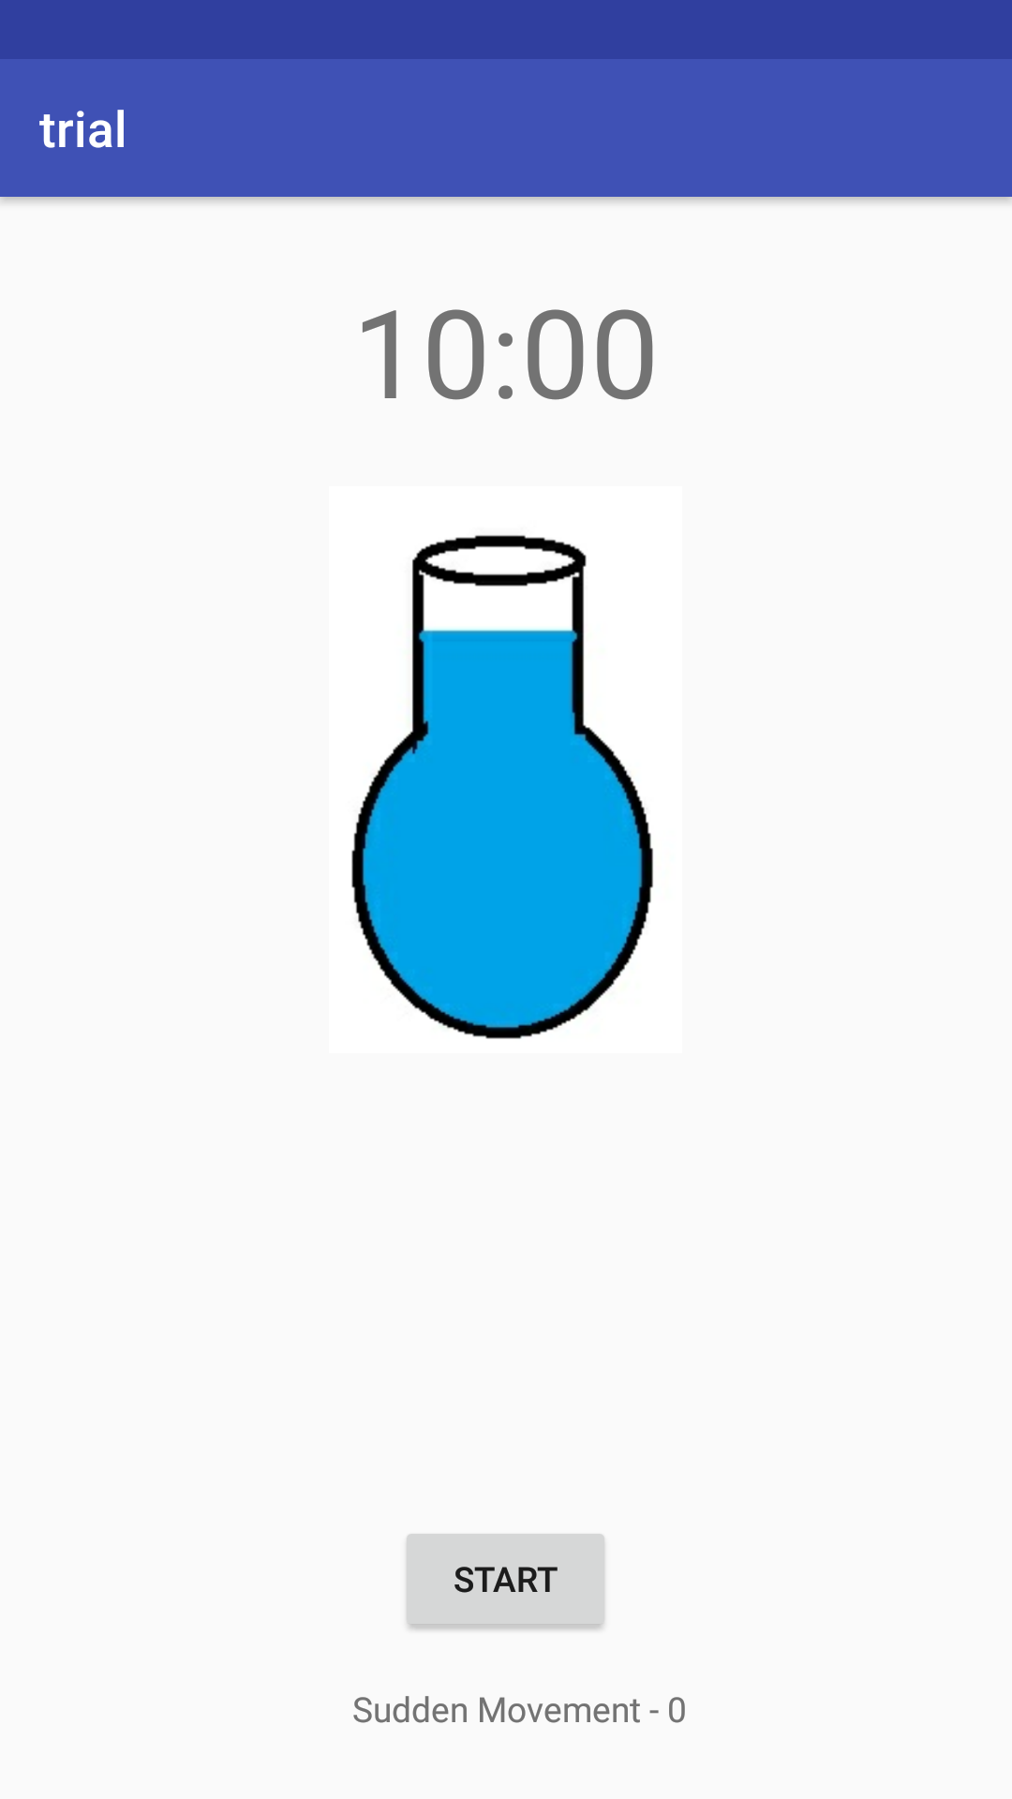
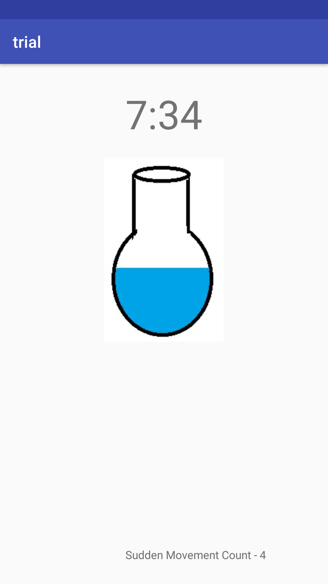
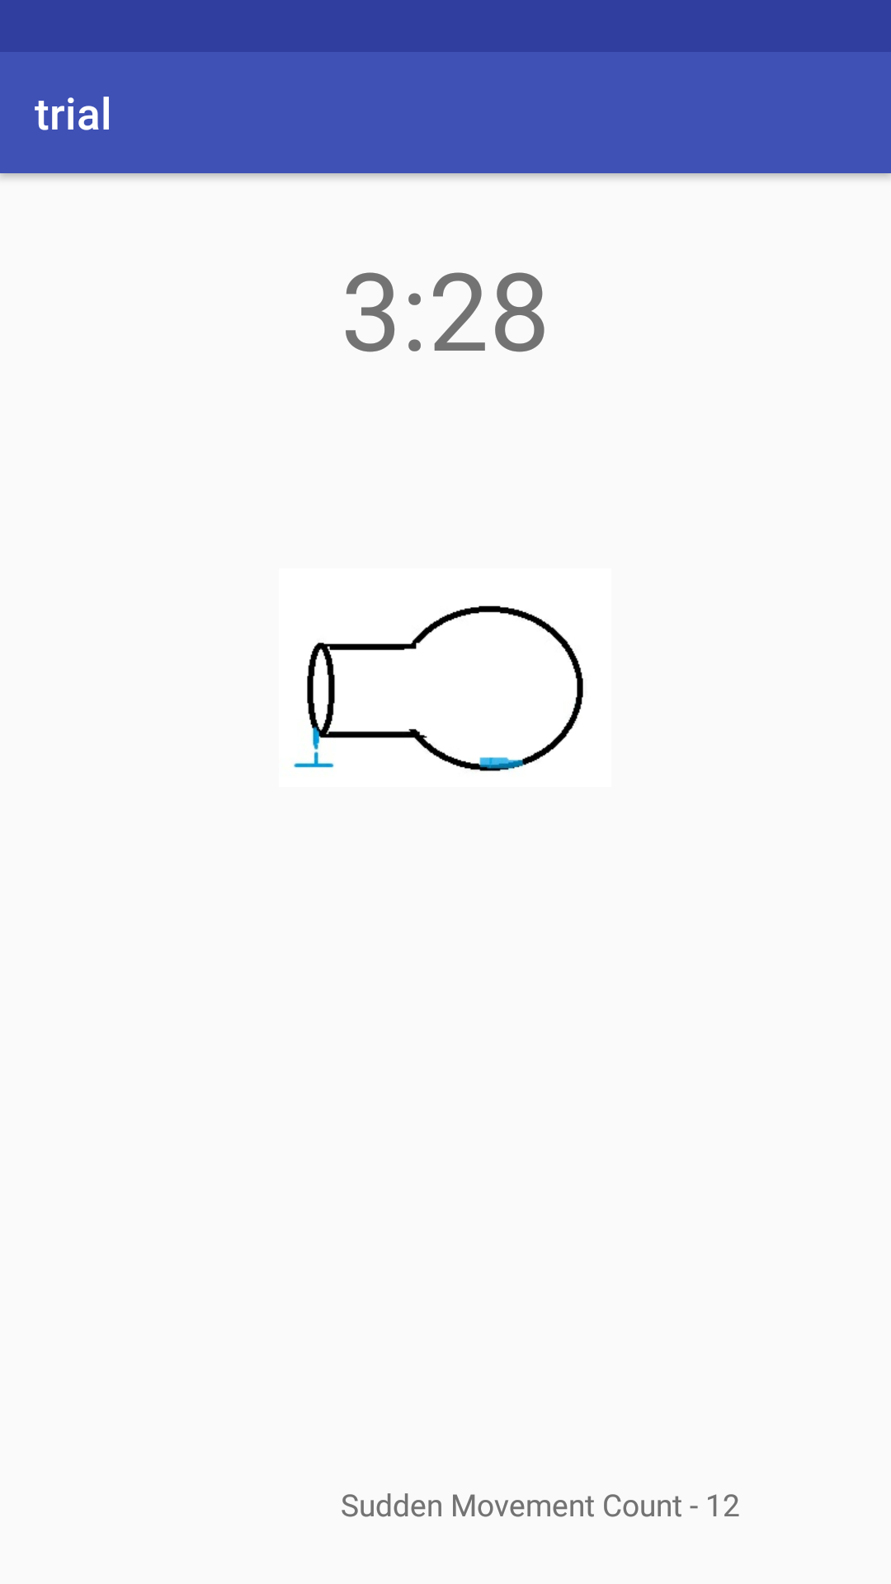

Slide 7
FUTURE SCOPE
BETTA-DRIVER AIMS TO BE A BENCHMARK STANDARD FOR PROMOTING SAFE-DRIVING AND MAKING DRIVERS MORE SELF-AWARE AND SAFETY-AWARE DURING RIDES.
FORESEEING THE RISE OF DRIVERLESS CARS, THIS SOLUTION WILL BE A “DRIVING” FACTOR TO INDICATE TO THE GENERAL PUBLIC THE SAFETY AND QUALITY OF DRIVING OF THESE CARS.

