Slide 1
RPS
learn..evolve
WIPRO NGA Program_26SUB0726_JAVA J2EE INTEGRATION
Capstone Project Presentation – 23 June 2026
Project Title Here – HelpDesk Ticketing System
Presented by - 70243 Geetanshu Kalra
70247 Neehal Rajput
www.rpsconsulting.in
General – RPS Data

Slide 2
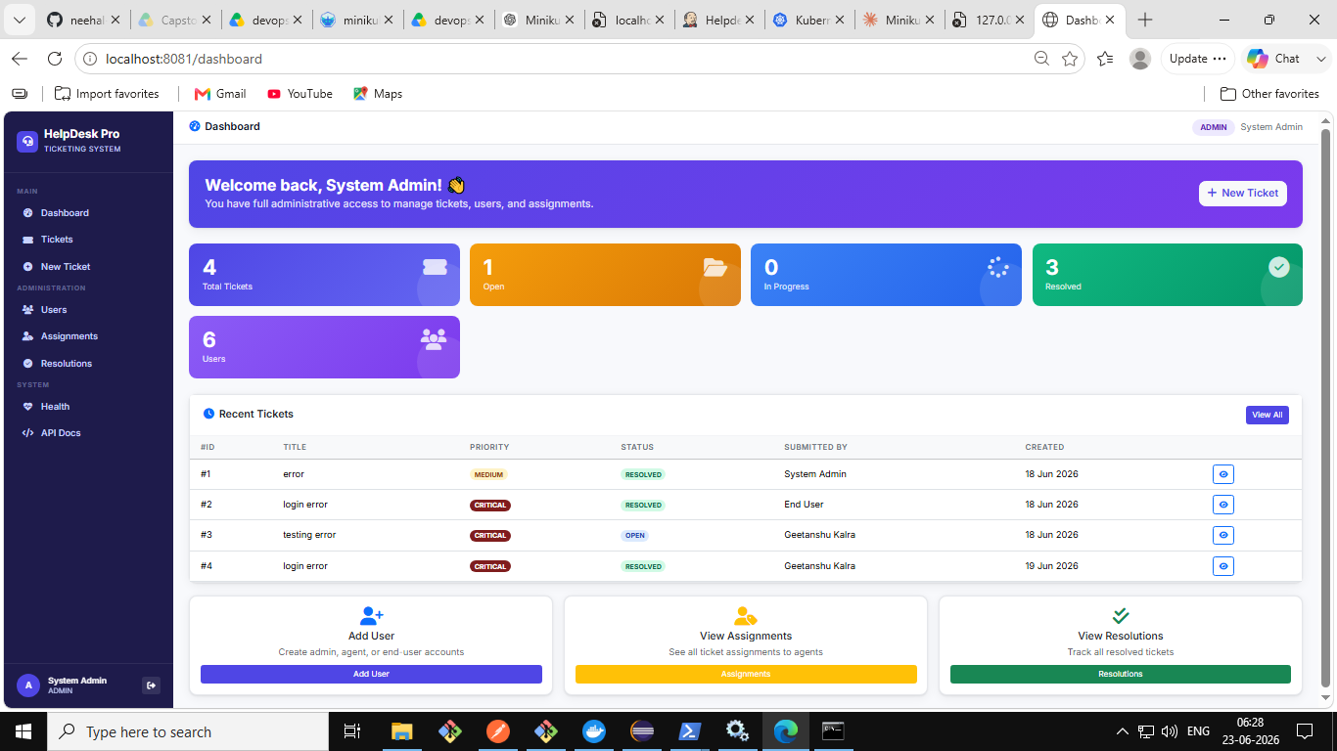
Project Overview
🌐 Web-Based Application
Role-based Helpdesk Ticketing System built with Spring Boot
🎫 Ticket Management
Users can create, track, and resolve support tickets
👥 Multi-Role Access
Admin, Agent, and End-User roles with different permissions
🔧 Tech Stack
Spring Boot · Spring Security · Hibernate/JPA · MySQL · Thymeleaf
2026 · RPS Consulting · Capstone Presentation

Slide 3
Key Features
🔐
🎫
📊
Role-Based Auth
Ticket Lifecycle
Admin Dashboard
Admin · Agent · End-User with Spring Security
Create, assign, track and resolve tickets
Real-time stats: tickets, users, assignments
👤
📋
✅
User Management
Assignments
Resolutions
Full CRUD for all users and roles
Assign tickets to agents, track workload
Document resolutions and close tickets
2026 · RPS Consulting · Capstone Presentation

Slide 4
Tools & Technologies
Backend
Frontend
Database
DevOps
Tools
▸ Java 17
▸ Thymeleaf (SSR)
▸ MySQL 8.0
▸ Docker
▸ Eclipse IDE
▸ Spring Boot 3.2.5
▸ HTML5 / CSS3
▸ Spring Data JPA
▸ Kubernetes (Minikube)
▸ Postman
▸ Spring Security (JWT)
▸ JavaScript
▸ Hibernate ORM 6.4
▸ Jenkins CI/CD
▸ Swagger UI
▸ Hibernate / JPA
▸ Bootstrap
▸ Git / GitHub
▸ MySQL Workbench
▸ Maven
Architecture: Controller → Service → Repository → MySQL Database (MVC Layered Architecture)
2026 · RPS Consulting · Capstone Presentation

Slide 5
Project Design & Architecture
Client
(Browser)
Controller
Layer (API)
Service Layer
(Business Logic)
Repository
Layer (DB Access)
MySQL
Database
→
→
→
→
Key Design Principles
✦ MVC Architecture
✦ DTO Pattern
Clean separation of concerns across Controller, Service, Repository
Dedicated Data Transfer Objects prevent exposing entities directly
✦ JWT Security
✦ Exception Handling
Stateless authentication with role-based access control
Global exception handler with meaningful error responses
2026 · RPS Consulting · Capstone Presentation

Slide 6
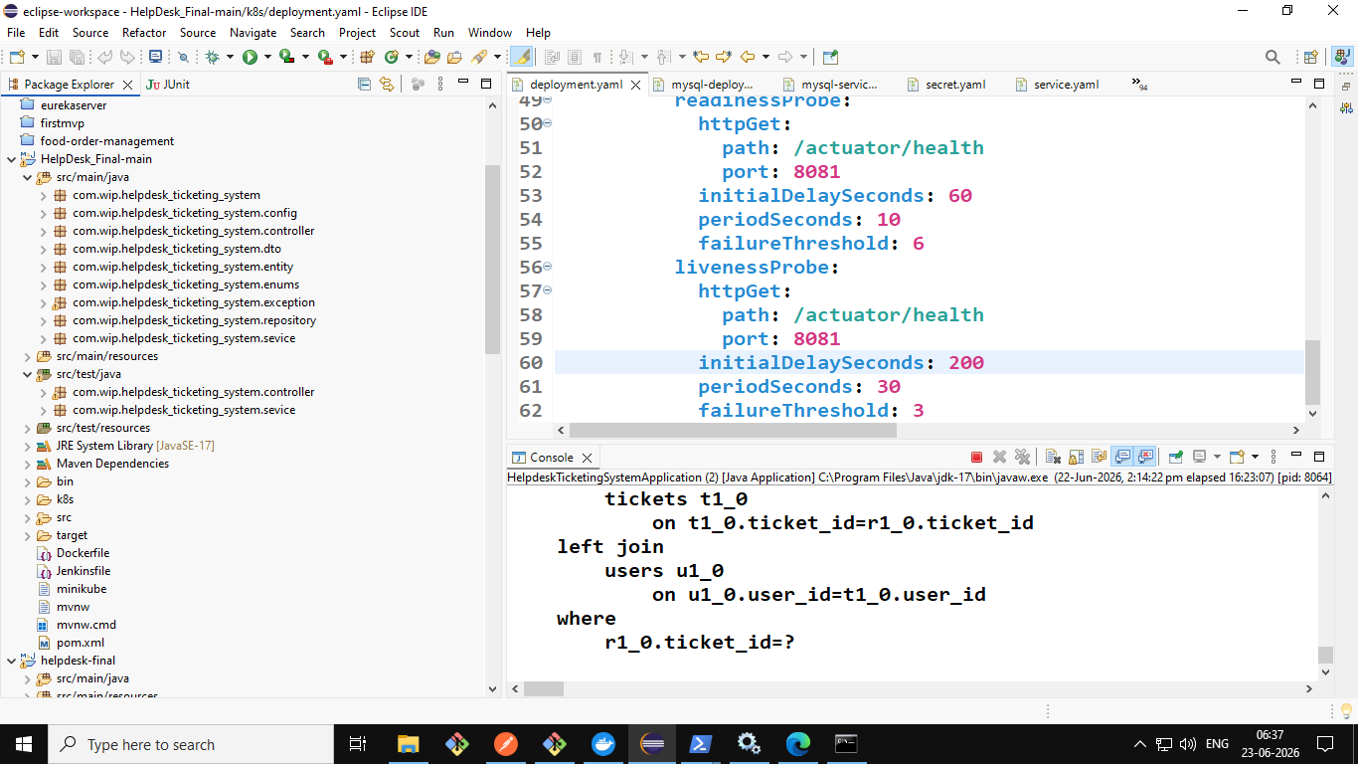
Project Structure
com.wip.helpdesk_ticketing_system
├── controller
├── service
├── repository
├── entity
├── dto
├── config
├── enums
├── exception
└── sevice (impl)
Eclipse IDE – HelpDesk Project Structure
2026 · RPS Consulting · Capstone Presentation

Slide 7
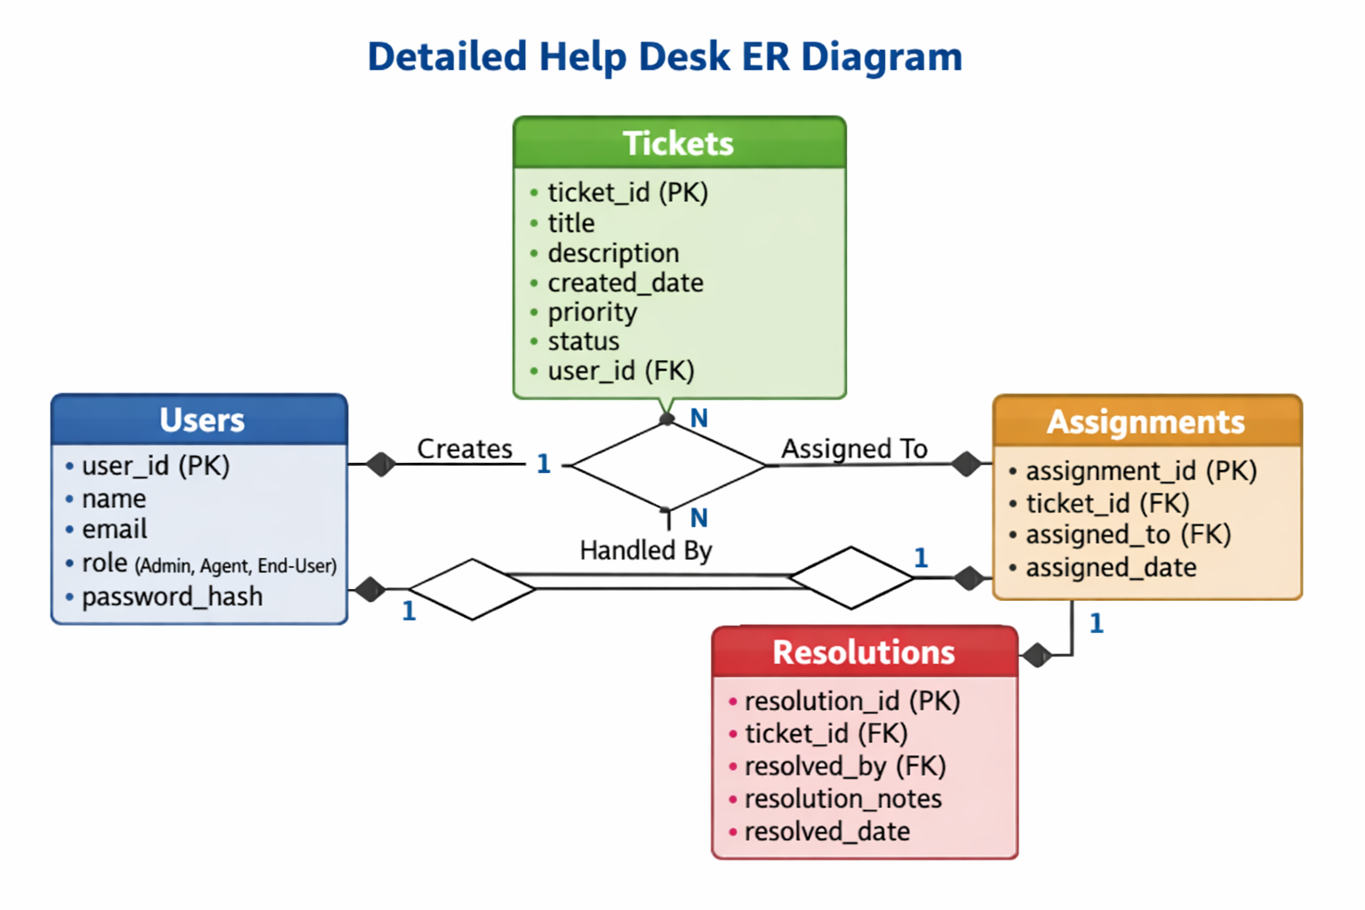
Database Design — ER Diagram
Users
user_id, name, email, role, password_hash
Tickets
ticket_id, title, description, priority, status, user_id (FK)
Assignments
assignment_id, ticket_id (FK), assigned_to (FK), date
Resolutions
resolution_id, ticket_id (FK), resolved_by, notes, date
2026 · RPS Consulting · Capstone Presentation

Slide 8
DevOps — CI/CD Pipeline
📥
⚙️
🧪
🐳
🚀
→
→
→
→
Stage 1
Stage 2
Stage 3
Stage 4
Stage 5
Checkout
Build
Test
Docker Build
Deploy
Pull source code from GitHub
mvn clean package -DskipTests
JUnit tests, publish results
Build image inside Minikube Docker
kubectl apply to Kubernetes
Kubernetes Deployment
secret.yaml
configmap.yaml
mysql-deployment.yaml
deployment.yaml
service.yaml
DB credentials (base64 encoded)
App config — port, DB name
MySQL 8.0 pod with emptyDir volume
Spring Boot app pod, probes, env vars
NodePort 30081 → 8081 (external access)
2026 · RPS Consulting · Capstone Presentation

Slide 9
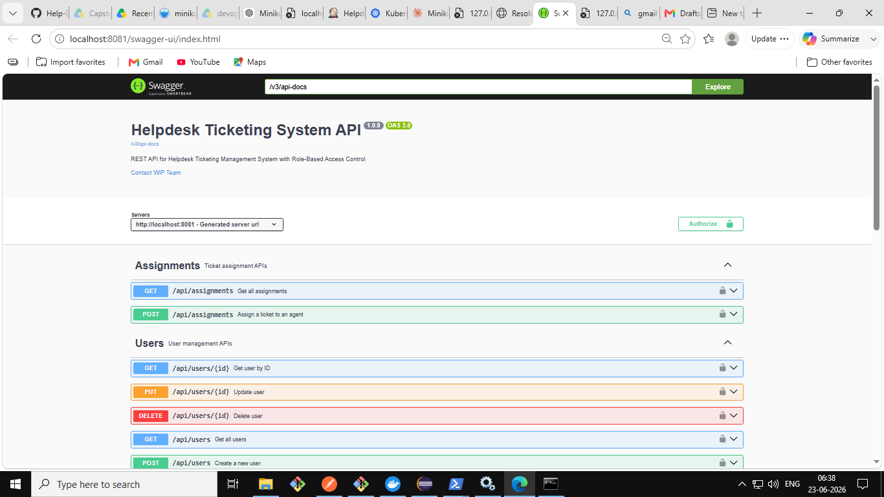
REST API — Swagger Documentation
API Endpoints
GET
/api/users
Get all users
POST
/api/users
Create new user
PUT
/api/users/{id}
Update user
DELETE
/api/users/{id}
Delete user
GET
/api/tickets
Get all tickets
POST
/api/assignments
Assign ticket
GET
/actuator/health
Health check
2026 · RPS Consulting · Capstone Presentation

Slide 10
Test Cases
Unit Testing with JUnit 5 & Mockito — Controller and Service layers
Test Case | Layer | Expected Result | Status
Create Ticket | Service | Ticket created with valid data | ✅ Pass
Get Ticket by ID | Service | Correct ticket returned | ✅ Pass
Get All Tickets | Service | List of all tickets | ✅ Pass
Update Ticket | Service | Ticket details updated | ✅ Pass
Delete Ticket | Service | Ticket removed successfully | ✅ Pass
Assign Ticket | Controller | Assignment created | ✅ Pass
Login (valid user) | Controller | JWT token returned | ✅ Pass
Login (invalid) | Controller | 401 Unauthorized | ✅ Pass
2026 · RPS Consulting · Capstone Presentation

Slide 11
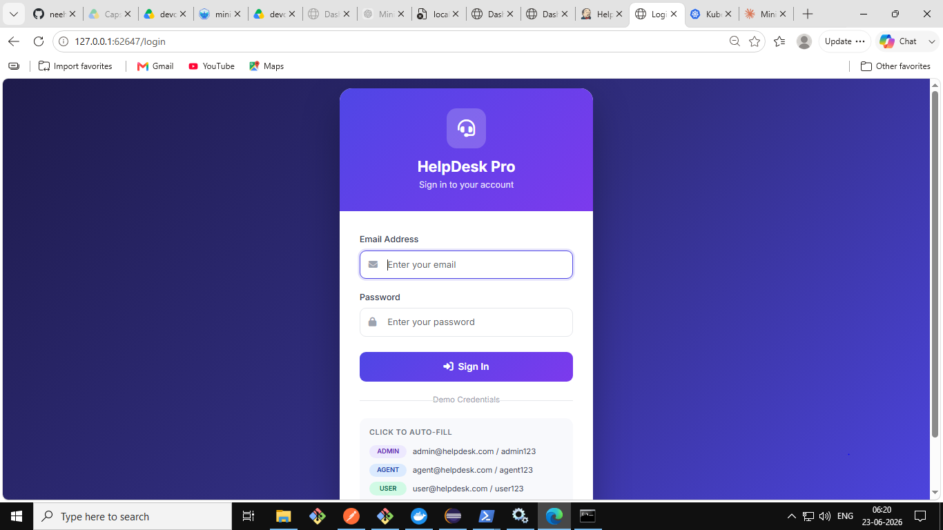
Application — Live Screenshots
Login Page — Role-based access
Admin Dashboard — Stats & Recent Tickets

Slide 12
Conclusion
✅ Successfully implemented a complete role-based Helpdesk Ticketing System
🔐 Secure JWT authentication with Admin, Agent, and End-User roles
🐳 Containerized with Docker and deployed on Kubernetes (Minikube)
⚙️ Automated CI/CD pipeline using Jenkins — Build, Test, Deploy
📊 RESTful APIs documented with Swagger UI; tested with JUnit 5 & Mockito
🏗️ Enterprise-level MVC layered architecture with Spring Boot 3.2.5
2026 · RPS Consulting · Capstone Presentation

Slide 13
Thank You!
HelpDesk Pro — Ticketing System
70243 Geetanshu Kalra · 70247 Neehal Rajput
WIPRO NGA Program · 26SUB0726 · Java J2EE Integration · 23 June 2026
www.rpsconsulting.in

