Slide 1
CLASSIC SNAKE GAME DEVELOPMENT USING PYTHON
"PROJECT REVIEW AND REPORT"

Slide 2
PROJECT NAME – SNAKE GAME
DESCRIPTION – This Python implementation of the Snake game is built using Pygame library. It is a classic arcade game where the player controls a snake that moves around the screen, consuming food to grow longer while avoiding collisions with the edges. The game features smooth movement, increasing difficulty as the snake grows, and a scoring system.

Slide 3
TECHNOLOGIES USED -
PROGRAMMING LANGUAGE ---> Python
LIBRARIES AND FRAMEWORK ---> Pygame
CONCEPTS USED -
Continuous – loop (movements)
Entering user inputs
Collision detection
Placing food at random positions
Scoring system.
FEATURES -
Player controls the snake movements using arrow keys -
When the snake eats food, it increases in length.
The game ends if snake collides with the walls or itself.
A message appears when the game is over, allowing user to restart.

Slide 4
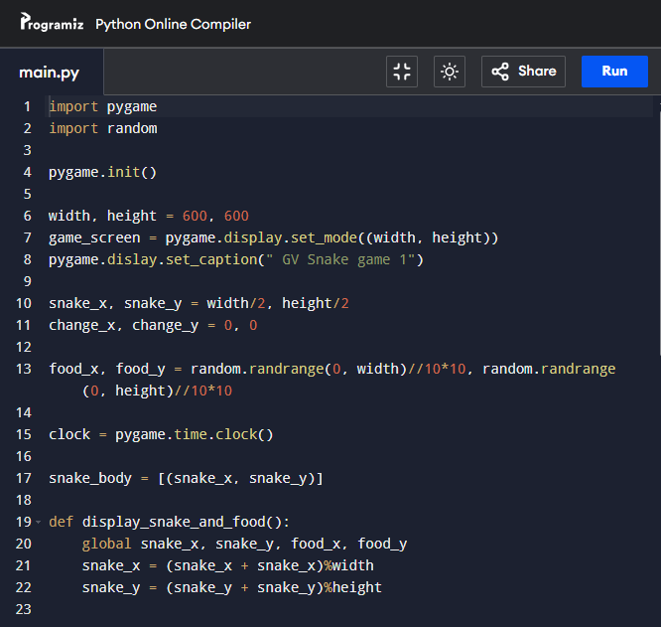
PROGRAM -

Slide 5
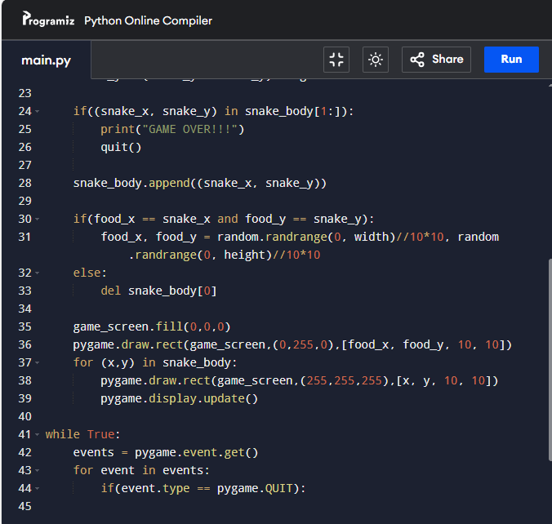

Slide 6
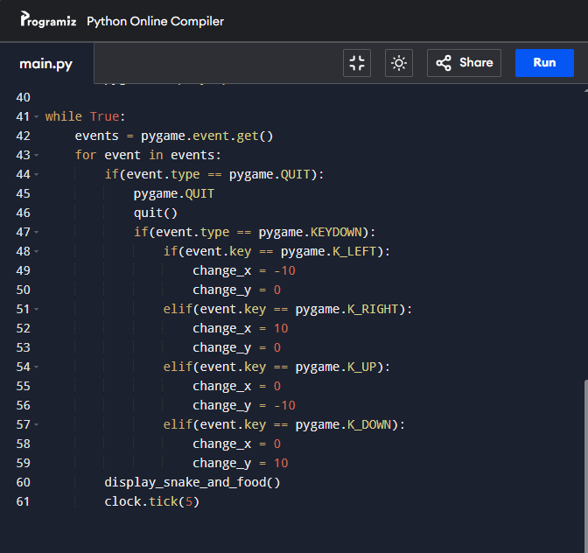

Slide 7
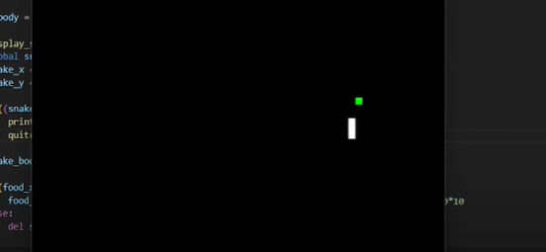
RESULT/OUTPUT

