Slide 1


Slide 2
Design and Implementation of Diseases Diagnosis System for Beans
Subtitle

Slide 3
Team Membres
Supervisor : Ms KBA Bhagyanie Chathurika
Co – supervisor : Ms Chamali Pabasara
Student Name | Student ID
Perera.M.T.G.E. | IT20647100
Subasinghe.H.K.A.A.S | IT20299170
Bandara Higgoda.T.T.S | IT20119362
Devinda.K.K.D | IT20249502

Slide 4
Introduction to the overall project
The cultivation of beans plays a vital role in Sri Lanka's economy, providing livelihoods to numerous farmers. However, bean crops face significant threats from various plant diseases, leading to reduced yields and financial losses. The conventional approach to disease identification relies heavily on manual visual inspection, resulting in high costs and time-consuming processes.
Our research project aims to tackle this critical issue by developing an advanced Disease Diagnosis System for beans. Leveraging cutting-edge machine learning techniques, specifically convolutional neural networks (CNNs), we seek to create an automated vision system capable of accurately detecting and classifying different leaf diseases affecting bean plants
The proposed system will empower farmers with an efficient and cost-effective solution for early disease detection, enabling timely and targeted management strategies. By integrating machine learning algorithms, the system will autonomously analyze leaf symptoms, providing precise disease classification and informed decision-making support for farmers. Through this project, we aim to revolutionize the way bean crop diseases are diagnosed and managed, fostering sustainable agricultural practices and contributing to the well-being of farmers and the overall economy of Sri Lanka. By leveraging state-of-the-art technology, the Disease Diagnosis System for Beans is poised to make a significant impact on the agricultural sector, ensuring food security and enhancing the livelihoods of farmers across the region.

Slide 5
Legacy Systems
Outdated Manual Diagnosis
Time consuming process
Hight costs
Limited scalability
Lack of Accuracy

Slide 6
Research Question
Research Question
Hypothesis test
Can an Automated Disease Diagnosis system for Beans be Developed?
Yes
No

Slide 7
Benefits of design and implementation of diseases diagnosis system for beans
Benefits of design and implementation of diseases diagnosis system for beans Increased Agricultural Productivity: By promptly detecting diseases, farmers can implement appropriate measures to prevent disease spread and optimize yields.
Cost Savings for Farmers: Reduced crop losses due to disease result in financial savings for farmers, increasing overall profitability.
Enhanced Farmer Decision-making: Access to accurate disease information enables farmers to make informed decisions about disease management strategies.
Improved Sustainability: Early disease detection and management contribute to sustainable farming practices, reducing the need for excessive pesticide use.
Efficient Resource Allocation: The system allows for targeted use of resources, such as pesticides and fungicides, resulting in efficient resource utilization.

Slide 8
Objective
The objective of the project "Design and Implementation of Diseases Diagnosis System for Beans" is to develop an advanced and user-friendly Disease Diagnosis System using convolutional neural networks (CNNs) to accurately detect and classify various leaf diseases affecting bean plants. The system aims to empower farmers in Sri Lanka with an efficient and economical solution for early disease detection, enabling timely and targeted management strategies to enhance agricultural productivity and minimize crop losses due to plant diseases

Slide 9
Sub Objectives
Data Collection and Preprocessing
Machine Learning Model Training
User Interface Development
Quality Prediction of Beans
Prediction of Diseases of Beans
Prediction of Market Value of Beans
Prediction of Weather Conditions for Beans

Slide 10
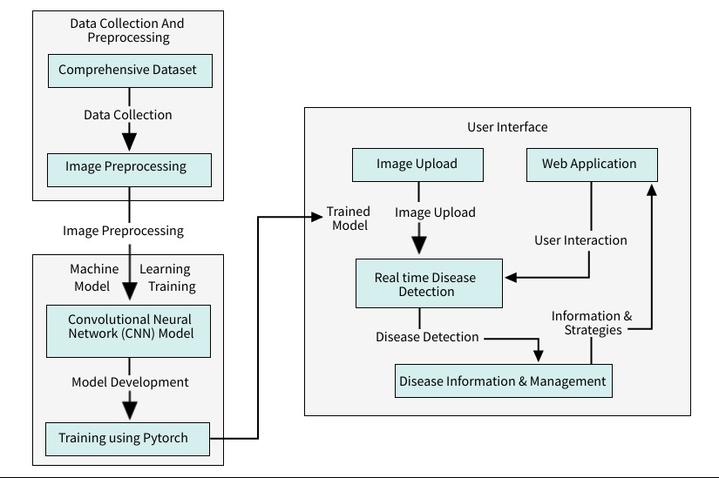
System Overall Diagram

Slide 11
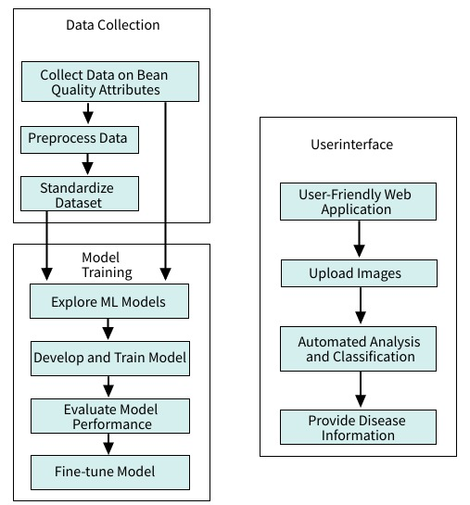
Mythology
System Architecture

Slide 12
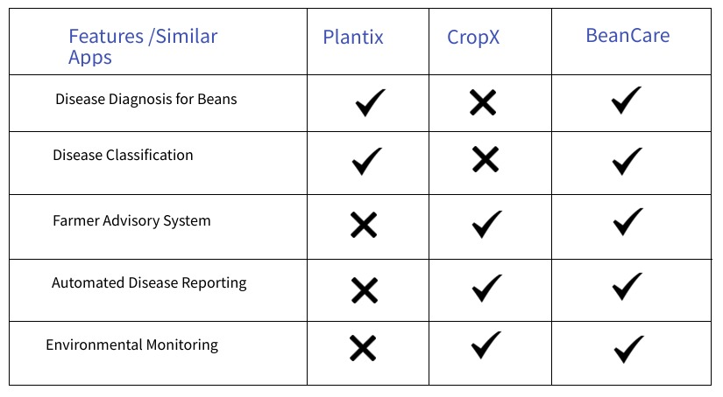

Slide 13
IT20647100 Perera M.T.G.E Introduction and Background:
The detection and timely diagnosis of crop diseases are critical factors that significantly impact agricultural productivity and the livelihoods of farmers. In various agricultural regions, such as Sri Lanka, where bean cultivation plays a crucial role in the economy, plant diseases pose a significant threat to crop yields and the income of farmers. The conventional approach to identifying these diseases relies heavily on manual visual inspection by experts, resulting in high costs, time consuming processes, and limited scalability

Slide 14
Research Gap:
The existing disease diagnosis systems for beans in Sri Lanka often lack the capability to predict the quality of beans based on various attributes like size, color, and texture. There is a need for an advanced system that can accurately assess the quality of beans using machine learning models

Slide 15
Research Problem:
The research problem revolves around predicting the quality of beans using machine learning techniques. The goal is to develop a robust model that can accurately assess the quality of beans based on their attributes, providing valuable insights to farmers

Slide 16
Specific Objectives:
Gather data on bean quality attributes such as size, color, and texture from local farms and markets.
Preprocess the collected data to remove outliers and standardize the dataset.
Explore and select appropriate machine learning models (e.g., regression, decision trees) for quality prediction.
Develop and train the selected model using the preprocessed dataset.

Slide 17
Sub Objectives:
Collect a comprehensive dataset of bean quality attributes from various sources to ensure diversity and representativeness.
Apply data preprocessing techniques to clean the dataset, remove outliers, and standardize the data for consistency.
Investigate and evaluate different machine learning models suitable for quality prediction.
Train the chosen machine learning model using the preprocessed dataset and optimize its performance for accurate quality assessment.

Slide 18
Methodology:
The proposed methodology involves collecting data on bean quality attributes and preprocessing the dataset. Machine learning models such as regression and decision trees will be explored and utilized to predict the quality of beans.
User Interface
Data Collection
User Friendly Web Application
Collect Data on Bean Quality Attributes
Upload Images
Preprocess Data
Standardize Dataset
Automated Analysis and Classification
Model Training
Provide Disease Information
Explore ML Model
Develop & Train Model
Evaluate Model Performance
Fine- tune Model

Slide 19
Tools and Technologies:
Python: Programming language for model development and web application.
PyTorch: Deep learning framework for training CNN models.
Flask: Web application framework for user interface development.
HTML/CSS: Markup and styling languages for web interface.
JavaScript: Scripting language for interactive web features.
TensorFlow: Library for machine learning model development.
Git: Version control system for collaborative development..

Slide 20
Non-Functional Requirements:
Functional Requirements:
The model should accurately predict the quality of beans based on attributes like size, color, and texture.
The system should be efficient and capable of processing a large volume of data for quality prediction.

Slide 21
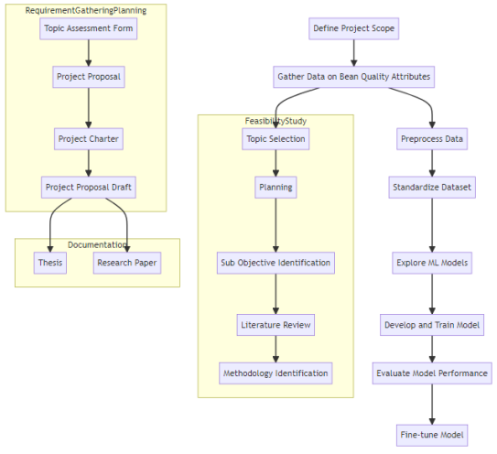
Work Breakdown Structure:

Slide 22
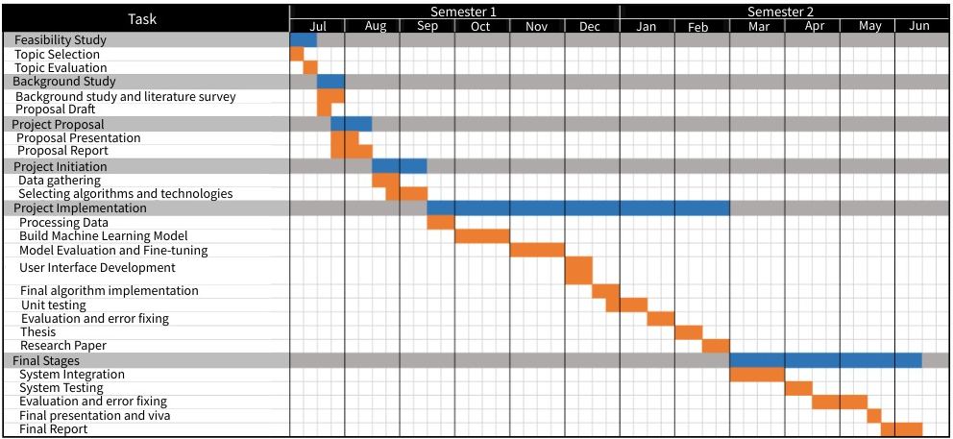
Gantt Chart:

Slide 23
References:
Seneviratne, H. M. N. K., & Premarathne, W. M. J. K. (2017). Automatic Pest Detection in Paddy Leaves using Image Processing Techniques. In Proceedings of the International Research Conference on Smart Computing and Systems Engineering (SCSE) (pp. 119-124). IEEE.
Samarasekara, G., Perera, R., & De Silva, K. (2019). Automated Pest Detection in Rice Plant Leaves using Image Processing Techniques. In Proceedings of the 2019 IEEE International Conference on Industrial Engineering and Engineering Management (IEEM) (pp. 1702-1706). IEEE.
Kodagoda, D. K., Hewavithana, P. G. A., & Premaratne, H. (2017). Development of a Decision Support System for Pest and Disease Management in Rice Production in Sri Lanka. In Proceedings of the 10th International Conference on Information and Automation for Sustainability (ICIAfS) (pp. 1-5). IEEE.
Tharanga, A. G. H. D., Edirisinghe, E. A. S., & Nanayakkara, S. A. P. (2018). Detection of Common Diseases in Papaya using Image Processing Techniques. In Proceedings of the 2018 IEEE International Conference on Advanced Robotics and its Social Impacts (ARSO) (pp. 64-69). IEEE.
Ratnaweera, R. A. D. C., Wijayakulasooriya, J. V. S. R., & Senarath, A. D. (2020). Detection of Banana Diseases Using Deep Learning Techniques. In Proceedings of the 2020 IEEE International Conference on Big Data and Smart Computing (BigComp) (pp. 53-57). IEEE.

Slide 24
Subasinghe H.K.A.A.S Introduction and Background:
The detection and timely diagnosis of crop diseases are vital for agricultural productivity in regions like Sri Lanka, where bean cultivation plays a significant role in the economy. Manual visual inspection of bean plant leaves to identify diseases can be time-consuming and prone to errors. Therefore, there is a need for an advanced Disease Diagnosis System that can accurately classify various bean leaf diseases using state-of-the-art machine learning techniques.

Slide 25
Research Gap:
The existing disease diagnosis systems for beans in Sri Lanka lack advanced image preprocessing techniques and the integration of convolutional neural networks (CNNs) for accurate disease classification. There is a gap in utilizing advanced image analysis methods to enhance the quality of the dataset and select appropriate CNN architectures for improved disease classification.

Slide 26
Research Problem:
The research problem revolves around optimizing image preprocessing techniques and selecting suitable CNN architectures for precise disease classification in bean plant leaves. The goal is to build a robust and efficient Disease Diagnosis System that can accurately identify and classify different bean leaf diseases

Slide 27
Specific Objectives:
Collect a diverse dataset of bean plant leaf images with various prevalent diseases in Sri Lanka.
Implement image preprocessing techniques to remove noise, enhance image quality, and standardize the dataset for improved analysis.
Research and select appropriate convolutional neural network (CNN) architectures for leaf disease classification.
Develop and train a CNN model using PyTorch based on the selected architecture and the preprocessed dataset.

Slide 28
Sub Objectives:
Curate a comprehensive dataset from local farms and markets, ensuring representation of various bean leaf diseases.
Apply state-of-the-art image preprocessing techniques to eliminate noise and enhance image clarity.
Explore and evaluate different CNN architectures to identify the most suitable model for accurate disease classification.
Train the selected CNN model with the preprocessed dataset, optimizing its performance for precise disease identification.

Slide 29
Methodology:
The proposed methodology involves collecting a diverse dataset of bean plant leaf images and applying image preprocessing techniques. We will experiment with various CNN architectures and leverage PyTorch for model development and training.
Data Collection
Collect Diverse Dataset of Bean Plant Leaf Image
Implement Image preprocessing Technique
Research & select CNN Architectures for Disease Classification
Develop and Train CNN Model
Evaluate Model Performance
Fine tune Model if Need

Slide 30
Tools and Technologies:
Python: Programming language for model development and web application.
PyTorch: Deep learning framework for training CNN models.
Flask: Web application framework for user interface development.
HTML/CSS: Markup and styling languages for web interface.
JavaScript: Scripting language for interactive web features.
TensorFlow: Library for machine learning model development .
Git: Version control system for collaborative development.

Slide 31
Non-Functional Requirements:
Functional Requirements:
The system should accurately classify different bean leaf diseases with exceptional precision.
The image preprocessing techniques should improve the quality and consistency of the dataset.
The system should be efficient and capable of handling a large volume of bean plant leaf images for analysis.

Slide 32
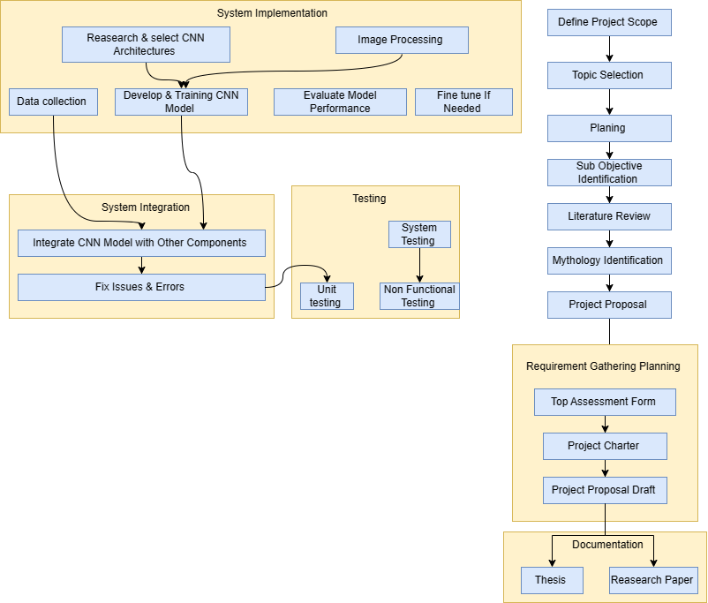
Work Breakdown Structure

Slide 33
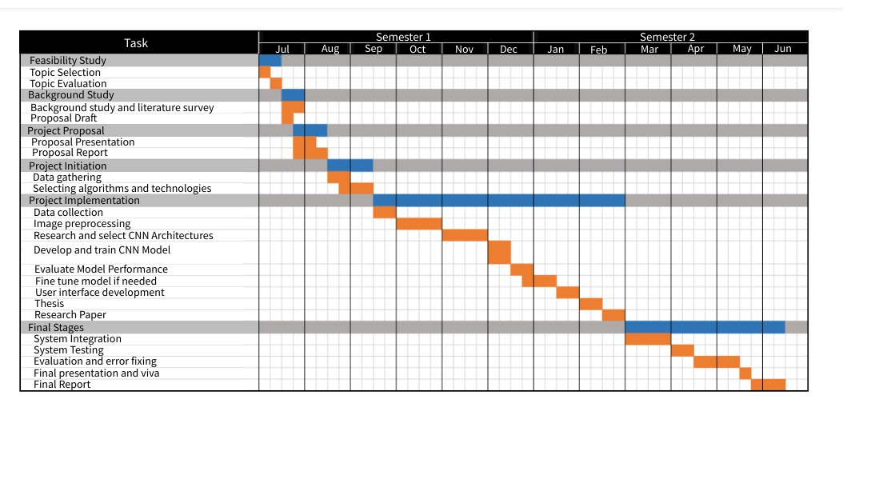
Gantt Chart

Slide 34
References
Seneviratne, H. M. N. K., & Premarathne, W. M. J. K. (2017). Automatic Pest Detection in Paddy Leaves using Image Processing Techniques. In Proceedings of the International Research Conference on Smart Computing and Systems Engineering (SCSE) (pp. 119-124). IEEE.
Samarasekara, G., Perera, R., & De Silva, K. (2019). Automated Pest Detection in Rice Plant Leaves using Image Processing Techniques. In Proceedings of the 2019 IEEE International Conference on Industrial Engineering and Engineering Management (IEEM) (pp. 1702-1706). IEEE.
Kodagoda, D. K., Hewavithana, P. G. A., & Premaratne, H. (2017). Development of a Decision Support System for Pest and Disease Management in Rice Production in Sri Lanka. In Proceedings of the 10th International Conference on Information and Automation for Sustainability (ICIAfS) (pp. 1-5). IEEE.
Tharanga, A. G. H. D., Edirisinghe, E. A. S., & Nanayakkara, S. A. P. (2018). Detection of Common Diseases in Papaya using Image Processing Techniques. In Proceedings of the 2018 IEEE International Conference on Advanced Robotics and its Social Impacts (ARSO) (pp. 64-69). IEEE.
Ratnaweera, R. A. D. C., Wijayakulasooriya, J. V. S. R., & Senarath, A. D. (2020). Detection of Banana Diseases Using Deep Learning Techniques. In Proceedings of the 2020 IEEE International Conference on Big Data and Smart Computing (BigComp) (pp. 53-57). IEEE.

Slide 35
Bandara Higgoda T.T.S Introduction and Background:
The accurate prediction of market value for beans is crucial for farmers in Sri Lanka to make informed decisions regarding their crop sales. Gathering historical data on bean prices from local markets and trading platforms can provide valuable insights into market trends and fluctuations. Therefore, developing a predictive model for market value estimation will empower farmers with a better understanding of the bean market dynamics.

Slide 36
Research Gap:
Existing market value prediction models for beans may not be tailored specifically to Sri Lanka's agricultural conditions and market trends. There is a gap in the research concerning the development of a localized predictive model that caters to the unique requirements of the Sri Lankan bean market.

Slide 37
Research Problem:
The research problem revolves around predicting the market value of beans in Sri Lanka based on historical data. The goal is to develop an accurate and localized predictive model that considers local market dynamics and provides real-time market value estimates.

Slide 38
Specific Objectives:
Gather historical data on bean prices from local markets and trading platforms.
Preprocess the market data to remove outliers and ensure consistency.
Investigate and choose suitable machine learning models (e.g., time series analysis, regression) for market value prediction.
Develop and train the selected model using the preprocessed market data

Slide 39
Sub Objectives:
Collect a comprehensive historical dataset of bean prices from various local markets and trading platforms in Sri Lanka.
Apply data preprocessing techniques to clean the dataset, handle outliers, and ensure data uniformity.
Research and evaluate different machine learning models suitable for market value prediction.
Train the selected machine learning model with the preprocessed dataset, optimizing its performance for accurate market value estimation

Slide 40
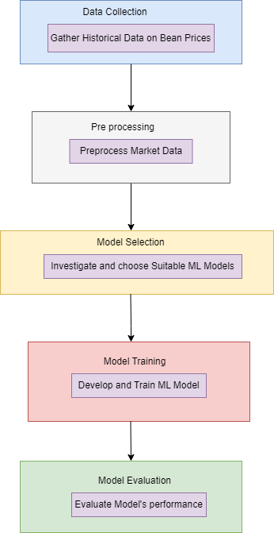
Methodology:
The proposed methodology involves gathering historical market data on bean prices and implementing data preprocessing techniques. Machine learning models, such as time series analysis and regression, will be researched and utilized for market value prediction.

Slide 41
Tools and Technologies:
Python: Programming language for model development and web application.
PyTorch: Deep learning framework for training CNN models.
Flask: Web application framework for user interface development.
HTML/CSS: Markup and styling languages for web interface.
JavaScript: Scripting language for interactive web features.
TensorFlow: Library for machine learning model development .
Git: Version control system for collaborative development.

Slide 42
Non-Functional Requirements:
Functional Requirements:
The model should accurately predict the market value of beans based on historical data.
The model should be reliable and capable of providing real-time market value estimates.

Slide 43
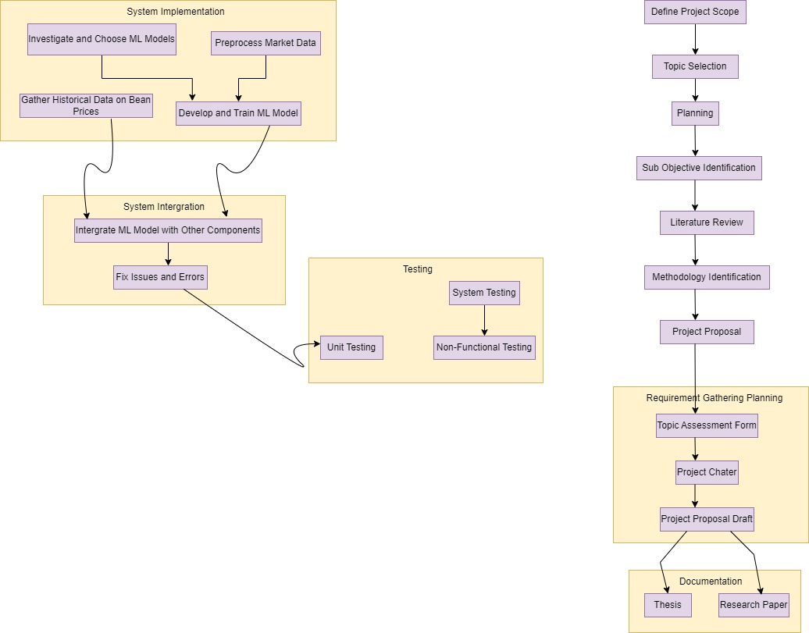
Work Breakdown Structure

Slide 44
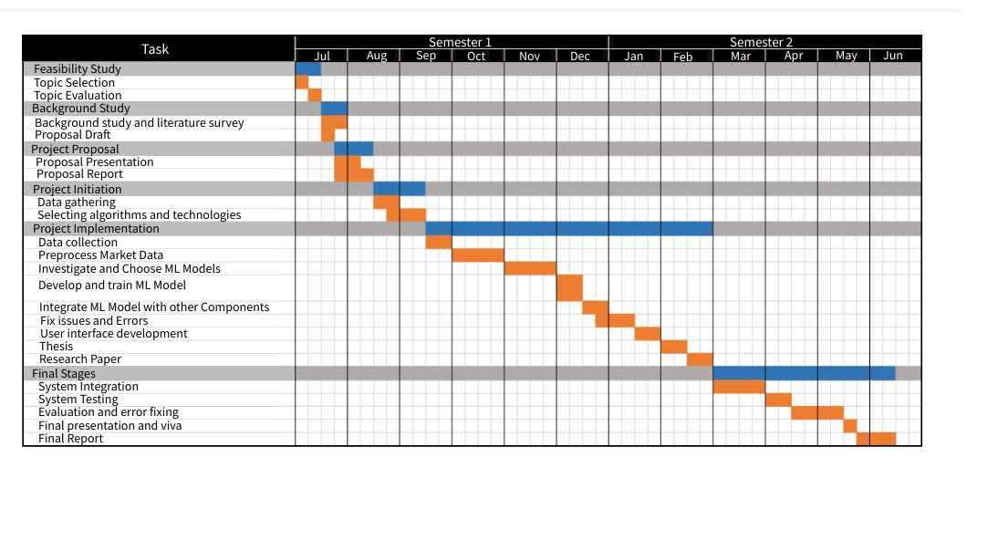
Gantt Chart

Slide 45
References
Seneviratne, H. M. N. K., & Premarathne, W. M. J. K. (2017). Automatic Pest Detection in Paddy Leaves using Image Processing Techniques. In Proceedings of the International Research Conference on Smart Computing and Systems Engineering (SCSE) (pp. 119-124). IEEE.
Samarasekara, G., Perera, R., & De Silva, K. (2019). Automated Pest Detection in Rice Plant Leaves using Image Processing Techniques. In Proceedings of the 2019 IEEE International Conference on Industrial Engineering and Engineering Management (IEEM) (pp. 1702-1706). IEEE.
Kodagoda, D. K., Hewavithana, P. G. A., & Premaratne, H. (2017). Development of a Decision Support System for Pest and Disease Management in Rice Production in Sri Lanka. In Proceedings of the 10th International Conference on Information and Automation for Sustainability (ICIAfS) (pp. 1-5). IEEE.
Tharanga, A. G. H. D., Edirisinghe, E. A. S., & Nanayakkara, S. A. P. (2018). Detection of Common Diseases in Papaya using Image Processing Techniques. In Proceedings of the 2018 IEEE International Conference on Advanced Robotics and its Social Impacts (ARSO) (pp. 64-69). IEEE.
Ratnaweera, R. A. D. C., Wijayakulasooriya, J. V. S. R., & Senarath, A. D. (2020). Detection of Banana Diseases Using Deep Learning Techniques. In Proceedings of the 2020 IEEE International Conference on Big Data and Smart Computing (BigComp) (pp. 53-57). IEEE.

Slide 46
Devinda K.K.D Introduction and Background:
Accurate weather condition prediction plays a vital role in effective disease management for bean crops in Sri Lanka. Weather factors like temperature, humidity, and precipitation significantly impact disease outbreaks. Therefore, developing a predictive model for weather conditions tailored to bean-growing regions will provide farmers with invaluable support in optimizing their agricultural practices.

Slide 47
Research Gap:
Existing weather prediction models for bean-growing regions in Sri Lanka may not fully utilize machine learning algorithms to handle missing data and ensure precise predictions. There is a gap in research concerning the development of an advanced weather prediction model that can handle real-world weather data and provide reliable forecasts

Slide 48
Research Problem:
The research problem focuses on predicting weather conditions for bean-growing regions in Sri Lanka using machine learning techniques. The goal is to build an accurate and robust predictive model that can analyze historical weather data and forecast future weather conditions.

Slide 49
Specific Objectives:
Acquire historical weather data (temperature, humidity, precipitation, etc.) from relevant sources for bean-growing regions in Sri Lanka.
Preprocess the weather data to handle missing values and ensure uniformity for accurate predictions.
Research and select appropriate machine learning models (e.g., time series analysis, regression) for weather condition prediction.
Develop and train the chosen model using the preprocessed weather data

Slide 50
Sub Objectives:
Gather comprehensive historical weather data from reliable sources for relevant bean-growing regions in Sri Lanka.
Apply data preprocessing techniques to handle missing values, ensure data consistency, and prepare the data for analysis.
Research and evaluate different machine learning models suitable for weather condition prediction in bean-growing regions.
Train the selected machine learning model using the preprocessed weather data, optimizing its performance for precise weather condition forecasts.

Slide 51
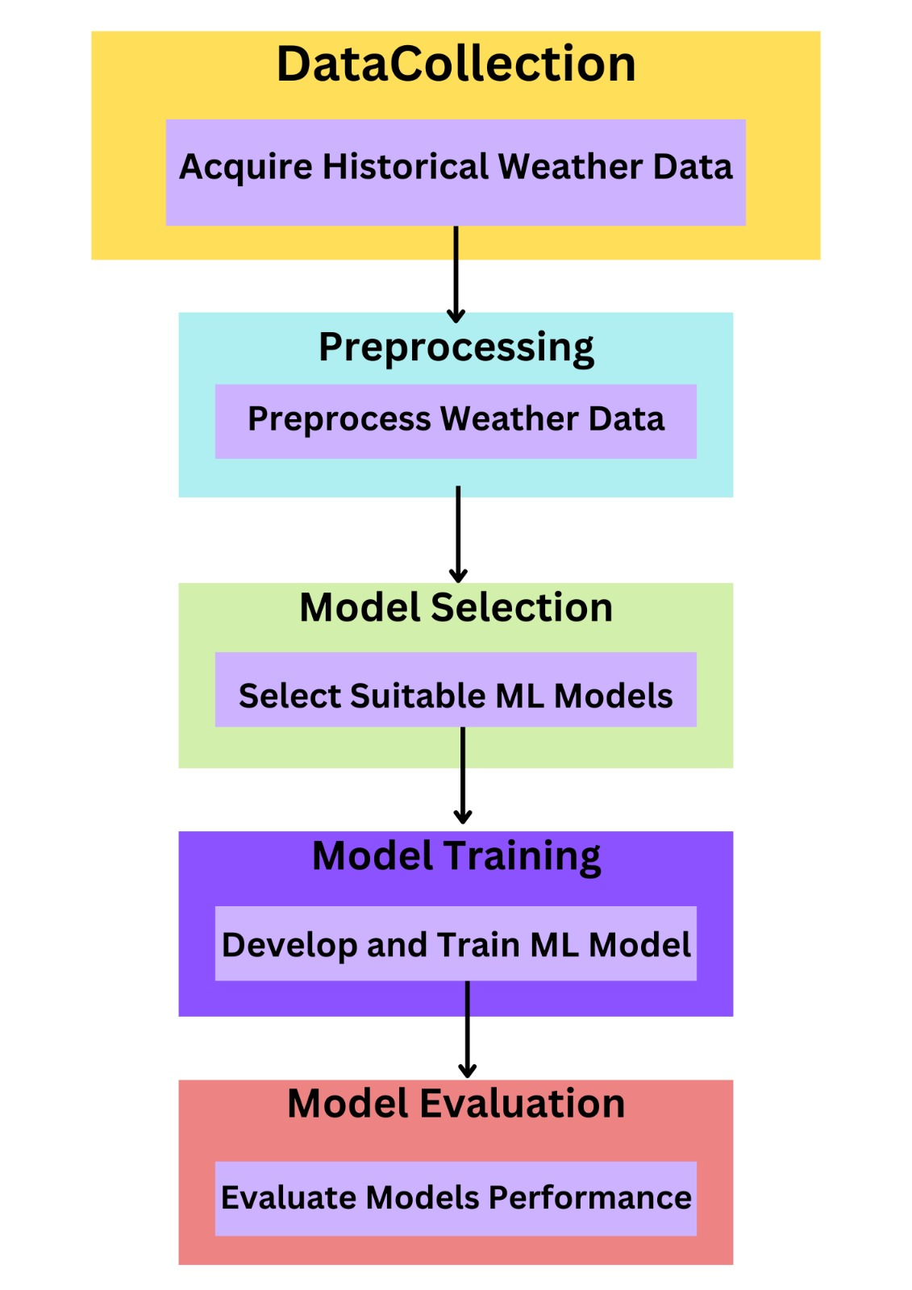
Methodology:
The proposed methodology involves acquiring historical weather data for bean-growing regions and implementing data preprocessing techniques. Machine learning models such as time series analysis and regression will be researched and utilized for weather condition prediction.

Slide 52
Tools and Technologies:
Python: Programming language for model development and web application.
PyTorch: Deep learning framework for training CNN models.
Flask: Web application framework for user interface development.
HTML/CSS: Markup and styling languages for web interface.
JavaScript: Scripting language for interactive web features.
TensorFlow: Library for machine learning model development .
Git: Version control system for collaborative development.

Slide 53
Non-Functional Requirements:
Functional Requirements:
The weather prediction model should accurately forecast weather conditions for bean-growing regions in Sri Lanka.
The model should be reliable and capable of handling real-world weather data for accurate predictions.

Slide 54
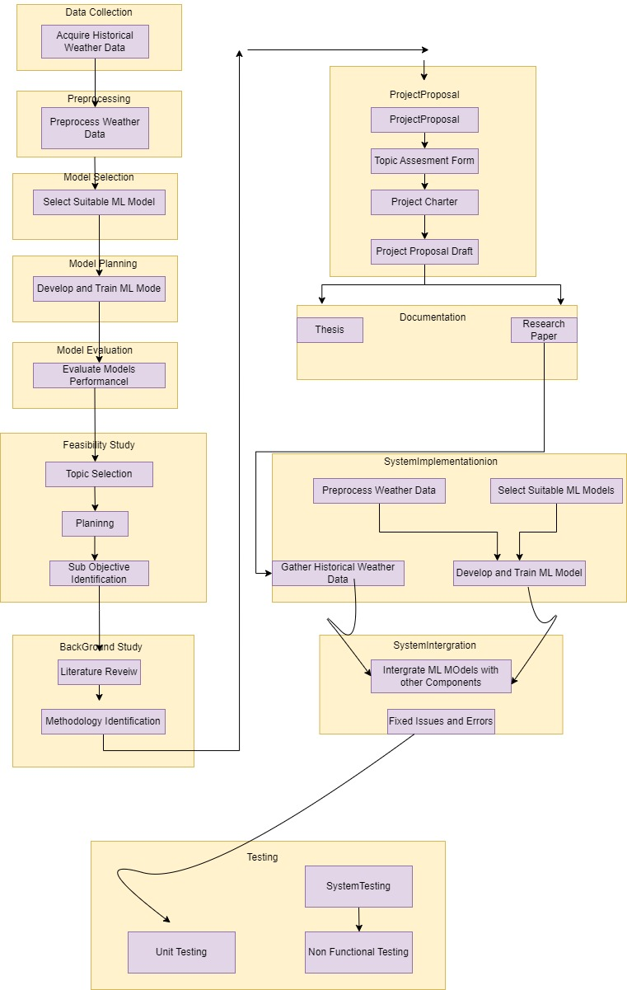
Work Breakdown Structure

Slide 55
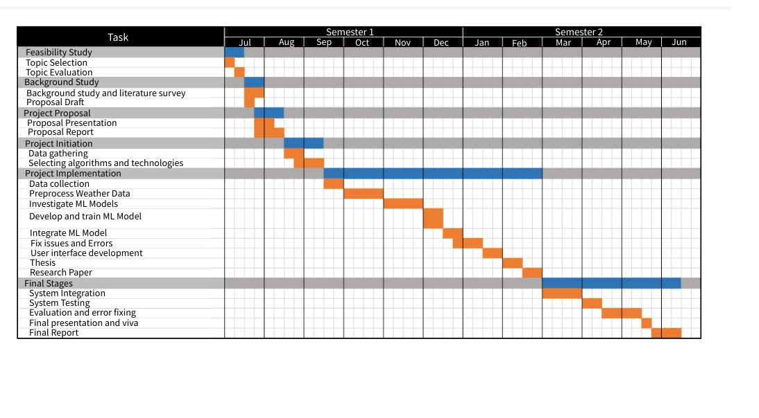
Gantt Chart

Slide 56
References
Seneviratne, H. M. N. K., & Premarathne, W. M. J. K. (2017). Automatic Pest Detection in Paddy Leaves using Image Processing Techniques. In Proceedings of the International Research Conference on Smart Computing and Systems Engineering (SCSE) (pp. 119-124). IEEE.
Samarasekara, G., Perera, R., & De Silva, K. (2019). Automated Pest Detection in Rice Plant Leaves using Image Processing Techniques. In Proceedings of the 2019 IEEE International Conference on Industrial Engineering and Engineering Management (IEEM) (pp. 1702-1706). IEEE.
Kodagoda, D. K., Hewavithana, P. G. A., & Premaratne, H. (2017). Development of a Decision Support System for Pest and Disease Management in Rice Production in Sri Lanka. In Proceedings of the 10th International Conference on Information and Automation for Sustainability (ICIAfS) (pp. 1-5). IEEE.
Tharanga, A. G. H. D., Edirisinghe, E. A. S., & Nanayakkara, S. A. P. (2018). Detection of Common Diseases in Papaya using Image Processing Techniques. In Proceedings of the 2018 IEEE International Conference on Advanced Robotics and its Social Impacts (ARSO) (pp. 64-69). IEEE.
Ratnaweera, R. A. D. C., Wijayakulasooriya, J. V. S. R., & Senarath, A. D. (2020). Detection of Banana Diseases Using Deep Learning Techniques. In Proceedings of the 2020 IEEE International Conference on Big Data and Smart Computing (BigComp) (pp. 53-57). IEEE.

Slide 57
Commercialization
Increased Agricultural Productivity: The automated disease diagnosis system helps farmers identify and manage crop diseases more efficiently. By taking timely actions based on accurate diagnoses, farmers can improve crop yields and overall agricultural productivity.
Cost Savings for Farmers: By automating the disease diagnosis process, farmers can save on labor costs and reduce the expenses associated with manual inspections and treatments. This cost-saving measure contributes to their profitability and financial well-being.
Enhanced Farmer Decision-making: With the disease diagnosis system providing precise information about crop diseases and management strategies, farmers can make better-informed decisions. This empowers them to take appropriate actions to protect their crops and optimize their farming practices.
Improved Sustainability: Early disease detection and targeted management practices promoted by the system reduce the reliance on chemical treatments and promote sustainable agricultural practices. This contributes to environmental preservation and long-term sustainability.
Efficient Resource Allocation: The automation of disease diagnosis and documentation processes optimizes the allocation of resources, such as workforce and time. This efficiency leads to reduced operational costs and improved utilization of available resources.

Slide 58
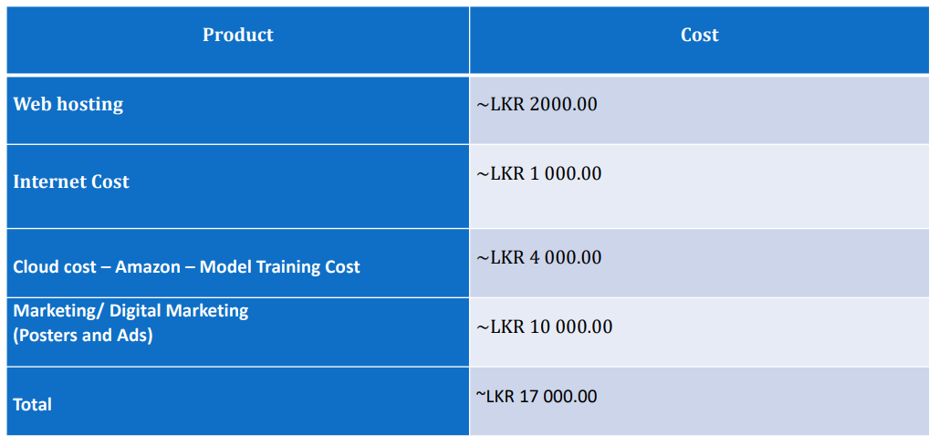
Budget & Budget Justification

Slide 59
THANK YOU

