Slide 1
Hotel Business Performance Analysis
Power BI Dashboard Overview
Prepared by: Geetha
Date: 30-Aug-2025

Slide 2
Introduction:
This presentation provides an overview of Hotel Business Performance using a Power BI dashboard.
The dashboard analyzes key metrics such as:
Total Revenue (Sum of Total Price)
Average Daily Rate (ADR)
Total Bookings
Average Customers per Booking
The goal is to identify trends, patterns, and insights to improve hotel operations and profitability.

Slide 3
Data Source:
Title Slide
Title: Hotel Business Performance Analysis Subtitle: Data-driven insights from hotel dataset
Dataset Overview
Source: hotel_dataset_cleaned.xlsx
Total Records: (I’ll check this for you)
Key Columns: Booking ID, Customer Type, Room Type, Check-in Date, Check-out Date, Revenue, Rating, Country
Occupancy Trends
Monthly/Quarterly occupancy rate
Seasonal patterns (Peak vs Low season)

Slide 4
Revenue Analysis
Average Daily Rate (ADR)
Total Revenue by month/room type
Top revenue-generating segments
Customer Demographics
Booking distribution by country
Repeat vs new customers
Cancellations & No-Shows
Cancellation rate by booking channel
Revenue loss due to cancellations

Slide 5
Insights & Recommendations
Marketing strategies for low-season
Packages for high-demand customers
Improve cancellation policy
Steps In Project :
Define Objective
What do you want to show? Examples:
Hotel performance trends
Revenue optimization insights
Customer behavior patterns

Slide 6
Explore the Dataset
Open hotel_dataset_cleaned.xlsx
Check:
Number of rows and columns
Key features (columns) like Booking ID, Room Type, Check-in Date, Revenue, Customer Type, Country, Rating
Clean & Prepare Data
Handle missing values
Convert dates to proper format
Create additional columns:
Stay Duration = Check-out Date - Check-in Date
Month and Year from check-in date
Revenue per Stay

Slide 7
Analyze Data
Common analyses:
Occupancy Rate by month or season
Revenue Trends (monthly/quarterly)
Average Daily Rate (ADR) = Total Revenue ÷ Total Room Nights
Customer Demographics (country, customer type)
Booking Channels performance
Cancellations percentage and reasons
Visualize Data
Use Excel charts or Power BI visuals, then include in PPT:
Bar chart → Revenue by month
Line chart → Occupancy trend
Pie chart → Customer type distribution
Map → Bookings by country

Slide 8
Create PowerPoint Slides
Suggested Structure:
Title Slide – Project name & objective
Introduction – Why this analysis matters
Dataset Overview – Rows, columns, key metrics
Analysis & Visualizations – Charts, tables, insights
Findings & Insights – Key points in bullet form
Recommendations – How hotel can improve performance
Conclusion – Summary of findings
Add Insights & Recommendations
Example: “Occupancy drops by 20% in off-season → Suggest promotional packages.”
Example: “Major revenue from Deluxe rooms → Focus marketing there.”

Slide 9
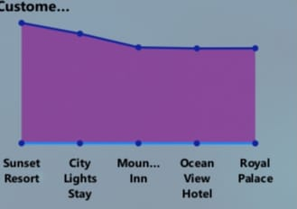
Occupancy & Booking Trends
Chart Type: Line Chart Purpose: Show occupancy or booking count over time Data Needed:
X-axis → Hotel Name
Y-axis → Number of Bookings, Sum of ADR , Average of Customer Rating.

Slide 10
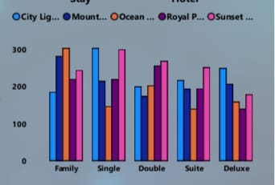
Revenue Analysis
Chart Type: Clustered Column Chart / Combo Chart Purpose: Display revenue patterns Options:
Revenue by Month
Revenue by Room Type (Standard, Deluxe, Suite, etc.)
ADR (Average Daily Rate) trends

Slide 11
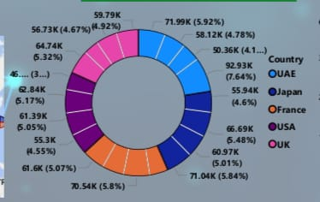
Customer Demographics
Chart Type: Donut Chart Purpose: Show proportion of customers by:
Country / Region
Customer Type (New vs Repeat)

Slide 12
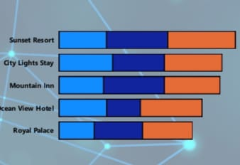
Cancellations vs Confirmed Bookings
Chart Type: Stacked Bar Chart Purpose: Compare confirmed vs canceled bookings
By Month or Booking Channel

Slide 13
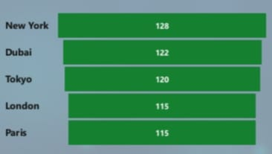
Customer Ratings
Chart Type: Funnel Chart Purpose:
Average rating by Room Type
Relationship between Rating and Revenue

Slide 14

Regional Overview – Province and Cities
Chart Type: Map Chart Purpose: Show proportion of customers by:
Country / Region
Customer Type (New vs Repeat): Country, Hotel Name, Booking ID .

Slide 15
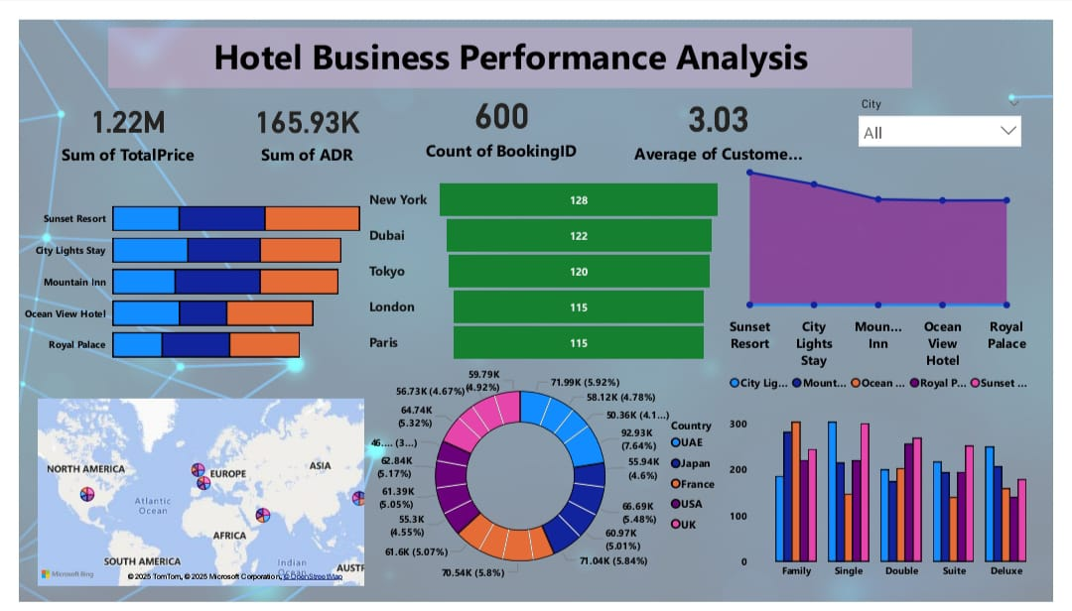
HOTEL ANALYSIS DASHBOARD

Slide 16
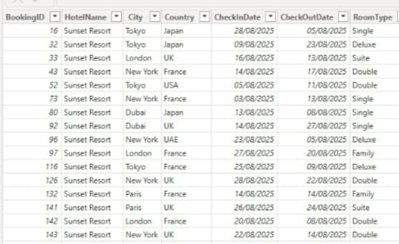
Navigation :
Navigation in Power BI help users move between different report pages smoothly.
It improve user experience by making the dashboard interactive and easy to explore.

Slide 17
Conclusion:
In summary, the analysis of our hotel business data highlights key insights into occupancy trends, revenue performance, and customer behavior.
We observed peak periods that can be leveraged for targeted marketing, areas of operational inefficiency that can be optimized, and opportunities to enhance guest satisfaction and loyalty.
By focusing on data-driven strategies, the hotel can improve revenue management, streamline operations, and strengthen its competitive position in the market. Continuous monitoring and analysis will ensure sustainable growth and long-term success.

