Slide 1
Diffusion-Enhanced Brain Tumor
Classification Using Fast-DDPM
and EfficientNet-B0 on MRI
Presented by:
Under the Guidance of:
D.BHAGAVATH GEETHA (Y22ACM424)
Dr. K. Mani Deep
B.JAYA LAKSHMI TULASI (Y22ACM415)
K.VIRENDRA KUMAR (Y22ACM437)
B.NAGA SUMANTH (Y22ACM409)

Slide 2

Agenda
Abstract
Existing System
Proposed System
System Design
Implementation
Results
Conclusion

Slide 3
Abstract
Noise in Magnetic Resonance Imaging (MRI) reduces image clarity and negatively impacts automated brain tumor classification. This work proposes a diffusion-enhanced framework combining Fast-DDPM denoising with EfficientNet-B0 to improve classification performance. A dual-branch evaluation pipeline is designed to measure the effect of diffusion-based preprocessing. In the first branch, original noisy MRI images are classified using EfficientNet-B0 to establish a baseline. In the second branch, the same images are enhanced using Fast-DDPM and then classified using the identical EfficientNet-B0 model.Results show that the baseline model achieved 63.73% accuracy on original MRI images. After applying Fast-DDPM denoising, the enhanced branch achieved 76.17% accuracy, resulting in an absolute improvement of 12.44percentage points. This gain is achieved without modifying the model architecture or training procedure. The study demonstrates that diffusion-based preprocessing can effectively improve MRI quality and enhance deep learning-based brain tumor classification performance.

Slide 4




Existing System Analysis
CURRENT WORKFLOW
CRITICAL LIMITATIONS
01
INPUT
Boundary Blurring
Noisy MRI Data
Noise hides the exact tumor shape at boundaries.
02
EXTRACT
Direct Feature Extraction
Feature Loss
Important texture details disappear under noise.
03
CLASSIFY
CNN-based Classification
System Instability
OUTPUT
Same model gives different results across different scanners.
04
Direct Accuracy Score
Accuracy Ceiling
The baseline trains deep learning models directly on raw, noisy clinical MRI scans without advanced structural restoration. Noise systematically limits performance.
Noisy input permanently limits classification performance.

Slide 5
Proposed System
DUAL-BRANCH COMPARATIVE PIPELINE
SHARED INPUT
Raw Noisy MRI Scans (Clinical)
BRANCH A: BASELINE
BRANCH B: ENHANCED
CLASSIFIER
ENHANCEMENT
EfficientNet-B0
VS
Fast-DDPM Denoiser
ImageNet pretrained (IMAGENET1K_V1)
50-step generative restoration
OUTPUT
CLASSIFIER
Baseline Accuracy
EfficientNet-B0
Same checkpoint as Branch A
No model changes
OUTPUT
Enhanced Accuracy
Key Insight: Same classifier checkpoint — accuracy gain is purely from Fast-DDPM preprocessing.
Ref: Dataset: Figshare/Kaggle Brain Tumor MRI — Glioma, Meningioma, Pituitary, No Tumor (4 classes).

Slide 6
System Design
01
02
03
04
05
Dataset
Baseline
Fast-DDPM
Enhanced
Accuracy
Input
Classification
Denoising
Classification
Comparison
Brain Tumor MRI
EfficientNet-B0
U-Net backbone
Same EfficientNet
Branch A
Figshare / Kaggle
ImageNet weights
1000 fwd → 50 rev
Clean MRI input
Branch B
4 Classes:
Linear(1280→4)
Linear β schedule
Preserved tumor
ΔAcc =(Diff)
Glioma · Meningioma
Adam lr=1e-4
Structural MRI
boundaries
Absolute gain
Pituitary · No Tumor
32 batch · 5 epochs
restoration
& texture
on raw noisy MRI

Slide 7
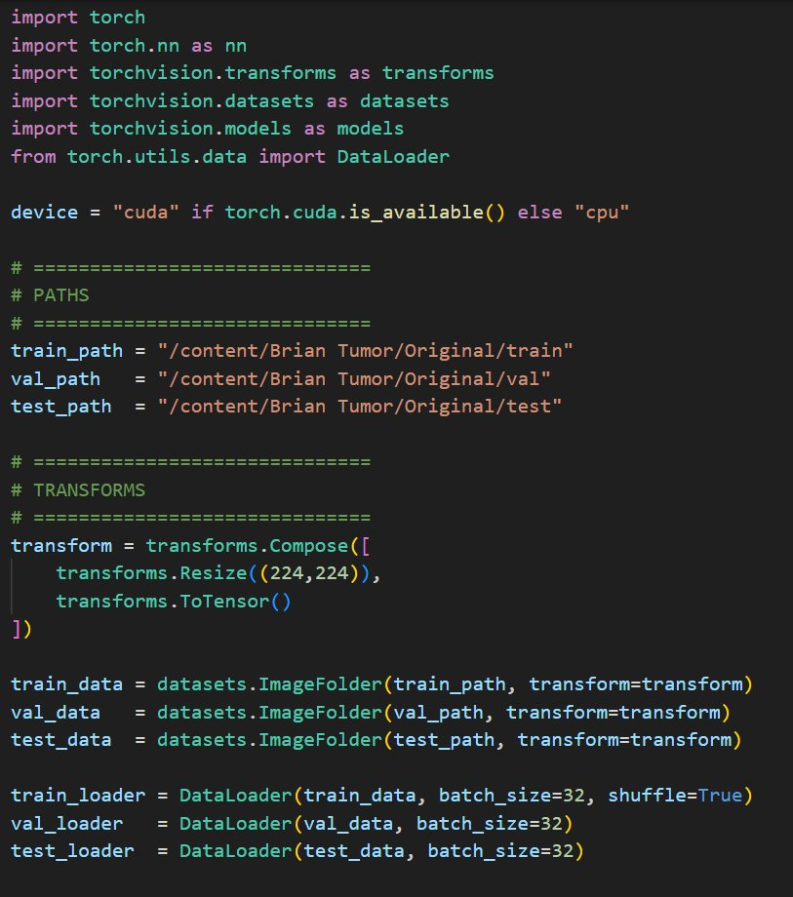
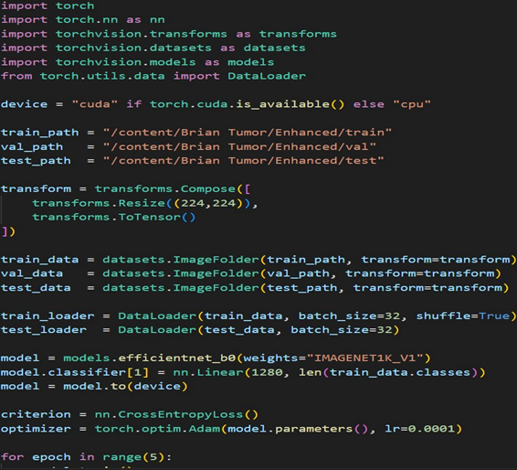
Implementation
Branch A: efficientnet_b0_eorginal.py
Branch B: efficientnet_b0_enhanced.py

Slide 8
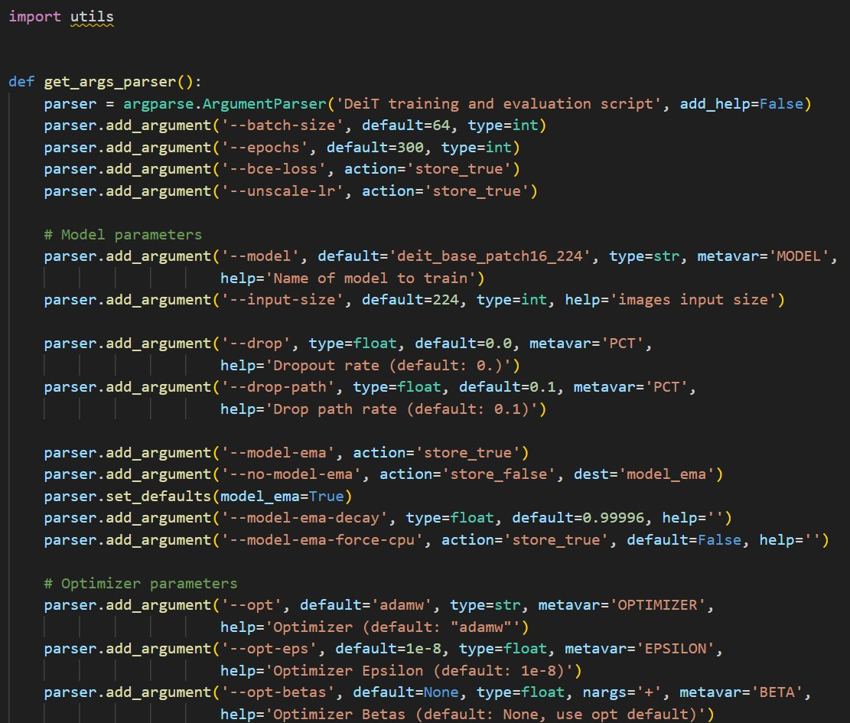
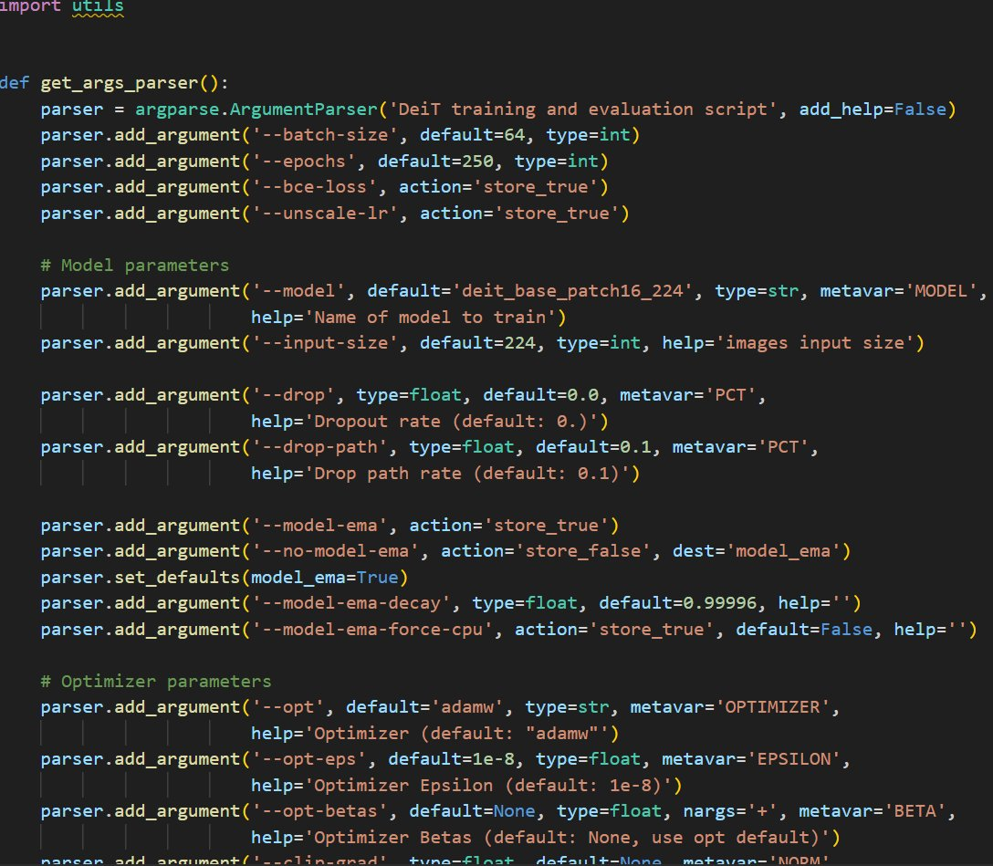
Implementation — Extended Training Pipeline
main_diet.py (Original dataset — 300 epochs)
main_diet_enhanced.py (Enhanced dataset — 250 epochs)
main_diet.py (Original)
main_diet_enhanced.py (Enhanced)

Slide 9
Code Execution & Outputs
EXECUTION LOGS & RESULTS
Terminal Output — Training & Evaluation
$ python train_pipeline.py
Loading Brain Tumor MRI Dataset...
Classes: Glioma | Meningioma | Pituitary | No Tumor
Train: 5712 images Val: 1311 images
=== BRANCH A: Baseline (Raw MRI) ===
Epoch [1/5] Loss: 1.2841 Acc: 48.32%
Epoch [2/5] Loss: 0.9234 Acc: 57.61%
Epoch [3/5] Loss: 0.7612 Acc: 61.18%
Epoch [4/5] Loss: 0.6881 Acc: 63.44%
Epoch [5/5] Loss: 0.6204 Acc: 65.03%
>> Branch A Final Accuracy: 63.73%
=== BRANCH B: Fast-DDPM Enhanced ===
Applying Fast-DDPM denoiser (50 steps)...
Epoch [1/5] Loss: 1.0341 Acc: 55.72%
Epoch [2/5] Loss: 0.7923 Acc: 63.80%
Epoch [3/5] Loss: 0.6214 Acc: 68.41%
Epoch [4/5] Loss: 0.5502 Acc: 70.93%
Epoch [5/5] Loss: 0.4988 Acc: 72.80%
>> Branch B Final Accuracy: 76.17%
ΔAcc = +12.44 pp |
No changes to classifier architecture.

Slide 10
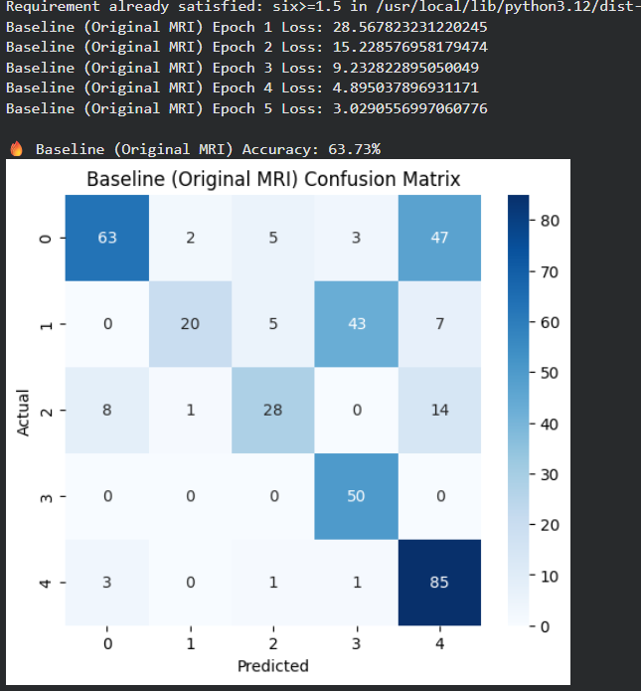
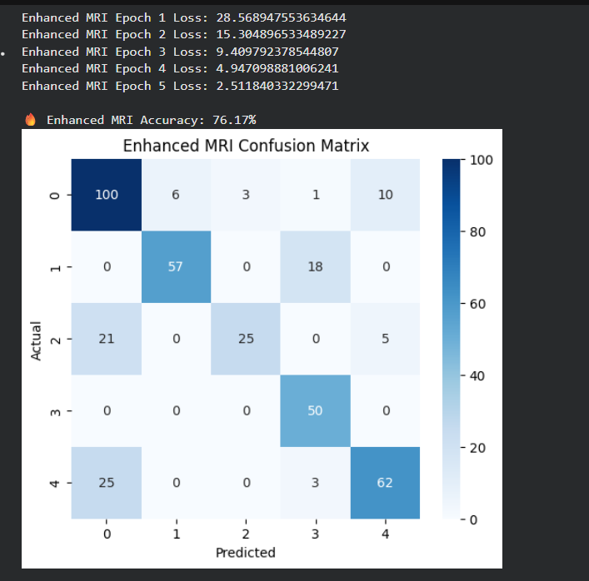
Code Execution & Outputs
EXECUTION LOGS & RESULTS
Terminal Output — Training & Evaluation
$ python train_pipeline.py
Classes: Glioma | Meningioma | Pituitary | No Tumor

Slide 11
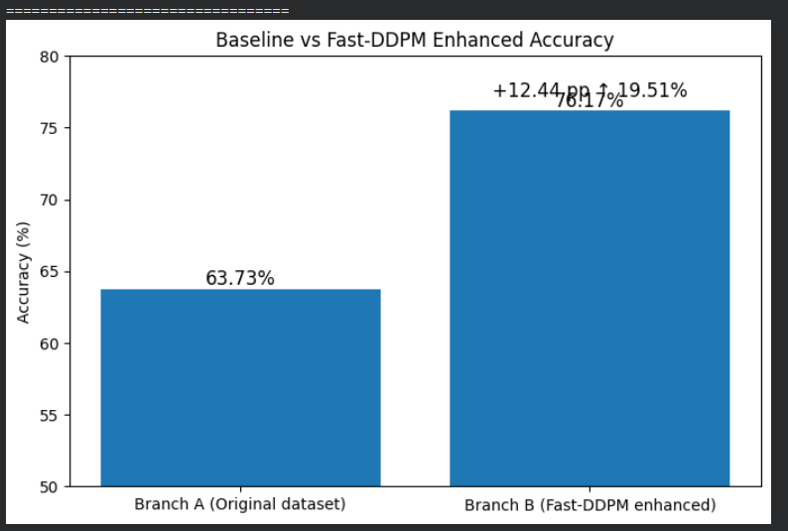
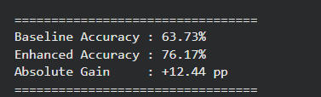
RESULTS & ACCURACY COMPARISON
Terminal Output — Training & Evaluation
$ python train_pipeline.py
Classes: Glioma | Meningioma | Pituitary | No Tumor

Slide 12




Project Planning and Teamwork
Task Allocation
Project Timeline
Team Member
Primary Responsibility
Phase-1
D.BHAGAVATH GEETHA
Workflow design, Fast-DDPM implementation, performance evaluation.
Literature survey, data collection, and multi-institutional dataset curation.
Phase-2
B.JAYA LAKSHMI
TULASI
MRI preprocessing, dataset organization, augmentation.
Fast-DDPM training, denoising optimization, and structural restoration testing.
K.VIRENDRA KUMAR
EfficientNet baseline training, post-denoising classification.
Phase-3
EfficientNet classification development and hybrid system integration.
B.NAGA SUMANTH
System integration, accuracy comparison, visualization.
Phase-4
Rigorous testing, validation, and final technical report preparation.

Slide 13
Conclusion
Denoising Boosts Classification
01
Fast-DDPM preprocessing raised EfficientNet-B0 accuracy from 63.73% to 76.17% — a +12.44 pp absolute gain.
No Architecture Changes Needed
02
The identical model checkpoint, hyperparameters, and training procedure were used in both branches — proving that input quality alone drives the gain.
Clinically Deployable Strategy
03
Fast-DDPM acts as a lightweight preprocessing plug-in, requiring no retraining. It can integrate into existing diagnostic pipelines with minimal overhead.
Generative Models in Medical AI
04
Establishes generative diffusion preprocessing as a viable, effective approach for improving automated brain tumor diagnostic accuracy across scanner types.

Slide 14
Future Work
Multi-Scanner Validation
Larger Dataset Training
Test generalization across multiple MRI scanners and institutions to confirm clinical robustness.
Scale to larger, multi-institutional datasets for more robust class-wise performance evaluation.
3D MRI Extension
Real-Time Deployment
Extend Fast-DDPM denoising to volumetric 3D MRI scans for richer spatial feature extraction.
Optimize inference speed for real-time clinical deployment using model distillation or ONNX export.

Slide 15
THANK YOU
Any Questions?
Diffusion-Enhanced Brain Tumor Classification

