Slide 1
Employee Data Analysis using Excel
STUDENT NAME:G.Geetha
REGISTER NO:312210163 ( asunm136322ca12)
DEPARTMENT:B.com ( computer application)
COLLEGE. Valliammmal college for women

Slide 2
PROJECT TITLE
Using pivot table for employee turnover analysis visulalsing

Slide 3


AGENDA
Problem Statement
Project Overview
End Users
Our Solution and Proposition
Dataset Description
Modelling Approach
Results and Discussion
Conclusion
3/21/2024 Annual Review

Slide 4

PROBLEM STATEMENT
High employee turnover rates lead to significant recruitment and training costs - Lack of visibility into attrition trends and patterns hinders proactive retention strategies - Inefficient use of HR resources due to limited data-driven insights - Inability to identify high-risk employees and predict turnover - Limited ability to measure the effectiveness of retention initiatives

Slide 5

PROJECT OVERVIEW
Develop an interactive Excel dashboard to analyze employee attrition trends - Identify key drivers of turnover and predict high-risk employees - Provide data-driven insights for proactive retention strategies - Track and measure the effectiveness of retention initiatives - Enhance organizational decision-making with actionable analytics and visualizations
.

Slide 6

WHO ARE THE END USERS?
HR Managers - Talent Management Teams - Department Heads - Business Leaders - Operations Teams - Analytics Teams - Organizational Development Teams - Executive Leadership These 8 groups will benefit from the insights and visualizations provided by the Excel dashboard.

Slide 7

OUR SOLUTION AND ITS VALUE PROPOSITION
Our Solution:_ - EmpowerHR - Employee Attrition Analysis Dashboard _Value Proposition:_ - Reduce turnover costs by up to 50% - Improve employee satisfaction and engagement - Enhance leadership development and succession planning - Inform strategic business decisions with data-driven intelligence - Boost organizational performance and competitiveness _Our Dashboard Provides:_ - Interactive visualizations for easy trend identification - Predictive analytics for proactive retention strategies - Customizable reports for tailored insights - Seamless integration with existing HR systems

Slide 8
Dataset Description
Employee data: demographics, job details, and tenure - Attrition data: exit dates, reasons, and notice periods - HR metrics: training, performance, and engagement scores - Historical data: 2-3 years of records for trend analysis - Anonymized data: ensuring confidentiality and compliance

Slide 9

THE "WOW" IN OUR SOLUTION
_Predictive Analytics_ _Interactive Visualizations_ _Real-time Insights_ _Customizable Reports_ _Seamless Integration_ _Actionable Recommendations_ _Cost Savings_ _Enhanced Decision Making_
3/21/2024 Annual Review
9

Slide 10
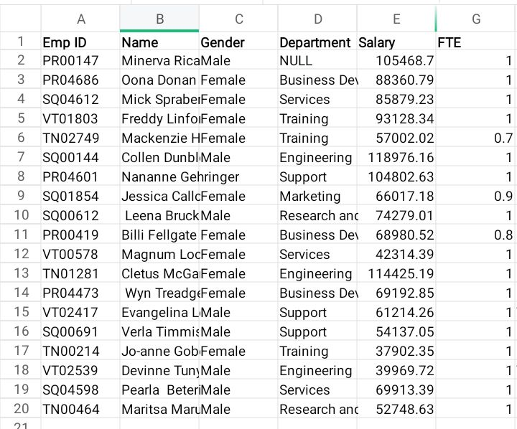
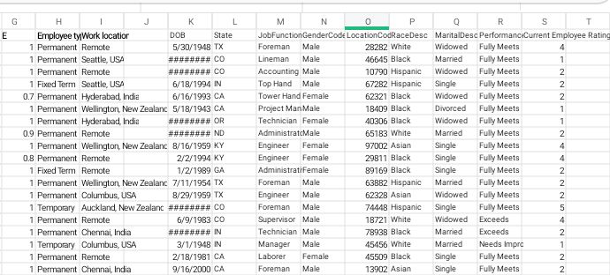
Modelling
10

Slide 11
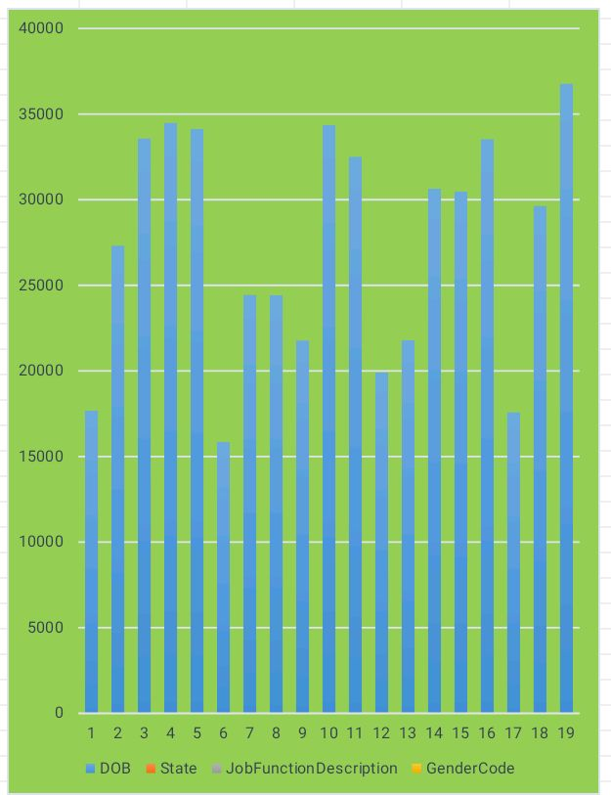
RESULTS
11

Slide 12
conclusion
"Employee attrition analysis using Excel dashboard provides a powerful tool for organizations to understand and address turnover. By leveraging predictive analytics, interactive visualizations, and real-time insights, businesses can identify high-risk employees, develop targeted retention strategies, and reduce turnover costs. With this solution, HR leaders and managers can make data-driven decisions to improve employee satisfaction, engagement, and retention, ultimately driving organizational success."

