Slide 1

Project Title - Seasonal Agriculture Performance Analysis
Student Name: Rachamalla Geethanjali
College Name: Vaageswari College of Engineering
AICTE STU ID : STU697605d65d8c91769342422

Slide 2

PROBLEM STATEMENT
(Agricultural activities are influenced by seasonal variations in environmental conditions, farming practices, resource availability and market conditions. As a result, agricultural performance may differ from one season to another. However, raw agricultural data does not clearly explain how agricultural performance changes across seasons or what patterns can be observed in different seasonal conditions. The problem is to analyze the given agricultural dataset and investigate seasonal differences in agricultural performance by identifying meaningful patterns, trends, relationships and variations within the available data.

Slide 3
Project Description
This project analyzes agricultural performance across different seasons using a structured dataset.
The analysis covers crop yield, production, revenue, profit, resource usage, irrigation practices and environmental conditions.
Python, Pandas, NumPy, Matplotlib and Seaborn are used for data cleaning, exploration, statistical analysis and visualization.
The objective is to identify seasonal patterns, compare performance, detect unusual observations and support better agricultural planning.

Slide 4

WHO ARE THE END USERS?
Farmers – To select suitable seasons and improve crop productivity.
Agricultural Departments – To monitor seasonal agricultural performance and support planning.
Agricultural Researchers – To analyze crop yield and environmental factors.
Irrigation Authorities – To manage water usage and improve irrigation efficiency.
Policy Makers – To make data-driven decisions for sustainable agriculture.
Agricultural Finance & Insurance Organizations – To assess crop profitability and agricultural risks.

Slide 5

Technology Used
• Python
• Jupyter Notebook / VS Code
• Pandas and NumPy – data handling and analysis
• Matplotlib and Seaborn – visualization
• Scikit-learn – analytical support
• CSV dataset – agricultural performance data

Slide 6
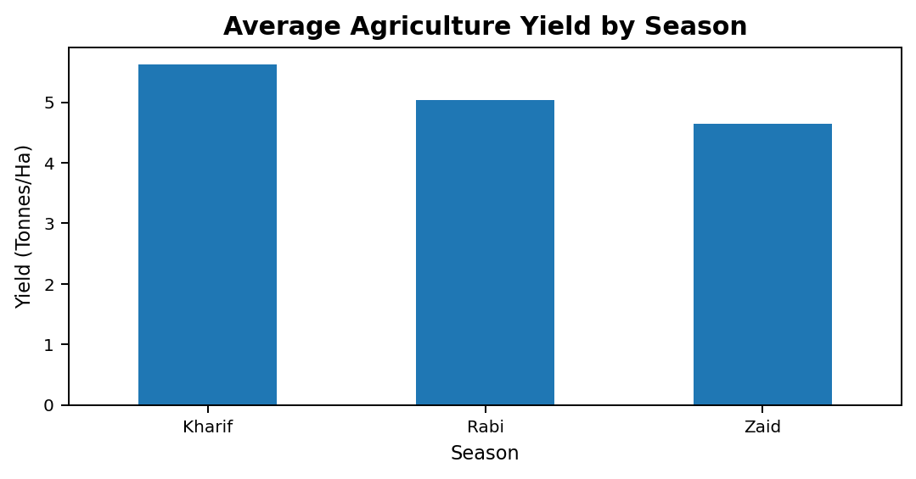
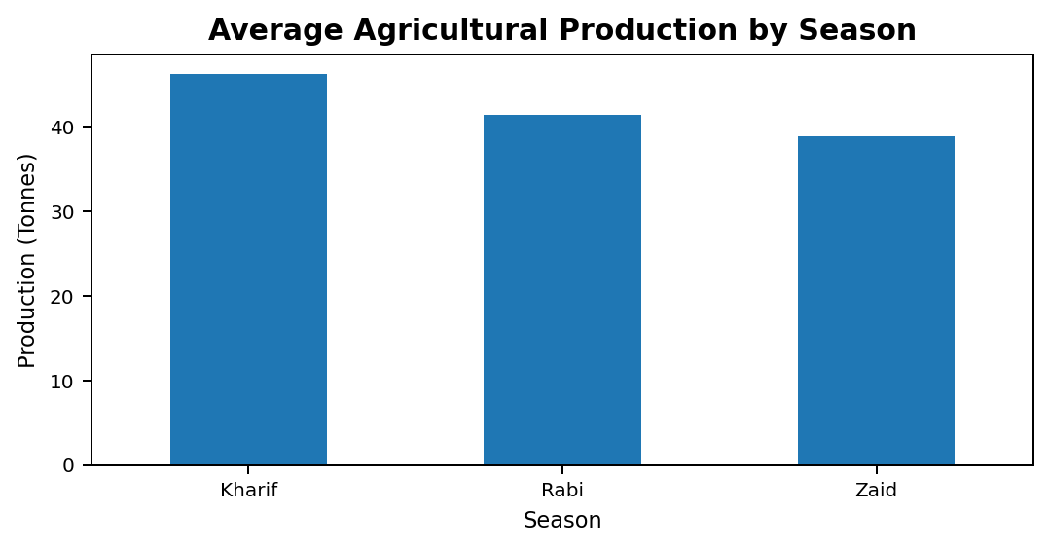
RESULTS – 1 | Seasonal Yield and Production
Average Agriculture Yield by Season
Average Agricultural Production by Season
Kharif shows the highest average yield and production among the three seasons.
Seasonal comparison helps identify stronger periods for agricultural performance.

Slide 7
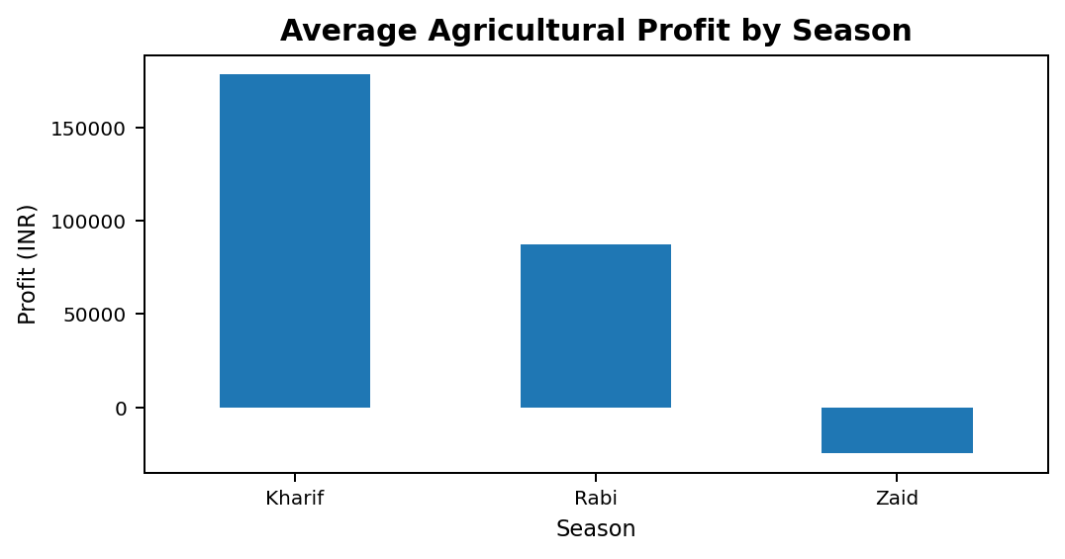
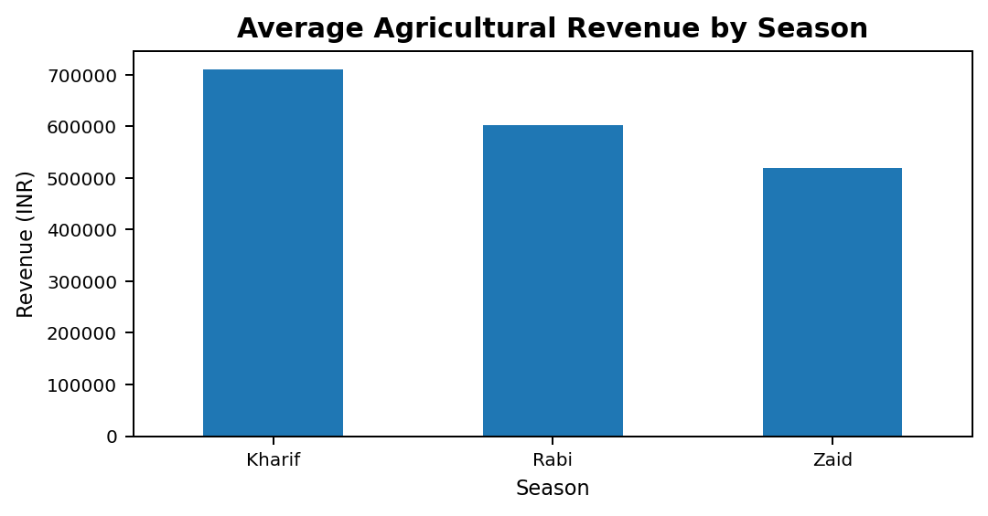
RESULTS – 2 | Seasonal Economic Performance
Average Agricultural Profit by Season
Average Agricultural Revenue by Season
Kharif has the highest average revenue and profit.
Zaid shows negative average profit, indicating lower economic performance in this dataset.

Slide 8
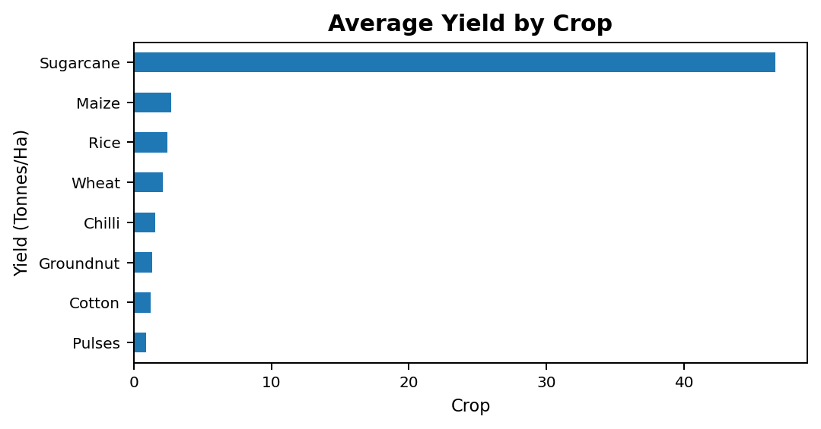
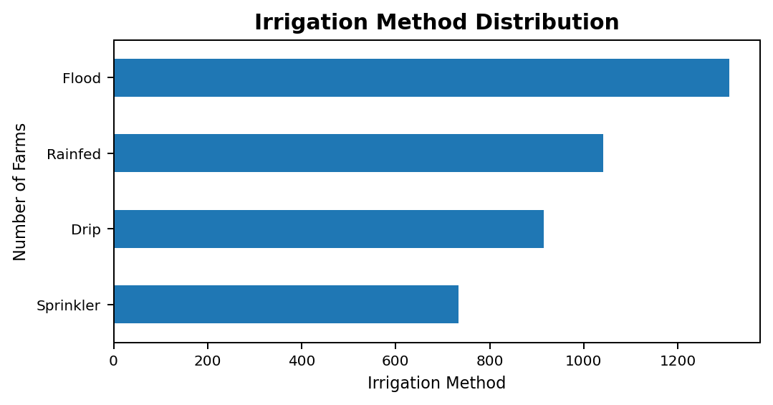
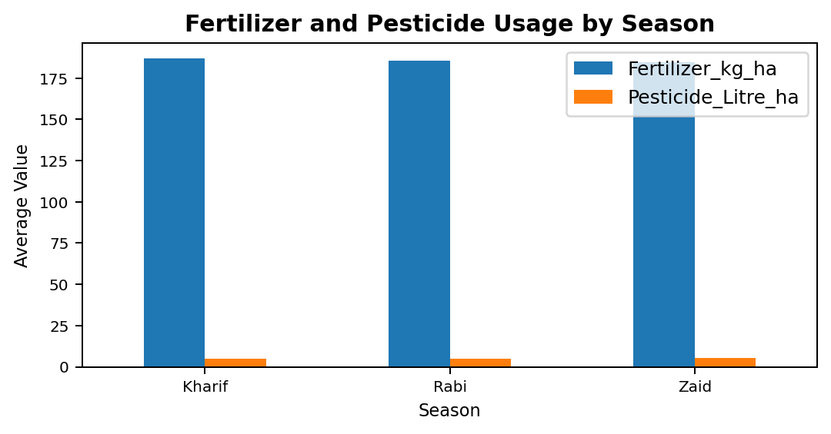
RESULTS – 3 | Crop and Resource Analysis
Average Yield by Crop
Irrigation Method Distribution
Fertilizer & Pesticide Usage
Crop-wise analysis identifies high-yield crops and resource-use patterns.
Irrigation and input usage provide additional context for performance differences.

Slide 9
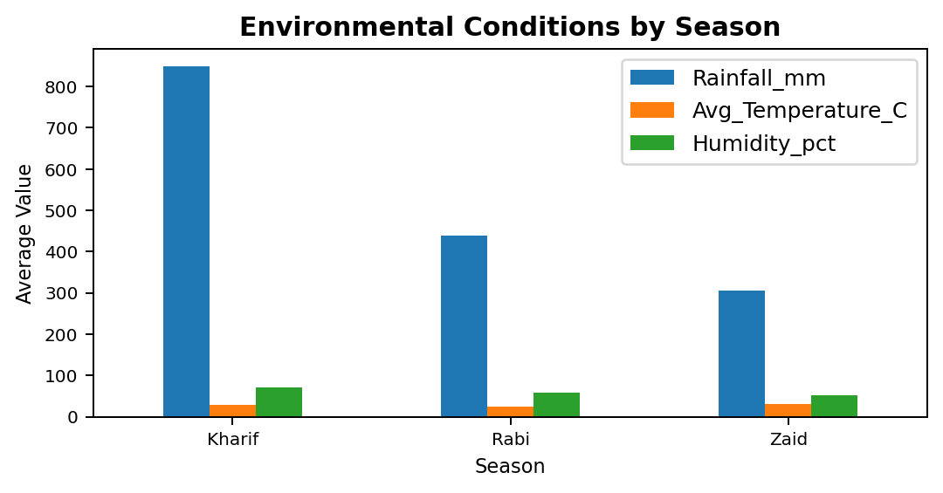
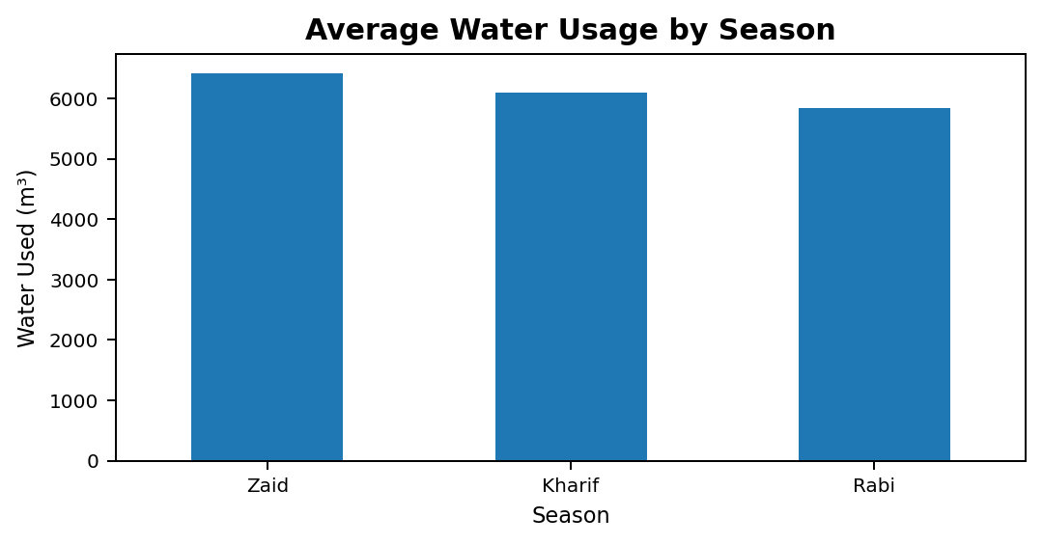
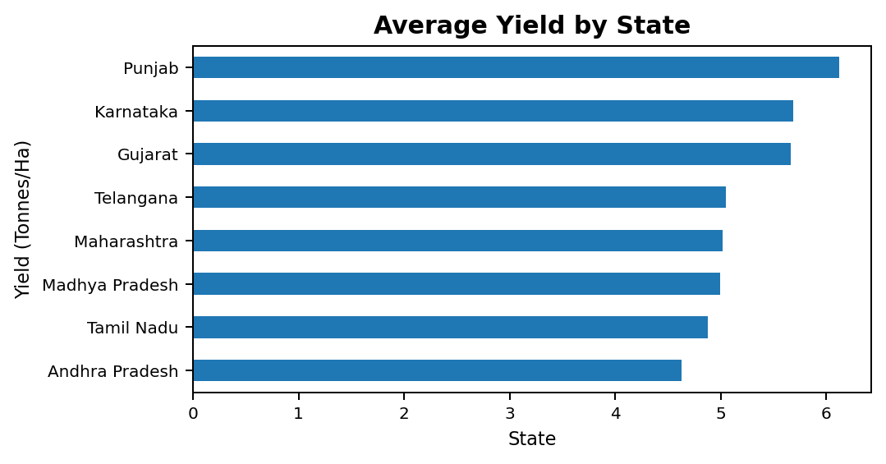
RESULTS – 4 | Environmental, Water and Regional Analysis
Environmental Conditions by Season
Average Water Usage by Season
Average Yield by State
Rainfall, temperature and humidity vary by season and affect farming conditions.
Water-use and state-wise comparisons support resource and regional planning.

Slide 10
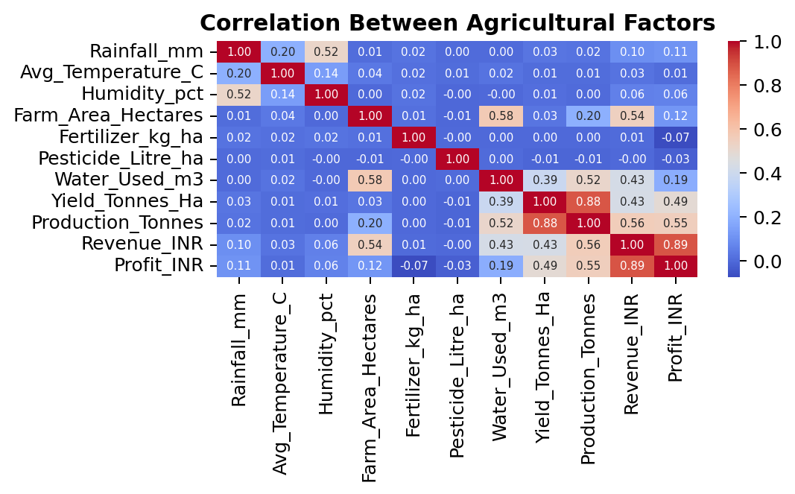
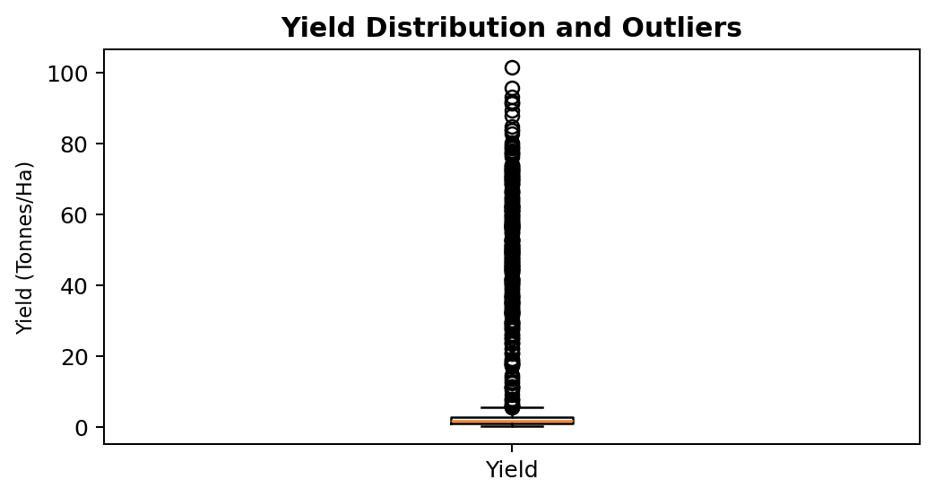
RESULTS – 5 | Correlation, Outliers and Key Insights
Best yield season: Kharif (5.63 tonnes/ha).
Best production season: Kharif (46.31 tonnes average).
Best profit season: Kharif (₹178,915 average).
Best-yield crop: Sugarcane | Most-profitable crop: Sugarcane.
Unusual yield records detected: 302.

Slide 11
Future scope
• Add real-time weather and market-price data
• Build predictive models for crop yield and profitability
• Provide region-specific crop recommendations
• Develop interactive dashboards for decision support
• Extend the analysis to multiple years for stronger trend detection

Slide 12
GitHub Link
GitHub Repository: https://github.com/Geetha245/Seasonal-Agriculture-Performance-Analysis.git

Slide 13
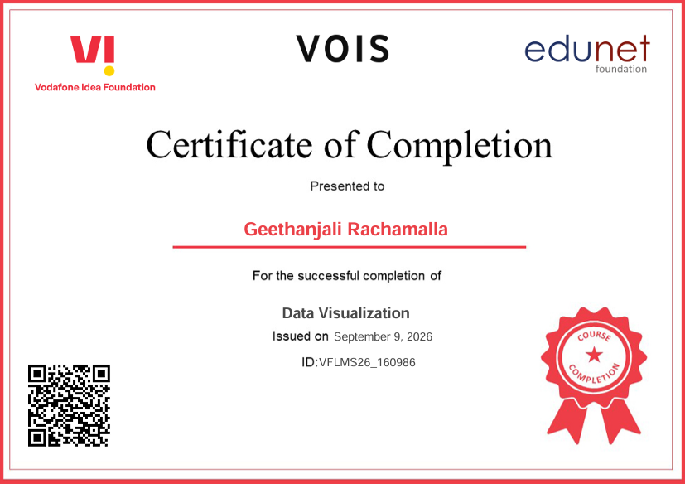
VOIS Course completion certificate -
Course name- Data Visualization

Slide 14
Thank you
.
.

