Slide 1

Leveraging Data to Reduce Employee Attrition
In today's competitive landscape, retaining top talent is crucial for organizational success. This project aims to analyze a dataset on employee attrition, identify key drivers, and develop a predictive model to proactively address employee turnover.
by Golla Geetha Durga Bhavani

Slide 2
Project Objectives and Employee Attrition
1
Understand Attrition Patterns
2
Develop Predictive Model
3
Recommend Retention Strategies
Analyze the dataset to identify the factors contributing to employee turnover.
Create a model to predict the likelihood of an employee leaving the organization.
Provide actionable insights to help the company reduce employee attrition.

Slide 3
Dataset Overview
Data Source
Features
Sample Size
The dataset was obtained from a leading HR analytics platform, providing comprehensive information on employee demographics, performance, and attrition.
The dataset includes over 20 features, such as age, tenure, department, salary, and performance ratings.
The dataset contains records for 1,470 employees, making it a robust and representative sample.

Slide 4
Dataset Analysis
Exploratory Analysis
Conducted a thorough exploratory data analysis to understand the distribution, relationships, and patterns within the dataset.
Insights Gained
Uncovered key insights, such as the correlation between job satisfaction, compensation, and turnover rates.
1
2
3
Feature Importance
Identified the most influential features contributing to employee attrition using various statistical techniques.

Slide 5
Preprocessing Steps
Missing Value Imputation
Categorical Encoding
Implemented appropriate techniques to handle missing values, such as mean/median imputation and KNN imputation.
Encoded categorical variables using techniques like one-hot encoding and label encoding to prepare the data for modeling.
Feature Engineering
Scaling and Normalization
Created new, meaningful features by combining and transforming existing variables to improve model performance.
Scaled and normalized the dataset to ensure all features are on a similar magnitude, preventing biases in the model.

Slide 6
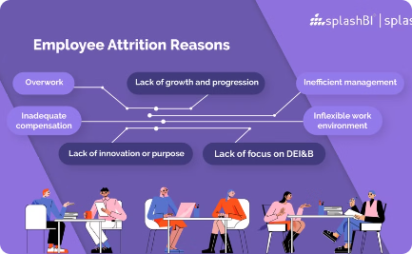
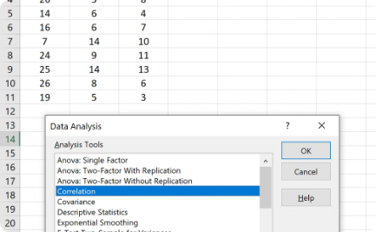
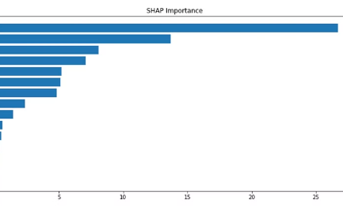
Preprocessing Techniques and Visualizations
Attrition Rate Distribution
Feature Correlation
Feature Importance
Visualized the distribution of employee attrition rates to identify potential patterns and outliers.
Analyzed the correlation matrix to uncover relationships between features and their impact on attrition.
Ranked the features based on their importance in predicting employee attrition using various techniques.

Slide 7




Model Development
Data Preparation
Model Selection
Model Training
Model Evaluation
Preprocessed the dataset, addressing data quality issues and transforming features for optimal model performance.
Evaluated and selected the most appropriate machine learning algorithm based on the problem and dataset characteristics.
Trained the selected model using the preprocessed data, optimizing hyperparameters to improve predictive accuracy.
Assessed the model's performance using relevant metrics, such as accuracy, precision, recall, and F1-score.

Slide 8



Conclusion
Key Insights
Predictive Model
Retention Strategies
Identified the most influential factors contributing to employee attrition, such as job satisfaction, compensation, and work-life balance.
Developed a robust machine learning model(Logistic Regression) to accurately predict the likelihood of employee turnover.
Provided actionable recommendations to address the root causes of attrition and improve employee retention.

