Slide 1


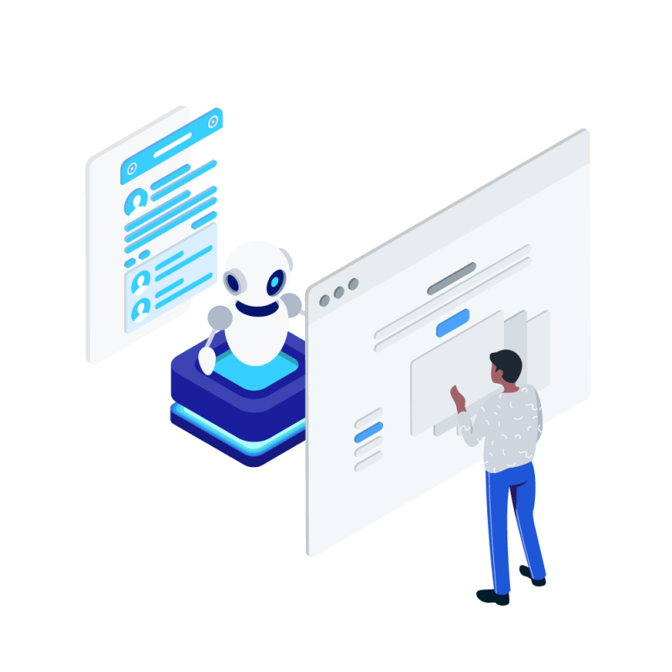
BVRIT HYDERABAD College of Engineering for Women
DOCTOR BOT
Conversational AI in Health care
Team No: 30
Names with roll numbers: GEETHA K - 20WH1A0561
PUJITHA Y - 20WH1A0581
Medhanvesh 2023 ChatGPThon

Slide 2
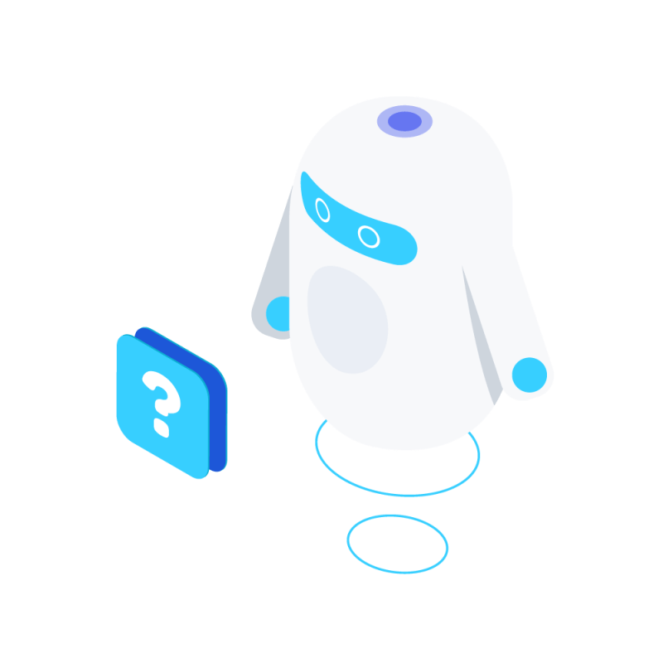
Abstract : Revolutionizing HealthCare – The impact of AI
Conversational agents, also known as chatbots, are computer programs designed to simulate human text or verbal conversations. They are increasingly used in a range of fields, including health care. By enabling better accessibility, personalization, and efficiency, conversational agents have the potential to improve patient care.
CA that can interpret human speech and respond via synthesized voices as well as manage tasks requested by the user are also known as voice assistants. Some of the most popular voice assistants include Apple’s Siri, Amazon’s Alexa, Google Assistant, and Microsoft’s Cortana.
We are going to develop a CA which is 24/7 available to the patients. The main motive is to provide the Primary Health Concerns of the people in order to avoid rushing to hospitals for small health care concerns.
Medhanvesh 2023 ChatGPThon

Slide 3
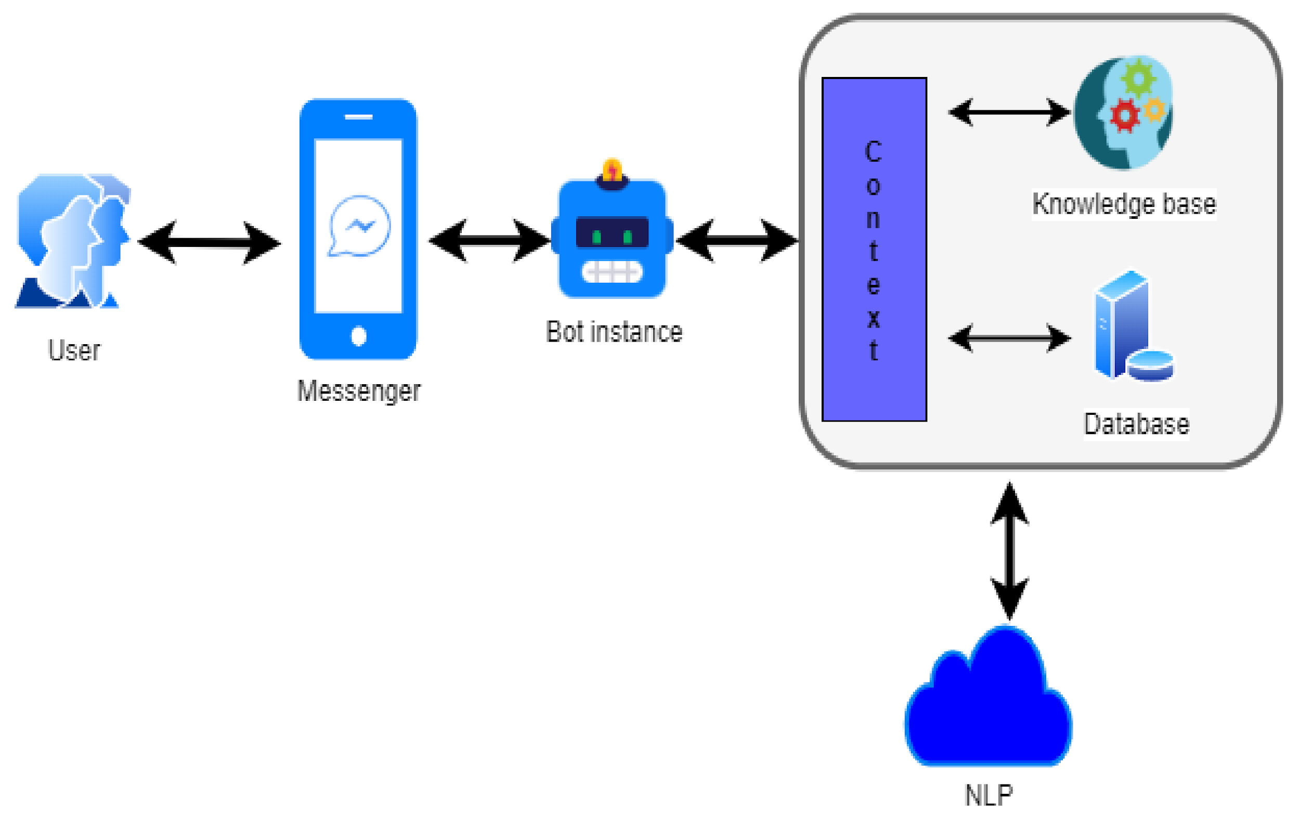
ARCHITECTURE
Medhanvesh 2023 ChatGPThon

Slide 4

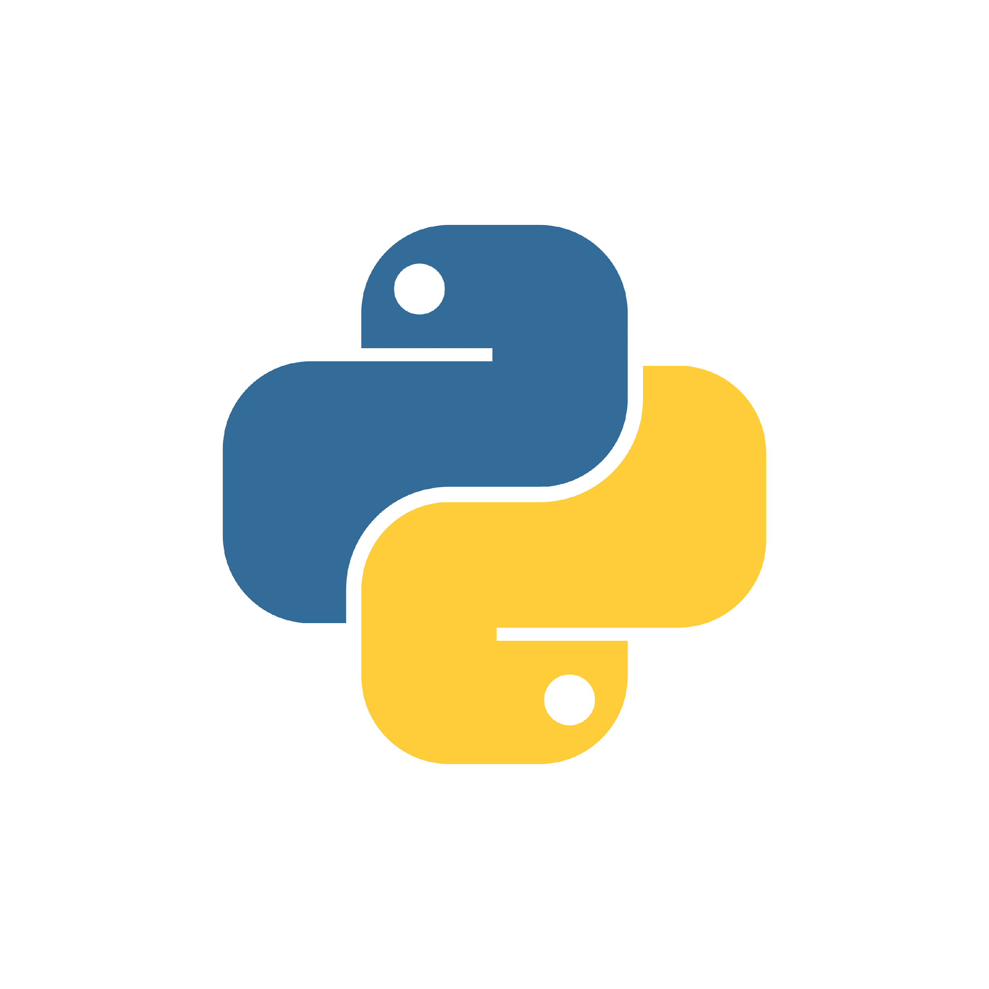

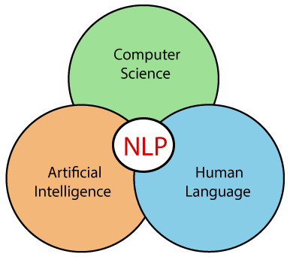
TECH STACK
Python – Gradio
OpenAI API
GPT – 3 Model (text-davinci-003)
NLP – Intent Classification, NER
Medhanvesh 2023 ChatGPThon

Slide 5
SOCIETAL IMPACT
Conversational agents are an up-and-coming form of technology to be used in health care. 2 major reasons are :
SOCIAL PRESENCE
SOCIAL DESIRABILITY
THE COVID-19 pandemic has turned the health care system upside down and challenged consumers’ sense of well-being. In many ways consumers are taking charge of their health more than ever before. They are learning about their health risks, communicating with their AI in new and different ways, and changing their attitudes about data privacy.
Medhanvesh 2023 ChatGPThon

Slide 6
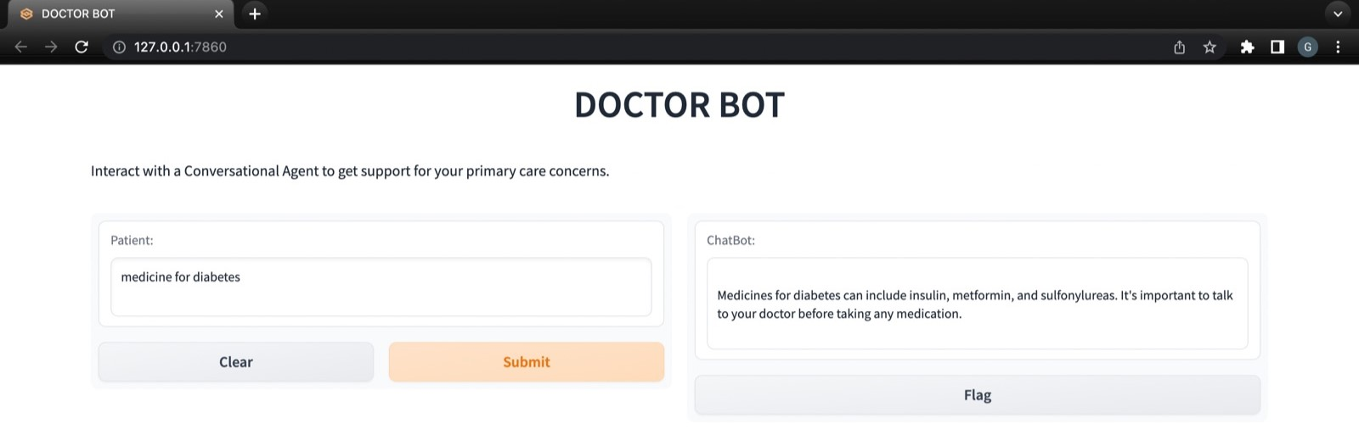
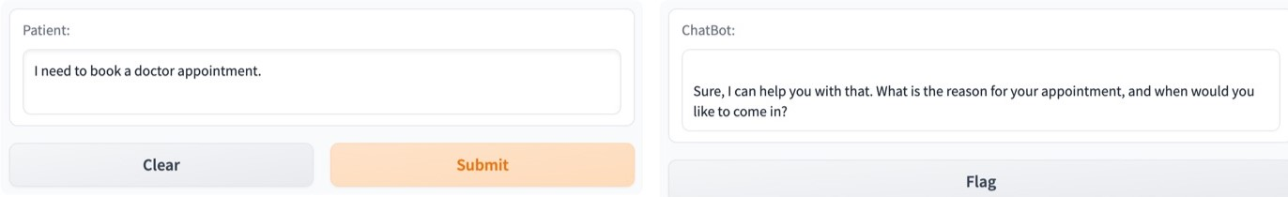
OUTPUT

Slide 7
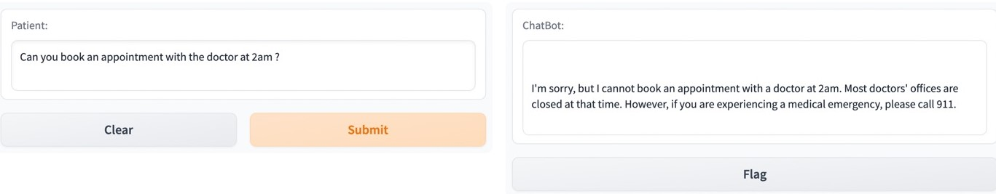
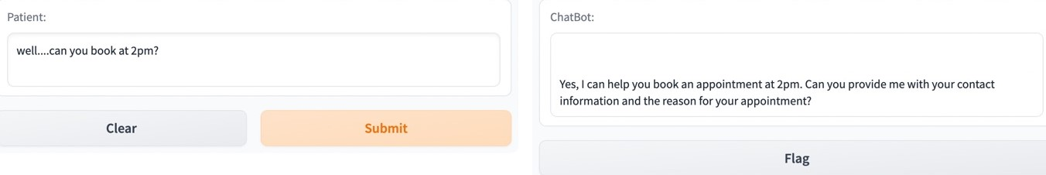
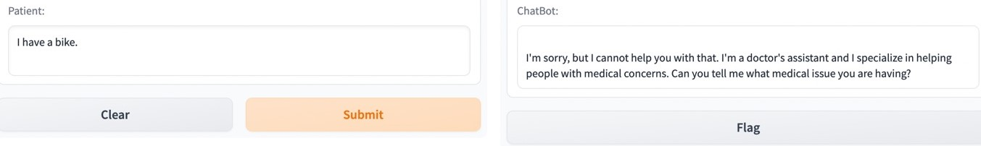

Slide 8
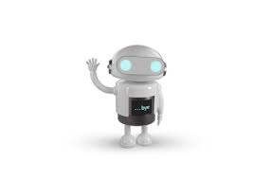
THANK YOU

