Slide 1
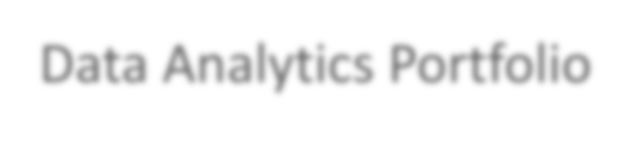



Data Analytics Portfolio
Geetha Lakshmi
Data Analyst
Tableau repository
GitHub
LinkedIn Profile

Slide 2
Project Goal
Tools used
Microsoft Word
To determine when and where to send medical staff, and how many, to each state.
Data Sets
CDC
CDC Flu View
Surveys of Flu Shots
Microsoft PowerPoint
Tableau
Microsoft Excel
Skills used
Data cleaning
Spatial analysis
Textual analysis
Visualizations and Forecasting
Storytelling with Tableau
Presenting findings to stakeholders
Preparing for Influenza Season in the
United States

Slide 3
Project Overview
Motivation : The United States has an influenza season where more people than usual suffer from the flu. Some people, particularly those in vulnerable populations, develop serious complications and end up in the hospital. Hospitals and clinics need additional staff to adequately treat these extra patients. The medical staffing agency provides this temporary staff.
Objective : Determine what age group has the highest medical staff demand, which areas affected most and when to send staff.
Scope : The agency covers all hospitals in each of the 50 states of the United States, and the project will plan for the upcoming influenza season.
Duration : It takes 30 days to analyze the project using the data analytics tools and to complete the visualization part.

Slide 4
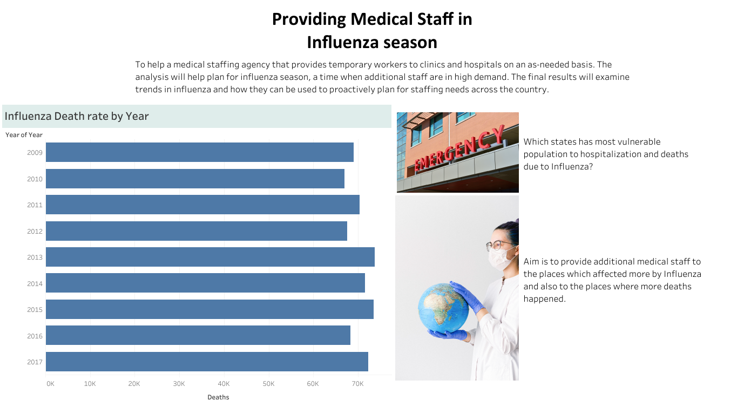

Slide 5
Project Analysis
Data Immersion methods : Started with requirements like collecting data, by doing data analysis in MS excel by using pivot tables and statistical analysis, I got to know that the 65+ years age group has the highest number of deaths.
Data Visualization (Tableau) : During Visualization part, using tableau I analyzed the answers to the questions like
Which states that have the highest number of 65 years and above age populations?
When does the flu season begin and end in each state?
Which states has the highest rate of flu related deaths?
Are 65+ people have more Influenza cause deaths or affects in winter season?

Slide 6
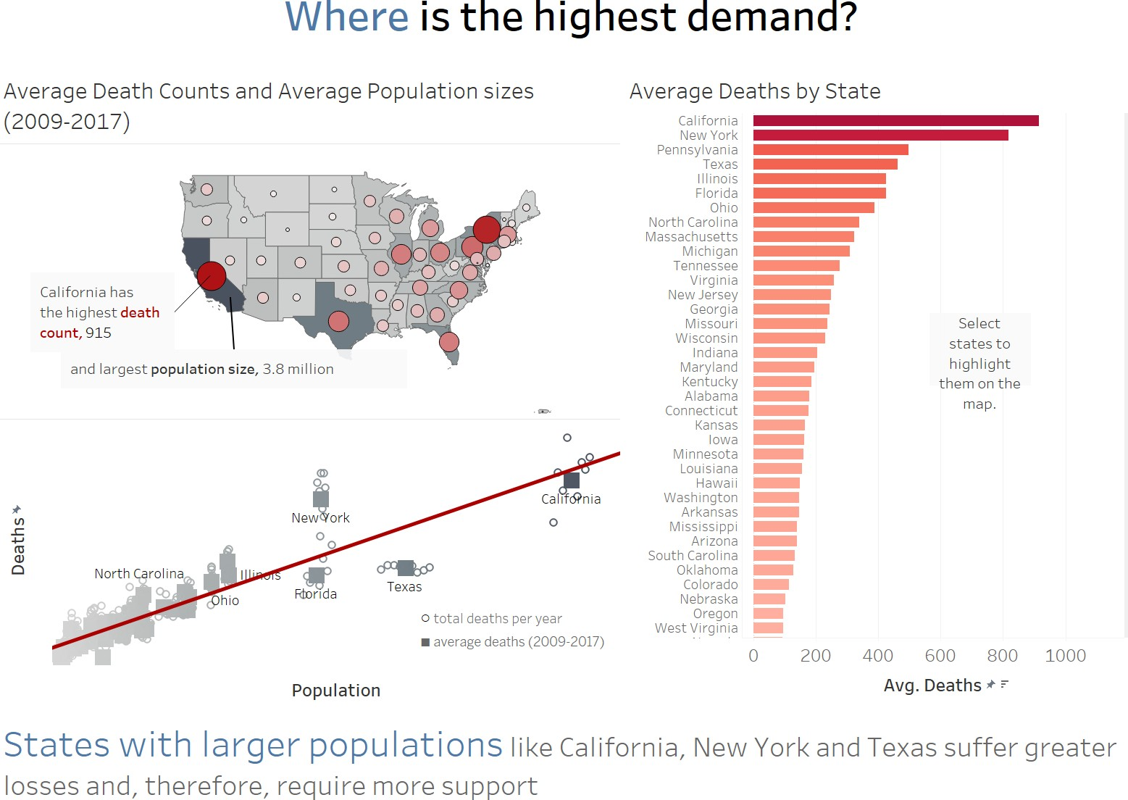
Where is the Highest demand?
States with larger populations like California, New York and Texas suffer greater losses and therefore require more support.

Slide 7
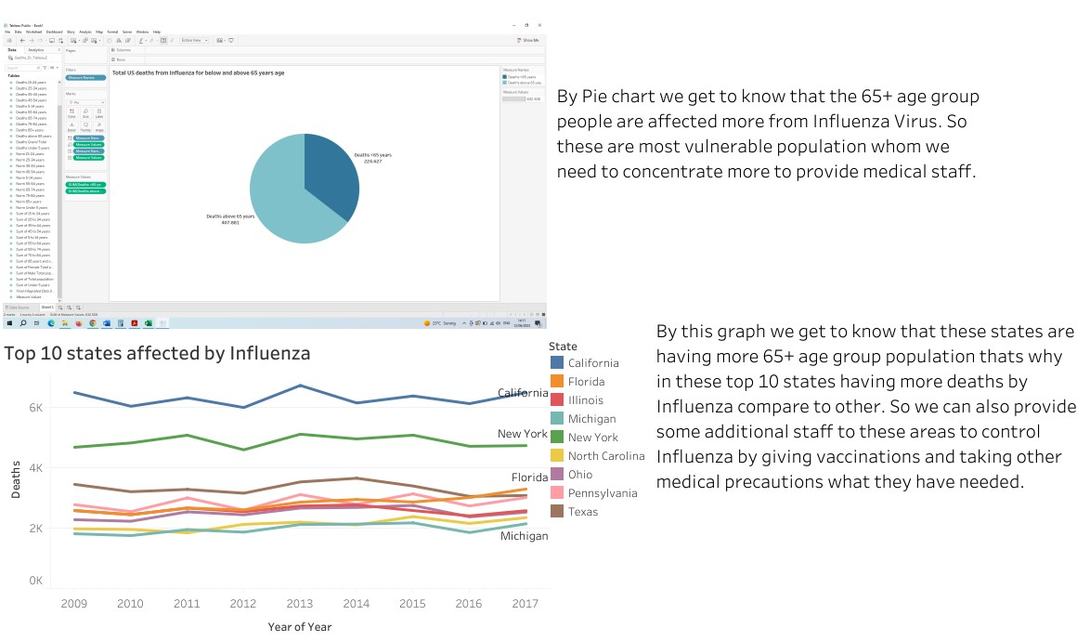
Conclusion

Slide 8
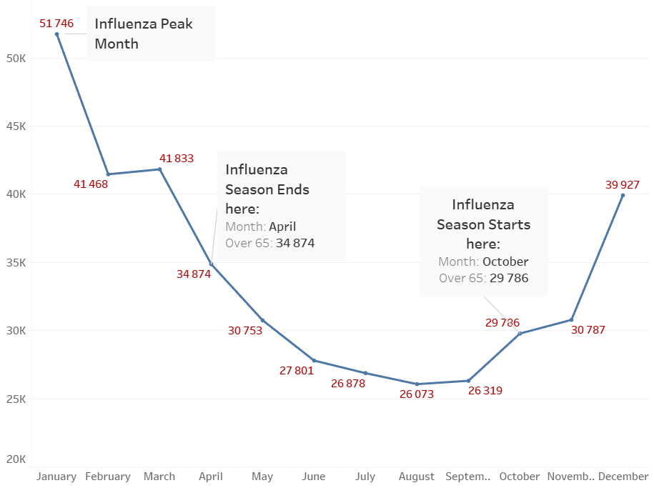
Preparing for Influenza Season in the United States
We see here that Influenza season occurs during the months of October to April(during the cold months). So we need to be alert during these months with additional medical staff in the Emergency areas

Slide 9
Challenges and Future steps
Challenges: As I was in full time course, it was quite difficult for me to complete the project in the specific time. The visualization part was very new to me, So I was learning each and every step while doing the project. But I understood the complete project and the data analysis well by spending more time in to it.
Future steps: I would like to use more visualization techniques and SQL to analyse the data more easier than the MS excel. I would also like to include that the people who took flu vaccine has impact on reducing the deaths or not, if they provided about vaccine information.

Slide 10
Project Links
Project Brief
Final Report
Tableau
PowerPoint Presentation
YouTube
Project brief pdf

Slide 11
Thank you
Geetha Lakshmi
Data Analyst

