Slide 1

AI Research Assistant
Automated Multi-Source Web Research Using Transformer Models

Slide 2

Problem Statement
In the digital age, information is abundant but scattered across numerous online sources.
Researchers and professionals often spend significant time reading multiple articles to extract useful insights.
Manual research is time-consuming, inefficient, and difficult when information is spread across many sources.
Goal
Build an AI system that automatically retrieves, summarizes, and extracts insights from web articles.

Slide 3
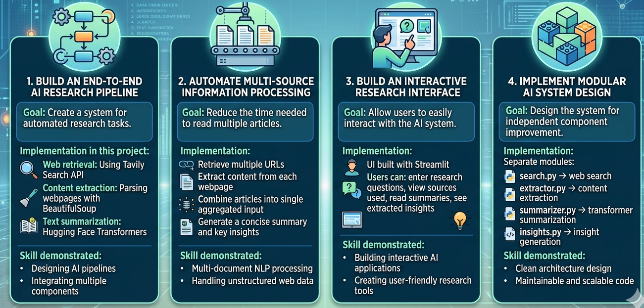
Project Objectives
Project demonstrates how modern AI systems combine web retrieval, NLP processing, and transformer models to automate research workflows.

Slide 4
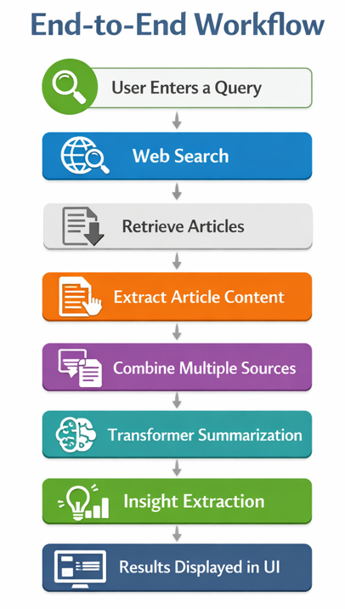
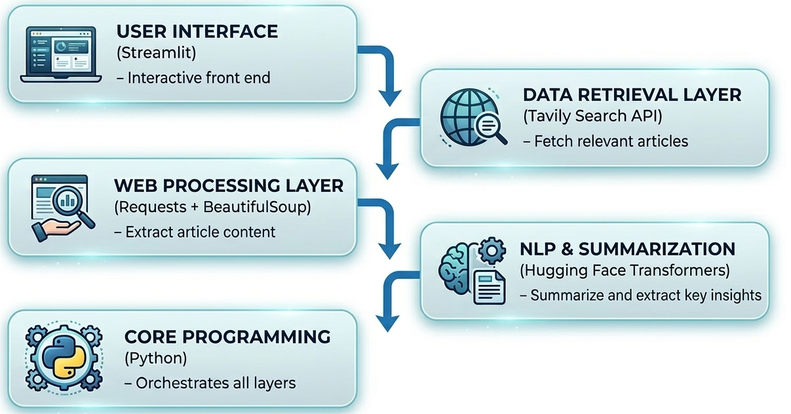
Project Architecture

Slide 5
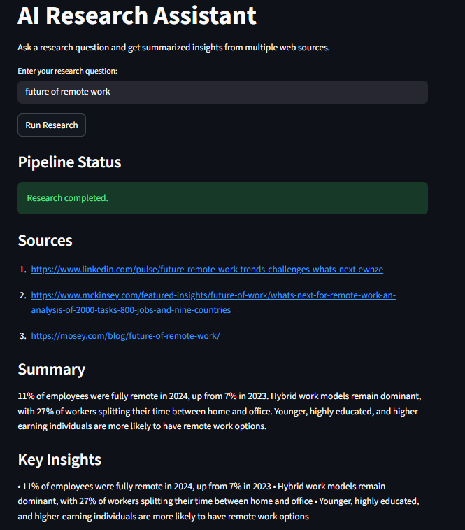
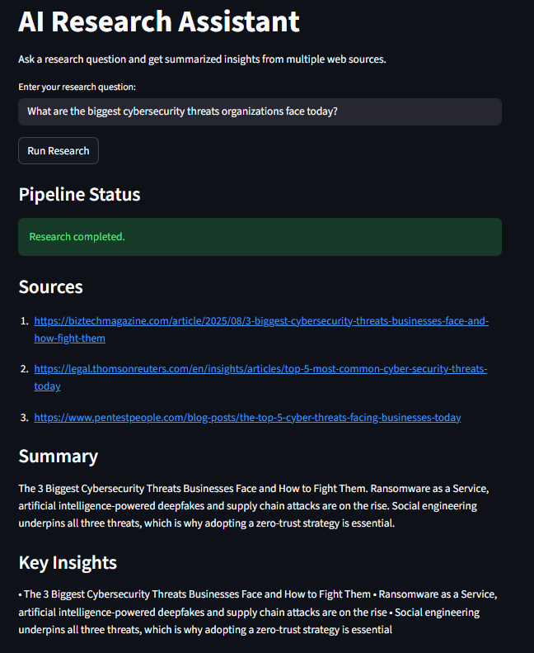
Example Output

Slide 6
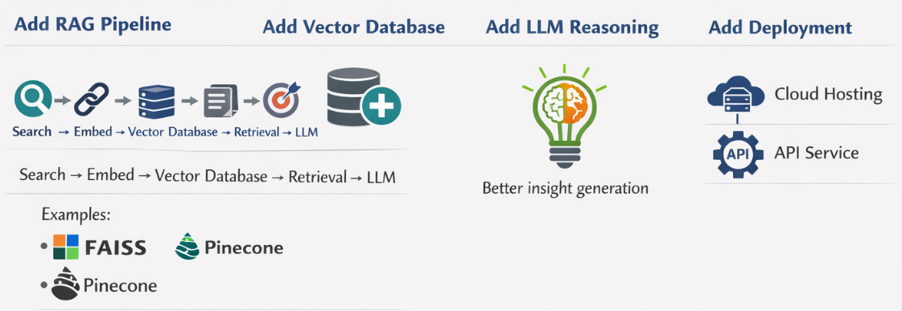
Real‑World Applications
Research assistant for professionals and students.
Market intelligence and competitive analysis
Academic research summarization for faster learning.
Technology trend Monitoring
Limitations
Dependence on external search API
Summarization model context length limits
Web content extraction may vary across websites
No semantic document retrieval yet
Future Improvements

