Slide 1

FITNESS TRACKER
DEVELOPED BY:-
K.GEETHA
R.BABY SOWJANYA
K.SUMA CHANDANA
B.ASHISH REDDY
V.S.SURYA BHARGAV
N.SUBHASHINI
N.PRIYADARSHINI

Slide 2
OVERVIEW OF PROPOSED FITNESS TRACKER:
Fitness Tracker is a single page application which is used to manage fitness plans.
This web application allows user to enter in and save the workout plans.
Each new workout entered by user will capture calories burnt per min.
It will present Dynamic graphs that show your progress over Day.
It will provide report on number of calories burnt.

Slide 3
TECHNOLOGIES USED:
ANGULAR
BOOTSTRAP
Spring Boot Rest
MySql
Firebase
Azure

Slide 4
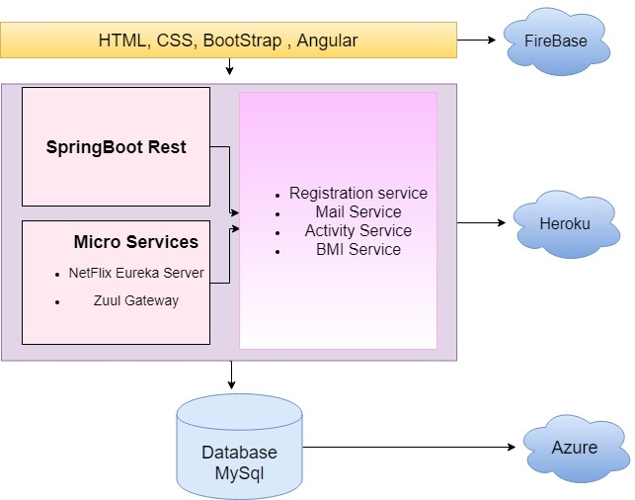
Architecture Diagram

Slide 5
THANK YOU

