Slide 1
EVALUATING LARGE LANGUAGE MODELS FOR MACHINE TRANSLATION ON INDIAN LANGUAGES
Geetha Syam Sai Akula
Master of Science – Computer Science
University of Wisconsin- Milwaukee
Supervised by Prof. Rohit J. Kate

Slide 2
Outline
Introduction
Objective
Literature Overview
Dataset
Methodology
Results and Discussion
Conclusion
References

Slide 3
Introduction
Machine translation
Machine translation (MT), often known as automated translation, is the process of translating text across languages using computer software without the need for human intervention.
Advantages of MT
Enables effective communication across languages, crucial for global businesses and travelers.
Provides fast turnaround, processing large volumes of text instantly for time-sensitive needs.
Notes:
This refers to the use of computer programs to translate text from one language to another without requiring a human translator. It's often called automated translation.,, Global Communication: Helps people and businesses talk across different languages, making it easier to connect worldwide.
Speed: Quickly translates large amounts of text, saving time for urgent tasks.

Slide 4
Introduction
Why Machine Translation Matters:
With over 22 main Indian languages and most internet content in English, many people struggle to access information in their native language. Machine translation helps bridge this gap, making communication easier for locals and travelers while promoting inclusivity.
Benefits of MT with Indian Languages:
Facilitates Tourism
Improves Accessibility
Boosts Communication
Notes:
India has more than 22 main languages, but most information online is in English. This makes it hard for many people to understand information in their native language. Machine Translation (MT) helps by translating this content into local languages, making communication easier for everyone, including locals and travelers.1.Facilitates Tourism: Helps travelers communicate with locals in Indian languages, Improves Accessibility: Makes digital content available to non-English speakers., Boosts Communication: Bridges language gaps for businesses and communities-Helps people connect and share ideas, even if they speak different languages.

Slide 5
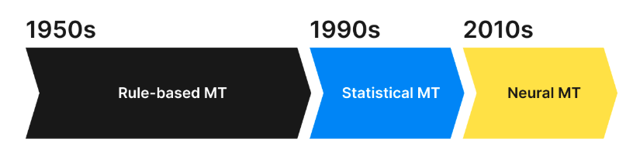
Types of Machine Translation
Rule-Based MT (RBMT): Uses predefined linguistic rules manually.
Statistical MT (SMT): Translates using statistical word models.
Neural MT (NMT):
AI-powered, learns languages like humans.
Notes:
Rule-Based MT (RBMT): Think of this as translation done using a big set of grammar and language rules. Humans create these rules, and the system follows them strictly to translate text.
Statistical MT (SMT): This type relies on patterns. It looks at lots of examples of translated text and uses statistics (math models) to guess the best translation.
Neural MT (NMT): This is the smart one! It uses artificial intelligence (AI) to learn languages like a human. It looks at the context and meaning, making translations more natural and accurate.

Slide 6
Large Language Models (LLMs)
Large Language Models (LLMs) are advanced artificial intelligence systems designed to understand, process and generate human-like text.
Trained on vast datasets, including books, websites, and other textual sources.
Examples: OpenAI's GPT, Google's PaLM, Meta's LLaMA.
Advantages of LLMs:
Work well even with limited bilingual data, benefiting underrepresented languages.
Translate faster than humans
Support diverse content types, from formal documents to casual conversations.
Notes:
What are Large Language Models (LLMs)?
LLMs are super-smart AI programs that can understand and create text like a human. They are trained on a lot of information from books, websites, and other text.
Examples of LLMs:
OpenAI's GPT
Google's PaLM
Meta's LLaMA
Why are LLMs Useful?
Help Underrepresented Languages: They work well even if there isn’t much data available in a specific language.
Speed: They translate text way faster than humans.
Versatility: They handle all kinds of text, like formal documents or casual chats.

Slide 7
LLMs for MT
LLMs for MT has significantly advanced the capabilities of machine translation systems superseding the traditional statistical MT methods.
Advantages of LLMs for Translation:
Adaptability
Lower Dependence on Bilingual Data
Notes:
How LLMs Improve Machine Translation (MT):
LLMs (Large Language Models) have made machine translation much smarter and better than older statistical methods.
Why LLMs are Great for Translation:
Adaptability: They can handle different languages, topics, and even tricky contexts much more effectively.
Less Need for Bilingual Data: Unlike older methods that required lots of examples in both languages, LLMs can still work well even with limited translation data.

Slide 8
Research Aim
To evaluate the performance of Large Language Models (LLMs) like GPT-3.5 and LLaMA-v3 in translating English to Indian languages using human and automated evaluation methods.
Notes:
The goal is to check how well Large Language Models (LLMs), like GPT-3.5 and LLaMA-v3, can translate English into Indian languages. This is done by testing their performance using both human feedback and computer-based evaluation tools.

Slide 9
Objectives
How effectively LLMs can translate English sentences into Indian languages?
How reliable are Machine Translation (MT) metrics in automatically evaluating LLM-generated translations?
Can the performance of LLM-based Machine Translation be improved by providing helpful prompts?
Notes:
How good are LLMs at translating English sentences into Indian languages? (Are the translations accurate and understandable?)
Can we trust machine translation (MT) tools to judge LLM-generated translations? (How reliable are automated tools for checking the quality of translations?)
Can adding helpful prompts improve LLM translations? (Does giving more context or specific instructions make translations better?)
In this work, above research questions are answered using state-of-the-art LLMs – GPT-3.5, GPT-4 and LLaMA, and a large recent MT dataset of Indian languages.

Slide 10
Literature Overview
The study “Multilingual Machine Translation with Large Language Models: Empirical Results and Analysis” conducted by Wenhao Zhu et al.(2023) focuses on enhancing machine translation (MT) performance for low-resource languages of Spain, specifically Aragonese, Aranese, and Asturian
The study utilises BLEU (Bilingual Evaluation Understudy) explores the use of Llama3-8B for translating from low-resource to high-resource languages.
The paper address limitations related to data quality, domain mismatch, and tagging strategies

Slide 11
Literature Overview
The study by Kolar et al.(2023) evaluates ChatGPT (gpt-3.5-turbo) as a translation tool for tourists, translating English to Hindi, Kannada, and Telugu using 50 travel-related questions.
Native speakers rated correctness and fluency on a scale of 1 to 5. Used BLEU scores for quantitative assessment.
Limited to three languages , used small dataset with 50 sentences, relies on subjective ratings, and lacks comparison with other translation tools.
Notes:
The paper - Multilingual tourist assistance using chatgpt: Comparing capabilities in hindi, telugu, and kannada.

Slide 12
Literature Overview
The study by Vandan, et al.(2023) explores Large Language Models (LLMs), trained on extensive datasets of text and code, to summarize text, translate languages, generate creative content, and answer questions.
Used BLEU Score to evaluates similarity between machine-generated and human translations and chrF to assesses similarity at the character level.
Dataset: The authors fine-tuned LLMs using the Bharat Parallel Corpus Collection (BPCC), specifically the BPCC-Human subset with 2.2 million English-Indic sentence pairs.
The authors note that further work is needed to develop LLMs with better representation of Indian languages to improve translation quality.
Notes:
Focus on Character n-grams: Instead of comparing word-level matches, chrF evaluates smaller chunks (n-grams) at the character level. For example, in the word "translation," it might look at overlapping sequences like "tra," "ans," and so on.
The authors say that more work is needed to make Large Language Models (LLMs) better at understanding and working with Indian languages. This will help improve the quality of translations into these languages.

Slide 13
Samanantar Dataset
Samanantar in Hindi means 'Parallel'
The Samanantar v0.2 Dataset, released on 15th May 2021 specifically designed for Indic languages, serves as the main source of data for this study.
Researchers employed various techniques to mine parallel sentences to build the Samanantar corpus.
Took parallel sentences from news sources, several sources, including scanned documents, web-crawled monolingual corpora, and multilingual content from websites educational platforms that publish content in multiple languages.
Notes:
News articlesScanned documentsText from websitesSingle-language content found onlineMultilingual content from educational websites that share information in many languages

Slide 14
Samanantar Dataset
Samanantar in Hindi means 'Parallel'
Includes 49.7 million English-to-11 Indian language sentence pairings
The updated dataset with LaBSE (Language -agnostic BERT Sentence Embedding) Scores was released on July 2021 , with 23,000 pairs were used for this study.
LaBSE score > 0.9 , Greater than 8 words were filtered for the reference sentences
Notes:
LaBSE (Language-Agnostic BERT Sentence Embedding) is a tool used to compare how similar two sentences are, even if they are in different languages. It gives a score between 0 and 1, where higher scores mean the sentences are very similar in meaning.

Slide 15
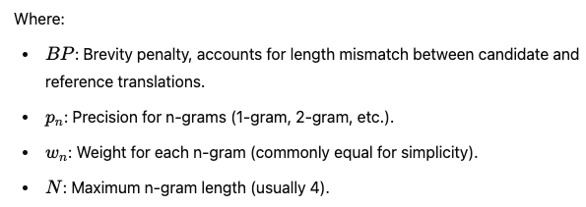

Automated Evaluation Metrics : BLEU
The BLEU (Bilingual Evaluation Understudy) score is a metric used to evaluate the quality of text translations by comparing the generated (candidate) translation to one or more reference translations
This metric assesses translations on a scale of 0 to 1
Better translation quality is indicated by a score nearer to 1
Notes:
The BLEU score is a way to measure how good a translation is by comparing it to one or more reference translations (ideal translations). It looks at how similar the words and phrases in the translated text are to the reference, and gives a score between 0 and 1

Slide 16
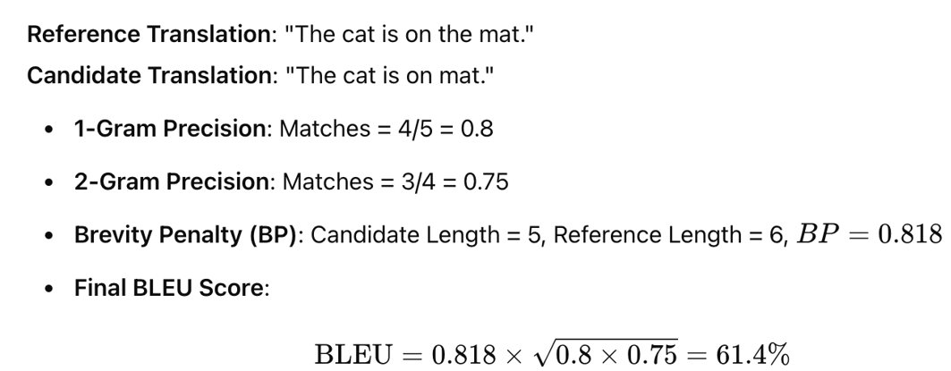
Example Calculation for BLEU Score

Slide 17

Automated Evaluation Metrics : METEOR
METEOR is an automatic metric for evaluating translation quality. Here the score ranges between 0 to 1, where 0 represents that there is no word overlap,1 represents the high fluency, correct word order.
METEOR is selected because to its capacity to take word order, stemming, and synonyms into account throughout the evaluation process .
Notes:
Word Order: It checks if the words are in the right sequence.
Stemming: It matches words even if they are in slightly different forms (e.g., "run" and "running").
Synonyms: It understands that words with similar meanings (like "big" and "large") are acceptable substitutes.

Slide 18
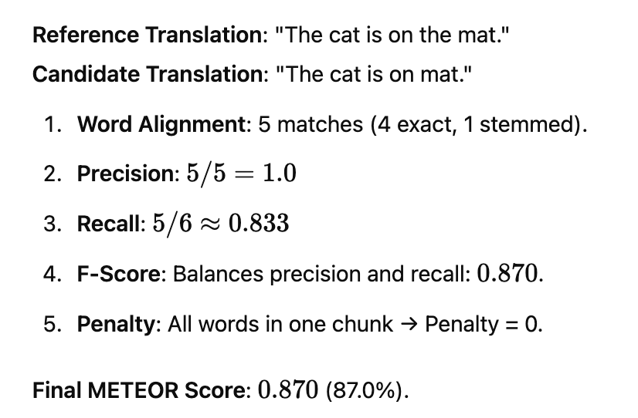
Example Calculation for METEOR Score
Notes:
chunks are groups of matching words that appear together without being broken up.

Slide 19
Automated Evaluation Metrics : BERTScore
BERTScore is an evaluation metric for Machine Translation and other text generation tasks that uses pre-trained contextual embeddings (like BERT) to compare similarity between the machine-generated text and the reference text.
These scores range from 0 to 1, with 0 representing no semantic similarity. If the score is 1, it means a perfect semantic match
BERTScore is versatile for various NLP tasks, also it provides fast and reliable results
Notes:
Instead of just matching exact words, it looks at the context and overall similarity of the sentences.
Versatile-BERTScore can handle different types of texts, including pairs, lists, and even single sentences. This versatility makes it a versatile tool for various NLP tasks, from text classification to information retrieval.,,,,,,
Despite using advanced models like BERT, BERTScore is still able to provide fast and reliable results. This efficiency is crucial, especially when dealing with large datasets.

Slide 20
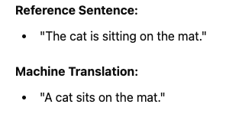
Example: BERTScore
Token Embedding:
BERT generates embeddings for each word (e.g., "The," "cat," "sits").
Cosine Similarity:
Compare embeddings of words between the machine translation and reference translation. Example: The embedding for "cat" in MT matches closely with "cat" in the reference translation (high cosine similarity).
Precision and Recall:
Precision: Find best match for each word in MT from reference.
Recall: Find best match for each word in the reference from MT.
F1-Score:Combine Precision and Recall into a single score.
BERTScore: High (because the meaning is almost identical).

Slide 21
Correlation coefficient
Pearson Correlation Coefficient: Measures the linear relationship between two variables. Values range from -1 (perfect negative correlation) to 1 (perfect positive correlation), with 0 indicating no correlation.
Cohen's Kappa: Measures agreement between two raters or classification systems, accounting for chance agreement. Values range from 0 (poor) to 0.8 (almost perfect), with 0.44 meaning meaning agreement.
Spearman's Rank Correlation Coefficient:Measures the monotonic relationship (not necessarily linear) between two variables.Values range from -1 to 1, with 0 indicating no rank correlation
Notes:
Pearson Correlation Coefficient:
It checks how two variables change together in a straight-line (linear) way.
Example: student with Higher study hours and higher grades often have a positive Pearson correlation.
Cohen's Kappa:
It measures how much two people (or systems) agree when categorizing or rating something, while ignoring agreement by chance.
Example: Two doctors diagnosing the same patients—Cohen’s Kappa measures how consistently they agree.
Spearman's Rank Correlation Coefficient:
It checks the order or ranking relationship between two variables (not necessarily in a straight line).
Example: Ranking of students by height compared to their ranking by weight.

Slide 22
Methodology
Dataset and Filtering Criteria
Dataset Used: The study uses the Samanantar v0.2 dataset, improved with updated similarity scores from LaBSE.
High-Quality Translations: Only sentence pairs with a similarity score above 0.9 are included to ensure they have almost the same meaning.
Sentence Length Requirement: Sentences must be at least 8 words long to better reflect real-world usage.
Short Sentence Errors: Short sentences (less than 5 words) often have more translation errors
Notes:
This means that only very accurate and closely matching translations are used. A similarity score measures how similar the meaning of two sentences is, and only pairs with a score higher than 0.9 (almost identical meaning) are kept for high-quality translations.

Slide 23
Methodology
Human Evaluation for Three Languages:
Language Selection: Hindi, Telugu, and Marathi chosen due to our language fluency.
Sample Size: 100 sentence pairs per language selected for evaluation.
Scores reference was taken from the paper by Graham et. Al. - based on overall translation accuracy and fluency.
Perfect (100 - 90), Good (80-79), Fair (69 - 51),
Poor (50 - 30), Bad (29 - 11), Worst (10 - 0)

Slide 24
Results
LLaMA consistently outperformed GPT-3.5 in all three languages, especially for Telugu where GPT-3.5 scored the lowest.
GPT-4.0 is used for Marathi translations which performs well compared to LLama

Slide 25
Common Errors Example1
Common errors included unnecessary English words, incorrect honorific plurals, tense inconsistencies, and nonsensical terms.
Input
In the case of an intrinsic, you already done this before, log of n versus 1 over T is just a straight line with 1 slope, so this is intrinsic.
output
में एक आंतरिक (intrinsic) के मामले में, आप पहले से ही यह कर चुके हैं, n बनाम 1 बनाम T के लॉग 1 (log of n versus 1 over T) केवल ढलान वाली सीधी रेखा (straight line with 1 slope) है, इसलिए यह आंतरिक (intrinsic) है।

Slide 26
Common Errors Example2
Input:
The Congress leader represents Sivaganga Lok Sabha segment from Tamil Nadu.
Output:
कांग्रेस नेता तमिलनाडु से सिवगंगा लोक सभा सegment का प्रतिनिधित्व करते हैं।

Slide 27
Methodology
Evaluation of Automatic Metrics:
Translation quality assessed using human evaluations and automatic scores.
Correlation analysis performed using Cohen’s Kappa, Spearman’s rank correlation, and Pearson correlation.
The Cohen's kappa correlation coefficient differs from other metrics employed in this study due to its requirement for continuous variables

Slide 28
Spearman Correlation Scores
Spearman Correlation Coefficient |  | Hindi | Telugu | Marathi
GPT | Human Eval vs BERTScore | 0.2900 | 0.1822 | 0.1163
 | Human Eval vs BLEU | 0.2246 | 0.2052 | 0.0819
LLAMA | Human Eval vs BERTScore | 0.2711 | 0.2287 | 0.1984
 | Human Eval vs BLEU | 0.0960 | 0.2242 | 0.0877
GPT’s (BERTScore vs Human Eval score) for Hindi shows highest correlation (0.2900), indicating best performance.
BERTScore consistently outperforms BLEU across languages.

Slide 29
Cohen’s Kappa Correlation Coefficient
Cohen’s Kappa Correlation |  | Hindi | Telugu | Marathi
GPT | Human Eval vs BERTScore | 0.1139 | 0.0308 | 0
 | Human Eval vs BLEU | -0.0002 | 0.0088 | 0
LLAMA | Human Eval vs BERTScore | 0.0571 | 0.0246 | 0.0619
 | Human Eval vs BLEU | 0.0094 | -0.0051 | -0.0014
GPT's BERTScore shows highest Kappa (0.1139) for Hindi translations.
Near-zero or negative Kappa scores for BLEU across most language pairs.
LLAMA shows marginally better Kappa scores for Marathi (0.0619) compared to GPT.
Telugu translations demonstrate very low agreement with human evaluations.

Slide 30
Pearson Correlation Score
Pearson Correlation Coefficient |  | Hindi | Telugu | Marathi
GPT | Human Eval vs BERTScore | 0.3266 | 0.1331 | 0.0847
 | Human Eval vs BLEU | 0.1950 | 0.2246 | 0.0979
LLAMA | Human Eval vs BERTScore | 0.2600 | 0.1806 | 0.1509
 | Human Eval vs BLEU | 0.0917 | 0.2018 | 0.1285
GPT's BERTScore shows highest correlation (0.3266) for Hindi translations.
Marathi translations demonstrate weakest correlation (0.0847) with BERTScore.
LLAMA's BERTScore performs consistently for Hindi (0.2600).

Slide 31
Methodology
Automated Evaluation of Translations for Eleven Indian Languages
The approach here is to evaluate with smaller set of sentences(e.g.,100) for initial testing to ensure
efficiency , quicker iterations and adjustments to the evaluation metric or system

Slide 32
BLEU Results
Best overall model – GPT4o
All models performed consistently well while translating into Hindi.

Slide 33
METOR Results
Best overall model – GPT4o
All models performed consistently well while translating into Hindi.

Slide 34
BERTScore Results
Best overall model – GPT4o
All models performed consistently well while translating into Oriya.
LLaMA outperforms GPT-4o while translating into Oriya.

Slide 35
Observations for Sample Size of 1000 Sentences
Automatic evaluation extended to 11 Indian languages, using 1,000 sentences per language.
The LLaMA was then used to machine translate them. After the translation process, the quality of the translation was then automatically evaluated using the aforementioned metrics

Slide 36
BERTScore Results (Llama)
BERTScore is above 0.8 for all the 11 languages and Oriya takes the highest score of 0.966 which implies the good translation quality of Llama model
Cost Implications: Translating 1,000 sentences using GPT-3.5 or GPT-4 involves significant expenses, as these models charge per token generated during the translation process.
Notes:
This is because they charge money based on the number of tokens (words or parts of words) they generate. Translating 1,000 sentences can involve a lot of tokens, so the cost adds up quickly.

Slide 37
Prompt Refinement for Quality Improvement
Applied prompt engineering to improve translation quality by providing contextual cues.
Translations carried out with and without prompts for all 11 languages to compare results.

Slide 38
Example Prompt
Prompt Input: Translate this sentence into Telugu- On his complaint, the police has registered a case.
Output: అతని ఫిర్యాద మీద, పోలీసు. ఒక కేసును నమోదు చేసింది.
(Athani Piryadhu meedha policu oka casunu namodhu chesindhi)
Enhanced Prompt Input:
“Translate with respectful language for authorities (e.g., police, ministers) by using plural forms in the target language rather than singular forms to indicate respect”. Now translate this sentence into Telugu: On his complaint, the police has registered a case.
Output: అతని ఫిర్యాదు మీద, పోలీసులు ఒక కేసు నమోదు చేసారు.
(Athani Piryadhu meedha policulu oka casunu namodhu chesaru)

Slide 39
With Prompt vs Without Prompt
Hindi shows highest BERTScore (0.887) without prompting.
Not a significant improvement on performance after prompting.

Slide 40
Conclusion
Translations by LLMs (Hindi, Marathi, Telugu) were rated good in human evaluations.
LLaMA outperformed GPT-3.5, showing better nuance understanding in Indic languages.
BERTScore was more reliable than BLEU and METEOR.

Slide 41
Future Work
Future assessments will concentrate on a methodical approach using predefined rules to have the scoring much more consistent.
Additional metrics like BLEURT (Bilingual Evaluation Understudy with Representations from Transformers) can also be used to test the translation quality.
The findings highlight the significance of customized prompting techniques and the need for a balanced and context-aware approach to prompt engineering in machine translation, particularly when addressing specific linguistic phenomena such as plurality and honorific forms.

Slide 42
Questions

Slide 43
References
Mujadia, Vandan et al. “Assessing Translation Capabilities of Large Language Models involving English and Indian Languages.” ArXiv abs/2311.09216 (2023): n. pag.
Ramesh, Gowtham, et al. "Samanantar: The largest publicly available parallel corpora collection for 11 indic languages." Transactions of the Association for Computational Linguistics 10 (2022): 145-162.
Kolar, Sanjana, and Rohit Kumar. "Multilingual tourist assistance using ChatGPT: Comparing capabilities in Hindi, Telugu, and Kannada." arXiv preprint arXiv:2307.15376 (2023).
Zhu, Wenhao, et al. "Multilingual machine translation with large language models: Empirical results and analysis." arXiv preprint arXiv:2304.04675 (2023).

