Slide 1


INTRODUCTION TO SOLID PRINCIPLES
A Quest Global Company

Slide 2
List of Topics to be covered
Single Responsibility Principle.
Open / Closed Principle.
Liskov Substitution Principle
Interface Segregation Principle
Dependency Inversion Principle.

Slide 3
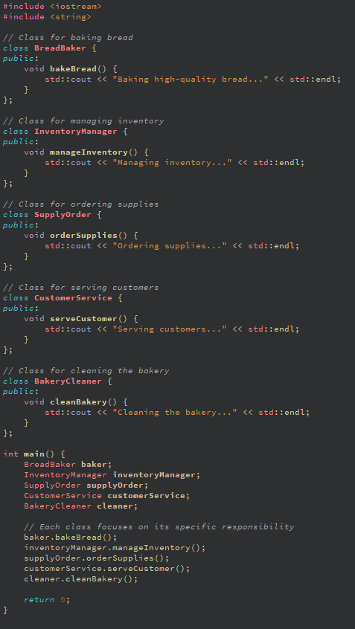
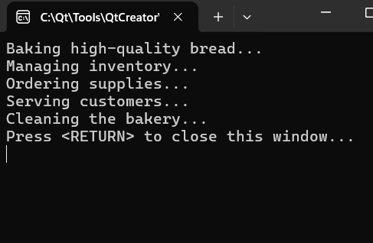
1. Single Responsibilty Principle
A Single Responsibility Principle states that every class should have a single responsibility or single job or single purpose.
In other words, a class should have only one job or purpose within the software system.
Example:-
Output:-

Slide 4
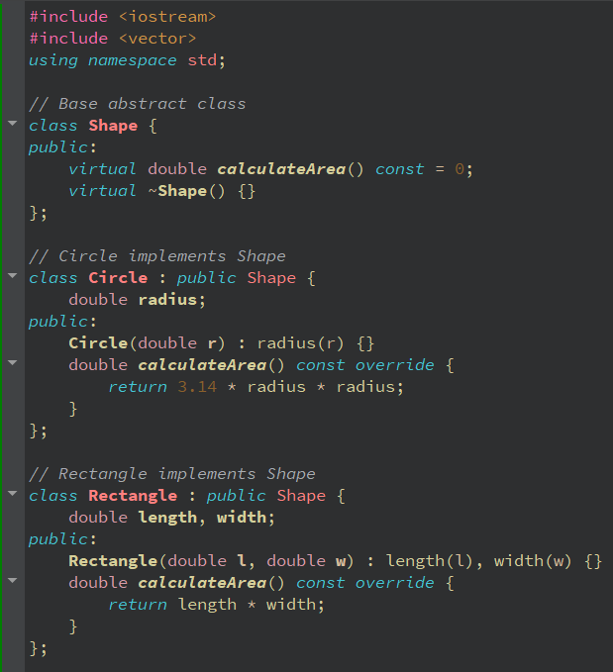
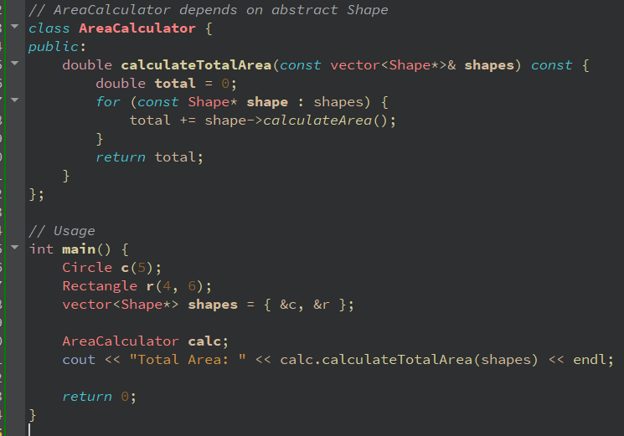
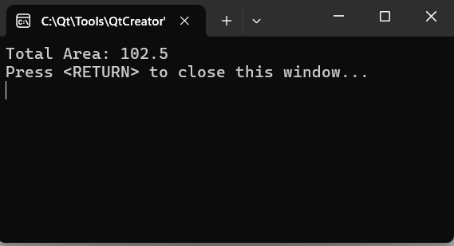
2. Open / Closed Principle
A Open / Closed Principle states that software entities (classes, modules, functions) should be open for extension, but closed for modification.
In other words, one should be able to extend a class behavior, without modifying it.
Example:-
Part-1
Part-2
Output:-

Slide 5
3. Liksov Substitution Principle
Liksov Substituion Principle tells us about Derived or Child classes must be substitutable for their base or parent classes.
This principle ensures that any class that is the child of a parent class should be usable in place of its parent without any unexpected behavior.
In C++ terms this means that if you have a base class and a derived class, then you should be able to use an object of the derived class anywhere you use an object of the base class without unexpected behavior or errors.
Key Requirements for LSP:
Method behavior in the subclass must match the expectations set by the base class.
Preconditions should not be strengthened in a subclass.
Postconditions should be weakened in a subclass.

Slide 6
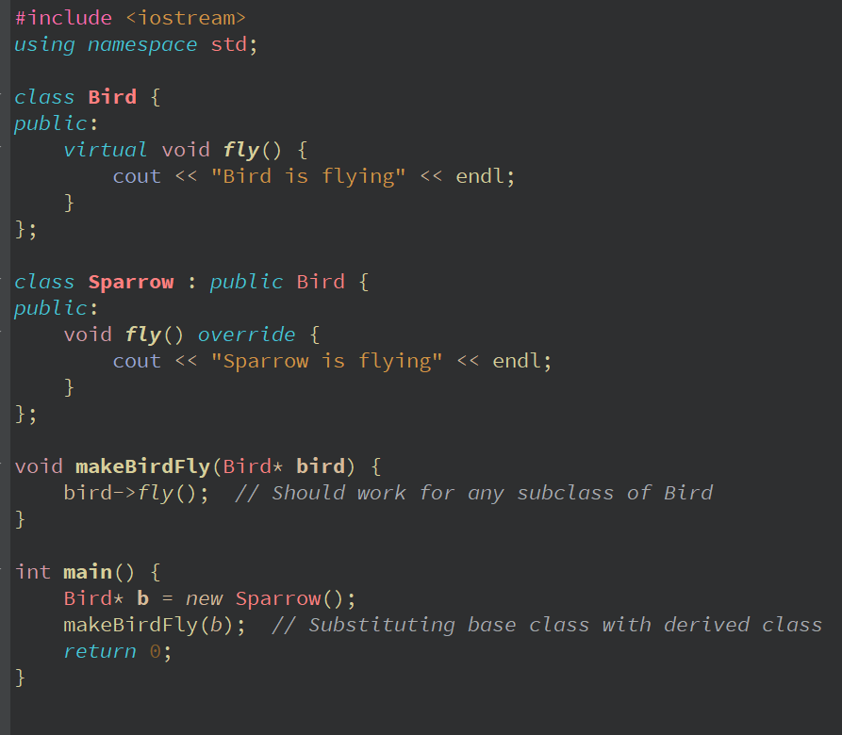
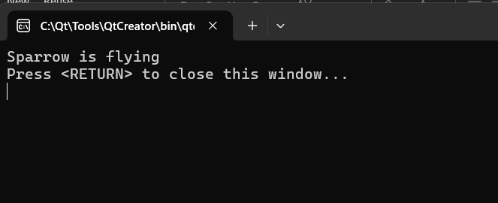
3. Liksov Substitution Principle
Example:-
Output:-

Slide 7
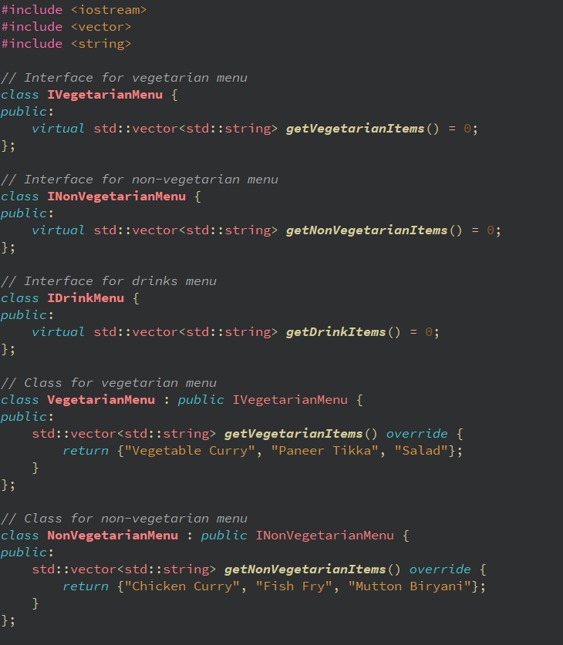
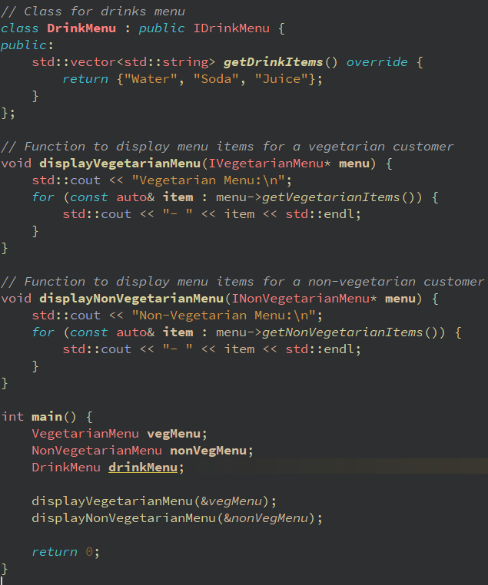
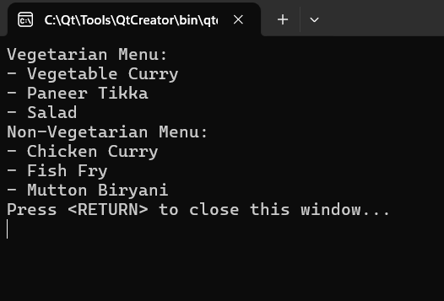
4. Interface Segregation Principle
Interface Segregation Principle is the first principle that applies to interfaces instead of classes in SOLID and it is similar to the single responsibility principle. It states that do not force any client to implement an interface which is irrelevant to them.
The main aim is to focus on avoiding fat interface and give preference to many small client- specific interfaces.
Example:-
Part-1
Part-2
Output:-

Slide 8
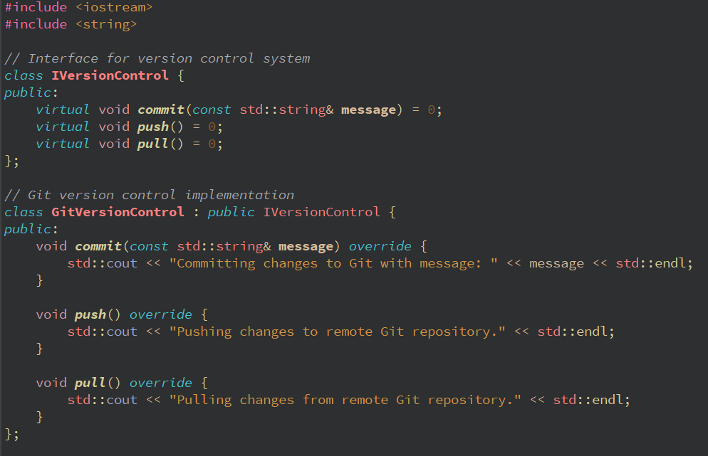
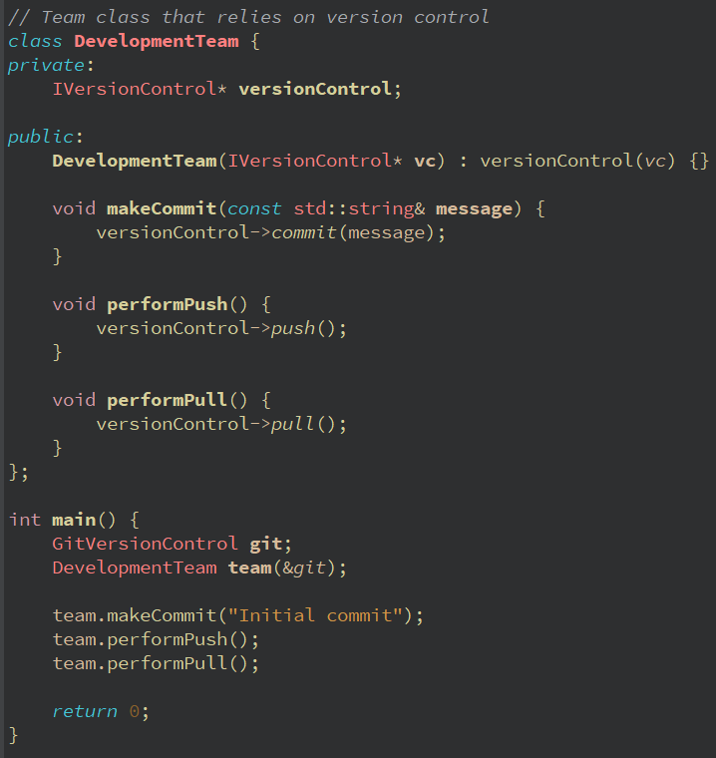
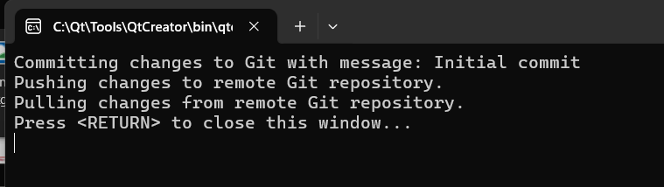
5. Dependency Inversion Principle
Dependency Inversion Principle states that High level modules should not depend on low level modules. Both should depend on abstractions.
Abstractions should not depend on details, details should depend on abstractions.
Example:-
Part-1
Part-2
Output:-

Slide 9


Thank You

